Slide 1

数据中台技术规划
Date：2019-02-20
Version：0.3.0
Author：Hefei Li
www.jd.com

Slide 2

目 录
架构概览
存储服务
计算服务
资源调度
安全服务
元数据管理
数据规范
数据开发套件

Slide 3

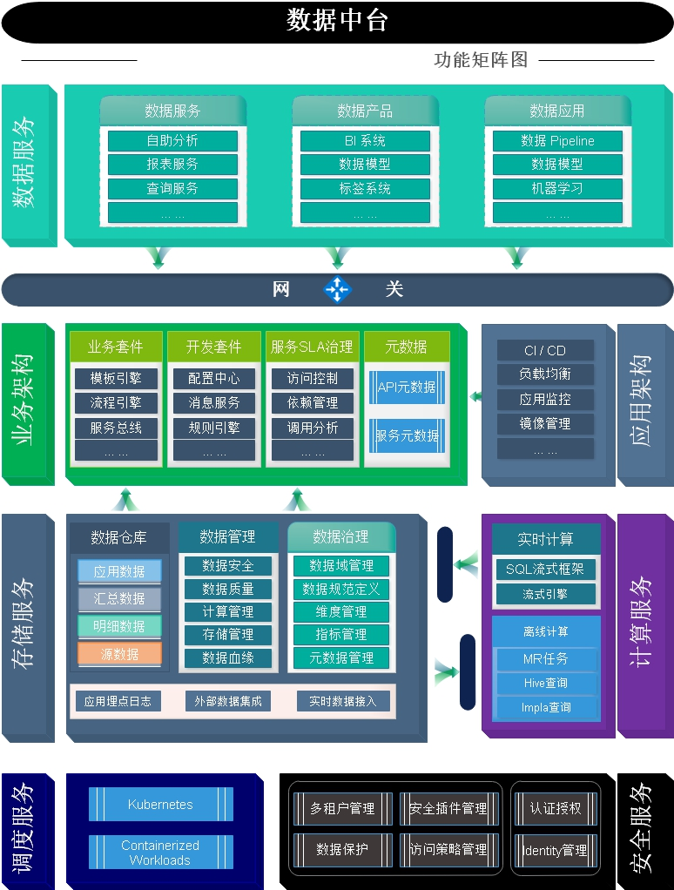
组件图

Slide 4
架构概览
MachineLearning
Data Exploration
Feature Engineering
Modeling
Visualization
User Profile
RESTful
Java
Feature Selection
Model Evaluation
Reporting
Data Insight
SDK
Python
Dev Suite
Data Migration
Data Hub
Job Scheduler
Drools
RabitMQ
Data Transfer
Data-bus
Oozie
Template Engine
Workflow Engine
Big Query
Data Runners
Luigi
Mngt Console
Tenant Service
Data Prevenance
Offline
Real Time Ingestion
Multidimensional Analysis
Graph Computing
YARN
MR2
Flink
SparkStreaming
Druid
Titan
Tenant Service
Hive
Storm
Apex
Elasticsearch
Neo4j
Data Prevenance
Metadata Server
Data Quality
Distributed FS
K/V Storage
In-Memory
Object Storage
Data Prevenance
HDFS
HBase
Kudu
Alluxio
Ceph
IAM
Ignite
Kudu
Cassandra
Parquet
Ignite
KMS
Redis
... ...
KDC

Slide 5
组件协作图

Slide 6








存储服务架构
Storage Architecture
SDK
Storage Service
Storage Gateway
IAM
Index
ES Cache
Volume Storage
Tenant Service
Directory Service
Management Console
Storage Units

Slide 7
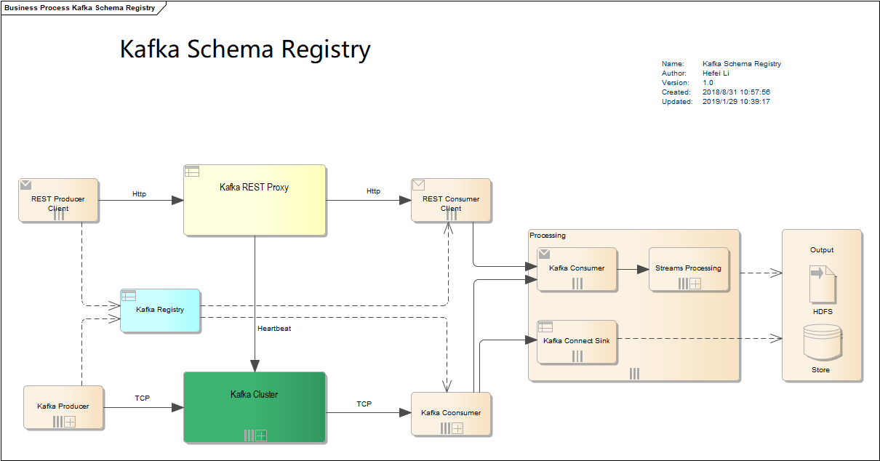
流式计算服务

Slide 8
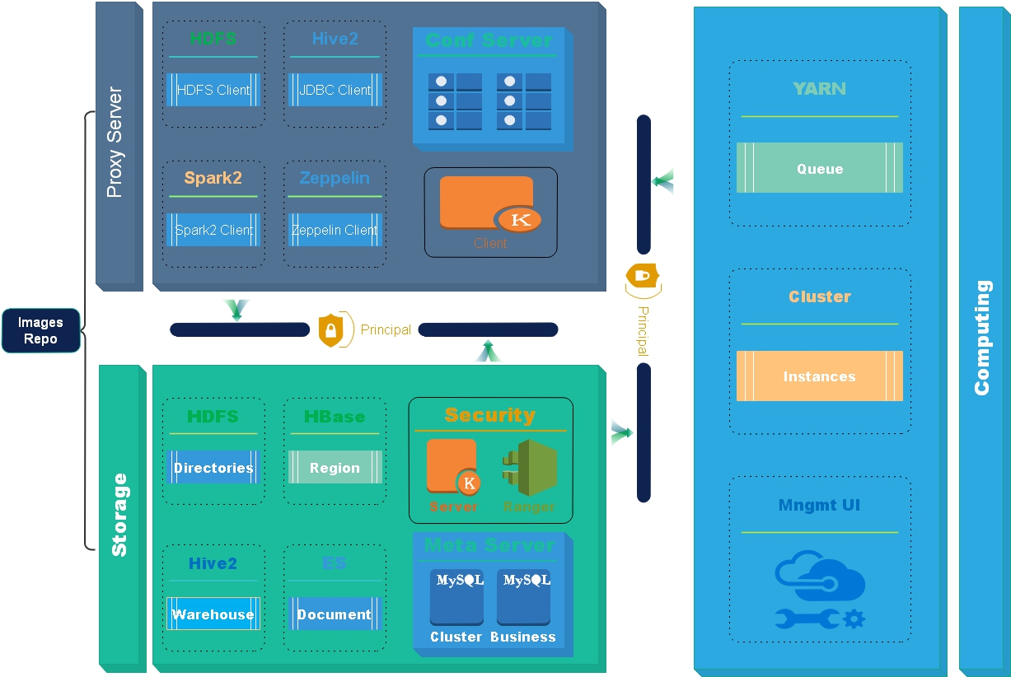
调度服务

Slide 9

安全服务
IAM
Administration Portal
LDAP
AD
ERP
JD Pin
JD Passport
JD Pin
JD Passport
Management Console
Audit Server
Policy Server
Apache Ranger -- Plugins
Kerberos
KDC
Data
security group

Slide 10
安全服务
Identity & Access Management
RESTful
SDK
Authenticator
Authorizer
Access Management
Prevention
Security Scanner
Key Management
Directory Management
Organizations
Access Policy
Identity
Identity
LDAP
AD
ERP
ID
JD Passport
JD Pin

Slide 11

元数据管理
Data Lifecycle
Management
Tag Based
Policies
Audit Store
... ...
Knowledge
Services
Msg
Search
Lineage
Exchange
Notification
Msg Consumer
{ RESTFul:API }
Kafka: pub/sub
Bridges
Changed
Hive
Bridge
HBase
Bridge
HDFS
Bridge
Kafka
Bridge
MySQL
Bridge
Data

Slide 12
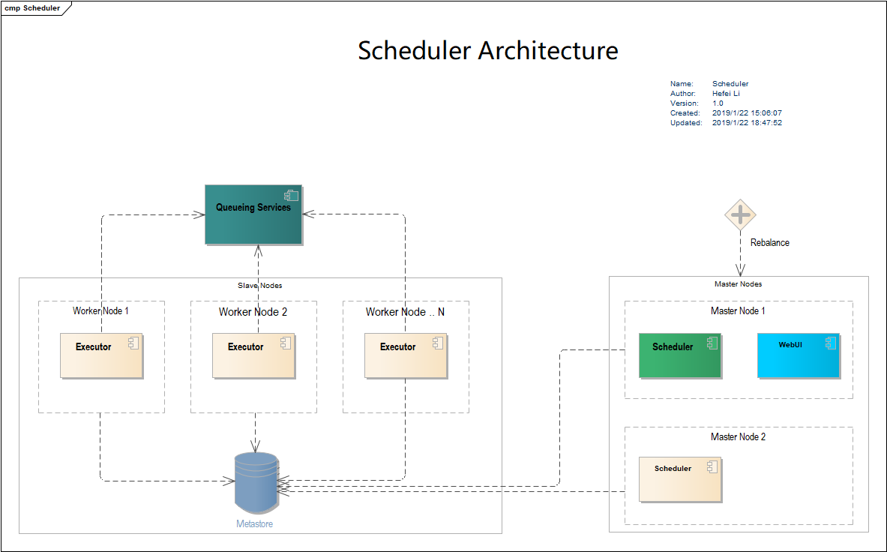
Pipeline 调度服务

Slide 13
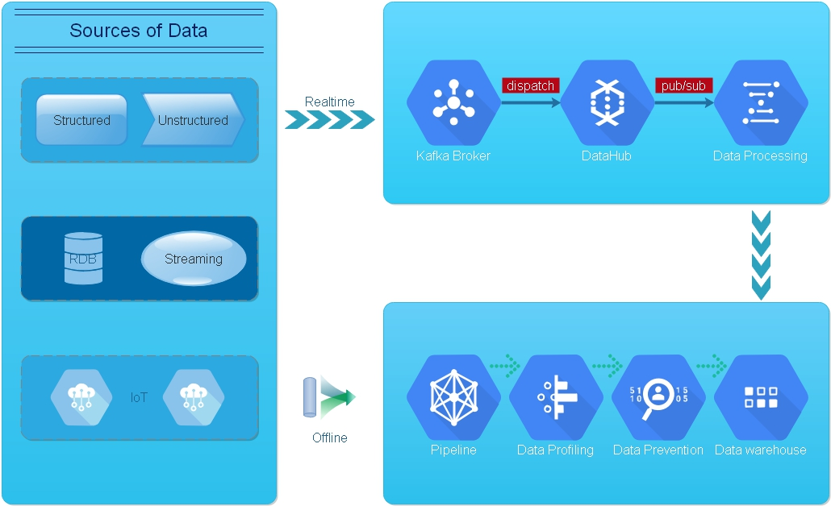
Data Collection

Slide 14
Thanks
北京市朝阳区北辰西路8号北辰世纪中心A座6层
6F Building A, North-Star Century Center, 8 Beichen West Street,
Chaoyang District, Beijing 100101
T. 010-5895 1234 F. 010-5895 1234
E. xingming@jd.com www.jd.com

