Slide 1

소프트웨어 종합설계 연구제안발표
페르소나를 반영한
영어 교육용 챗봇
Team CONAI
문승준 목요한 이혜지
Copyrightⓒ. Saebyeol Yu. All Rights Reserved.

Slide 2

CONTENTS
001
모델 정의
002
챗봇 구현
003
에러 수정 모델 구현
004
사용자 발화 예측 구현
005
전체 모델 병합
006
한계점
007
앞으로의 방향
Copyrightⓒ. Saebyeol Yu. All Rights Reserved.

Slide 3
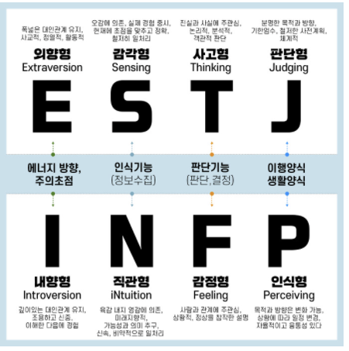
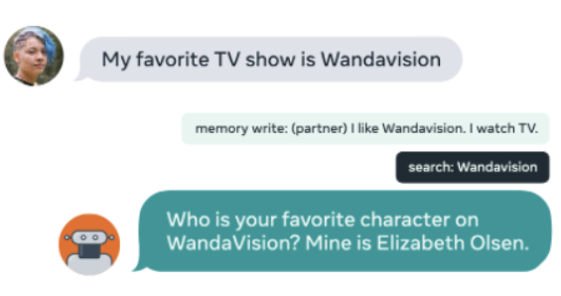
1
모델 정의
Model definition
Chatbot
Error generation
Word Extraction
DodecaDialogue 챗봇 모델
문법 오류 교정
응답 예측 및 추천
I am go.
I am going.
이미지 출처 :https://mk28.tistory.com/255, Proceedings of the 57th Annual Meeting of the Association for Computational Linguistics, pages 5370–5381 Florence, Italy, July 28 - August 2, 2019.

Slide 4
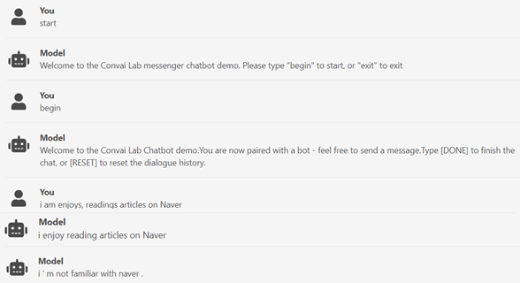


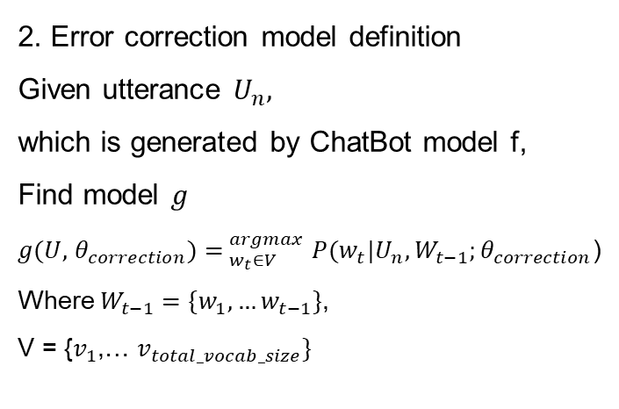
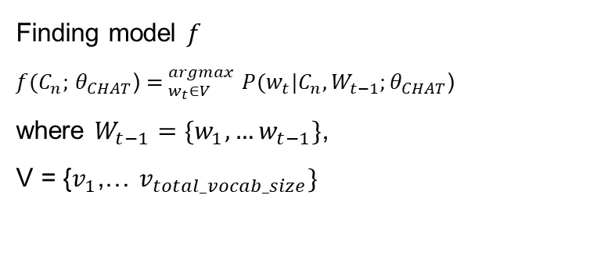
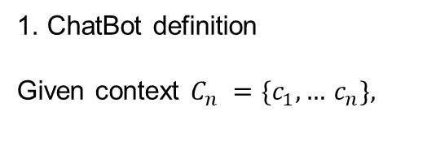
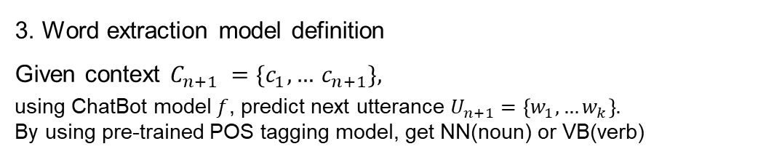
1
모델 정의
Model definition
1. ChatBot definition
Given context $C_{n} =\{c_{1},…$ $c_{n}\},$
2. Error correction model definition
Given utterance $U_{n},$
which is generated by ChatBot model f,
Find model $g$
$g(U,$ $θ_{correction})$ ${= }_{w_{t}∈V}^{argmax}P(w_{t}|U_{n},W_{t−1};θ_{correction}\text{)}$
Where $W_{t−1}=\{w_{1},…w_{t−1}\}$,
V = {$v_{1}$,… $v_{total_vocab_size}\}$
Finding model $f$
$f(C_{n};$ $θ_{CHAT}$) ${= }_{w_{t}∈V}^{argmax}P(w_{t}|C_{n},W_{t−1};θ_{CHAT}\text{)}$
where $W_{t−1}=\{w_{1},…w_{t−1}\}$,
V = {$v_{1}$,… $v_{total_vocab_size}\}$
3. Word extraction model definition
Given context $C_{n+1} =\{c_{1},…$ $c_{n+1}\},$
using ChatBot model $f$, predict next utterance $U_{n+1}=\left\{w_{1},…w_{k}\right\}.$
By using pre-trained POS tagging model, get NN(noun) or VB(verb)

Slide 5


1
모델 정의
Model definition
Error Correction Model
사용자 발화
“Helo?”
Chatbot Model
문법교정
문법교정
챗봇 응답
챗봇 응답
“Hello?”
Chatbot Model2
챗봇 응답
“Hi. What did you have for lunch?”
챗봇 발화
다음 발화 제시어
“I had a burger
and a brownie.”
다음 발화 제시어
Word Extraction
Model
Use “Burger” and “Brownie” in your next utterance

Slide 6

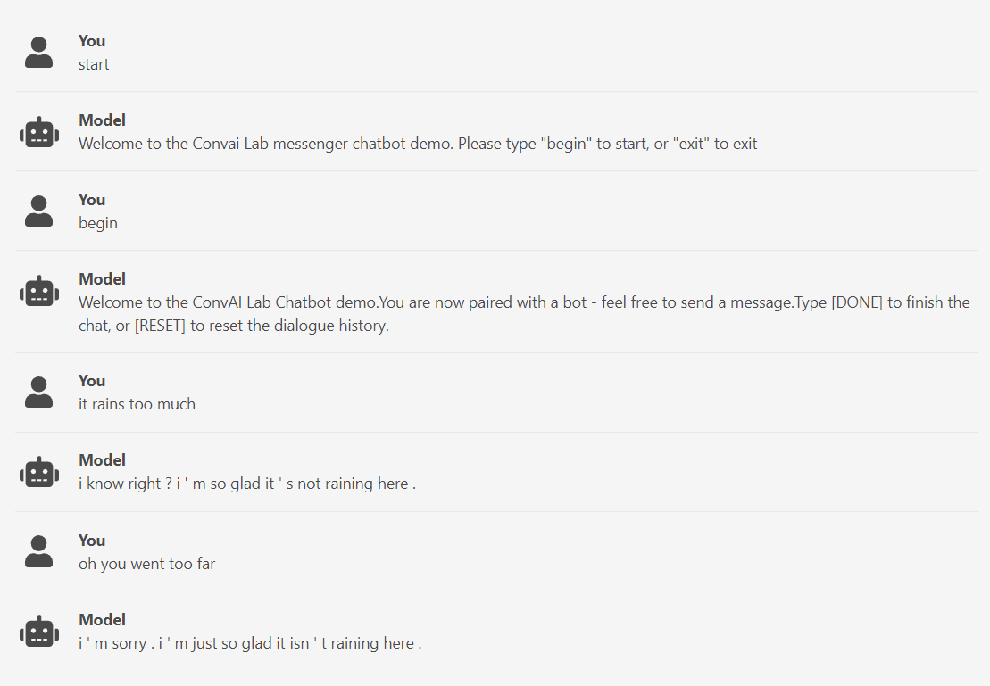
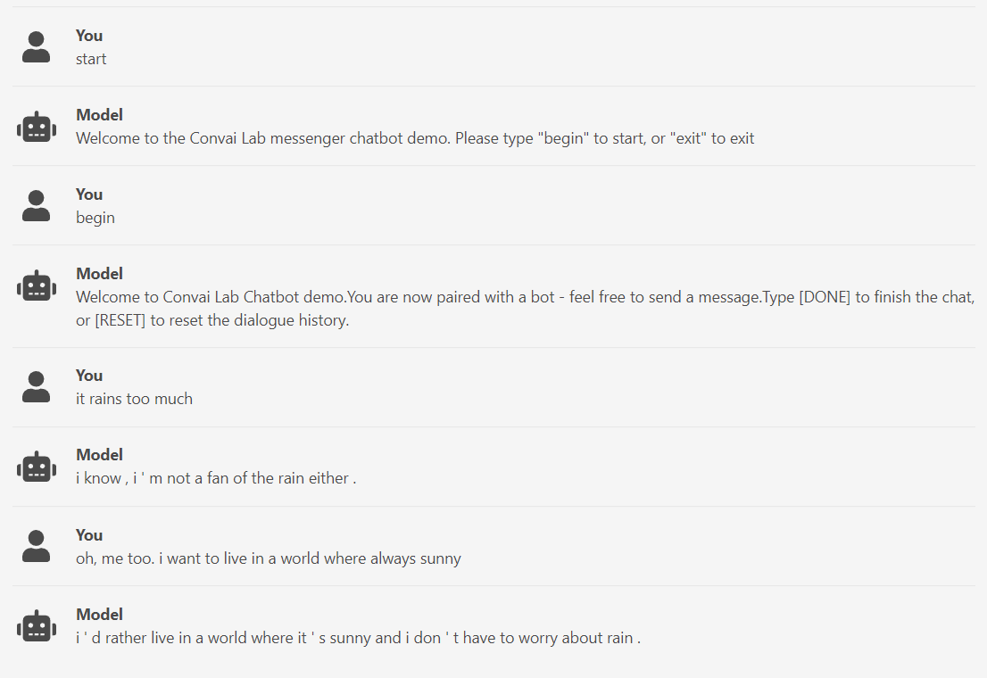
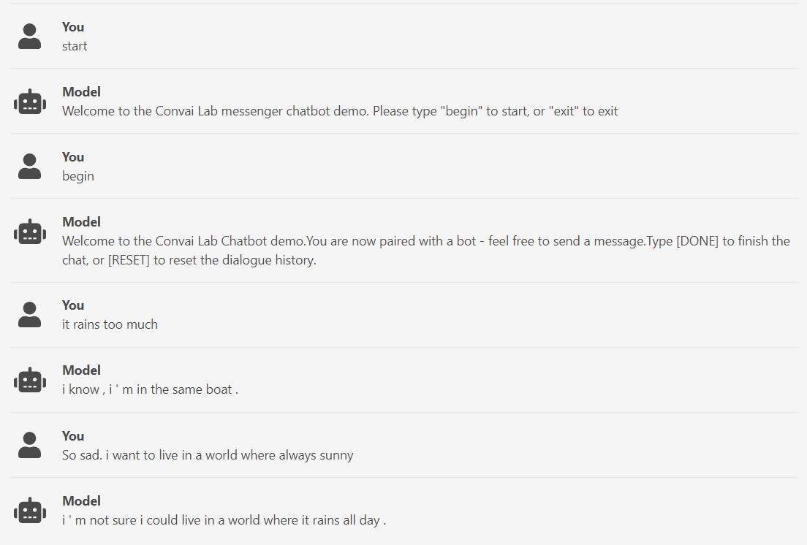
2
챗봇 구현
Implementing ChatBot
ParlAI chatbot
Imageseq2Seq Dodecadialogue fine-tuned on convai2
Imageseq2Seq Dodecadialogue with no fine-tuning
Imageseq2Seq Dodecadialogue fine-tuned on wizard of wikipedia

Slide 7
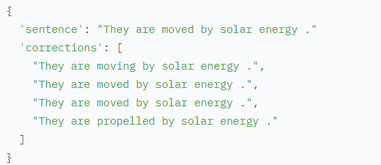
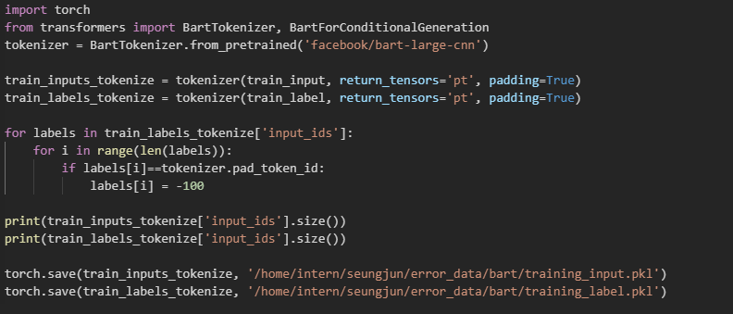
3
에러 수정 모델 구현
Implementing Error Correction model
Implementing Error Correction model with JFLEG Dataset
Dataset Summary: It is a gold standard benchmark for GEC(Grammatical Error Correction) with respect to fluency as well as grammaticality.
Pre-processing JFLEG Dataset to csv
Data in JFLEG
->each instances contains
1. one source sentence
2. four corrections
Tokenizing data example
: Why change pad token?

Slide 8
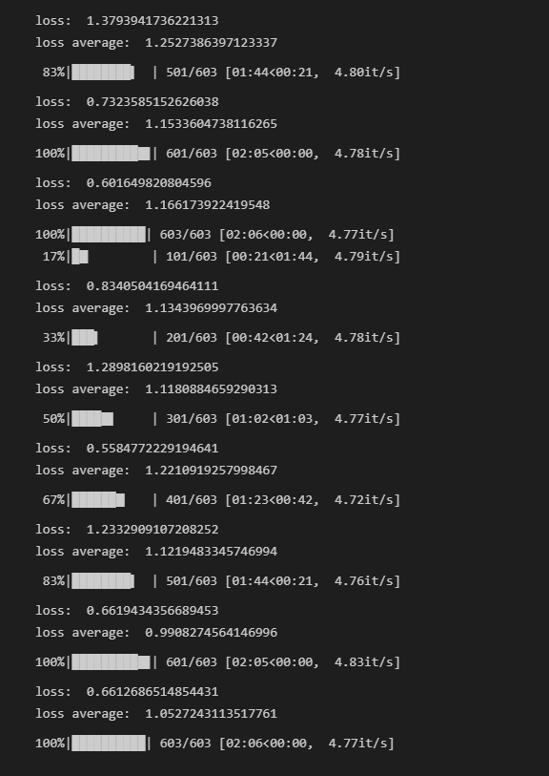
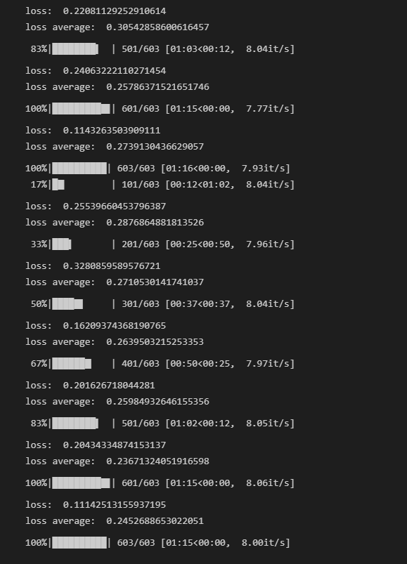


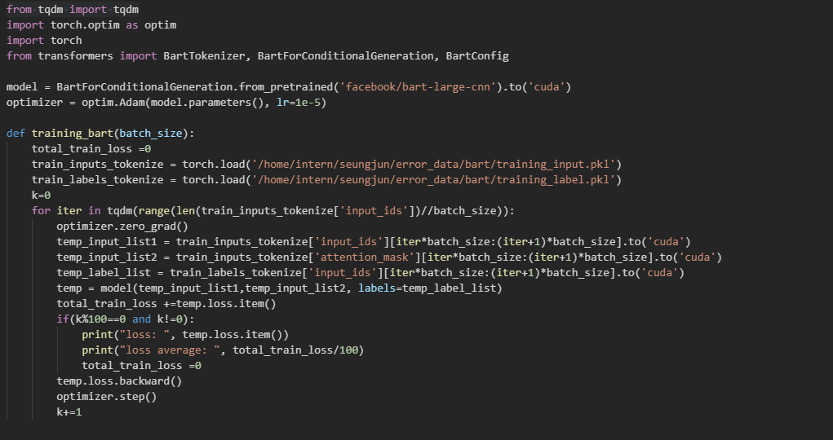
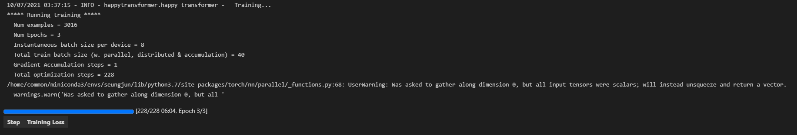
3
에러 수정 모델 구현
Implementing Error Correction model
Implementing Error Correction model with
1. Encoder Decoder model using Huggingface
2. Bart model using Huggingface
3. T5 model using HappyTransformer
Training step in bert encoder-decoder model
Training step in Bart model
Training step in T5 model
(Since HappyTransformer is a package build on top of HuggingFace, it doesn’t need any specific training loop)
Training loop example for Bart model

Slide 9



3
에러 수정 모델 구현
Implementing Error Correction model
Validation loss: T5 model < Bart model < bert encoder-decoder model
Validation loss in
bert encoder-decoder model
Validation loss in Bart
Validation loss in T5 model

Slide 10
3
에러 수정 모델 구현
Implementing Error Correction model
Modularization of Error Correction model
Modularization Details
Set max_length = length of tokenized input + 10
-> Without max_length
-> With max_length

Slide 11
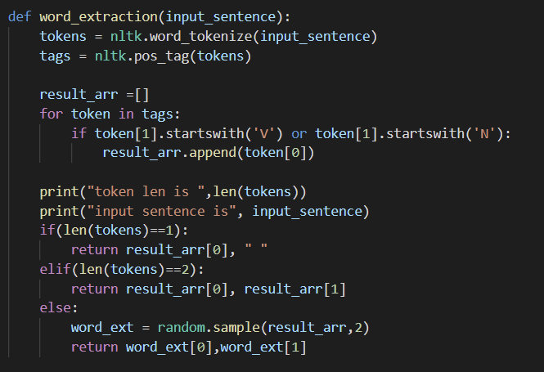
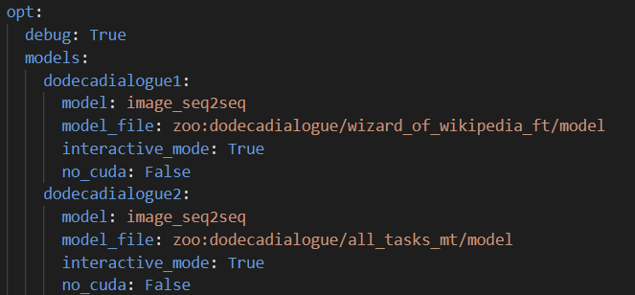
4
사용자 발화 예측 모델 구현
Implementing utterance prediction of user model
word_extraction
Model
Different with generating response model
Used pos_tag of nltk library

Slide 12
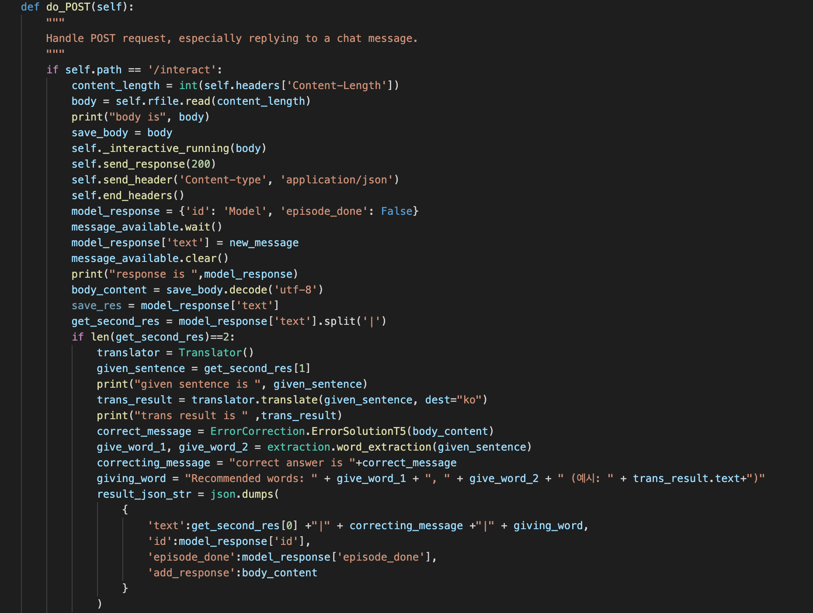
5
전체 모델 병합
Combining all modularized models
-By using modularized models,
Post
1. Error correction sentence
2. Model utterance
3. Recommended words
to client

Slide 13
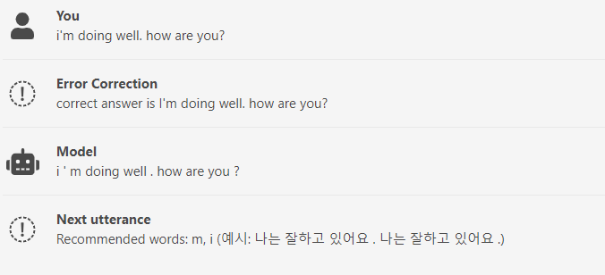
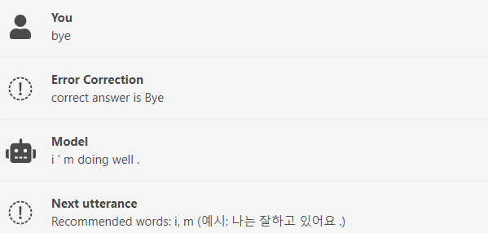
6
한계점
Limitations
Generate long sentence
Pos tag error
Repeat same response

Slide 14
7
앞으로의 방향
Plan
계획 ㈜ | 10 | 11 | 12 | 13
중간 발표
Pos tagging error 수정
문장 길이 조정, 그 외 에러 수정
보고서 작성, 최종 발표 준비
문승준 : 조장, 연구제안발표, 논문 정리, 발표 자료, 전체적 구현
목요한 : 발표자료, 논문 정리, 최종 발표
이혜지 : 발표자료, 논문 정리, 중간 발표

Slide 15
감사합니다
CONAI

