Slide 1
TrustNode Edge
Security & Architecture
Built for industrial operators. Read-only on the plant floor.
Outbound-only on the network. Tenant-isolated end-to-end.
Audience: Plant Managers · IT Security · OT Engineering · Compliance
Document version: 2026-05-15 (rev. 2)

Slide 2
The problem we solve
Industrial customers want their data — without changing the plant.
• Plants generate enormous amounts of data, locked inside PLCs and meters.
• Most monitoring tools require writing back to the PLC or opening inbound ports — neither is acceptable.
• IT teams must protect the corporate network from anything talking to the plant floor.
• OT teams must protect production from anything that might disturb control logic.
• Compliance teams need an audit trail, tenant isolation, and a story for IEC 62443 / NIS2.
TrustNode Edge — Security & Architecture
2 / 22

Slide 3
What TrustNode is, in one sentence
A read-only industrial data gateway with a cloud portal that never reaches back.
PLC → Edge → Cloud → Browser
Always that direction. The cloud cannot reach the edge.
The browser cannot reach the PLC.
TrustNode Edge — Security & Architecture
3 / 22

Slide 4
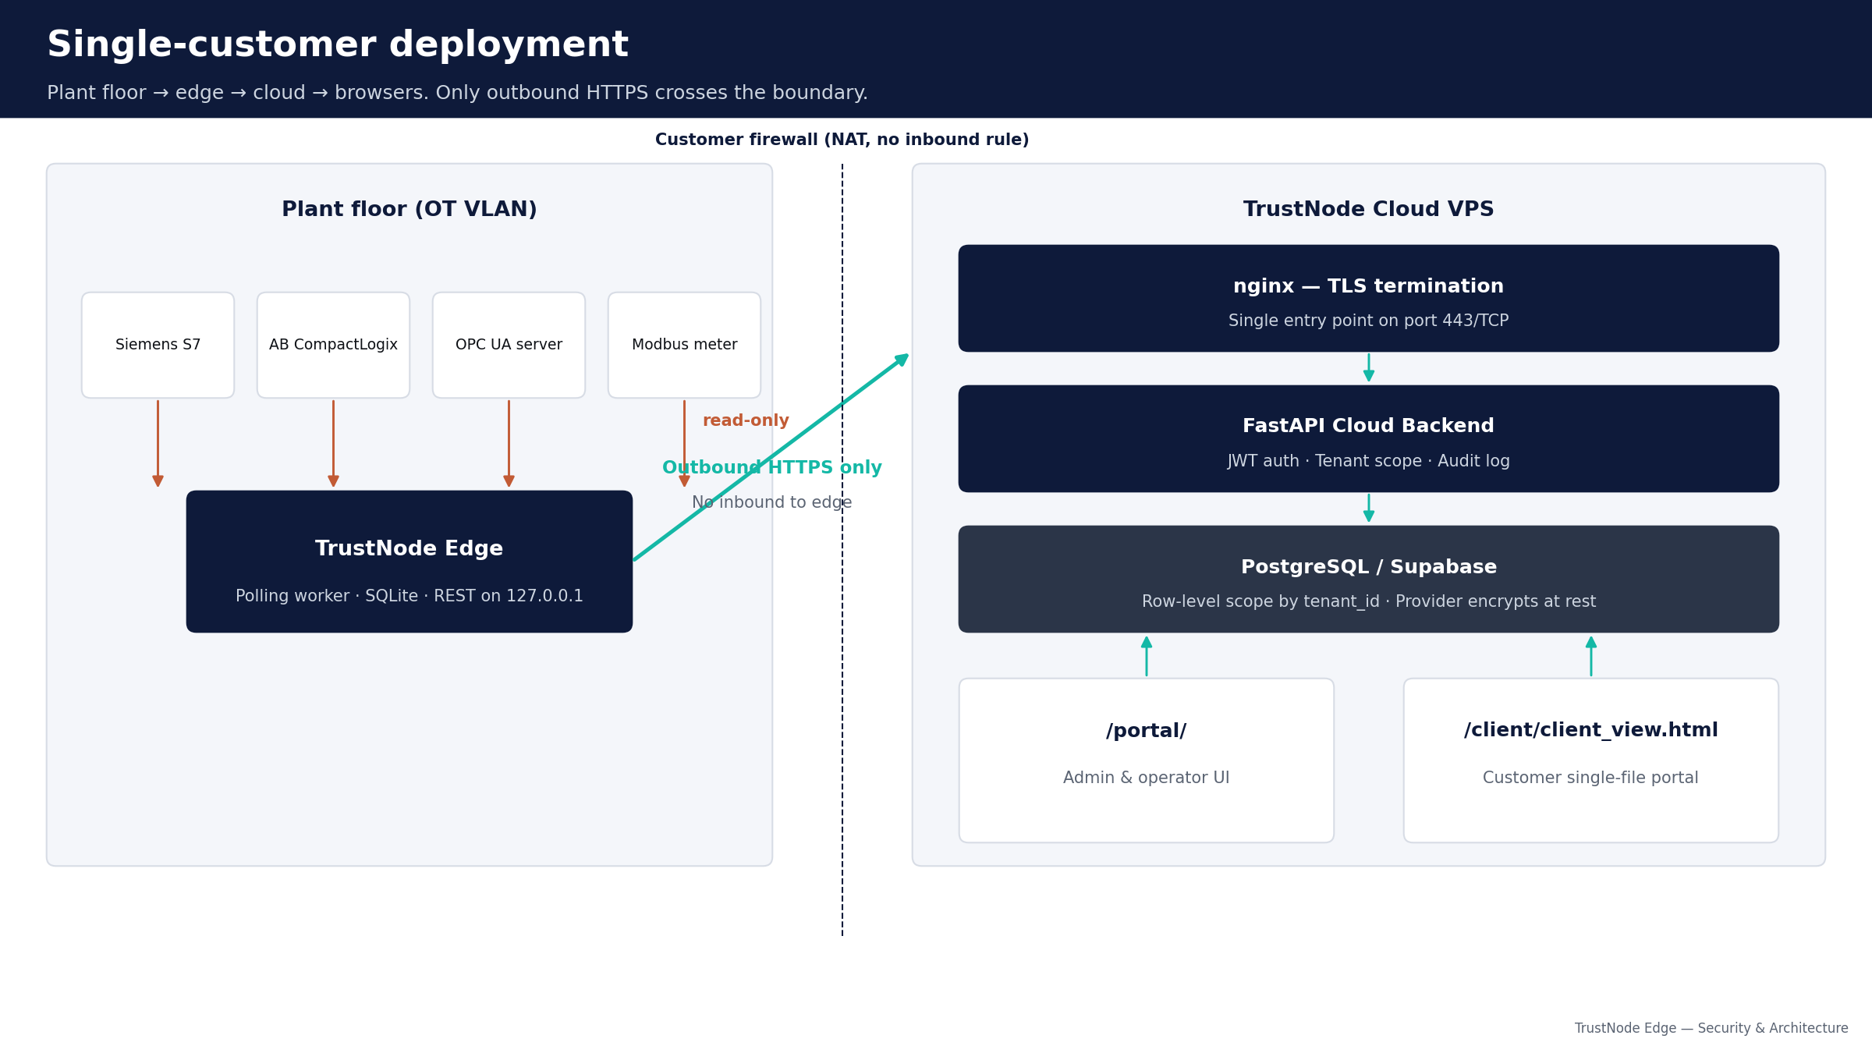
Single-customer deployment
Plant floor → edge → cloud → browsers. Only outbound HTTPS crosses the boundary.
TrustNode Edge — Security & Architecture
4 / 22

Slide 5
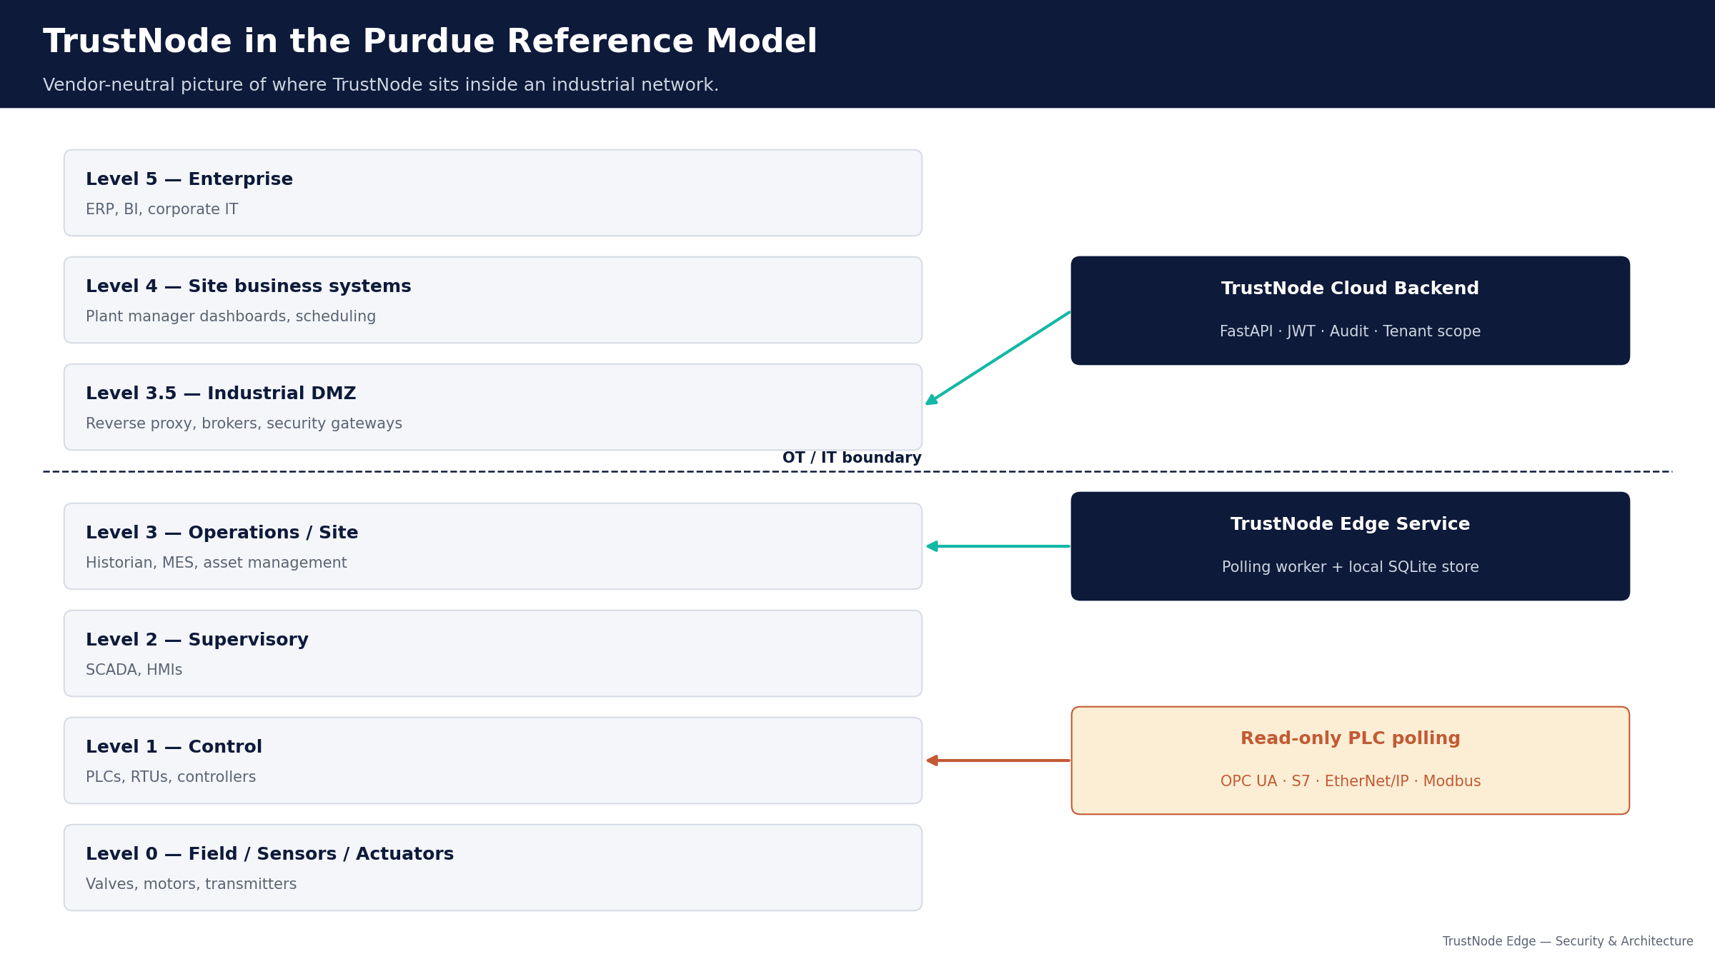
Purdue model alignment
Where TrustNode sits inside the industry's reference picture of plant networks.
TrustNode Edge — Security & Architecture
5 / 22

Slide 6
Read-only on the plant floor
Four industrial protocols. Zero write code paths.
OPC UA (IEC 62541)
Siemens S7 (Snap7)
Vendor-neutral standard. Siemens, Beckhoff, generic OPC servers.
Read-only tag access; server's auth & encryption respected.
Native S7-300/400/1200/1500. Read-only DB/M/I/Q access.
PLC's own ACL still applies.
Allen-Bradley (EtherNet/IP)
Modbus TCP
CompactLogix / ControlLogix via pycomm3 / pylogix.
Read-only. No write_tag bindings anywhere.
Universal protocol for power meters, VFDs, sensors.
Reads only holding & input registers.
TrustNode Edge — Security & Architecture
6 / 22

Slide 7
Outbound-only network
No inbound port on the edge, no inbound from cloud to plant.
• Edge dials out to cloud over HTTPS / TCP 443.
• Same direction as a web browser fetching a page.
• No NAT rule, no port forwarding, no listener exposed.
• Cloud VPS exposes only TCP/443 through nginx.
• FastAPI backend binds 127.0.0.1 — only reachable via nginx.
• No SSH server, no RDP listener, no reverse tunnel on edge.
Why this matters
Two of the largest industrial-breach categories of the past decade were remote-desktop tools left exposed and SSH servers without strong keys.
TrustNode simply does not run either.
Your perimeter stays closed. If your firewall is healthy today, installing TrustNode does not change that.
TrustNode Edge — Security & Architecture
7 / 22

Slide 8
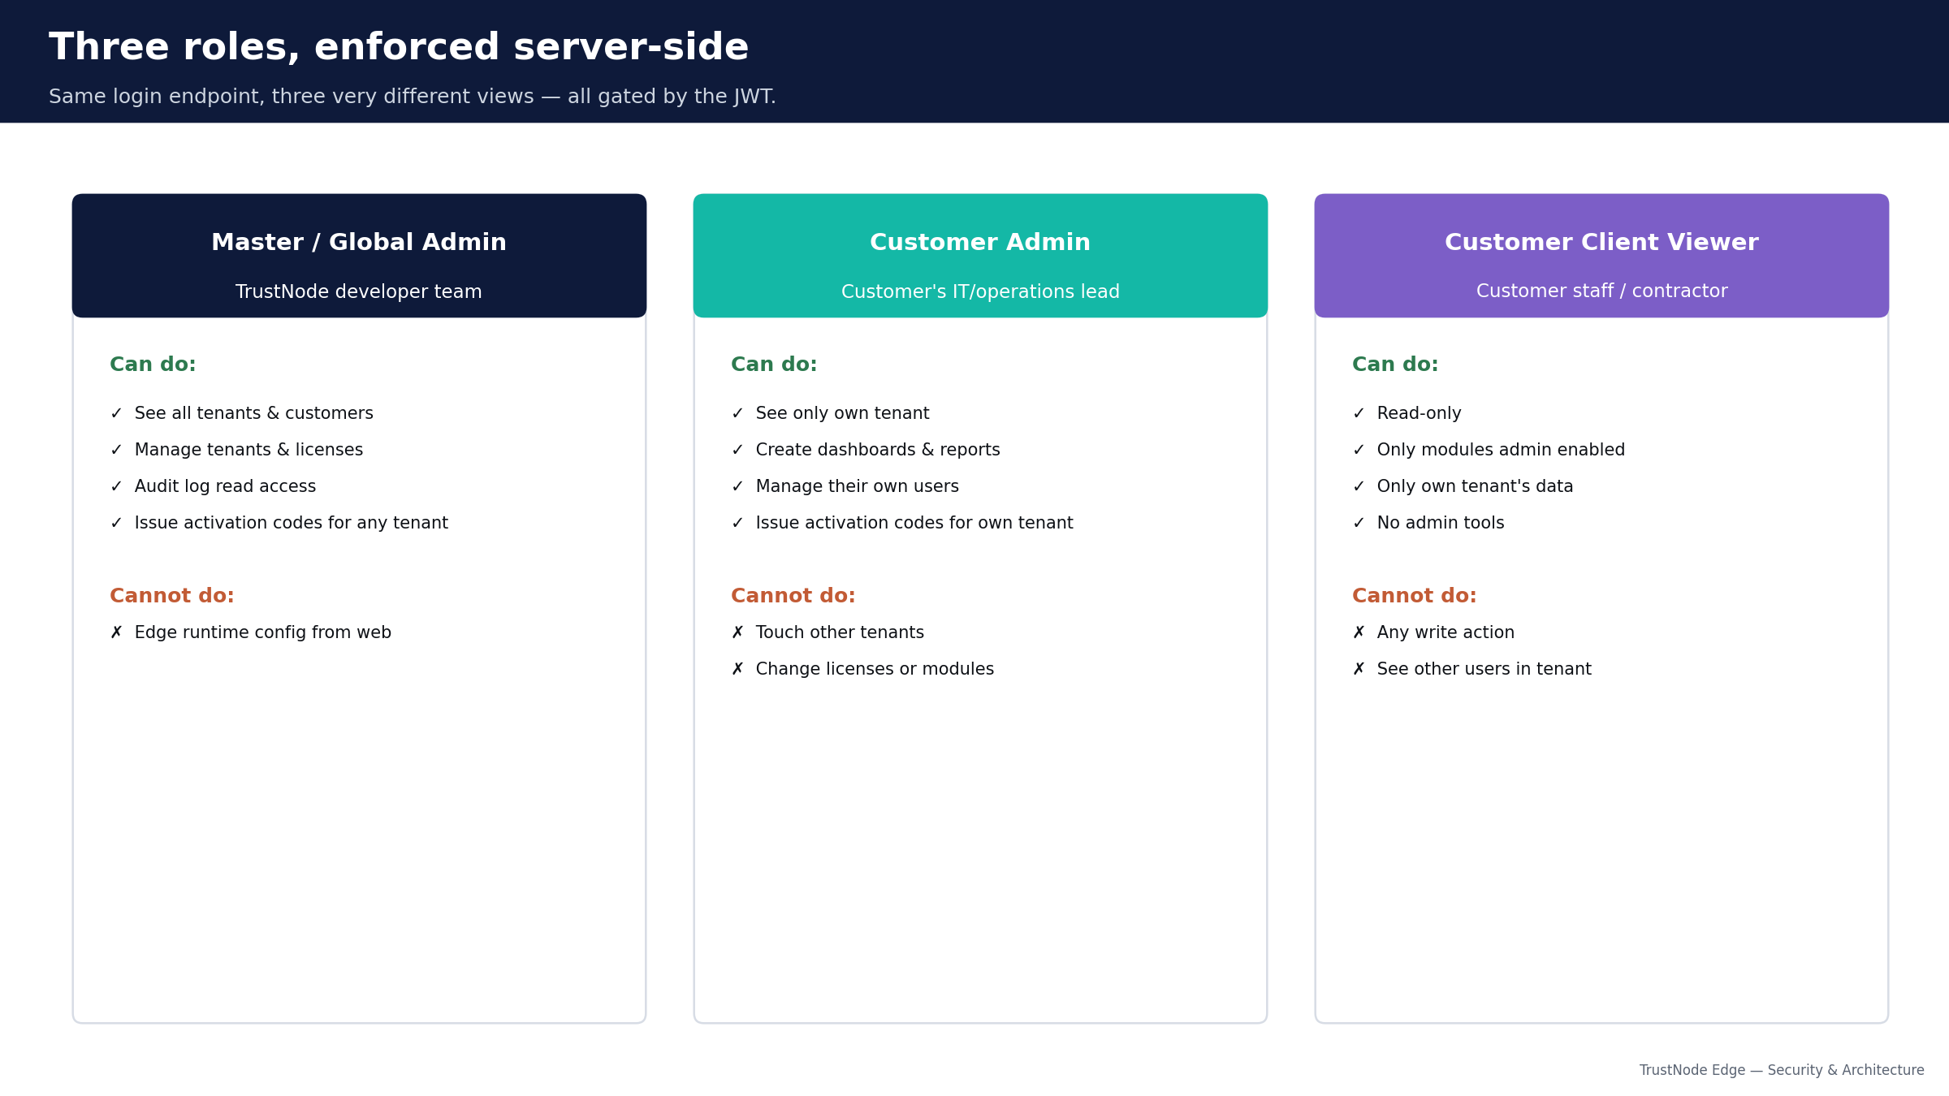
Three login roles, enforced server-side
Same login endpoint, three very different views.
TrustNode Edge — Security & Architecture
8 / 22

Slide 9
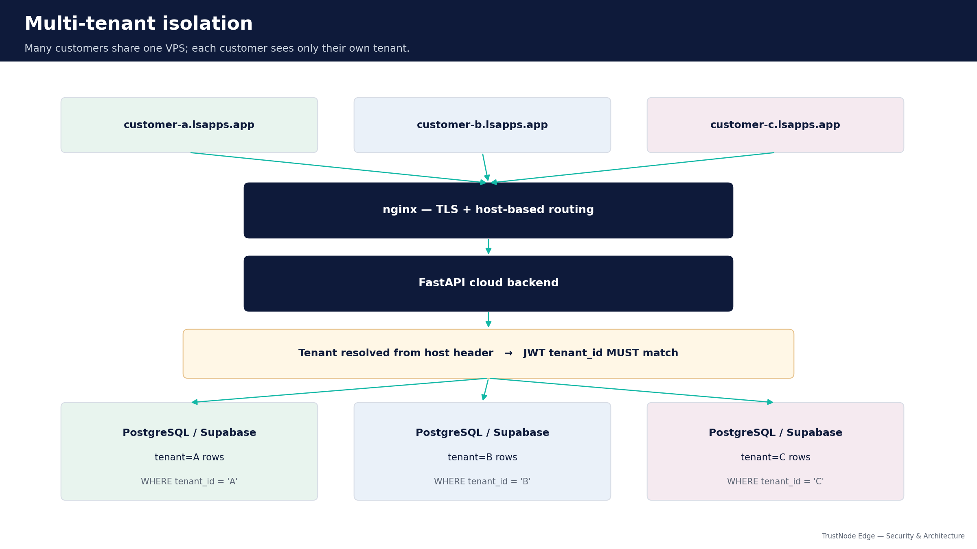
Multi-tenant isolation
One VPS, many customers, zero cross-tenant data.
TrustNode Edge — Security & Architecture
9 / 22

Slide 10
Authentication & data protection
Industry-standard cryptography, plain to explain to your CISO.
Authentication
Data protection
• JWT (RFC 7519) with HS256 signatures.
• 12-hour token lifetime; no refresh tokens.
• Passwords stored as PBKDF2-HMAC-SHA256, 120,000 iterations.
• Per-user salt; no plaintext ever logged or persisted.
• Three roles: master / customer-admin / client viewer.
• Every API call re-validates the JWT.
• TLS 1.2+ everywhere — browsers, edge↔cloud, DB↔backend.
• Postgres / Supabase: sslmode=require, provider encryption at rest.
• WSS auto-upgrade — mixed-content is structurally impossible.
• Edge SQLite on BitLocker / LUKS / FileVault for disk encryption.
• Activation codes: SHA-256 hashed, 30-min TTL, one-shot.
• Password reset tokens: hashed, 15-min TTL, one-shot.
TrustNode Edge — Security & Architecture
10 / 22

Slide 11
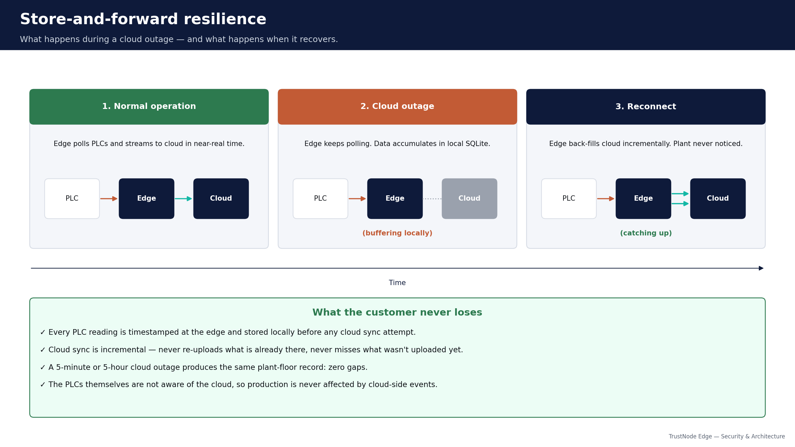
Store-and-forward resilience
Cloud outages do not become plant-floor data gaps.
TrustNode Edge — Security & Architecture
11 / 22

Slide 12
Deployment options — overview
Same software, five common shapes. Pick what fits your IT/OT reality.
A — Plant PC
Windows PC inside the plant. Local-only.
Best for: Smallest sites, pilots, no cloud needed.
B — IPC in panel
Rugged DIN-rail PC in the electrical cabinet.
Best for: Machine builders, OEMs, no server room.
C — Customer server
Linux VM in the customer's datacenter.
Best for: Mid/large customers with their own IT.
D — Cloud-bridged
Edge at plant + cloud portal. The default.
Best for: Web access from anywhere; multi-site.
E — Multi-plant
Several plants pooled into one central historian.
Best for: Multi-site enterprises, one source of truth.
TrustNode Edge — Security & Architecture
12 / 22

Slide 13
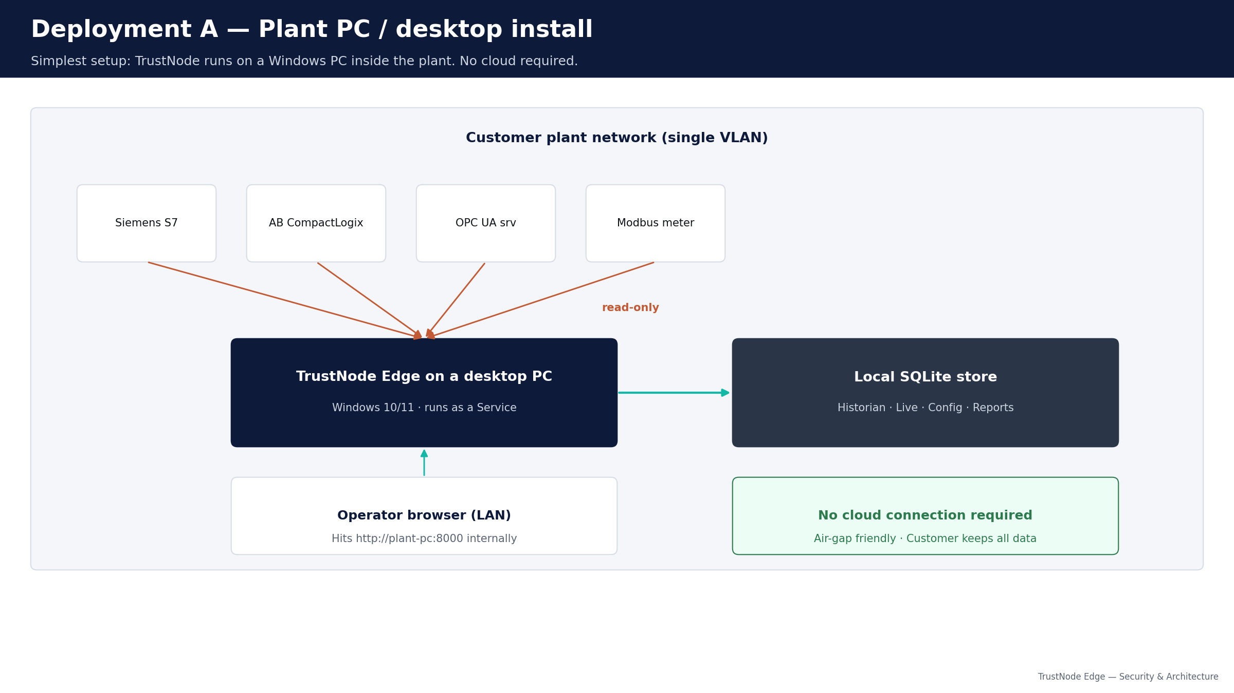
Deployment A — Plant PC / desktop install
Simplest setup. TrustNode runs on a Windows PC inside the plant.
Plant PC
• Windows 10/11 PC inside the plant LAN.
• Local SQLite store, no cloud needed.
• Operator browser hits it on the LAN.
• 16 GB RAM / 256 GB SSD typical.
Air-gap friendly. Best for small standalone sites and pilots.
TrustNode Edge — Security & Architecture
13 / 22

Slide 14
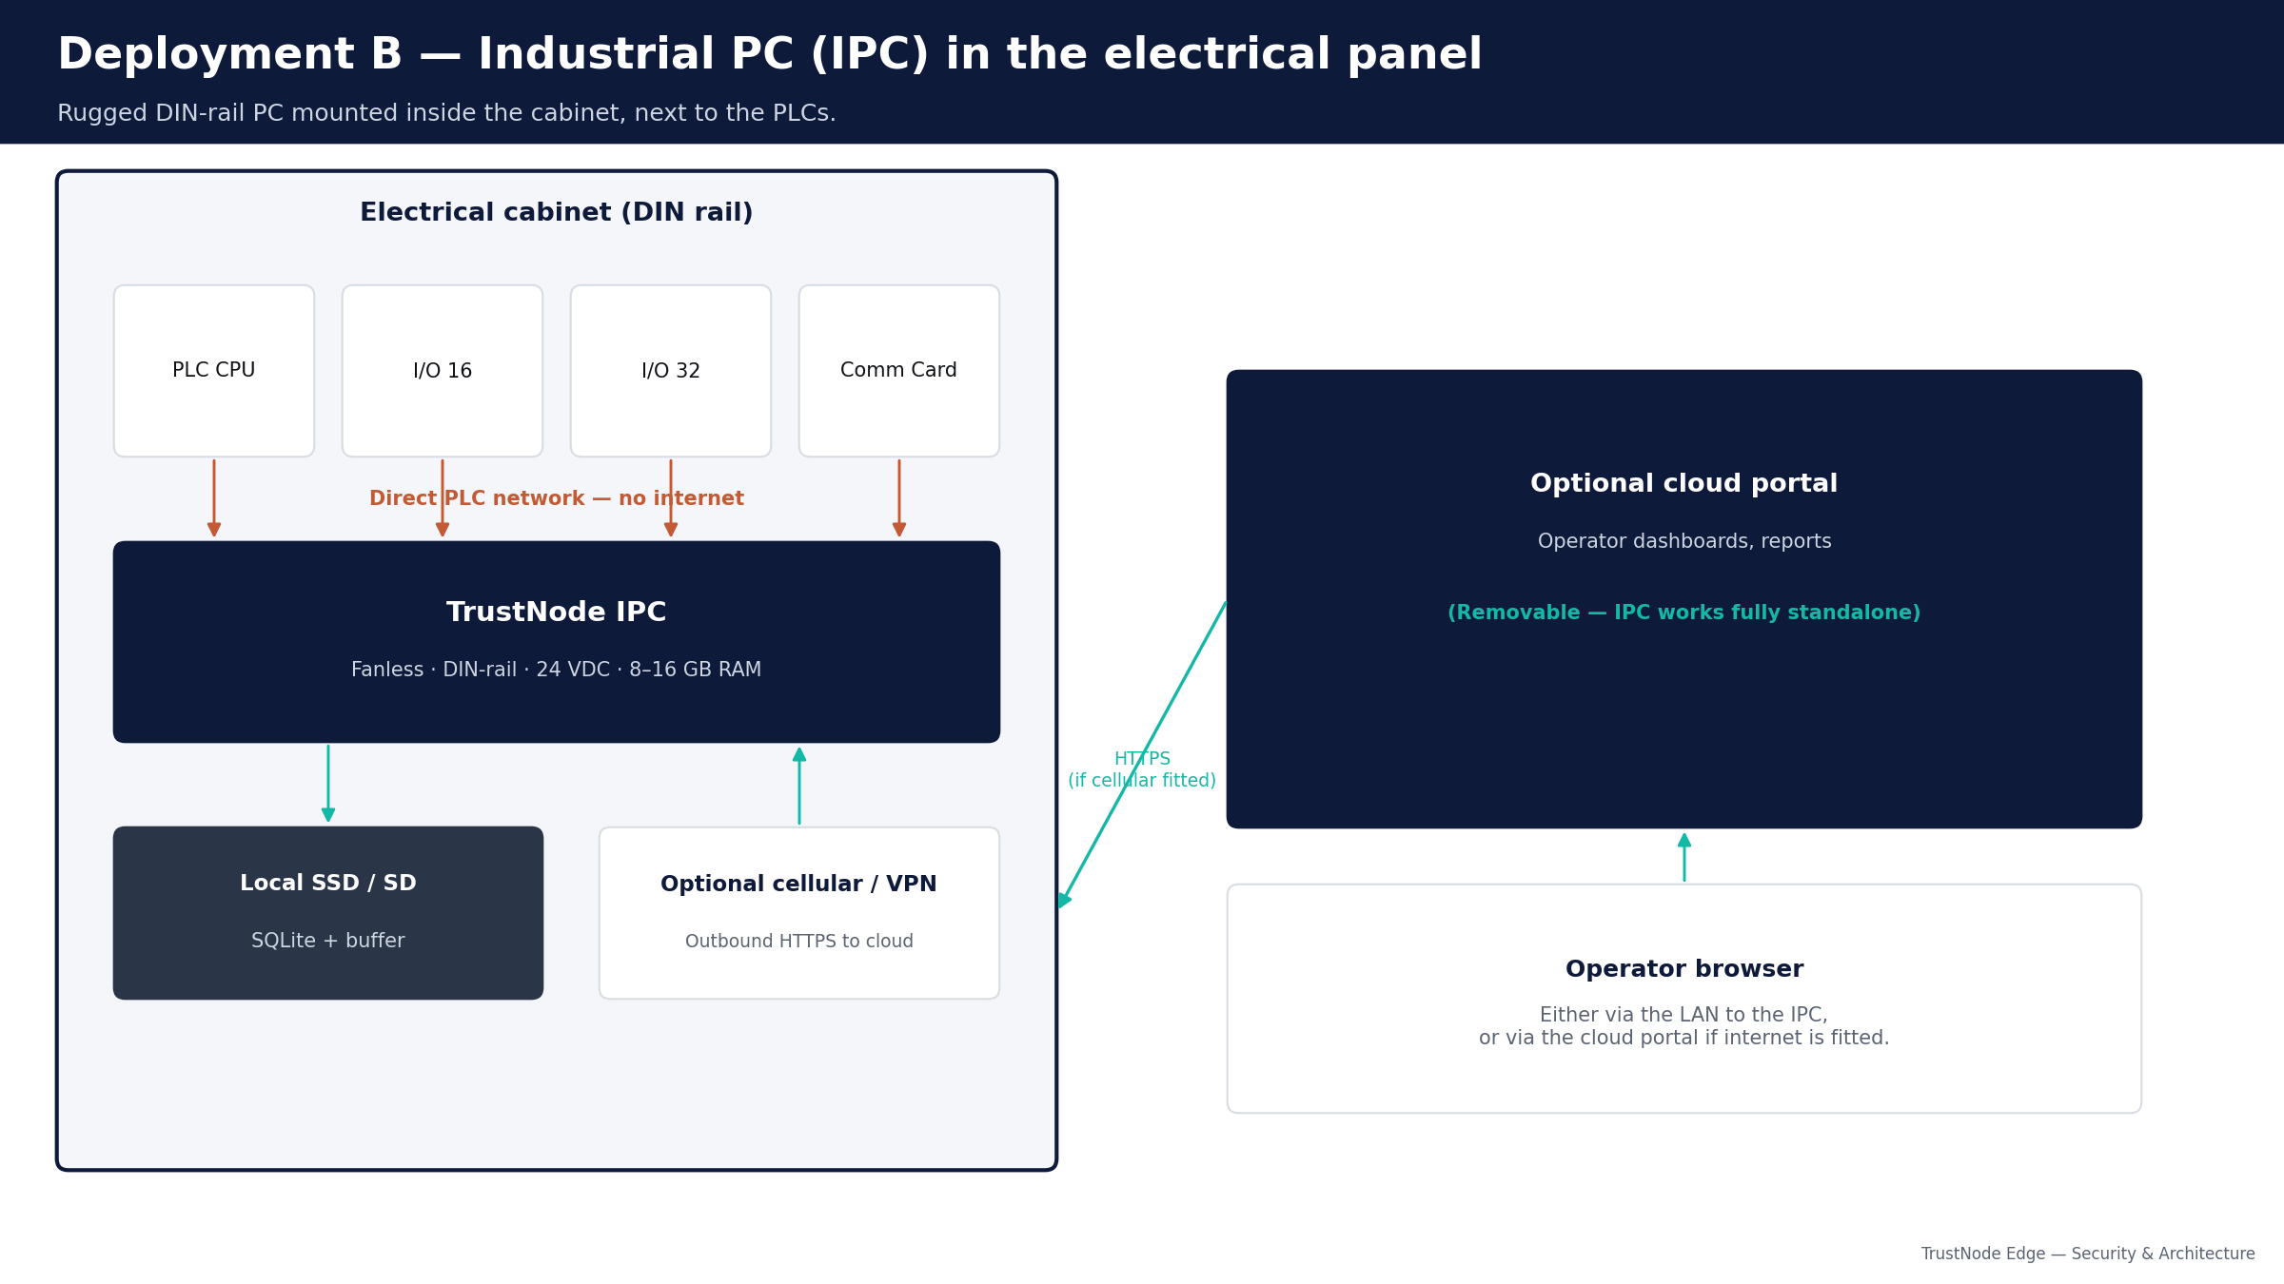
Deployment B — Industrial PC (IPC) in the panel
Rugged DIN-rail PC, fanless, 24 VDC. Mounted next to the PLCs.
IPC in panel
• Fanless, DIN-rail, 24 VDC supply.
• 8–16 GB RAM, industrial SSD/SD.
• Common: Siemens IPC127E, B&R APC910, Beckhoff CX, Advantech UNO.
• Optional cellular / VPN modem in same panel for cloud portal.
Best for machine builders shipping a turnkey line.
TrustNode Edge — Security & Architecture
14 / 22

Slide 15
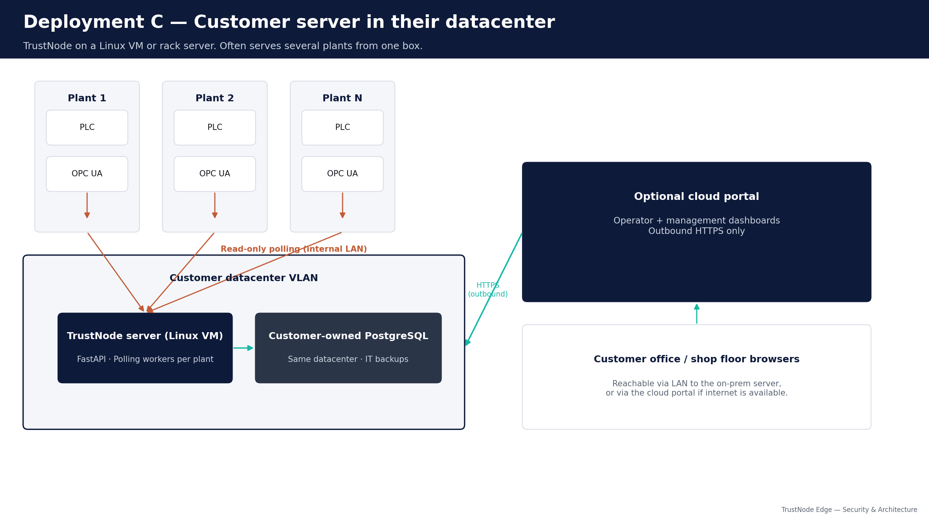
Deployment C — Customer server in datacenter
Linux VM or rack server. Often serves several plants from one box.
Customer server
• 4 vCPU / 8 GB RAM (start), Ubuntu / RHEL / Debian.
• Reaches each plant's PLCs over the customer's WAN/VPN.
• Writes into the customer's own PostgreSQL.
• Customer's IT runs backups, monitoring, HA.
Best for mid/large customers with internal IT and on-prem policy.
TrustNode Edge — Security & Architecture
15 / 22

Slide 16
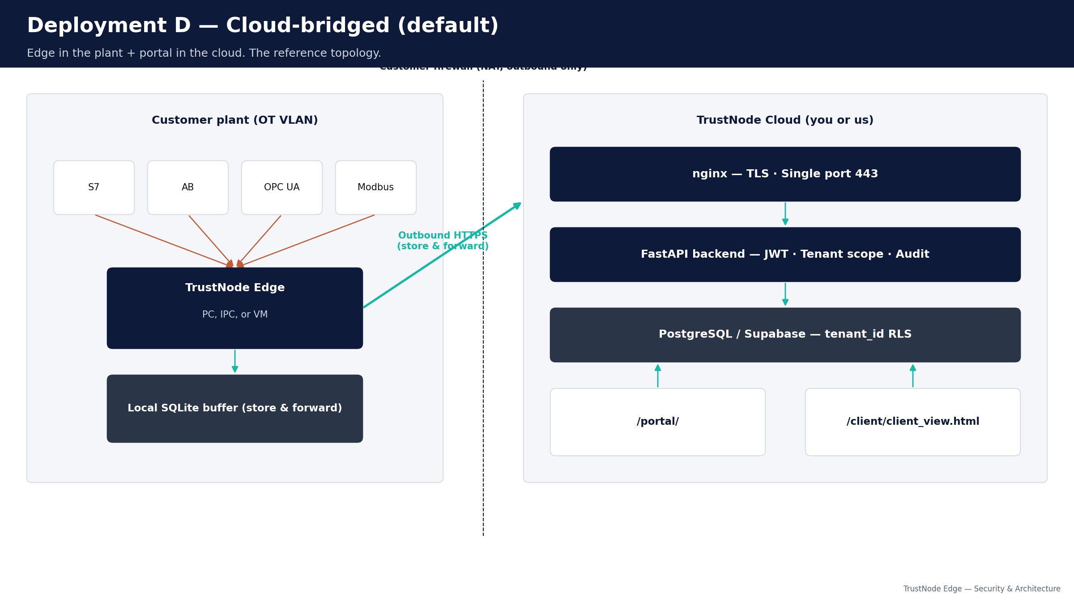
Deployment D — Cloud-bridged (the default)
Edge in the plant + cloud portal. Web access from anywhere.
Cloud-bridged
• Edge can be PC, IPC, or VM (A/B/C).
• Outbound HTTPS to a cloud VPS — ours or yours.
• Cloud handles dashboards, multi-tenant portal, audit log.
• Edge keeps SQLite buffer (store-and-forward).
Best when web access from anywhere matters.
TrustNode Edge — Security & Architecture
16 / 22

Slide 17
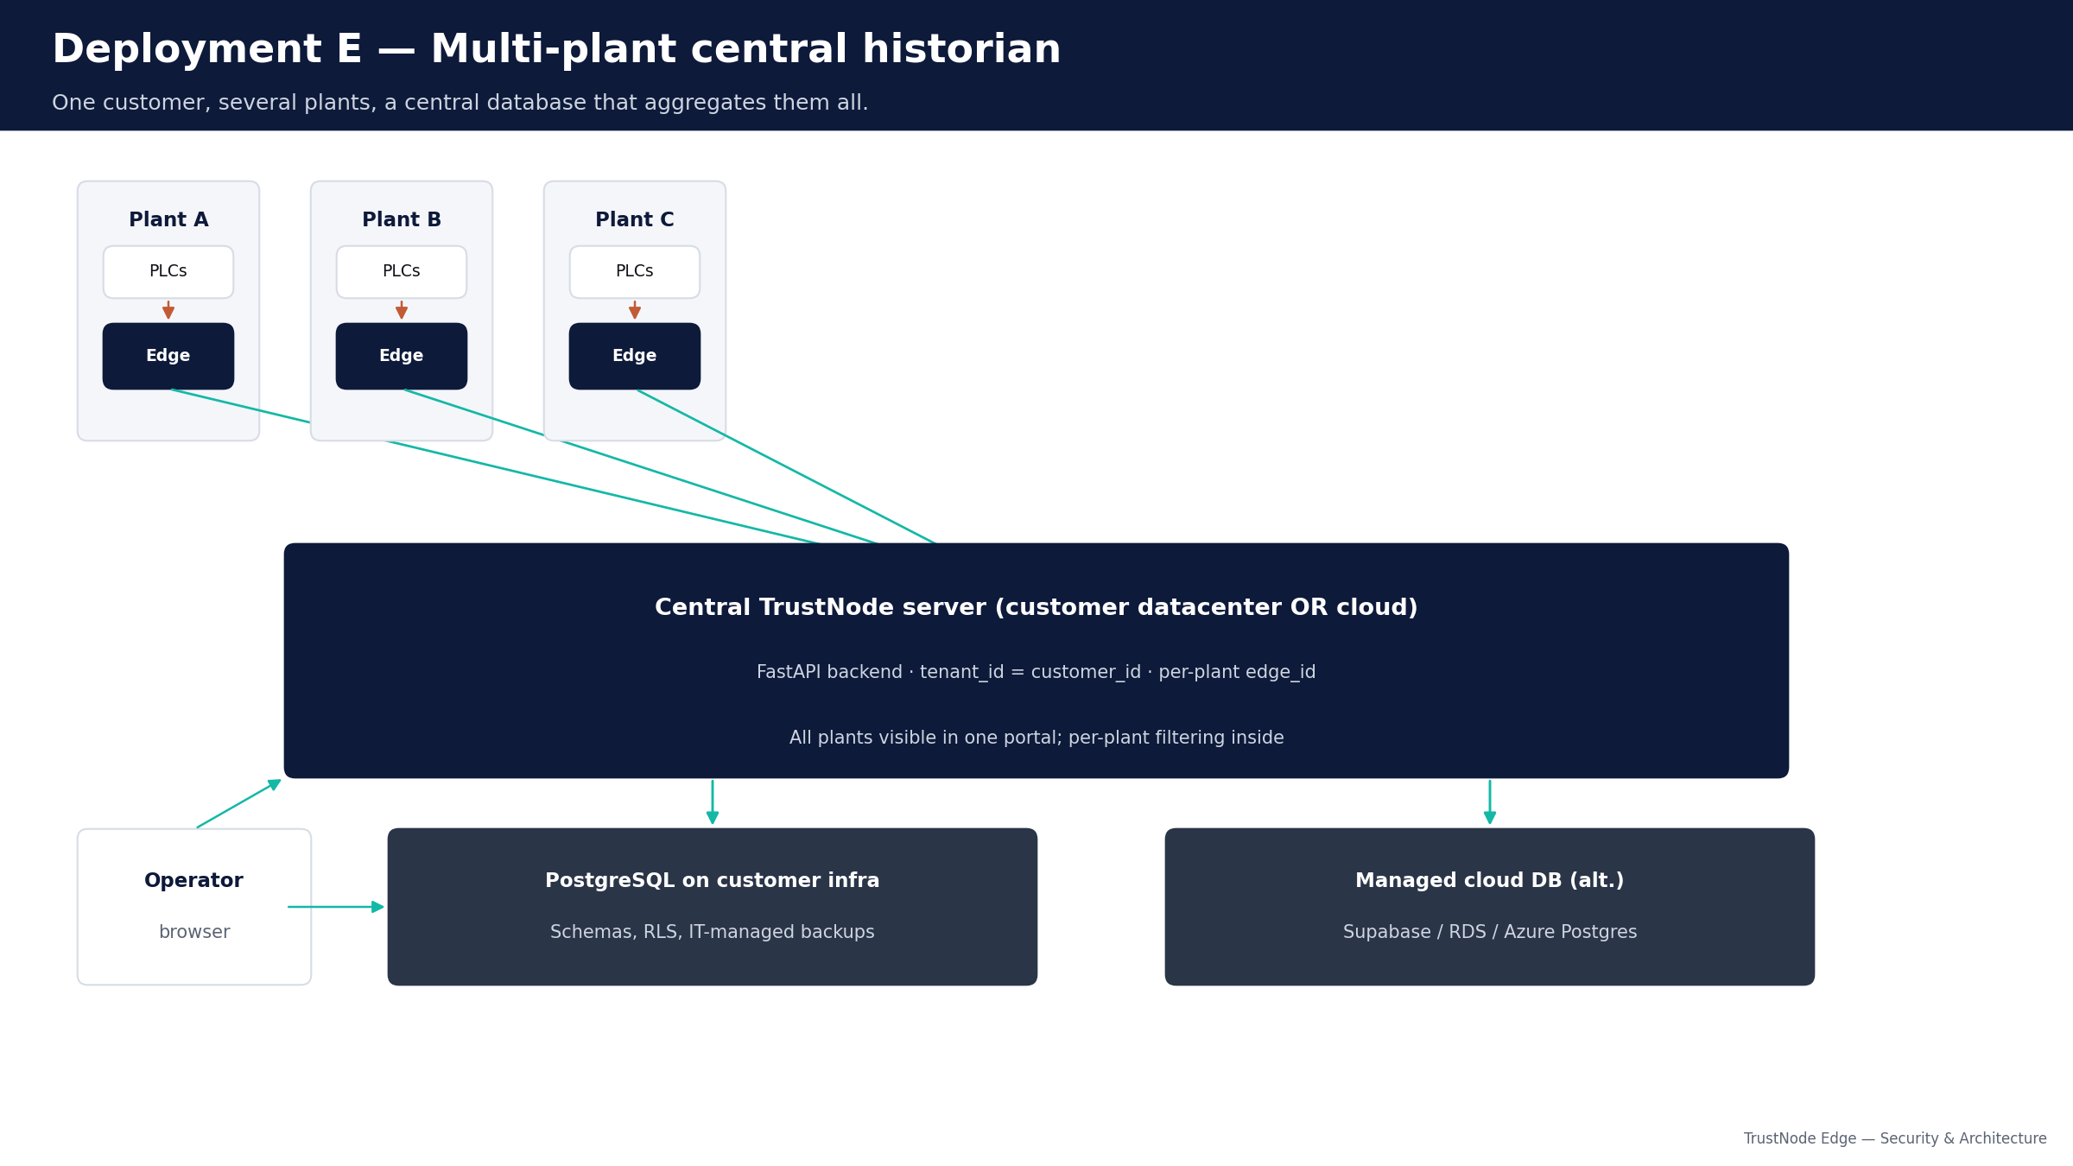
Deployment E — Multi-plant central historian
Several plants, one customer, one central historian.
Multi-plant
• One edge per plant; one central server (on-prem or cloud).
• tenant_id = customer; edge_id distinguishes plants.
• All plants visible in one portal, filterable per plant.
• PostgreSQL on customer infra OR managed cloud DB.
Best for multi-site enterprises wanting one source of truth.
TrustNode Edge — Security & Architecture
17 / 22

Slide 18
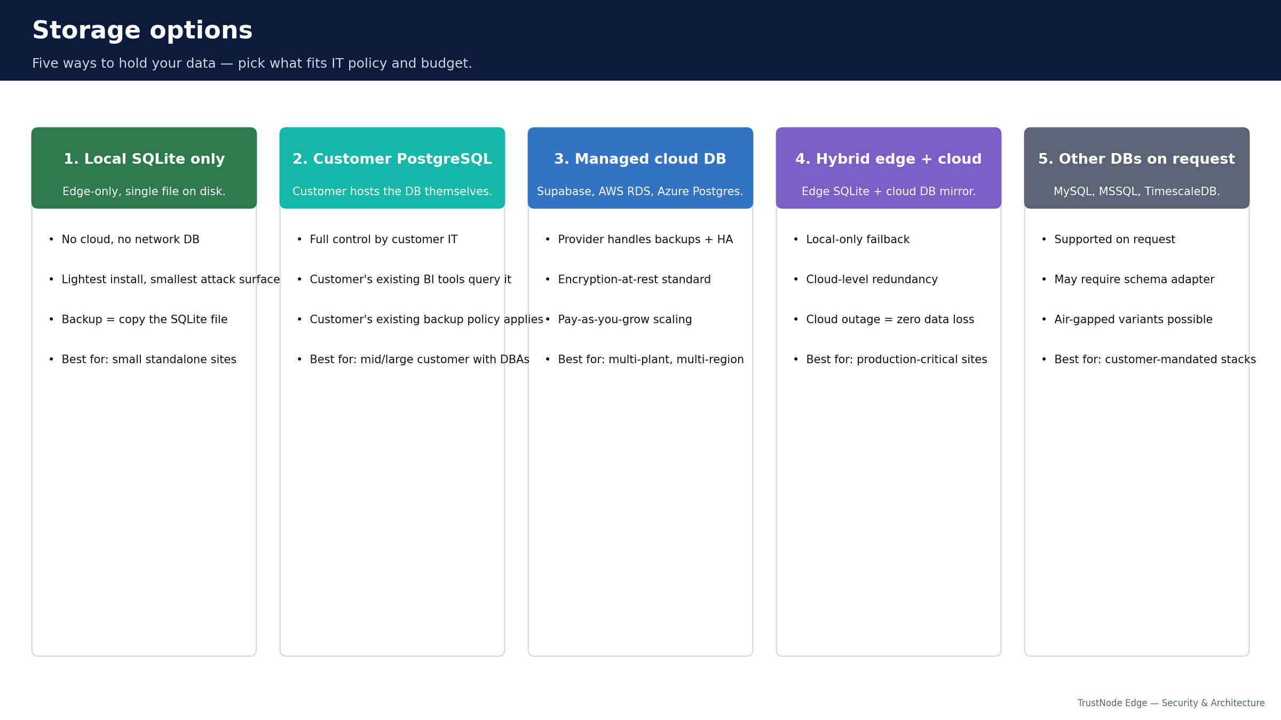
Storage options — where the data physically lives
Five options, pick what fits IT policy and budget.
TrustNode Edge — Security & Architecture
18 / 22

Slide 19
Networking prerequisites
The checklist your IT and OT teams can run through together.
TrustNode MUST reach
TrustNode does NOT need
• PLCs at configured IPs (typical ports: 502 Modbus, 4840 OPC UA, 102 S7, 44818 EtherNet/IP).
• DNS resolution (or use IPs).
• NTP for time sync — historian only useful if timestamps are correct.
• Outbound HTTPS/443 to cloud (cloud-bridged topologies only).
• Customer's proxy / custom CA bundle if enforced.
• Inbound ports on the edge — none.
• Internet access from the PLCs themselves.
• Open inbound firewall to the cloud.
• RDP / SSH / VNC servers on the edge.
• Domain admin or service-account privileges.
TrustNode Edge — Security & Architecture
19 / 22

Slide 20
Backup & redundancy
Who runs the backups depends on which storage option you picked.
Storage option
Backup owner
Redundancy options
Local SQLite only
Customer
Periodic file copy to NAS / external disk.
Customer Postgres
Customer IT
Postgres replication + customer's standard DB ops.
Managed cloud DB
Provider
Daily backups, point-in-time restore, multi-AZ replicas.
Hybrid (edge + cloud)
Both
Cloud backups + local SQLite is permanent backup-of-record.
Other DB on request
Varies
Whatever that DB engine offers natively.
Edge SQLite always retains a recent buffer regardless of long-term storage choice.
HA options on request: active-passive edge pair · load-balanced FastAPI · Postgres HA mode.
TrustNode Edge — Security & Architecture
20 / 22

Slide 21
Compliance map
We are not certified; we provide the evidence package.
IEC 62443
NIS2
International standard for industrial cybersecurity.
Zone & conduit (3-2), system security requirements (3-3).
EU directive on critical-infrastructure cybersecurity.
Risk management, incident handling, business continuity (Art. 21).
ISO 27001
Purdue Model
General information-security management standard.
Annex A — access, cryptography, supply chain, logging.
OT reference architecture for plant networks.
TrustNode at L3 (Operations); cloud at L4–L5.
TrustNode Edge — Security & Architecture
21 / 22

Slide 22
Why customers can trust us
Five reasons to keep on the prospect's notebook.
• Read-only on the plant floor. No PLC writes anywhere in the gateway code.
• Outbound-only on the network. Same direction as web traffic, no inbound to the edge.
• One customer cannot see another. 49+ automated checks per release verify this.
• Your data, your database. Five storage options. Migrate at any time.
• Continuous hardening. Audit log is append-only, dependencies are pinned, smokes run on every release.
Questions? Walk us through the full whitepaper at docs/TRUSTNODE_SECURITY_AND_ARCHITECTURE_WHITEPAPER.md
TrustNode Edge — Security & Architecture
22 / 22

