Slide 1

TrustNode Scalability Architecture
Low-cost, secure, multi-customer, near-real-time production design
Prepared date: 22 April 2026
Based on current TrustNode edge/cloud architecture
Focus: minimal-change path to commercial rollout

Slide 2
Executive Summary
Strong
Gap
Plan
What already works
Edge-first durability, outbox sync, scoped ingest, tenant-aware schema.
Main gap
Customer lifecycle, licensing, and edge activation are not yet first-class.
Best approach
Add a lightweight control plane over existing data plane.
Decision
Recommendation
Keep current telemetry architecture. Add control plane + wildcard tenant routing + stricter tenant security controls. This reaches sellable SaaS with minimal implementation risk.
TrustNode - Architecture 2026

Slide 3
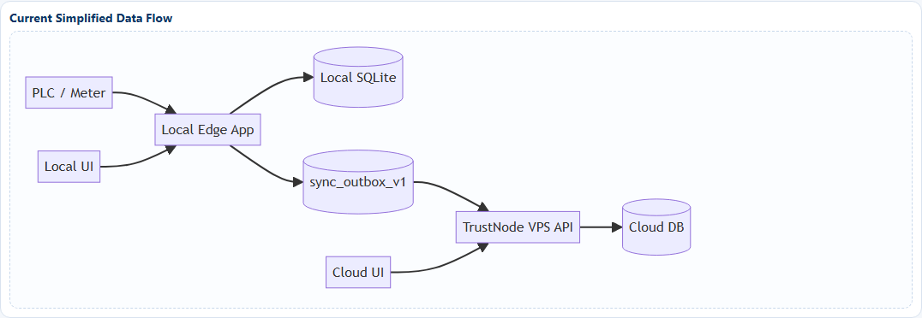
Current Architecture
TrustNode - Architecture 2026

Slide 4
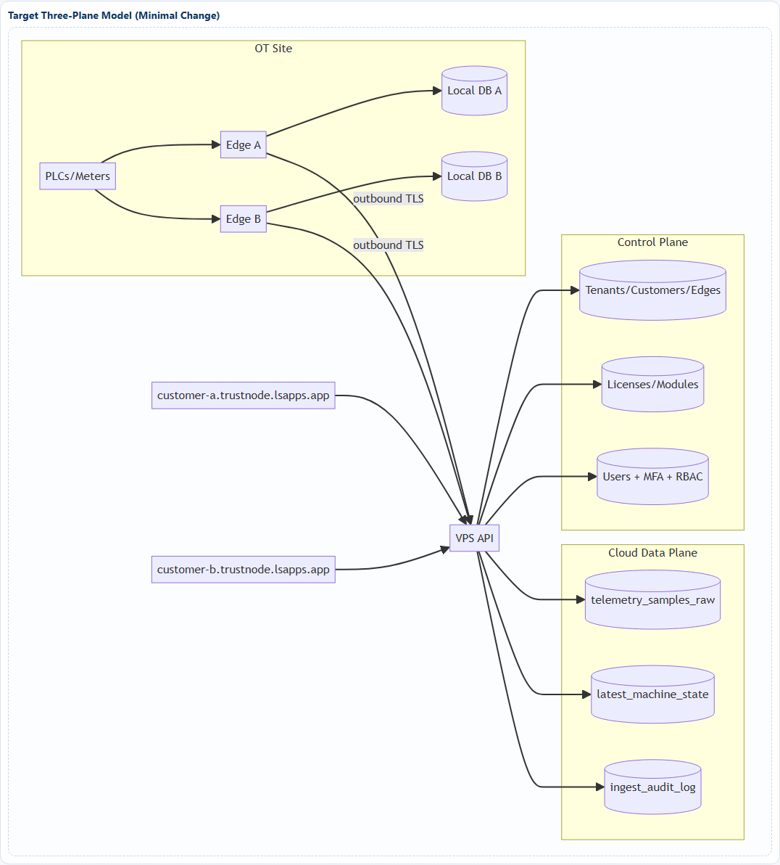
Target Three-Plane Architecture
TrustNode - Architecture 2026

Slide 5
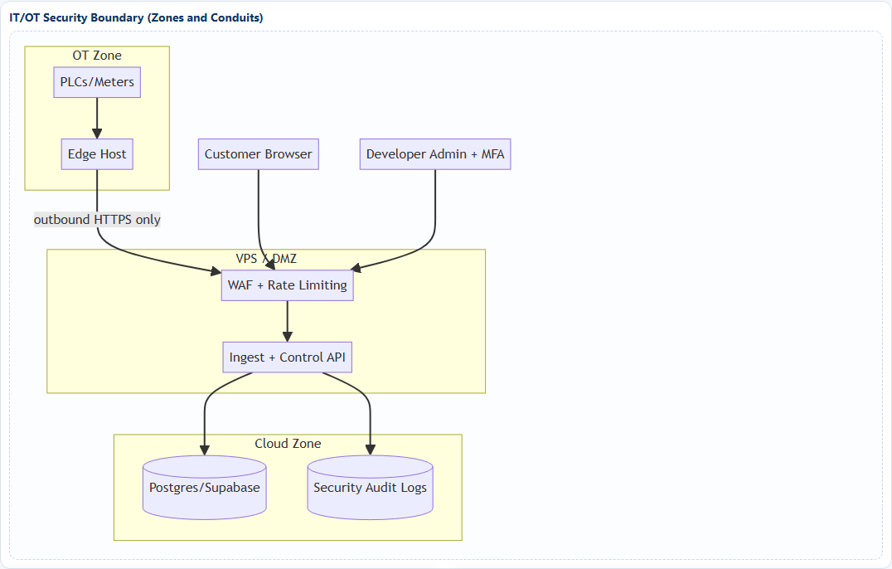
Security & Trust Boundaries
Must
Ops
Critical controls
Outbound-only edge traffic, separate human/device auth, strict tenant scoping, RLS on user tables.
Resilience
PITR backups, ingest audit trail, deterministic retry/idempotency, cloud delay alarms.
TrustNode - Architecture 2026

Slide 6
Data Model & Tenant Strategy
Core
Security
Scale
Raw + Latest split
telemetry_samples_raw (immutable) + latest_machine_state (live snapshot).
Tenant isolation
tenant_id on all rows + API scope checks + DB RLS policies.
Commercial tiers
Tier A shared DB, Tier B isolated schema, Tier C dedicated stack.
Recommended rollout by customer tier
Tier A (default)
Shared DB + RLS
Low
SMB / standard deployments
Tier B
Shared cluster + dedicated schema
Medium
Regulated mid-size customers
Tier C
Dedicated project/cluster
High
Enterprise/compliance-heavy
TrustNode - Architecture 2026

Slide 7
Customer URL, Access & Licensing
Routing
License
URL strategy
Use wildcard subdomains: customer-a.trustnode.lsapps.app. Resolve host header -> tenant context in backend.
Licensing
Control modules by tenant license and role claims. Same user can access only allowed modules.
Schema
Control plane entities
tenants, customers, edges, licenses, license_modules, edge_activation_codes, user_tenant_memberships, password_reset_events, security_audit_log
TrustNode - Architecture 2026

Slide 8
Implementation Timeline
Phase 0
1-2 wks
Pipeline stability Ingest URL/token diagnostics
Phase 1
2-3 wks
Control plane core Tenant/customer/edge/license
Phase 2
2-3 wks
Tenant routing Wildcard subdomains
Phase 3
2-4 wks
Security hardening MFA + audits + PITR drills
TrustNode - Architecture 2026

Slide 9
SLA Targets & Observability
SLA
SLA
Security
Local live latency
<= 1 second from sample commit to local UI
Cloud live latency
<= 2 seconds p95 from edge sample_ts to cloud UI
Tenant isolation
0 cross-tenant data leakage incidents
Metrics
Key metrics to monitor
PLC read duration, collection loop duration, local DB write latency, outbox depth, oldest unsynced age, batch upload latency, ack success rate, duplicate rate, rejected rate, websocket clients, end-to-end cloud latency.
TrustNode - Architecture 2026

Slide 10
Top Risks & Mitigations
High
Critical
Risk 1: Sync misconfiguration
Mitigation: startup diagnostics + hard fail warnings for missing ingest URL/token.
Risk 2: Tenant bleed
Mitigation: host->tenant binding, token scope checks, RLS policy tests in CI.
High
Critical
Risk 3: Backlog growth
Mitigation: adaptive batching, retry jitter, backlog alarms, capacity runbooks.
Risk 4: Admin account compromise
Mitigation: enforce MFA + privileged audit logs + password reset policy.
Gate
Go-live gate
No production rollout without cross-tenant isolation tests, restore drill pass, and p95 cloud latency validation.
TrustNode - Architecture 2026

Slide 11
Execution Next Steps
Recommended 30 / 60 / 90 Day Plan
30 days: stabilize ingest bootstrap, add diagnostics, add sync alarms.
60 days: deploy control plane core (tenant/customer/edge/license + activation).
90 days: enforce MFA, wildcard customer routing, full isolation test suite.
Outcome: sellable, secure, low-cost multi-customer platform with clean scale path.
TrustNode | Execute Phase 0 first

