Slide 1

TrustNode
Scalable Industrial Edge-to-Cloud Platform
Real-time PLC + meter telemetry
Secure multi-customer cloud architecture
Low-cost, fast rollout, enterprise-ready path

Slide 2
Why This Matters
Plant challenge
Data is fragmented across OT systems and hard to access remotely.
Business impact
Limited visibility delays decisions and increases downtime/energy waste.
Need
Secure real-time access with audit-grade data integrity.
TrustNode value
Single architecture for local edge operations and cloud client access, preserving exact telemetry provenance and enabling commercial multi-tenant delivery.
TrustNode Pitch Deck

Slide 3
Solution At A Glance
Edge-first durability
Outbox sync with retries
Tenant-isolated cloud ingest
Live dashboards from latest state
Historian/reporting from immutable raw data
Commercial-ready with minimal change
Keep current architecture, add control plane for customer onboarding, licensing, edge activation, and URL tenancy.
TrustNode Pitch Deck

Slide 4
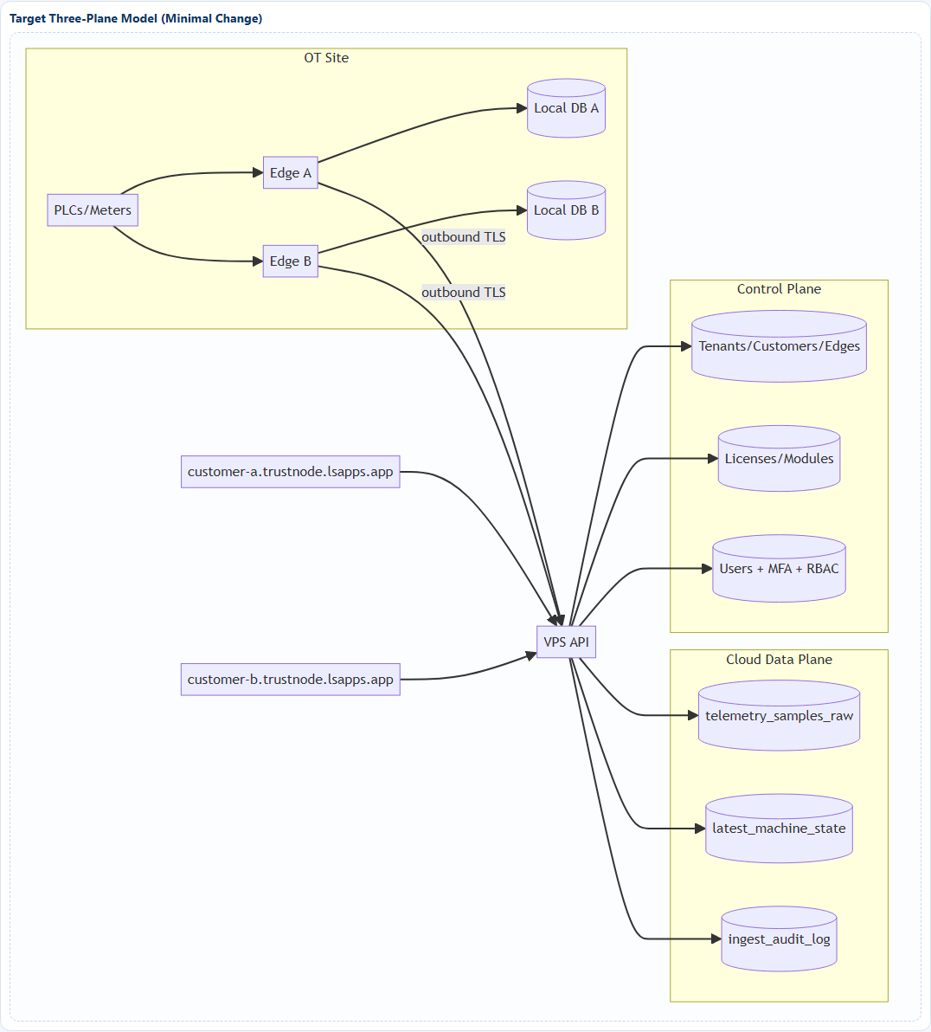
Target Architecture
TrustNode Pitch Deck

Slide 5
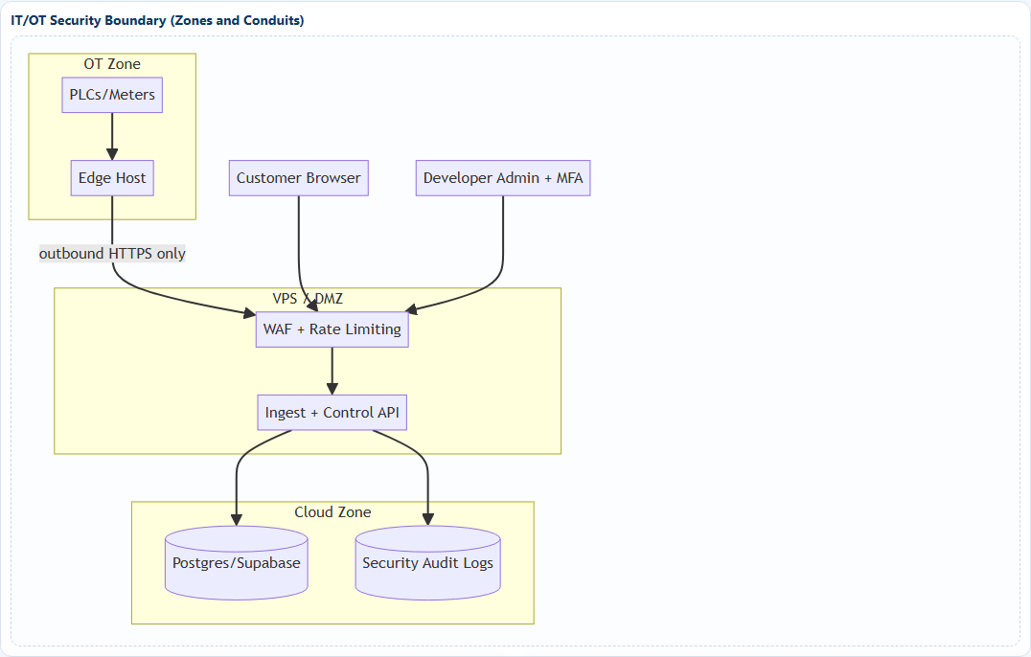
Security and Data Isolation
OT safety
Outbound-only edge traffic. No inbound internet to OT.
Tenant protection
Token scope + API checks + RLS for user-facing reads.
Admin security
MFA + security audit log for privileged actions.
TrustNode Pitch Deck

Slide 6
Scalability Model
Tier A
Shared DB + RLS Lowest cost Default for SMB
Tier B
Shared cluster + isolated schema Higher isolation
Tier C
Dedicated project/cluster Enterprise compliance
Performance targets
Local UI <= 1s, Cloud UI <= 2s p95, deterministic outbox sync, full provenance for historian/reporting.
TrustNode Pitch Deck

Slide 7
90-Day Rollout Plan
1
2
3
30 days
Stabilize ingest bootstrap + diagnostics
60 days
Control plane core + activation + licensing
90 days
Wildcard customer URLs + MFA + isolation tests
TrustNode Pitch Deck

Slide 8
Commercial Packaging
Core package
Edge collector + cloud client + dashboards + historian + reporting
Add-on modules
Power management, advanced analytics, AI advisory insights
Recurring value
Remote operations visibility, lower downtime, faster diagnostics, secure multi-site rollout
Upsell path
Isolation tiers, dedicated tenancy, compliance bundle, AI optimization
TrustNode Pitch Deck

Slide 9
Next Step
Ready for Pilot-to-Scale Execution
Deploy control-plane Phase 0 now
Run 2-3 customer pilot under tenancy model
Track latency, isolation, and reliability SLAs
Convert to commercial rollout with module licensing
TrustNode - Investor/Demo Deck

