Slide 1
A hybrid agent platform: frontier models where allowed, our own GPUs where required
DANOFFICE IT · AI & AUTOMATION · TARGET ARCHITECTURE
One gateway that classifies every conversation, sends it only to models the data rules allow, and lets agents work beside the data on a shared, Kubernetes-managed GPU tier.
Notes:
Purpose: approve a pilot of a hybrid agent platform. Frontier models are used where the data rules allow; confidential work stays on our own GPUs.

Slide 2
Our data has three sensitivities. Most platforms serve one
THE PROBLEM
Public
Internal
Confidential
Market research, product news, public documentation. Any model may see it, and the best cloud models give the best results.
Contracts, customer lists, budgets, system status. May use approved cloud models, but must not reach public web agents.
HR cases, pay, health, personal ID numbers, client-privileged material. Must stay on our own models and hardware.
Cloud assistants cover the first column well; private platforms cover the third. The target design is one platform that routes each conversation to the right column, in code, with a log.

Slide 3
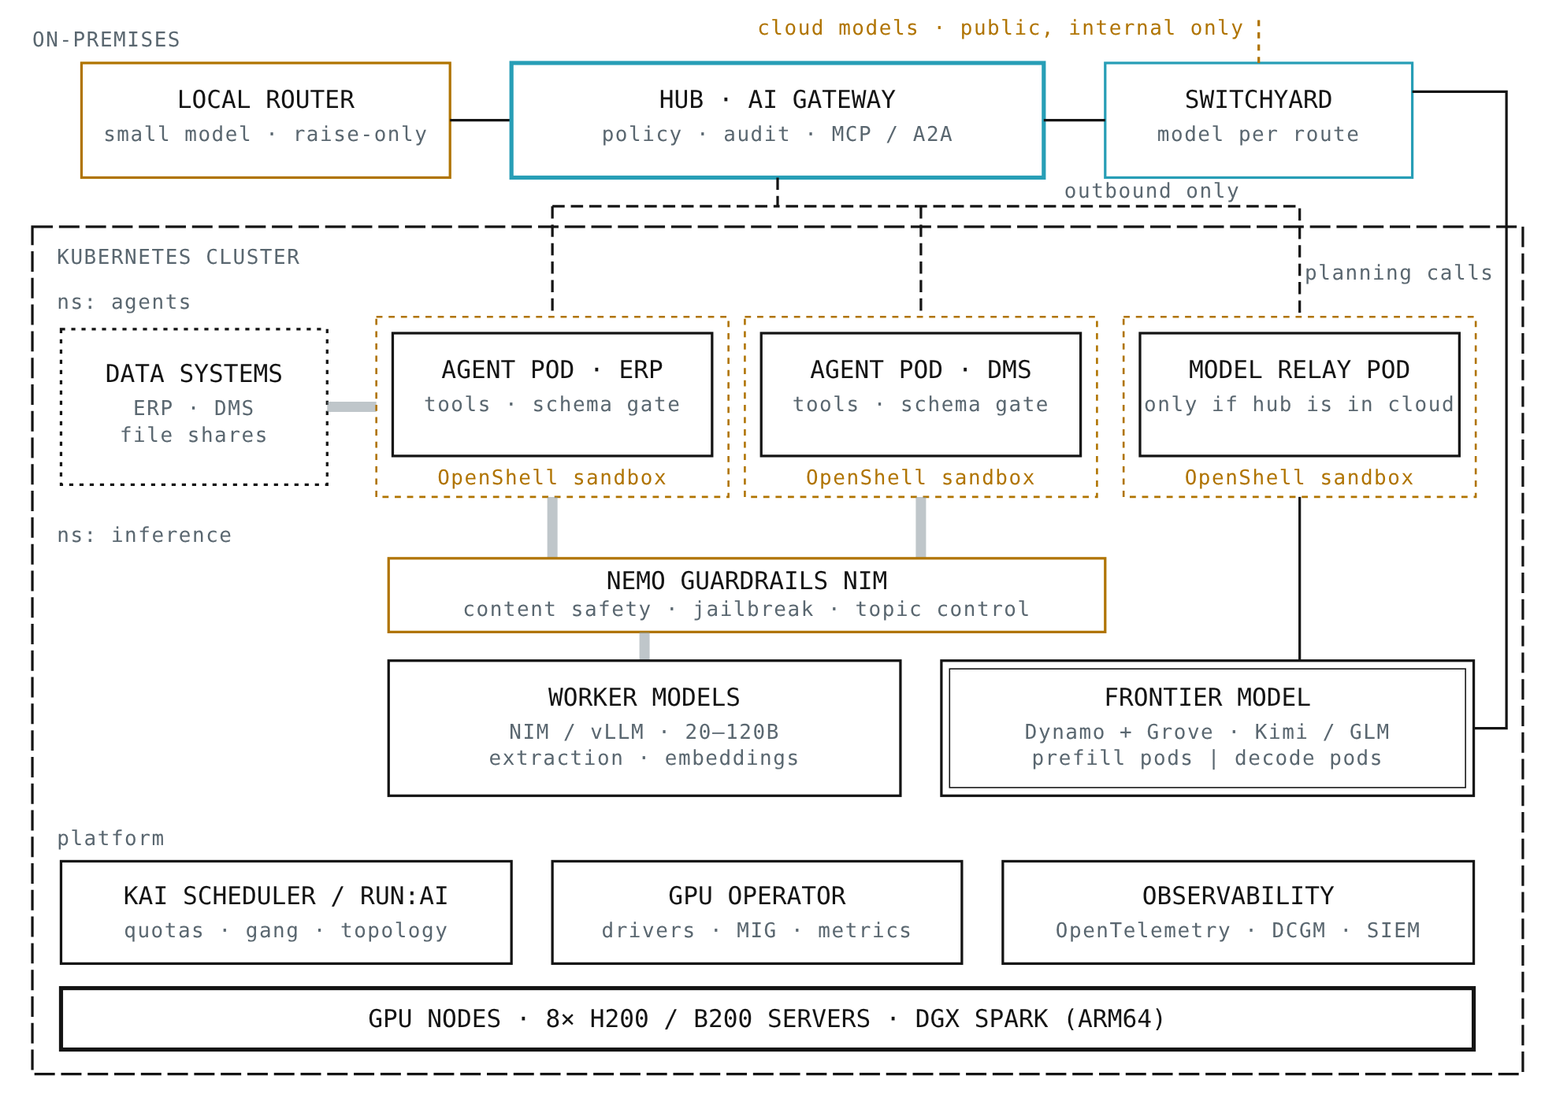
What we would build
TARGET ARCHITECTURE · FIG. 8
Router
classifies every conversation; raise-only, fail closed
Gateway
applies policy, audits, serves MCP
Switchyard
picks the model inside the allowed route
Agents
dial out; read data in place; sandboxed
GPU tier
Kubernetes, scheduler, GPU Operator

Slide 4
How a conversation moves through the platform
ONE REQUEST, END TO END
1
2
3
4
5
Classify
Route
Plan
Work
Return
Rules, then a small on-prem model, rate the prompt. They can raise the level, never lower it.
The policy picks the Switchyard route for that level; Switchyard picks the model inside it.
The chosen model sees only permitted tools and decides which agents to call.
Each job goes down the agent's own outbound connection. Data is read in place.
Only a schema-checked result goes back. Every step is logged and visible.
No inbound ports
Policy in code
Findings, not files
Agents and the model relay dial out. The cluster exposes nothing.
Tool calls are re-checked, so a misled model cannot reach a hidden tool.
About 90 tokens per document reach the planner instead of 4,000.

Slide 5
A small model decides where a conversation may go
THE LOCAL ROUTER
Rules first
Raise only
Fail closed
Then route
Personal ID numbers, pay, HR, health and "confidential" markings raise the level. No model can override them.
The router model may make a conversation stricter, never looser. A crafted prompt cannot unlock the cloud.
A slow, failed or malformed answer means confidential: the work stays on our own models.
The level picks a Switchyard route. Switchyard chooses the model inside it.
Runs on-prem because it reads every raw prompt. Built into the reference hub today with Qwen 2.5 3B in Ollama.

Slide 6
Our router sets the boundary. Switchyard picks the model
NVIDIA NEMO SWITCHYARD IN THE PLATFORM
DECISION | MADE BY | HOW
How sensitive is it? | Hub router | Rules, then a small on-prem model; raise-only, fail closed, logged
Which models may see it? | Hub policy | One Switchyard route per level; confidential routes hold on-prem models only
Which model answers? | Switchyard | A local judge estimates whether the cheaper model can solve it; otherwise the strong model
What if a model fails? | Switchyard | Retries, cooldown, fallback to the other target in the same route
What did it cost? | Switchyard | Per-request routing log with model and cost; live counters for benchmarking
Safe by construction
Harness ready
Pre-alpha
A wrong Switchyard judgement can cost money. It cannot move data across the boundary.
Speaks the OpenAI and Anthropic APIs, so Claude Code can run on an on-prem route.
v0.3.0, Apache 2.0, "not for production use". Pilot it; no commitments yet.

Slide 7
Standard components, with our policy on top
BUILDING BLOCKS
LAYER | PRODUCTION COMPONENT | REFERENCE BUILD | STATUS
Gateway | LiteLLM, Envoy AI Gateway or agentgateway | Hub with zones and policy | Built
Routing judgement | NVIDIA NeMo Switchyard; vLLM Semantic Router | Router + Switchyard routes | Built
Tools and agents | MCP for tools, A2A between agents | MCP endpoint; own agent protocol | Next: A2A
Agent sandbox | NVIDIA OpenShell, deny-by-default egress | Container per agent | Next
Guardrails | NeMo Guardrails NIM: safety, topic, jailbreak | Schema gate only | Next
Model serving | vLLM, NIM; Dynamo + Grove for multi-node | vLLM profile + relay | Built
GPU sharing | Kubernetes, GPU Operator, KAI Scheduler or Run:ai | Docker Compose | Plan
Identity and audit | Entra ID / OIDC, OpenTelemetry, SIEM | Token + JSON audit log | Plan

Slide 8
The planner is the expensive part
SIZING THE GPU TIER
~2 TB
1 node
20–120B
Kimi K3-class planner
300–700B open models
Workers
2.8T parameters, 1.56 TB of weights in MXFP4. Two 8-GPU H200 servers; one HGX H200 system is priced at $320–420k.
GLM and DeepSeek class fit one 8-GPU H200/B200 server, at some cost in planning quality.
Extraction, OCR and embeddings on MIG slices or DGX Spark nodes. This is where most documents are read.
A pragmatic start keeps the planner in the cloud for public and internal work, and a single-node open model for confidential planning until volumes justify more.

Slide 9
Three sizes, chosen by who plans confidential work
SERVER INFRASTRUCTURE · RECOMMENDED STARTING POINTS
TIER | HARDWARE | RUNS ON-PREM | CLOUD ROLE | RATE TO SIZE FOR
S · Pilot ≤ 100 users | 2× DGX Spark (128 GB each), or one server with 2× RTX PRO 6000 Blackwell (96 GB each) | Router (3B), workers 20–35B, embeddings; gpt-oss-120b-class planner for confidential work | Plans public and internal work | ~0.5k tok/s
M · Business unit ≤ 1,000 users | One 8-GPU H200 (1.1 TB) or B200 (1.4 TB) server for the planner, plus a 4-GPU worker node; Kubernetes | 300–700B open planner for all non-public work; workers on MIG slices | Public research only | ~5k tok/s
L · Enterprise 1,000+ users | Two 8-GPU H200 servers (≈2.2 TB) for a Kimi K3-class planner, two or more worker nodes, shared storage | Frontier-class planner and all agents; guardrails and sandboxes | Optional, by policy | ~25k tok/s
Rate = average tokens per second the on-prem tier processes over an 8-hour day under the next slide's assumptions; plan for 3–5× peaks. Benchmark the chosen model before buying, and keep 15–25% memory headroom for context.

Slide 10
How much cloud traffic the platform takes over
PUBLIC TOKENS REPLACED · WORKED EXAMPLE
93%
98%
≈100%
S · cloud plans
M · on-prem planner
L · fully sovereign
100 users: 14.5M → 1.1M cloud input tokens a day.
1,000 users: 145M → 2.6M a day.
5,000 users: 723M tokens a day, all in-house.
ASSUMPTION | VALUE | WHY IT MATTERS
Task | 3 documents × 4,150 tokens + 2,000 prompt | Cloud-only sends every document: 14,450 input tokens
Hybrid task to cloud | 3 × 210 tokens of findings + 2,000 | 2,630 input tokens: documents are read on-prem
Mix | 20% confidential · 40% simple · 40% complex | Router keeps confidential and simple work local
Volume | 10 tasks per user per day | Scales linearly with users
Price (for scale) | $3 per million input tokens | Tier M: ≈$108k a year cloud-only vs ≈$2k hybrid

Slide 11
How it compares with the alternatives
EVALUATION
CRITERION | CLOUD ASSISTANT | HYPERSCALER AGENTS | TURNKEY PRIVATE AI | IN-HOUSE OSS | HYBRID DESIGN
Data stays in-house | ●○○ | ●●○ | ●●● | ●●● | ●●●
Best models | ●●● | ●●● | ●○○ | ●●○ | ●●●
Mixed sensitivity | ●○○ | ●●○ | ●●○ | ●●○ | ●●●
Low operating effort | ●●● | ●●○ | ●●○ | ●○○ | ●○○
Freedom to switch | ●○○ | ●○○ | ●●○ | ●●● | ●●●
Maturity, support | ●●● | ●●● | ●●● | ●●○ | ●○○
●●● strong · ●●○ partial · ●○○ weak, by default configuration. Qualitative assessment by solution type. The hybrid design combines a turnkey private platform with a cloud tier rather than replacing either.

Slide 12
From reference build to shared platform
ROLLOUT
1 · Reference
2 · Pilot
3 · Sovereign tier
4 · Platform
One host, Docker Compose
Router, Switchyard, policy, relay, MCP
Demo data
Two real use cases
Agents beside one DMS and one ERP
Cloud planner for internal work
Kubernetes, GPU Operator, scheduler
On-prem planner for confidential work
OpenShell sandboxes, guardrails
SSO, per-team quotas
SIEM export, high availability
Agent catalogue for business units
Exit: Runs in three steps; tests green
Exit: Router accuracy and token savings measured
Exit: Confidential use case live on-prem
Exit: Teams onboard without the core team

Slide 13
Approve a pilot with two use cases
DECISION NEEDED
What we need
What we measure
What we decide after
Two business owners with data that cannot go to the cloud, one GPU server or DGX Spark cluster, and a platform engineer.
Extraction accuracy against a baseline, router accuracy on labelled prompts, cloud tokens saved, time per task.
Whether to build the sovereign tier, and which components to buy as a turnkey platform.

