Slide 1





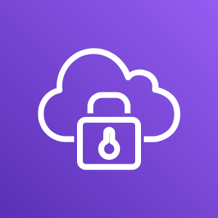



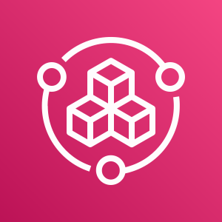
End Users / Customers
Production VPC
Development VPC
Public subnet
Public subnet
Company
Offices
Employees / Developers
Public subnet
Public subnet
Management VPC
Private subnet
Private subnet
Public subnet
Public subnet
Private subnet
Private subnet
AWS Client VPN
AWS Client VPN
Peering connection
Peering connection
Isolated subnet
Isolated subnet
Private subnet
Private subnet
Isolated subnet
Isolated subnet
AWS Config
Amazon Route 53
AWS Service Catalog

Slide 2


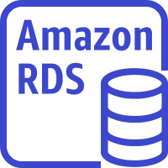
End Users / Customers
Production VPC
Development VPC
Public subnet
Public subnet
Company
Offices
Employees / Developers
DMZ subnet
DMZ subnet
Application Load Balancers
Management VPC
Application Load Balancers
Private subnet
Private subnet
Public subnet
Public subnet
Private subnet
Private subnet
Application Servers
AWS Client VPN
AWS Client VPN
Dev Servers
Peering connection
Peering connection
Isolated subnet
Isolated subnet
Private subnet
Private subnet
Isolated subnet
Isolated subnet
Database Servers
DevOps Resources
Database Servers
AWS Config
Amazon Route 53
AWS Service Catalog

Slide 3
Employees / Developers
Management VPC
Allowed
Allowed
AWS Client VPN
Production VPC
Development VPC
Not allowed

