Slide 1










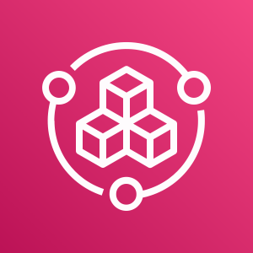
Company
offices
End users (customers)
Employees
Developers
AWS Cloud
Availability Zone 1
Availability Zone 2
Availability Zone 1
Availability Zone 2
Availability Zone 1
Availability Zone 2
Production VPC
Management VPC
Development VPC
Public subnet
Public subnet
Public subnet
Public subnet
Public subnet
Public subnet
AWS client VPN
Private subnet
Private subnet
Private subnet
Private subnet
Private subnet
Private subnet
Peering connection
Peering connection
Isolated subnet
Isolated subnet
Isolated subnet
Isolated subnet
AWS Config
Amazon Route 53
AWS Service Catalog

Slide 2


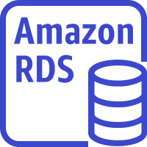
Company
offices
End users (customers)
Employees
Developers
AWS Cloud
Availability Zone 1
Availability Zone 2
Availability Zone 1
Availability Zone 2
Availability Zone 1
Availability Zone 2
Production VPC
Management VPC
Development VPC
Public subnet
Public subnet
Public subnet
Public subnet
Public subnet
Public subnet
Application Load Balancers
AWS client VPN
Application Load Balancers
Private subnet
Private subnet
Private subnet
Private subnet
Private subnet
Private subnet
Peering connection
Peering connection
DevOps resources
Application servers
Dev servers
Isolated subnet
Isolated subnet
Isolated subnet
Isolated subnet
Database servers
Database servers
AWS Config
Amazon Route 53
AWS Service Catalog

Slide 3
Employees (developers)
Management VPC
Allowed
Allowed
AWS client VPN
Production VPC
Development VPC
Not allowed

