Slide 1





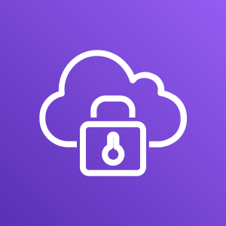
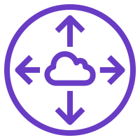


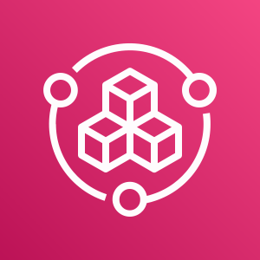
End users (customers)
Availability Zone 1
Availability Zone 2
Availability Zone 1
Availability Zone 2
Production VPC
Development VPC
Public subnet
Public subnet
Company
offices
Employees (developers)
Public subnet
Public subnet
Availability Zone 1
Availability Zone 2
Management VPC
Public subnet
Public subnet
Private subnet
Private subnet
Private subnet
Private subnet
AWS client VPN
AWS client VPN
Peering connection
Peering connection
Isolated subnet
Isolated subnet
Private subnet
Private subnet
Isolated subnet
Isolated subnet
AWS Config
Amazon Route 53
AWS Service Catalog

Slide 2


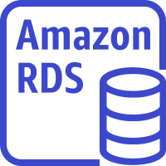
End users (customers)
Availability Zone 1
Availability Zone 2
Availability Zone 1
Availability Zone 2
Production VPC
Development VPC
Public subnet
Public subnet
Company
offices
Employees (developers)
Public subnet
Public subnet
Availability Zone 1
Availability Zone 2
Application Load Balancers
Management VPC
Application Load Balancers
Public subnet
Public subnet
Private subnet
Private subnet
Private subnet
Private subnet
AWS client VPN
AWS client VPN
Application servers
Dev servers
Peering connection
Peering connection
Isolated subnet
Isolated subnet
Private subnet
Private subnet
Isolated subnet
Isolated subnet
DevOps resources
Database servers
Database servers
AWS Config
Amazon Route 53
AWS Service Catalog

Slide 3
Employees (developers)
Management VPC
Allowed
Allowed
AWS Client VPN
Production VPC
Development VPC
Not allowed

