Slide 1





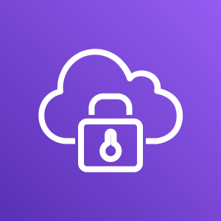




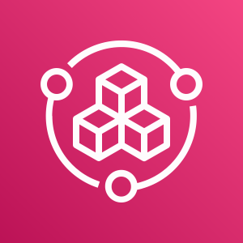
Company
offices
Employees (developers)
End users (customers)
AWS Cloud
Availability Zone 1
Availability Zone 2
Availability Zone 1
Availability Zone 2
Availability Zone 1
Availability Zone 2
Production VPC
Management VPC
Development VPC
Public subnet
Public subnet
Public subnet
Public subnet
Public subnet
Public subnet
AWS client VPN
AWS client VPN
Peering connection
Peering connection
Private subnet
Private subnet
Private subnet
Private subnet
Private subnet
Private subnet
Isolated subnet
Isolated subnet
Isolated subnet
Isolated subnet
AWS Config
Amazon Route 53
AWS Service Catalog

Slide 2


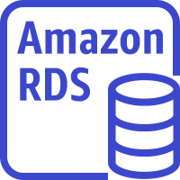
Company
offices
Employees (developers)
End users (customers)
AWS Cloud
Availability Zone 1
Availability Zone 2
Availability Zone 1
Availability Zone 2
Availability Zone 1
Availability Zone 2
Production VPC
Management VPC
Development VPC
Public subnet
Public subnet
Public subnet
Public subnet
Public subnet
Public subnet
AWS client VPN
AWS client VPN
Application Load Balancers
Application Load Balancers
Peering connection
Peering connection
Private subnet
Private subnet
Private subnet
Private subnet
Private subnet
Private subnet
DevOps resources
Application servers
Dev servers
Isolated subnet
Isolated subnet
Isolated subnet
Isolated subnet
Database servers
AWS Config
Amazon Route 53
AWS Service Catalog
Database servers

Slide 3
Employees (developers)
Management VPC
Allowed
Allowed
AWS client VPN
Production VPC
Development VPC
Not allowed

