Slide 1
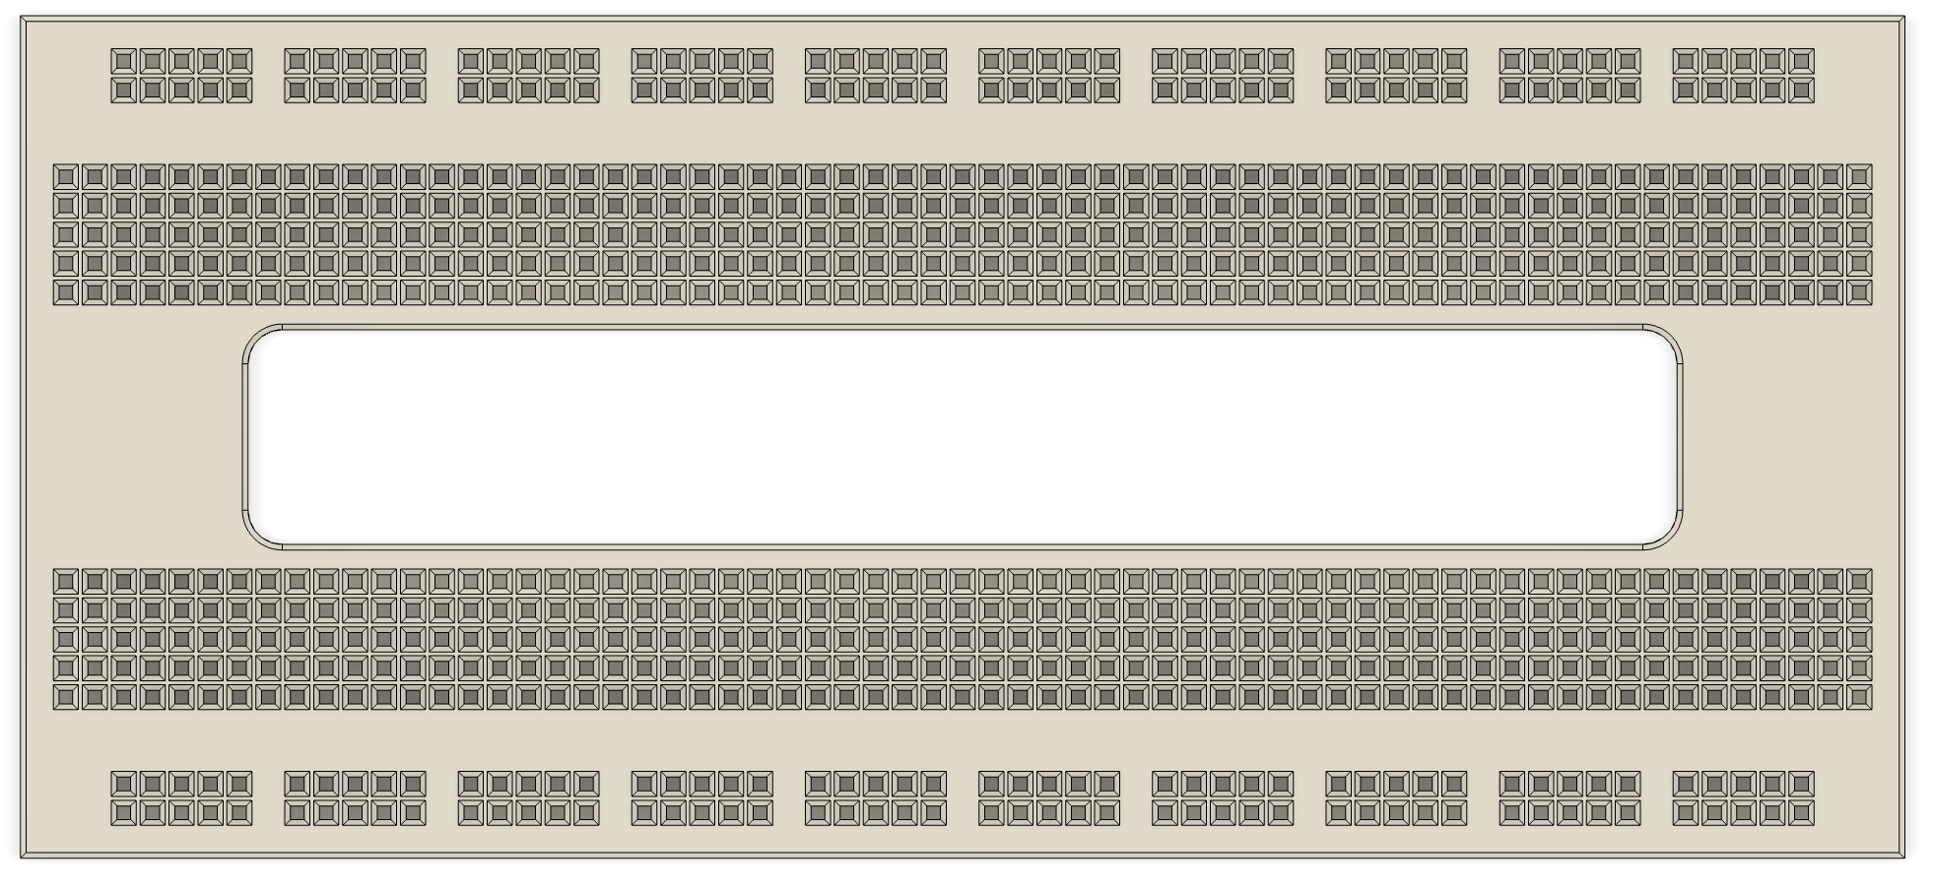
top_ESP32_1000mil
1000 mil = 25.40 mm
please note: This breadboard fits the standard ESP32 module (width: 25.4 mm = 1000 mil).

Slide 2
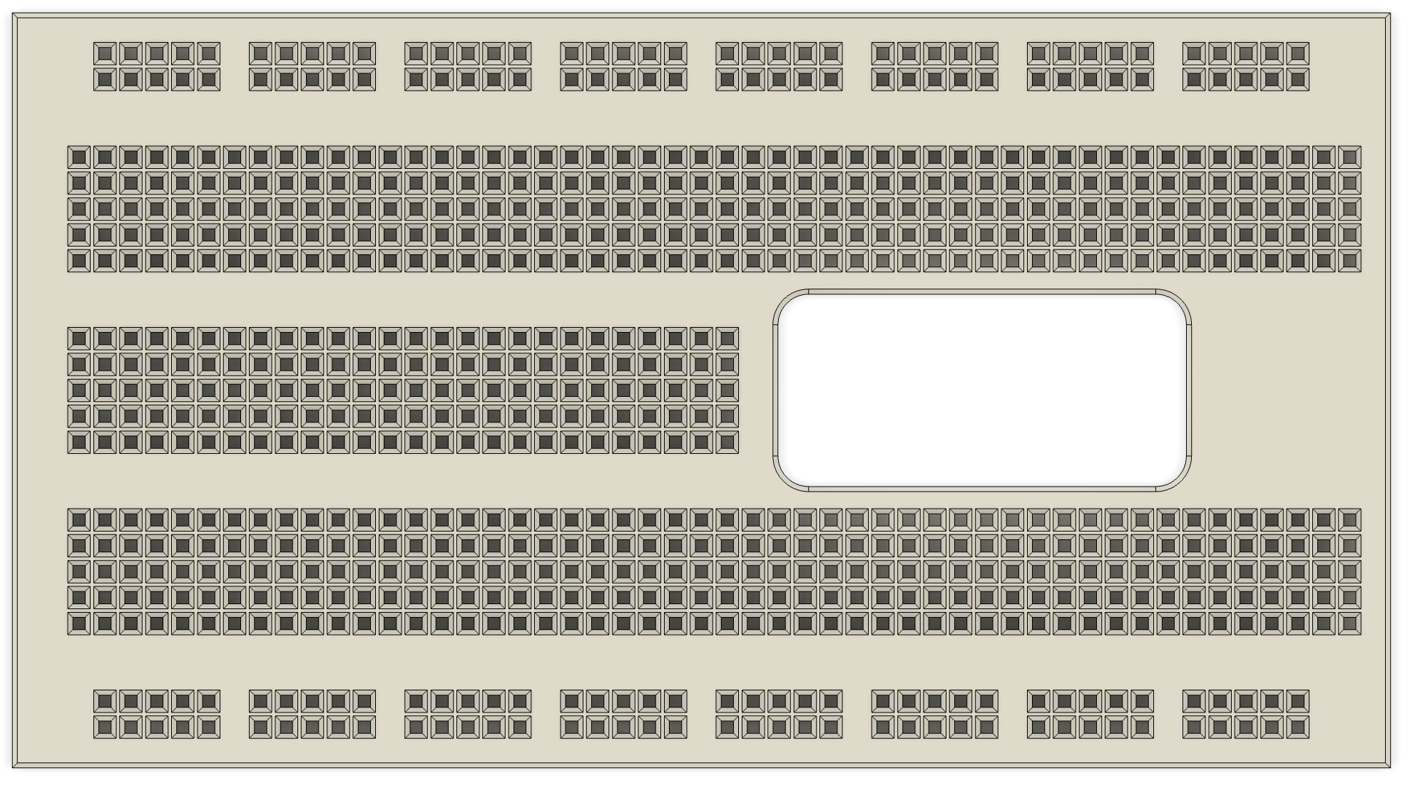
top_ESP32_1000mil_flex
1000 mil = 25.40 mm
please note: This breadboard fits the standard ESP32 module (width: 25.4 mm = 1000 mil).

Slide 3
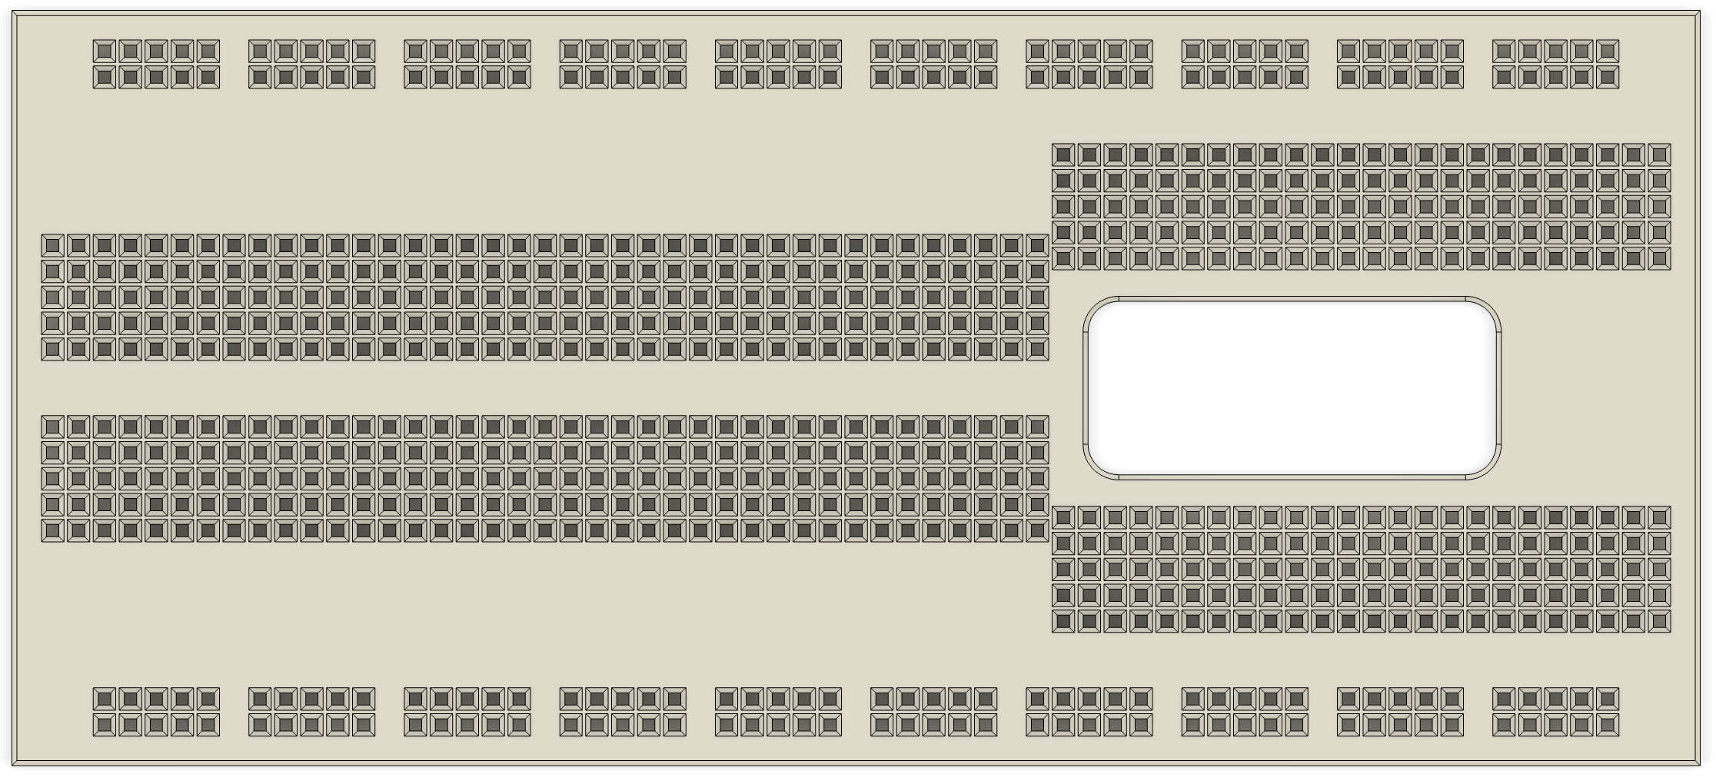
top_ESP32_1000mil_flex2
1000 mil = 25.40 mm
please note: This breadboard fits the standard ESP32 module (width: 25.4 mm = 1000 mil).

Slide 4
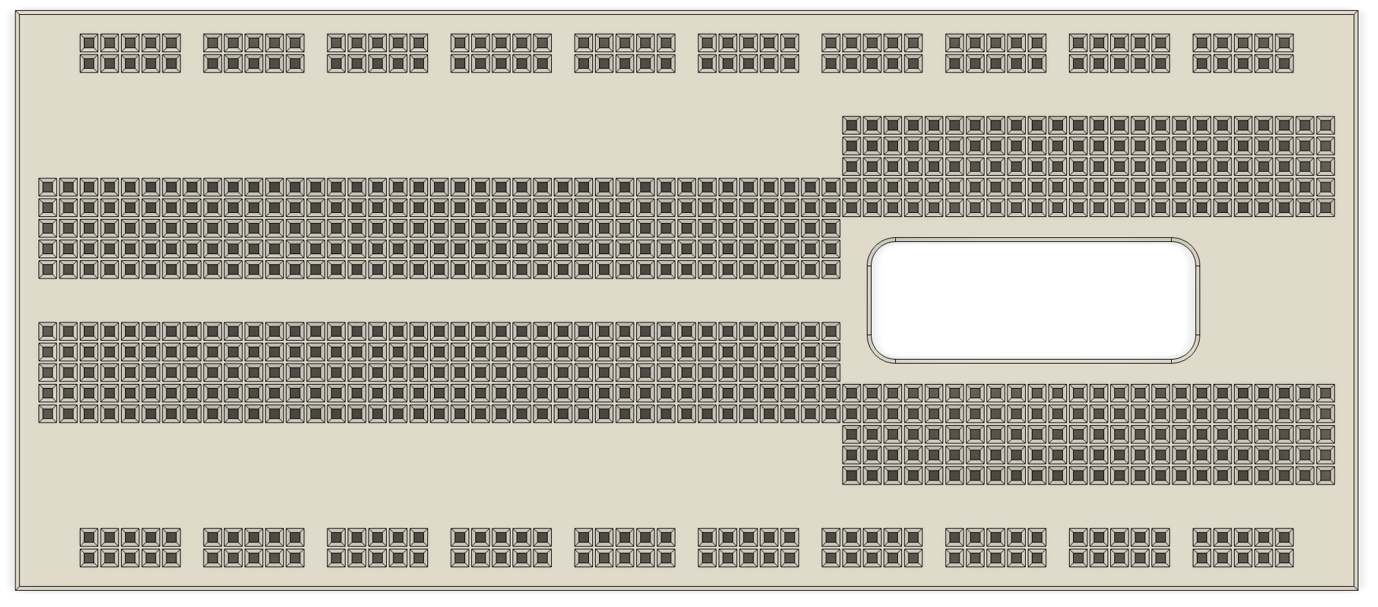
top_ESP32_900mil_flex2
900 mil = 22.86 mm
please note: this breadboard fits a narrow version of the ESP32 module. Use the 1000 mil files for standard width

Slide 5
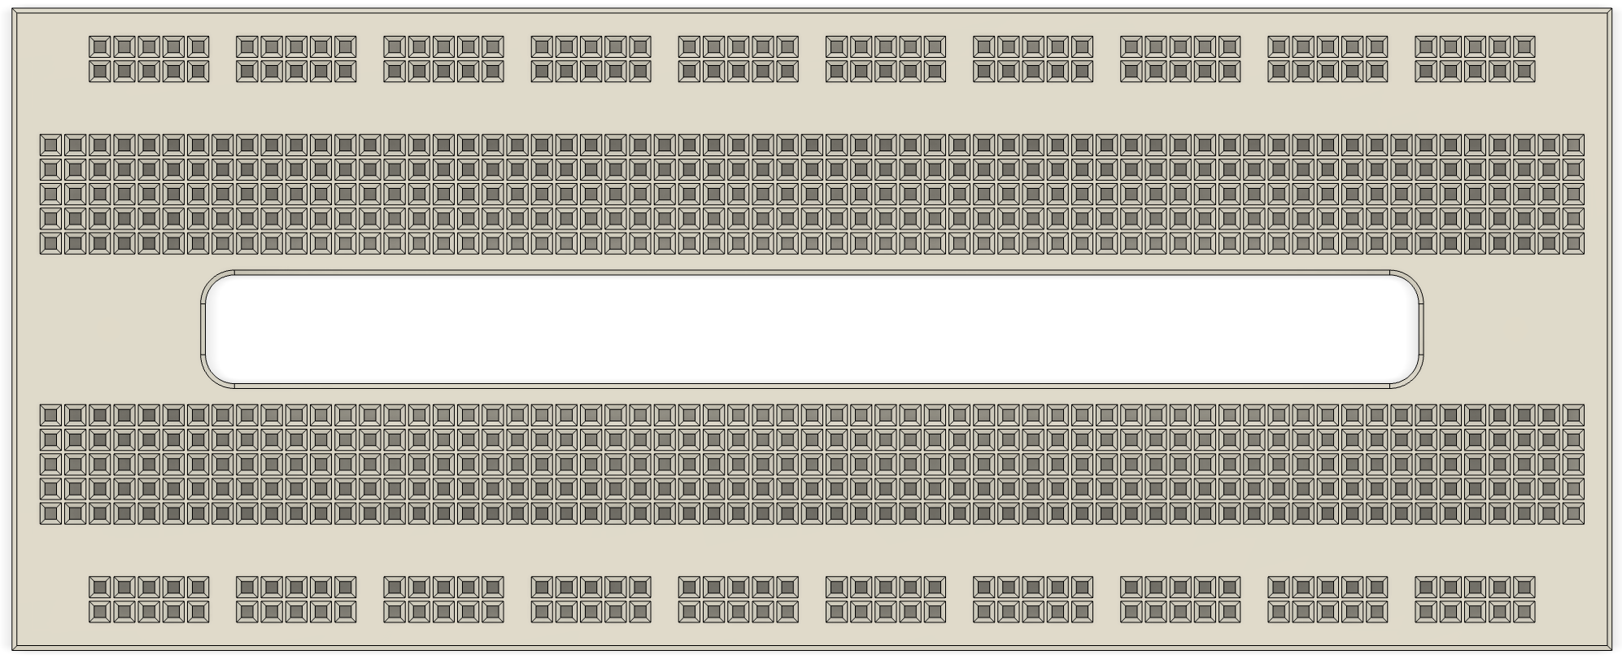
top_RPPico_700mil
700 mil = 17.78 mm
please note: This breadboard fits the Raspberry Pi pico (width: 17.78 mm = 700 mil).

Slide 6
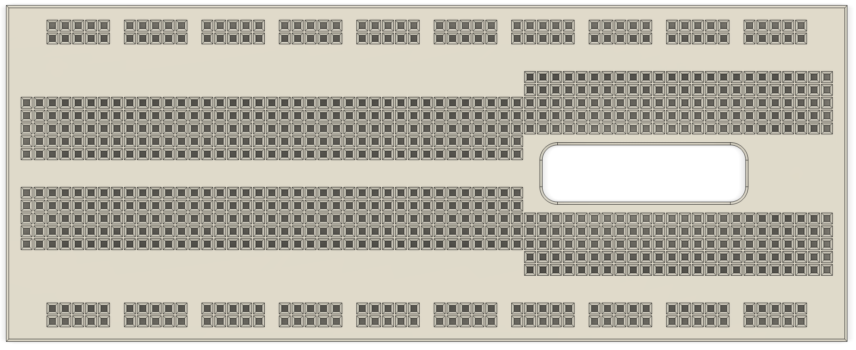
top_rppico_700mil_flex
700 mil = 17.78 mm
please note: This breadboard fits the Raspberry Pi pico (width: 17.78 mm = 700 mil).

Slide 7
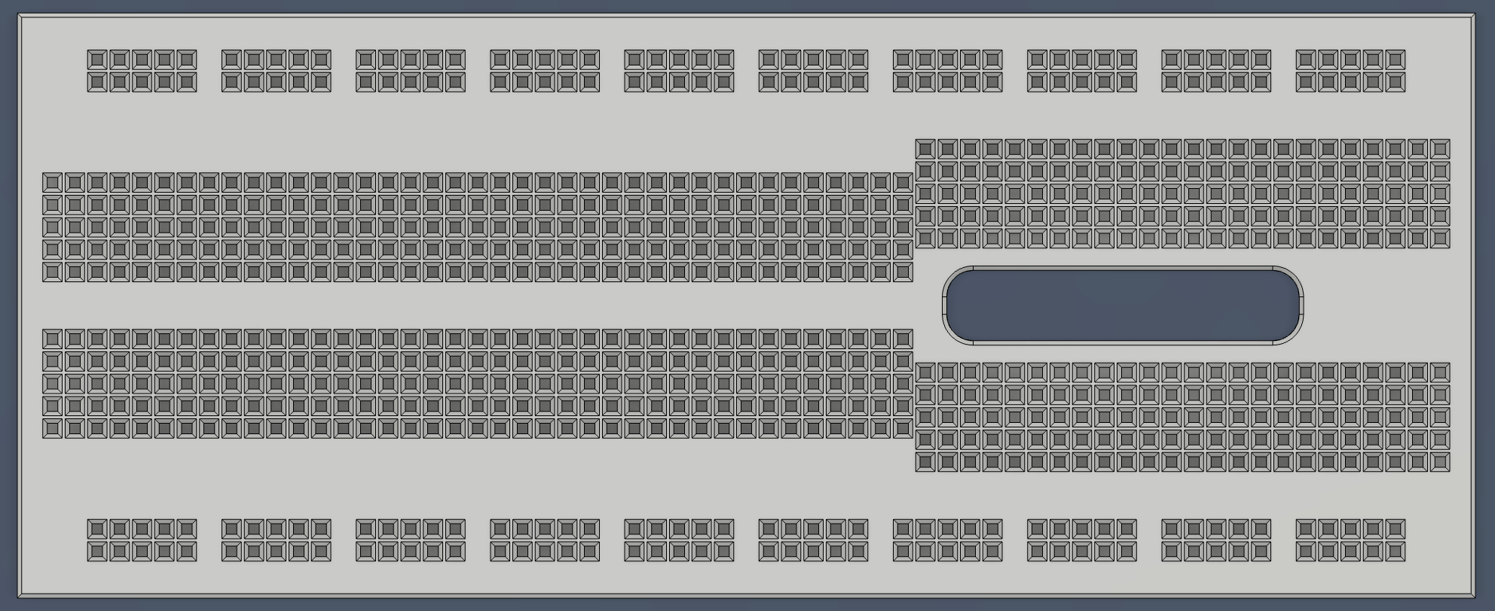
top_Arduino_nano_600mil_flex2
600 mil = 15.24 mm
please note: This breadboard fits the Arduino nano (width: 15.24 mm = 600 mil).

