Slide 1
Network Common Data Form (NetCDF)
‘Array-orientated’ scientific data (can be multidimensional)
Self-describing
Open standard
Machine-independent
Earlier versions supported by future versions
Notes:
The key point that I want you to take home here is that having a wealth of freely and easily accessible data relies heavily on contributions from the research community. I believe that researchers all have an individual responsibility to make their data available in the best way that they can, and this will contribute to something that we will all benefit from. And the quicker you publish your data, the quicker we progress. And this goes for whatever subject you are interested in.
I have shown that it really matters where you publish your data. There are specialist data centres just like OBIS and GBIF that are the default for certain types of data. Therefore, someone is likely to find your data if they’re doing a speculative search, as they are likely to be looking in the right place to begin with.
And there are data access portals that facilitate this too. These also specialise, so they might provide access to all data collected from a particular region, or perhaps a particular type of data.
For data to be made easily availble to researchers in a standardised way, it also matter HOW you publish your data. We data managers talk about the FAIR data management principles that guide researchers on how to do this. And I will talk about these principles in my next video. Thanks for watching.

Slide 2
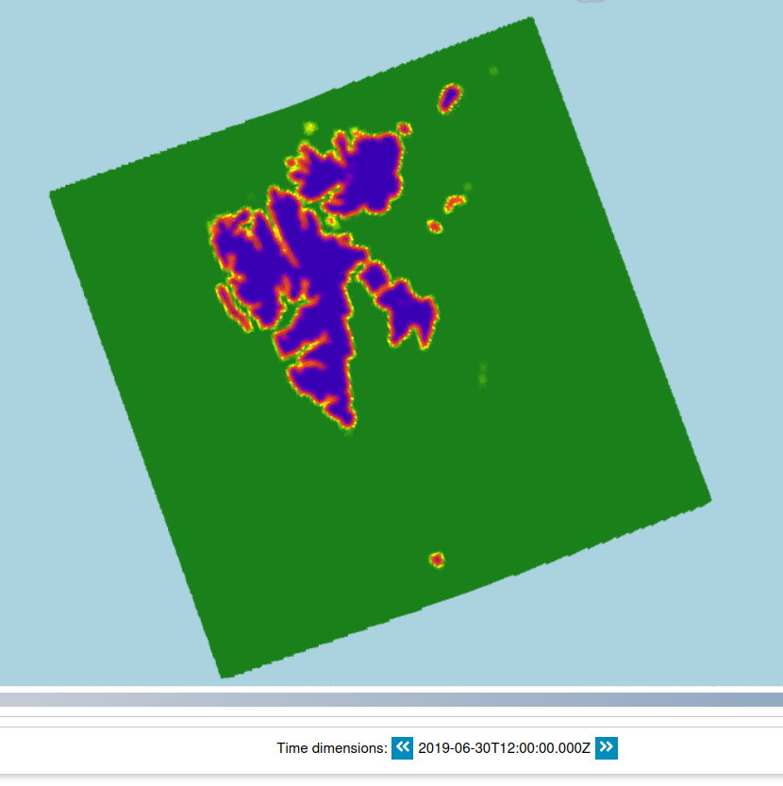
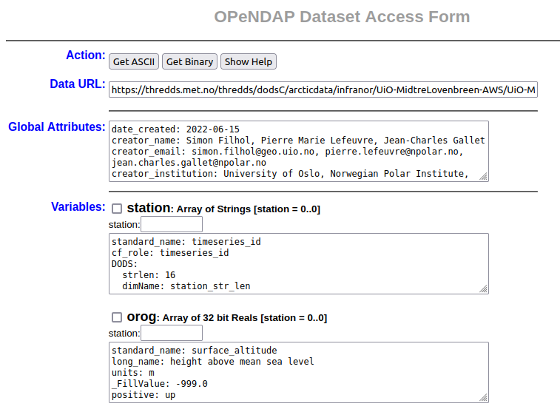
Services on top of data
Notes:
The key point that I want you to take home here is that having a wealth of freely and easily accessible data relies heavily on contributions from the research community. I believe that researchers all have an individual responsibility to make their data available in the best way that they can, and this will contribute to something that we will all benefit from. And the quicker you publish your data, the quicker we progress. And this goes for whatever subject you are interested in.
I have shown that it really matters where you publish your data. There are specialist data centres just like OBIS and GBIF that are the default for certain types of data. Therefore, someone is likely to find your data if they’re doing a speculative search, as they are likely to be looking in the right place to begin with.
And there are data access portals that facilitate this too. These also specialise, so they might provide access to all data collected from a particular region, or perhaps a particular type of data.
For data to be made easily availble to researchers in a standardised way, it also matter HOW you publish your data. We data managers talk about the FAIR data management principles that guide researchers on how to do this. And I will talk about these principles in my next video. Thanks for watching.

Slide 3
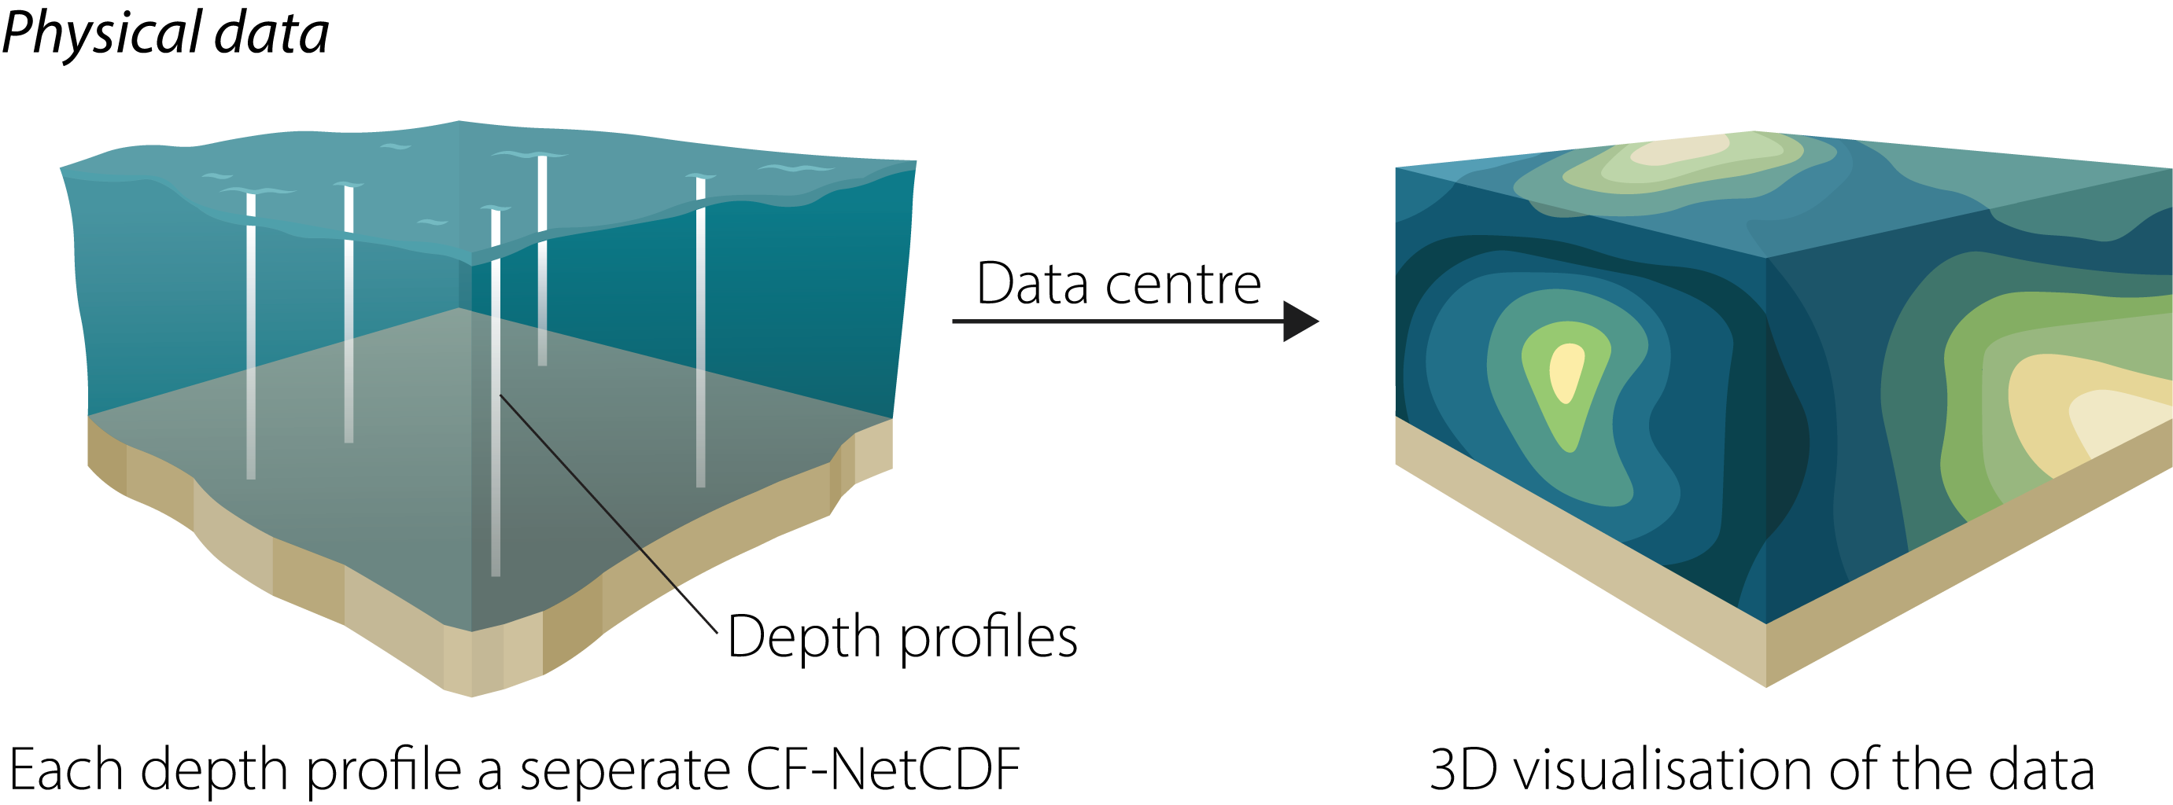

The future?
The future?
Illustration by Frida Cnossen
Notes:
The key point that I want you to take home here is that having a wealth of freely and easily accessible data relies heavily on contributions from the research community. I believe that researchers all have an individual responsibility to make their data available in the best way that they can, and this will contribute to something that we will all benefit from. And the quicker you publish your data, the quicker we progress. And this goes for whatever subject you are interested in.
I have shown that it really matters where you publish your data. There are specialist data centres just like OBIS and GBIF that are the default for certain types of data. Therefore, someone is likely to find your data if they’re doing a speculative search, as they are likely to be looking in the right place to begin with.
And there are data access portals that facilitate this too. These also specialise, so they might provide access to all data collected from a particular region, or perhaps a particular type of data.
For data to be made easily availble to researchers in a standardised way, it also matter HOW you publish your data. We data managers talk about the FAIR data management principles that guide researchers on how to do this. And I will talk about these principles in my next video. Thanks for watching.

Slide 4
Timeline
Notes:
The key point that I want you to take home here is that having a wealth of freely and easily accessible data relies heavily on contributions from the research community. I believe that researchers all have an individual responsibility to make their data available in the best way that they can, and this will contribute to something that we will all benefit from. And the quicker you publish your data, the quicker we progress. And this goes for whatever subject you are interested in.
I have shown that it really matters where you publish your data. There are specialist data centres just like OBIS and GBIF that are the default for certain types of data. Therefore, someone is likely to find your data if they’re doing a speculative search, as they are likely to be looking in the right place to begin with.
And there are data access portals that facilitate this too. These also specialise, so they might provide access to all data collected from a particular region, or perhaps a particular type of data.
For data to be made easily availble to researchers in a standardised way, it also matter HOW you publish your data. We data managers talk about the FAIR data management principles that guide researchers on how to do this. And I will talk about these principles in my next video. Thanks for watching.

Slide 5


Timeline
1988
Project started
Notes:
The key point that I want you to take home here is that having a wealth of freely and easily accessible data relies heavily on contributions from the research community. I believe that researchers all have an individual responsibility to make their data available in the best way that they can, and this will contribute to something that we will all benefit from. And the quicker you publish your data, the quicker we progress. And this goes for whatever subject you are interested in.
I have shown that it really matters where you publish your data. There are specialist data centres just like OBIS and GBIF that are the default for certain types of data. Therefore, someone is likely to find your data if they’re doing a speculative search, as they are likely to be looking in the right place to begin with.
And there are data access portals that facilitate this too. These also specialise, so they might provide access to all data collected from a particular region, or perhaps a particular type of data.
For data to be made easily availble to researchers in a standardised way, it also matter HOW you publish your data. We data managers talk about the FAIR data management principles that guide researchers on how to do this. And I will talk about these principles in my next video. Thanks for watching.

Slide 6

Timeline
1985
1988
Common Data Format
Project started
Notes:
The key point that I want you to take home here is that having a wealth of freely and easily accessible data relies heavily on contributions from the research community. I believe that researchers all have an individual responsibility to make their data available in the best way that they can, and this will contribute to something that we will all benefit from. And the quicker you publish your data, the quicker we progress. And this goes for whatever subject you are interested in.
I have shown that it really matters where you publish your data. There are specialist data centres just like OBIS and GBIF that are the default for certain types of data. Therefore, someone is likely to find your data if they’re doing a speculative search, as they are likely to be looking in the right place to begin with.
And there are data access portals that facilitate this too. These also specialise, so they might provide access to all data collected from a particular region, or perhaps a particular type of data.
For data to be made easily availble to researchers in a standardised way, it also matter HOW you publish your data. We data managers talk about the FAIR data management principles that guide researchers on how to do this. And I will talk about these principles in my next video. Thanks for watching.

Slide 7

Timeline
1985
1988
Common Data Format
Project started
Notes:
The key point that I want you to take home here is that having a wealth of freely and easily accessible data relies heavily on contributions from the research community. I believe that researchers all have an individual responsibility to make their data available in the best way that they can, and this will contribute to something that we will all benefit from. And the quicker you publish your data, the quicker we progress. And this goes for whatever subject you are interested in.
I have shown that it really matters where you publish your data. There are specialist data centres just like OBIS and GBIF that are the default for certain types of data. Therefore, someone is likely to find your data if they’re doing a speculative search, as they are likely to be looking in the right place to begin with.
And there are data access portals that facilitate this too. These also specialise, so they might provide access to all data collected from a particular region, or perhaps a particular type of data.
For data to be made easily availble to researchers in a standardised way, it also matter HOW you publish your data. We data managers talk about the FAIR data management principles that guide researchers on how to do this. And I will talk about these principles in my next video. Thanks for watching.

Slide 8

Timeline
1985
1988
Common Data Format
Project started
Notes:
The key point that I want you to take home here is that having a wealth of freely and easily accessible data relies heavily on contributions from the research community. I believe that researchers all have an individual responsibility to make their data available in the best way that they can, and this will contribute to something that we will all benefit from. And the quicker you publish your data, the quicker we progress. And this goes for whatever subject you are interested in.
I have shown that it really matters where you publish your data. There are specialist data centres just like OBIS and GBIF that are the default for certain types of data. Therefore, someone is likely to find your data if they’re doing a speculative search, as they are likely to be looking in the right place to begin with.
And there are data access portals that facilitate this too. These also specialise, so they might provide access to all data collected from a particular region, or perhaps a particular type of data.
For data to be made easily availble to researchers in a standardised way, it also matter HOW you publish your data. We data managers talk about the FAIR data management principles that guide researchers on how to do this. And I will talk about these principles in my next video. Thanks for watching.

Slide 9
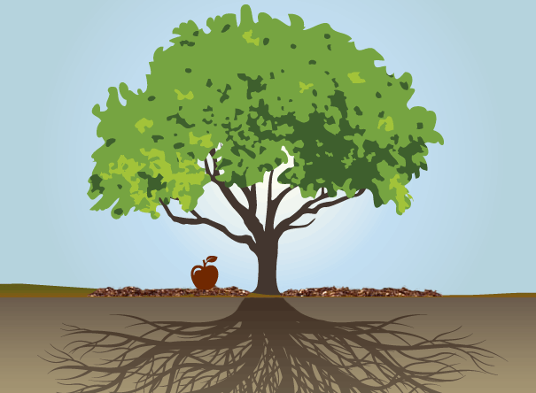
Timeline
1985
1988
Common Data Format
Project started
Notes:
The key point that I want you to take home here is that having a wealth of freely and easily accessible data relies heavily on contributions from the research community. I believe that researchers all have an individual responsibility to make their data available in the best way that they can, and this will contribute to something that we will all benefit from. And the quicker you publish your data, the quicker we progress. And this goes for whatever subject you are interested in.
I have shown that it really matters where you publish your data. There are specialist data centres just like OBIS and GBIF that are the default for certain types of data. Therefore, someone is likely to find your data if they’re doing a speculative search, as they are likely to be looking in the right place to begin with.
And there are data access portals that facilitate this too. These also specialise, so they might provide access to all data collected from a particular region, or perhaps a particular type of data.
For data to be made easily availble to researchers in a standardised way, it also matter HOW you publish your data. We data managers talk about the FAIR data management principles that guide researchers on how to do this. And I will talk about these principles in my next video. Thanks for watching.

Slide 10

Notes:
The key point that I want you to take home here is that having a wealth of freely and easily accessible data relies heavily on contributions from the research community. I believe that researchers all have an individual responsibility to make their data available in the best way that they can, and this will contribute to something that we will all benefit from. And the quicker you publish your data, the quicker we progress. And this goes for whatever subject you are interested in.
I have shown that it really matters where you publish your data. There are specialist data centres just like OBIS and GBIF that are the default for certain types of data. Therefore, someone is likely to find your data if they’re doing a speculative search, as they are likely to be looking in the right place to begin with.
And there are data access portals that facilitate this too. These also specialise, so they might provide access to all data collected from a particular region, or perhaps a particular type of data.
For data to be made easily availble to researchers in a standardised way, it also matter HOW you publish your data. We data managers talk about the FAIR data management principles that guide researchers on how to do this. And I will talk about these principles in my next video. Thanks for watching.

Slide 11
Dimensions
Notes:
The key point that I want you to take home here is that having a wealth of freely and easily accessible data relies heavily on contributions from the research community. I believe that researchers all have an individual responsibility to make their data available in the best way that they can, and this will contribute to something that we will all benefit from. And the quicker you publish your data, the quicker we progress. And this goes for whatever subject you are interested in.
I have shown that it really matters where you publish your data. There are specialist data centres just like OBIS and GBIF that are the default for certain types of data. Therefore, someone is likely to find your data if they’re doing a speculative search, as they are likely to be looking in the right place to begin with.
And there are data access portals that facilitate this too. These also specialise, so they might provide access to all data collected from a particular region, or perhaps a particular type of data.
For data to be made easily availble to researchers in a standardised way, it also matter HOW you publish your data. We data managers talk about the FAIR data management principles that guide researchers on how to do this. And I will talk about these principles in my next video. Thanks for watching.

Slide 12
Dimensions
Variables
Notes:
The key point that I want you to take home here is that having a wealth of freely and easily accessible data relies heavily on contributions from the research community. I believe that researchers all have an individual responsibility to make their data available in the best way that they can, and this will contribute to something that we will all benefit from. And the quicker you publish your data, the quicker we progress. And this goes for whatever subject you are interested in.
I have shown that it really matters where you publish your data. There are specialist data centres just like OBIS and GBIF that are the default for certain types of data. Therefore, someone is likely to find your data if they’re doing a speculative search, as they are likely to be looking in the right place to begin with.
And there are data access portals that facilitate this too. These also specialise, so they might provide access to all data collected from a particular region, or perhaps a particular type of data.
For data to be made easily availble to researchers in a standardised way, it also matter HOW you publish your data. We data managers talk about the FAIR data management principles that guide researchers on how to do this. And I will talk about these principles in my next video. Thanks for watching.

Slide 13
Dimensions
Variables
Attributes
Notes:
The key point that I want you to take home here is that having a wealth of freely and easily accessible data relies heavily on contributions from the research community. I believe that researchers all have an individual responsibility to make their data available in the best way that they can, and this will contribute to something that we will all benefit from. And the quicker you publish your data, the quicker we progress. And this goes for whatever subject you are interested in.
I have shown that it really matters where you publish your data. There are specialist data centres just like OBIS and GBIF that are the default for certain types of data. Therefore, someone is likely to find your data if they’re doing a speculative search, as they are likely to be looking in the right place to begin with.
And there are data access portals that facilitate this too. These also specialise, so they might provide access to all data collected from a particular region, or perhaps a particular type of data.
For data to be made easily availble to researchers in a standardised way, it also matter HOW you publish your data. We data managers talk about the FAIR data management principles that guide researchers on how to do this. And I will talk about these principles in my next video. Thanks for watching.

Slide 14
Dimensions
coordinate variables
Variables
Attributes
Notes:
The key point that I want you to take home here is that having a wealth of freely and easily accessible data relies heavily on contributions from the research community. I believe that researchers all have an individual responsibility to make their data available in the best way that they can, and this will contribute to something that we will all benefit from. And the quicker you publish your data, the quicker we progress. And this goes for whatever subject you are interested in.
I have shown that it really matters where you publish your data. There are specialist data centres just like OBIS and GBIF that are the default for certain types of data. Therefore, someone is likely to find your data if they’re doing a speculative search, as they are likely to be looking in the right place to begin with.
And there are data access portals that facilitate this too. These also specialise, so they might provide access to all data collected from a particular region, or perhaps a particular type of data.
For data to be made easily availble to researchers in a standardised way, it also matter HOW you publish your data. We data managers talk about the FAIR data management principles that guide researchers on how to do this. And I will talk about these principles in my next video. Thanks for watching.

Slide 15
Dimensions
coordinate variables
Variables
Attributes
data variables
Notes:
The key point that I want you to take home here is that having a wealth of freely and easily accessible data relies heavily on contributions from the research community. I believe that researchers all have an individual responsibility to make their data available in the best way that they can, and this will contribute to something that we will all benefit from. And the quicker you publish your data, the quicker we progress. And this goes for whatever subject you are interested in.
I have shown that it really matters where you publish your data. There are specialist data centres just like OBIS and GBIF that are the default for certain types of data. Therefore, someone is likely to find your data if they’re doing a speculative search, as they are likely to be looking in the right place to begin with.
And there are data access portals that facilitate this too. These also specialise, so they might provide access to all data collected from a particular region, or perhaps a particular type of data.
For data to be made easily availble to researchers in a standardised way, it also matter HOW you publish your data. We data managers talk about the FAIR data management principles that guide researchers on how to do this. And I will talk about these principles in my next video. Thanks for watching.

Slide 16
Dimensions
coordinate variables
global attributes
Variables
Attributes
data variables
Notes:
The key point that I want you to take home here is that having a wealth of freely and easily accessible data relies heavily on contributions from the research community. I believe that researchers all have an individual responsibility to make their data available in the best way that they can, and this will contribute to something that we will all benefit from. And the quicker you publish your data, the quicker we progress. And this goes for whatever subject you are interested in.
I have shown that it really matters where you publish your data. There are specialist data centres just like OBIS and GBIF that are the default for certain types of data. Therefore, someone is likely to find your data if they’re doing a speculative search, as they are likely to be looking in the right place to begin with.
And there are data access portals that facilitate this too. These also specialise, so they might provide access to all data collected from a particular region, or perhaps a particular type of data.
For data to be made easily availble to researchers in a standardised way, it also matter HOW you publish your data. We data managers talk about the FAIR data management principles that guide researchers on how to do this. And I will talk about these principles in my next video. Thanks for watching.

Slide 17
Dimensions
coordinate variables
global attributes
Variables
Attributes
data variables
variable attributes
Notes:
The key point that I want you to take home here is that having a wealth of freely and easily accessible data relies heavily on contributions from the research community. I believe that researchers all have an individual responsibility to make their data available in the best way that they can, and this will contribute to something that we will all benefit from. And the quicker you publish your data, the quicker we progress. And this goes for whatever subject you are interested in.
I have shown that it really matters where you publish your data. There are specialist data centres just like OBIS and GBIF that are the default for certain types of data. Therefore, someone is likely to find your data if they’re doing a speculative search, as they are likely to be looking in the right place to begin with.
And there are data access portals that facilitate this too. These also specialise, so they might provide access to all data collected from a particular region, or perhaps a particular type of data.
For data to be made easily availble to researchers in a standardised way, it also matter HOW you publish your data. We data managers talk about the FAIR data management principles that guide researchers on how to do this. And I will talk about these principles in my next video. Thanks for watching.

Slide 18
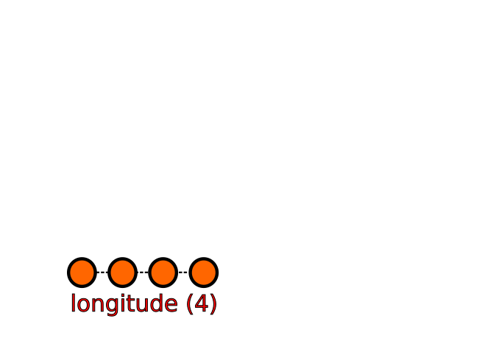
Notes:
The key point that I want you to take home here is that having a wealth of freely and easily accessible data relies heavily on contributions from the research community. I believe that researchers all have an individual responsibility to make their data available in the best way that they can, and this will contribute to something that we will all benefit from. And the quicker you publish your data, the quicker we progress. And this goes for whatever subject you are interested in.
I have shown that it really matters where you publish your data. There are specialist data centres just like OBIS and GBIF that are the default for certain types of data. Therefore, someone is likely to find your data if they’re doing a speculative search, as they are likely to be looking in the right place to begin with.
And there are data access portals that facilitate this too. These also specialise, so they might provide access to all data collected from a particular region, or perhaps a particular type of data.
For data to be made easily availble to researchers in a standardised way, it also matter HOW you publish your data. We data managers talk about the FAIR data management principles that guide researchers on how to do this. And I will talk about these principles in my next video. Thanks for watching.

Slide 19
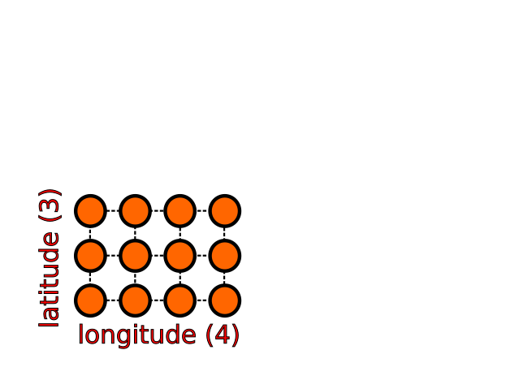
Notes:
The key point that I want you to take home here is that having a wealth of freely and easily accessible data relies heavily on contributions from the research community. I believe that researchers all have an individual responsibility to make their data available in the best way that they can, and this will contribute to something that we will all benefit from. And the quicker you publish your data, the quicker we progress. And this goes for whatever subject you are interested in.
I have shown that it really matters where you publish your data. There are specialist data centres just like OBIS and GBIF that are the default for certain types of data. Therefore, someone is likely to find your data if they’re doing a speculative search, as they are likely to be looking in the right place to begin with.
And there are data access portals that facilitate this too. These also specialise, so they might provide access to all data collected from a particular region, or perhaps a particular type of data.
For data to be made easily availble to researchers in a standardised way, it also matter HOW you publish your data. We data managers talk about the FAIR data management principles that guide researchers on how to do this. And I will talk about these principles in my next video. Thanks for watching.

Slide 20
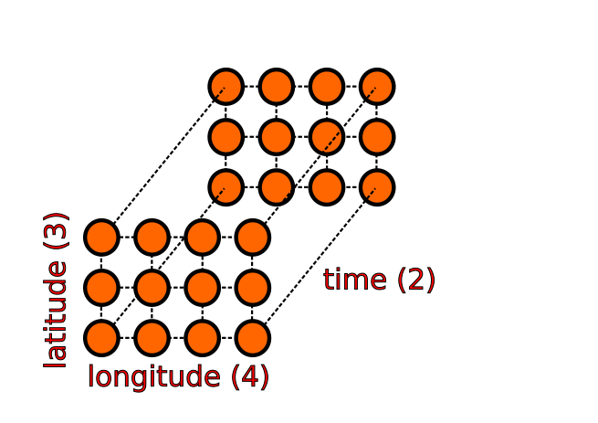
Notes:
The key point that I want you to take home here is that having a wealth of freely and easily accessible data relies heavily on contributions from the research community. I believe that researchers all have an individual responsibility to make their data available in the best way that they can, and this will contribute to something that we will all benefit from. And the quicker you publish your data, the quicker we progress. And this goes for whatever subject you are interested in.
I have shown that it really matters where you publish your data. There are specialist data centres just like OBIS and GBIF that are the default for certain types of data. Therefore, someone is likely to find your data if they’re doing a speculative search, as they are likely to be looking in the right place to begin with.
And there are data access portals that facilitate this too. These also specialise, so they might provide access to all data collected from a particular region, or perhaps a particular type of data.
For data to be made easily availble to researchers in a standardised way, it also matter HOW you publish your data. We data managers talk about the FAIR data management principles that guide researchers on how to do this. And I will talk about these principles in my next video. Thanks for watching.

Slide 21

Notes:
The key point that I want you to take home here is that having a wealth of freely and easily accessible data relies heavily on contributions from the research community. I believe that researchers all have an individual responsibility to make their data available in the best way that they can, and this will contribute to something that we will all benefit from. And the quicker you publish your data, the quicker we progress. And this goes for whatever subject you are interested in.
I have shown that it really matters where you publish your data. There are specialist data centres just like OBIS and GBIF that are the default for certain types of data. Therefore, someone is likely to find your data if they’re doing a speculative search, as they are likely to be looking in the right place to begin with.
And there are data access portals that facilitate this too. These also specialise, so they might provide access to all data collected from a particular region, or perhaps a particular type of data.
For data to be made easily availble to researchers in a standardised way, it also matter HOW you publish your data. We data managers talk about the FAIR data management principles that guide researchers on how to do this. And I will talk about these principles in my next video. Thanks for watching.

Slide 22

Notes:
The key point that I want you to take home here is that having a wealth of freely and easily accessible data relies heavily on contributions from the research community. I believe that researchers all have an individual responsibility to make their data available in the best way that they can, and this will contribute to something that we will all benefit from. And the quicker you publish your data, the quicker we progress. And this goes for whatever subject you are interested in.
I have shown that it really matters where you publish your data. There are specialist data centres just like OBIS and GBIF that are the default for certain types of data. Therefore, someone is likely to find your data if they’re doing a speculative search, as they are likely to be looking in the right place to begin with.
And there are data access portals that facilitate this too. These also specialise, so they might provide access to all data collected from a particular region, or perhaps a particular type of data.
For data to be made easily availble to researchers in a standardised way, it also matter HOW you publish your data. We data managers talk about the FAIR data management principles that guide researchers on how to do this. And I will talk about these principles in my next video. Thanks for watching.

Slide 23
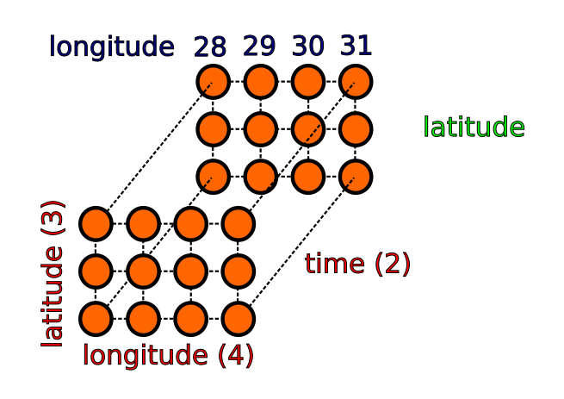
Notes:
The key point that I want you to take home here is that having a wealth of freely and easily accessible data relies heavily on contributions from the research community. I believe that researchers all have an individual responsibility to make their data available in the best way that they can, and this will contribute to something that we will all benefit from. And the quicker you publish your data, the quicker we progress. And this goes for whatever subject you are interested in.
I have shown that it really matters where you publish your data. There are specialist data centres just like OBIS and GBIF that are the default for certain types of data. Therefore, someone is likely to find your data if they’re doing a speculative search, as they are likely to be looking in the right place to begin with.
And there are data access portals that facilitate this too. These also specialise, so they might provide access to all data collected from a particular region, or perhaps a particular type of data.
For data to be made easily availble to researchers in a standardised way, it also matter HOW you publish your data. We data managers talk about the FAIR data management principles that guide researchers on how to do this. And I will talk about these principles in my next video. Thanks for watching.

Slide 24
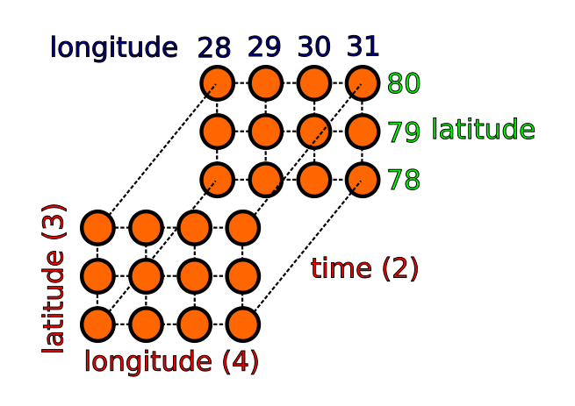
Notes:
The key point that I want you to take home here is that having a wealth of freely and easily accessible data relies heavily on contributions from the research community. I believe that researchers all have an individual responsibility to make their data available in the best way that they can, and this will contribute to something that we will all benefit from. And the quicker you publish your data, the quicker we progress. And this goes for whatever subject you are interested in.
I have shown that it really matters where you publish your data. There are specialist data centres just like OBIS and GBIF that are the default for certain types of data. Therefore, someone is likely to find your data if they’re doing a speculative search, as they are likely to be looking in the right place to begin with.
And there are data access portals that facilitate this too. These also specialise, so they might provide access to all data collected from a particular region, or perhaps a particular type of data.
For data to be made easily availble to researchers in a standardised way, it also matter HOW you publish your data. We data managers talk about the FAIR data management principles that guide researchers on how to do this. And I will talk about these principles in my next video. Thanks for watching.

Slide 25
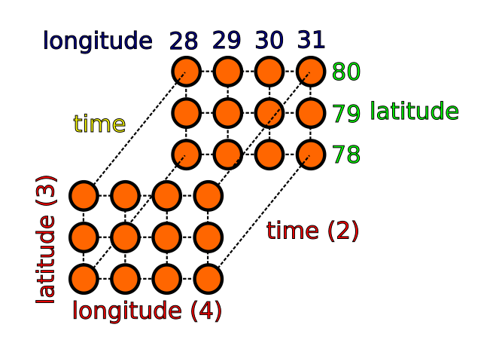
Notes:
The key point that I want you to take home here is that having a wealth of freely and easily accessible data relies heavily on contributions from the research community. I believe that researchers all have an individual responsibility to make their data available in the best way that they can, and this will contribute to something that we will all benefit from. And the quicker you publish your data, the quicker we progress. And this goes for whatever subject you are interested in.
I have shown that it really matters where you publish your data. There are specialist data centres just like OBIS and GBIF that are the default for certain types of data. Therefore, someone is likely to find your data if they’re doing a speculative search, as they are likely to be looking in the right place to begin with.
And there are data access portals that facilitate this too. These also specialise, so they might provide access to all data collected from a particular region, or perhaps a particular type of data.
For data to be made easily availble to researchers in a standardised way, it also matter HOW you publish your data. We data managers talk about the FAIR data management principles that guide researchers on how to do this. And I will talk about these principles in my next video. Thanks for watching.

Slide 26
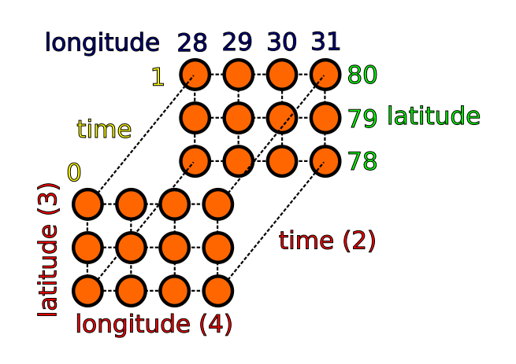
Notes:
The key point that I want you to take home here is that having a wealth of freely and easily accessible data relies heavily on contributions from the research community. I believe that researchers all have an individual responsibility to make their data available in the best way that they can, and this will contribute to something that we will all benefit from. And the quicker you publish your data, the quicker we progress. And this goes for whatever subject you are interested in.
I have shown that it really matters where you publish your data. There are specialist data centres just like OBIS and GBIF that are the default for certain types of data. Therefore, someone is likely to find your data if they’re doing a speculative search, as they are likely to be looking in the right place to begin with.
And there are data access portals that facilitate this too. These also specialise, so they might provide access to all data collected from a particular region, or perhaps a particular type of data.
For data to be made easily availble to researchers in a standardised way, it also matter HOW you publish your data. We data managers talk about the FAIR data management principles that guide researchers on how to do this. And I will talk about these principles in my next video. Thanks for watching.

Slide 27
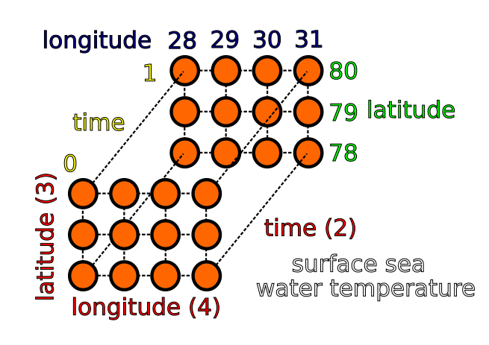
Notes:
The key point that I want you to take home here is that having a wealth of freely and easily accessible data relies heavily on contributions from the research community. I believe that researchers all have an individual responsibility to make their data available in the best way that they can, and this will contribute to something that we will all benefit from. And the quicker you publish your data, the quicker we progress. And this goes for whatever subject you are interested in.
I have shown that it really matters where you publish your data. There are specialist data centres just like OBIS and GBIF that are the default for certain types of data. Therefore, someone is likely to find your data if they’re doing a speculative search, as they are likely to be looking in the right place to begin with.
And there are data access portals that facilitate this too. These also specialise, so they might provide access to all data collected from a particular region, or perhaps a particular type of data.
For data to be made easily availble to researchers in a standardised way, it also matter HOW you publish your data. We data managers talk about the FAIR data management principles that guide researchers on how to do this. And I will talk about these principles in my next video. Thanks for watching.

Slide 28
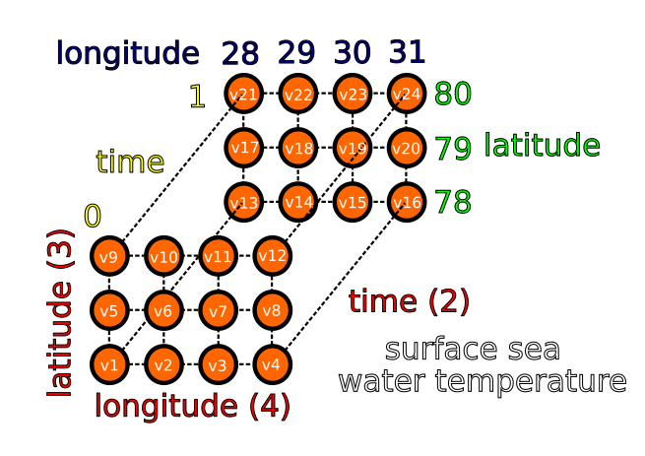
Notes:
The key point that I want you to take home here is that having a wealth of freely and easily accessible data relies heavily on contributions from the research community. I believe that researchers all have an individual responsibility to make their data available in the best way that they can, and this will contribute to something that we will all benefit from. And the quicker you publish your data, the quicker we progress. And this goes for whatever subject you are interested in.
I have shown that it really matters where you publish your data. There are specialist data centres just like OBIS and GBIF that are the default for certain types of data. Therefore, someone is likely to find your data if they’re doing a speculative search, as they are likely to be looking in the right place to begin with.
And there are data access portals that facilitate this too. These also specialise, so they might provide access to all data collected from a particular region, or perhaps a particular type of data.
For data to be made easily availble to researchers in a standardised way, it also matter HOW you publish your data. We data managers talk about the FAIR data management principles that guide researchers on how to do this. And I will talk about these principles in my next video. Thanks for watching.

Slide 29
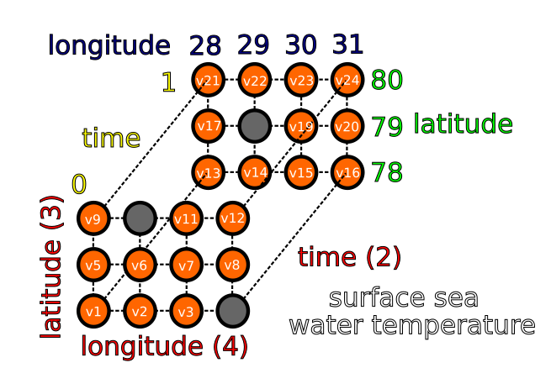
Notes:
The key point that I want you to take home here is that having a wealth of freely and easily accessible data relies heavily on contributions from the research community. I believe that researchers all have an individual responsibility to make their data available in the best way that they can, and this will contribute to something that we will all benefit from. And the quicker you publish your data, the quicker we progress. And this goes for whatever subject you are interested in.
I have shown that it really matters where you publish your data. There are specialist data centres just like OBIS and GBIF that are the default for certain types of data. Therefore, someone is likely to find your data if they’re doing a speculative search, as they are likely to be looking in the right place to begin with.
And there are data access portals that facilitate this too. These also specialise, so they might provide access to all data collected from a particular region, or perhaps a particular type of data.
For data to be made easily availble to researchers in a standardised way, it also matter HOW you publish your data. We data managers talk about the FAIR data management principles that guide researchers on how to do this. And I will talk about these principles in my next video. Thanks for watching.

Slide 30
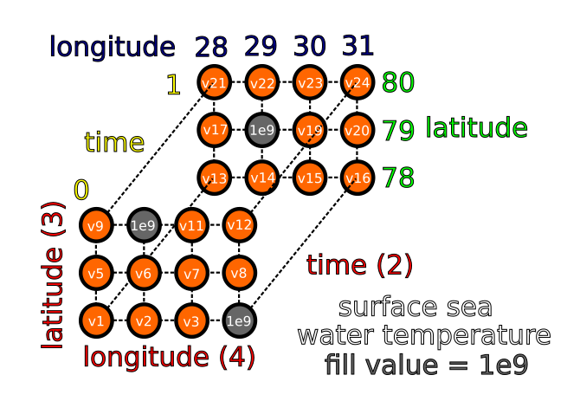
Notes:
The key point that I want you to take home here is that having a wealth of freely and easily accessible data relies heavily on contributions from the research community. I believe that researchers all have an individual responsibility to make their data available in the best way that they can, and this will contribute to something that we will all benefit from. And the quicker you publish your data, the quicker we progress. And this goes for whatever subject you are interested in.
I have shown that it really matters where you publish your data. There are specialist data centres just like OBIS and GBIF that are the default for certain types of data. Therefore, someone is likely to find your data if they’re doing a speculative search, as they are likely to be looking in the right place to begin with.
And there are data access portals that facilitate this too. These also specialise, so they might provide access to all data collected from a particular region, or perhaps a particular type of data.
For data to be made easily availble to researchers in a standardised way, it also matter HOW you publish your data. We data managers talk about the FAIR data management principles that guide researchers on how to do this. And I will talk about these principles in my next video. Thanks for watching.

Slide 31
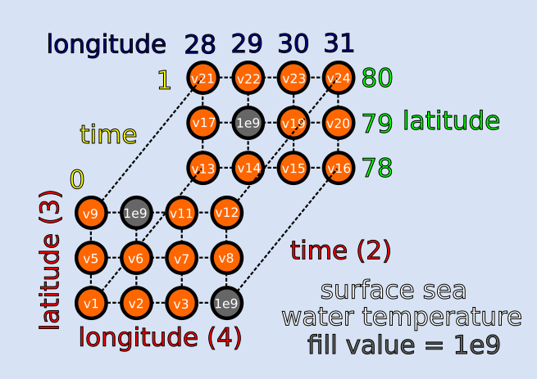
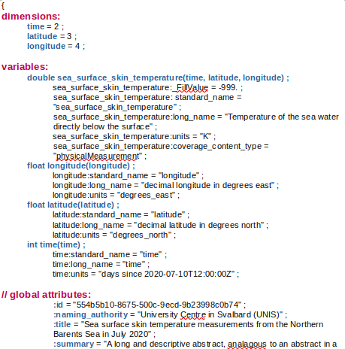
Notes:
The key point that I want you to take home here is that having a wealth of freely and easily accessible data relies heavily on contributions from the research community. I believe that researchers all have an individual responsibility to make their data available in the best way that they can, and this will contribute to something that we will all benefit from. And the quicker you publish your data, the quicker we progress. And this goes for whatever subject you are interested in.
I have shown that it really matters where you publish your data. There are specialist data centres just like OBIS and GBIF that are the default for certain types of data. Therefore, someone is likely to find your data if they’re doing a speculative search, as they are likely to be looking in the right place to begin with.
And there are data access portals that facilitate this too. These also specialise, so they might provide access to all data collected from a particular region, or perhaps a particular type of data.
For data to be made easily availble to researchers in a standardised way, it also matter HOW you publish your data. We data managers talk about the FAIR data management principles that guide researchers on how to do this. And I will talk about these principles in my next video. Thanks for watching.

Slide 32
Notes:
The key point that I want you to take home here is that having a wealth of freely and easily accessible data relies heavily on contributions from the research community. I believe that researchers all have an individual responsibility to make their data available in the best way that they can, and this will contribute to something that we will all benefit from. And the quicker you publish your data, the quicker we progress. And this goes for whatever subject you are interested in.
I have shown that it really matters where you publish your data. There are specialist data centres just like OBIS and GBIF that are the default for certain types of data. Therefore, someone is likely to find your data if they’re doing a speculative search, as they are likely to be looking in the right place to begin with.
And there are data access portals that facilitate this too. These also specialise, so they might provide access to all data collected from a particular region, or perhaps a particular type of data.
For data to be made easily availble to researchers in a standardised way, it also matter HOW you publish your data. We data managers talk about the FAIR data management principles that guide researchers on how to do this. And I will talk about these principles in my next video. Thanks for watching.

Slide 33
Notes:
The key point that I want you to take home here is that having a wealth of freely and easily accessible data relies heavily on contributions from the research community. I believe that researchers all have an individual responsibility to make their data available in the best way that they can, and this will contribute to something that we will all benefit from. And the quicker you publish your data, the quicker we progress. And this goes for whatever subject you are interested in.
I have shown that it really matters where you publish your data. There are specialist data centres just like OBIS and GBIF that are the default for certain types of data. Therefore, someone is likely to find your data if they’re doing a speculative search, as they are likely to be looking in the right place to begin with.
And there are data access portals that facilitate this too. These also specialise, so they might provide access to all data collected from a particular region, or perhaps a particular type of data.
For data to be made easily availble to researchers in a standardised way, it also matter HOW you publish your data. We data managers talk about the FAIR data management principles that guide researchers on how to do this. And I will talk about these principles in my next video. Thanks for watching.

Slide 34
Notes:
The key point that I want you to take home here is that having a wealth of freely and easily accessible data relies heavily on contributions from the research community. I believe that researchers all have an individual responsibility to make their data available in the best way that they can, and this will contribute to something that we will all benefit from. And the quicker you publish your data, the quicker we progress. And this goes for whatever subject you are interested in.
I have shown that it really matters where you publish your data. There are specialist data centres just like OBIS and GBIF that are the default for certain types of data. Therefore, someone is likely to find your data if they’re doing a speculative search, as they are likely to be looking in the right place to begin with.
And there are data access portals that facilitate this too. These also specialise, so they might provide access to all data collected from a particular region, or perhaps a particular type of data.
For data to be made easily availble to researchers in a standardised way, it also matter HOW you publish your data. We data managers talk about the FAIR data management principles that guide researchers on how to do this. And I will talk about these principles in my next video. Thanks for watching.

Slide 35
Notes:
The key point that I want you to take home here is that having a wealth of freely and easily accessible data relies heavily on contributions from the research community. I believe that researchers all have an individual responsibility to make their data available in the best way that they can, and this will contribute to something that we will all benefit from. And the quicker you publish your data, the quicker we progress. And this goes for whatever subject you are interested in.
I have shown that it really matters where you publish your data. There are specialist data centres just like OBIS and GBIF that are the default for certain types of data. Therefore, someone is likely to find your data if they’re doing a speculative search, as they are likely to be looking in the right place to begin with.
And there are data access portals that facilitate this too. These also specialise, so they might provide access to all data collected from a particular region, or perhaps a particular type of data.
For data to be made easily availble to researchers in a standardised way, it also matter HOW you publish your data. We data managers talk about the FAIR data management principles that guide researchers on how to do this. And I will talk about these principles in my next video. Thanks for watching.

Slide 36
Notes:
The key point that I want you to take home here is that having a wealth of freely and easily accessible data relies heavily on contributions from the research community. I believe that researchers all have an individual responsibility to make their data available in the best way that they can, and this will contribute to something that we will all benefit from. And the quicker you publish your data, the quicker we progress. And this goes for whatever subject you are interested in.
I have shown that it really matters where you publish your data. There are specialist data centres just like OBIS and GBIF that are the default for certain types of data. Therefore, someone is likely to find your data if they’re doing a speculative search, as they are likely to be looking in the right place to begin with.
And there are data access portals that facilitate this too. These also specialise, so they might provide access to all data collected from a particular region, or perhaps a particular type of data.
For data to be made easily availble to researchers in a standardised way, it also matter HOW you publish your data. We data managers talk about the FAIR data management principles that guide researchers on how to do this. And I will talk about these principles in my next video. Thanks for watching.

Slide 37
Notes:
The key point that I want you to take home here is that having a wealth of freely and easily accessible data relies heavily on contributions from the research community. I believe that researchers all have an individual responsibility to make their data available in the best way that they can, and this will contribute to something that we will all benefit from. And the quicker you publish your data, the quicker we progress. And this goes for whatever subject you are interested in.
I have shown that it really matters where you publish your data. There are specialist data centres just like OBIS and GBIF that are the default for certain types of data. Therefore, someone is likely to find your data if they’re doing a speculative search, as they are likely to be looking in the right place to begin with.
And there are data access portals that facilitate this too. These also specialise, so they might provide access to all data collected from a particular region, or perhaps a particular type of data.
For data to be made easily availble to researchers in a standardised way, it also matter HOW you publish your data. We data managers talk about the FAIR data management principles that guide researchers on how to do this. And I will talk about these principles in my next video. Thanks for watching.

Slide 38
Notes:
The key point that I want you to take home here is that having a wealth of freely and easily accessible data relies heavily on contributions from the research community. I believe that researchers all have an individual responsibility to make their data available in the best way that they can, and this will contribute to something that we will all benefit from. And the quicker you publish your data, the quicker we progress. And this goes for whatever subject you are interested in.
I have shown that it really matters where you publish your data. There are specialist data centres just like OBIS and GBIF that are the default for certain types of data. Therefore, someone is likely to find your data if they’re doing a speculative search, as they are likely to be looking in the right place to begin with.
And there are data access portals that facilitate this too. These also specialise, so they might provide access to all data collected from a particular region, or perhaps a particular type of data.
For data to be made easily availble to researchers in a standardised way, it also matter HOW you publish your data. We data managers talk about the FAIR data management principles that guide researchers on how to do this. And I will talk about these principles in my next video. Thanks for watching.

Slide 39
Notes:
The key point that I want you to take home here is that having a wealth of freely and easily accessible data relies heavily on contributions from the research community. I believe that researchers all have an individual responsibility to make their data available in the best way that they can, and this will contribute to something that we will all benefit from. And the quicker you publish your data, the quicker we progress. And this goes for whatever subject you are interested in.
I have shown that it really matters where you publish your data. There are specialist data centres just like OBIS and GBIF that are the default for certain types of data. Therefore, someone is likely to find your data if they’re doing a speculative search, as they are likely to be looking in the right place to begin with.
And there are data access portals that facilitate this too. These also specialise, so they might provide access to all data collected from a particular region, or perhaps a particular type of data.
For data to be made easily availble to researchers in a standardised way, it also matter HOW you publish your data. We data managers talk about the FAIR data management principles that guide researchers on how to do this. And I will talk about these principles in my next video. Thanks for watching.

Slide 40
Notes:
The key point that I want you to take home here is that having a wealth of freely and easily accessible data relies heavily on contributions from the research community. I believe that researchers all have an individual responsibility to make their data available in the best way that they can, and this will contribute to something that we will all benefit from. And the quicker you publish your data, the quicker we progress. And this goes for whatever subject you are interested in.
I have shown that it really matters where you publish your data. There are specialist data centres just like OBIS and GBIF that are the default for certain types of data. Therefore, someone is likely to find your data if they’re doing a speculative search, as they are likely to be looking in the right place to begin with.
And there are data access portals that facilitate this too. These also specialise, so they might provide access to all data collected from a particular region, or perhaps a particular type of data.
For data to be made easily availble to researchers in a standardised way, it also matter HOW you publish your data. We data managers talk about the FAIR data management principles that guide researchers on how to do this. And I will talk about these principles in my next video. Thanks for watching.

Slide 41
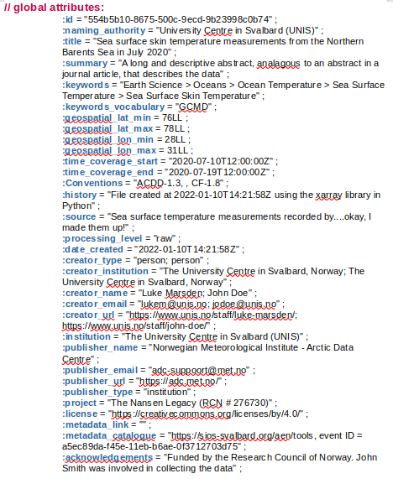
Notes:
The key point that I want you to take home here is that having a wealth of freely and easily accessible data relies heavily on contributions from the research community. I believe that researchers all have an individual responsibility to make their data available in the best way that they can, and this will contribute to something that we will all benefit from. And the quicker you publish your data, the quicker we progress. And this goes for whatever subject you are interested in.
I have shown that it really matters where you publish your data. There are specialist data centres just like OBIS and GBIF that are the default for certain types of data. Therefore, someone is likely to find your data if they’re doing a speculative search, as they are likely to be looking in the right place to begin with.
And there are data access portals that facilitate this too. These also specialise, so they might provide access to all data collected from a particular region, or perhaps a particular type of data.
For data to be made easily availble to researchers in a standardised way, it also matter HOW you publish your data. We data managers talk about the FAIR data management principles that guide researchers on how to do this. And I will talk about these principles in my next video. Thanks for watching.

Slide 42
Notes:
The key point that I want you to take home here is that having a wealth of freely and easily accessible data relies heavily on contributions from the research community. I believe that researchers all have an individual responsibility to make their data available in the best way that they can, and this will contribute to something that we will all benefit from. And the quicker you publish your data, the quicker we progress. And this goes for whatever subject you are interested in.
I have shown that it really matters where you publish your data. There are specialist data centres just like OBIS and GBIF that are the default for certain types of data. Therefore, someone is likely to find your data if they’re doing a speculative search, as they are likely to be looking in the right place to begin with.
And there are data access portals that facilitate this too. These also specialise, so they might provide access to all data collected from a particular region, or perhaps a particular type of data.
For data to be made easily availble to researchers in a standardised way, it also matter HOW you publish your data. We data managers talk about the FAIR data management principles that guide researchers on how to do this. And I will talk about these principles in my next video. Thanks for watching.

Slide 43
Notes:
The key point that I want you to take home here is that having a wealth of freely and easily accessible data relies heavily on contributions from the research community. I believe that researchers all have an individual responsibility to make their data available in the best way that they can, and this will contribute to something that we will all benefit from. And the quicker you publish your data, the quicker we progress. And this goes for whatever subject you are interested in.
I have shown that it really matters where you publish your data. There are specialist data centres just like OBIS and GBIF that are the default for certain types of data. Therefore, someone is likely to find your data if they’re doing a speculative search, as they are likely to be looking in the right place to begin with.
And there are data access portals that facilitate this too. These also specialise, so they might provide access to all data collected from a particular region, or perhaps a particular type of data.
For data to be made easily availble to researchers in a standardised way, it also matter HOW you publish your data. We data managers talk about the FAIR data management principles that guide researchers on how to do this. And I will talk about these principles in my next video. Thanks for watching.

Slide 44
Notes:
The key point that I want you to take home here is that having a wealth of freely and easily accessible data relies heavily on contributions from the research community. I believe that researchers all have an individual responsibility to make their data available in the best way that they can, and this will contribute to something that we will all benefit from. And the quicker you publish your data, the quicker we progress. And this goes for whatever subject you are interested in.
I have shown that it really matters where you publish your data. There are specialist data centres just like OBIS and GBIF that are the default for certain types of data. Therefore, someone is likely to find your data if they’re doing a speculative search, as they are likely to be looking in the right place to begin with.
And there are data access portals that facilitate this too. These also specialise, so they might provide access to all data collected from a particular region, or perhaps a particular type of data.
For data to be made easily availble to researchers in a standardised way, it also matter HOW you publish your data. We data managers talk about the FAIR data management principles that guide researchers on how to do this. And I will talk about these principles in my next video. Thanks for watching.

Slide 45
Notes:
The key point that I want you to take home here is that having a wealth of freely and easily accessible data relies heavily on contributions from the research community. I believe that researchers all have an individual responsibility to make their data available in the best way that they can, and this will contribute to something that we will all benefit from. And the quicker you publish your data, the quicker we progress. And this goes for whatever subject you are interested in.
I have shown that it really matters where you publish your data. There are specialist data centres just like OBIS and GBIF that are the default for certain types of data. Therefore, someone is likely to find your data if they’re doing a speculative search, as they are likely to be looking in the right place to begin with.
And there are data access portals that facilitate this too. These also specialise, so they might provide access to all data collected from a particular region, or perhaps a particular type of data.
For data to be made easily availble to researchers in a standardised way, it also matter HOW you publish your data. We data managers talk about the FAIR data management principles that guide researchers on how to do this. And I will talk about these principles in my next video. Thanks for watching.

Slide 46
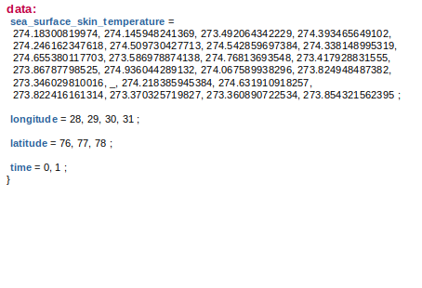
Notes:
The key point that I want you to take home here is that having a wealth of freely and easily accessible data relies heavily on contributions from the research community. I believe that researchers all have an individual responsibility to make their data available in the best way that they can, and this will contribute to something that we will all benefit from. And the quicker you publish your data, the quicker we progress. And this goes for whatever subject you are interested in.
I have shown that it really matters where you publish your data. There are specialist data centres just like OBIS and GBIF that are the default for certain types of data. Therefore, someone is likely to find your data if they’re doing a speculative search, as they are likely to be looking in the right place to begin with.
And there are data access portals that facilitate this too. These also specialise, so they might provide access to all data collected from a particular region, or perhaps a particular type of data.
For data to be made easily availble to researchers in a standardised way, it also matter HOW you publish your data. We data managers talk about the FAIR data management principles that guide researchers on how to do this. And I will talk about these principles in my next video. Thanks for watching.

Slide 47
CF Conventions
Climate and Forecast https://cfconventions.org/
ACDD Conventions
Attribute Conventions for Data Discovery
https://wiki.esipfed.org/Attribute_Convention_for_Data_Discovery_1-3
Some requirements for SIOS:
https://adc.met.no/node/4
Notes:
The key point that I want you to take home here is that having a wealth of freely and easily accessible data relies heavily on contributions from the research community. I believe that researchers all have an individual responsibility to make their data available in the best way that they can, and this will contribute to something that we will all benefit from. And the quicker you publish your data, the quicker we progress. And this goes for whatever subject you are interested in.
I have shown that it really matters where you publish your data. There are specialist data centres just like OBIS and GBIF that are the default for certain types of data. Therefore, someone is likely to find your data if they’re doing a speculative search, as they are likely to be looking in the right place to begin with.
And there are data access portals that facilitate this too. These also specialise, so they might provide access to all data collected from a particular region, or perhaps a particular type of data.
For data to be made easily availble to researchers in a standardised way, it also matter HOW you publish your data. We data managers talk about the FAIR data management principles that guide researchers on how to do this. And I will talk about these principles in my next video. Thanks for watching.

Slide 48
GCMD Keywords
Global Change Master Directory
Keyword viewer:
https://gcmd.earthdata.nasa.gov/KeywordViewer/
Notes:
The key point that I want you to take home here is that having a wealth of freely and easily accessible data relies heavily on contributions from the research community. I believe that researchers all have an individual responsibility to make their data available in the best way that they can, and this will contribute to something that we will all benefit from. And the quicker you publish your data, the quicker we progress. And this goes for whatever subject you are interested in.
I have shown that it really matters where you publish your data. There are specialist data centres just like OBIS and GBIF that are the default for certain types of data. Therefore, someone is likely to find your data if they’re doing a speculative search, as they are likely to be looking in the right place to begin with.
And there are data access portals that facilitate this too. These also specialise, so they might provide access to all data collected from a particular region, or perhaps a particular type of data.
For data to be made easily availble to researchers in a standardised way, it also matter HOW you publish your data. We data managers talk about the FAIR data management principles that guide researchers on how to do this. And I will talk about these principles in my next video. Thanks for watching.

Slide 49
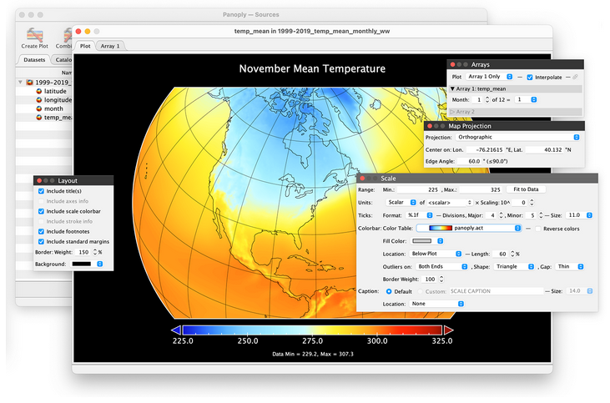
Tools
Panoply
Python
R
Matlab
…
http://tomcat.nersc.no/rosetta/
http://netcdf4excel.github.io/
https://www.unidata.ucar.edu/software/netcdf/software.html
Notes:
The key point that I want you to take home here is that having a wealth of freely and easily accessible data relies heavily on contributions from the research community. I believe that researchers all have an individual responsibility to make their data available in the best way that they can, and this will contribute to something that we will all benefit from. And the quicker you publish your data, the quicker we progress. And this goes for whatever subject you are interested in.
I have shown that it really matters where you publish your data. There are specialist data centres just like OBIS and GBIF that are the default for certain types of data. Therefore, someone is likely to find your data if they’re doing a speculative search, as they are likely to be looking in the right place to begin with.
And there are data access portals that facilitate this too. These also specialise, so they might provide access to all data collected from a particular region, or perhaps a particular type of data.
For data to be made easily availble to researchers in a standardised way, it also matter HOW you publish your data. We data managers talk about the FAIR data management principles that guide researchers on how to do this. And I will talk about these principles in my next video. Thanks for watching.

