Slide 1



Notes:
Thanks everyone for coming today. For those of you who don’t know me, I’m Luke. I’m a data manager, working mainly for the Norwegian Meteorological Institute, but I also have a 20% position at the University Centre on Svalbard. And recently I became the chair of the SIOS data management system working group.
I spend a lot of time working with scientists and teaching them how to work with FAIR data. I have run a few workshops like this before, though this is the first time I am running the workshop fully online.

Slide 2
Aim
Get you on your way with creating CF-NetCDF files
Notes:
The aim of this workshop is to get you on your way with creating CF-NetCDF files.
You are a diverse group – some of you will have created a NetCDF file before – that’s fine. Some of you will be quite comfortable creating NetCDF files but might want to learn about what the best practices are. That’s also fine.
Some of you might leave today with a CF-NetCDF file. Some of you will only get part of the way there. We can stay in touch with emails after today and I can arrange a one-on-one zoom chat if you like too.

Slide 3
Workshop plan
20-25 min intro presentation
  About CF-NetCDF
  Best practices
You work on your data
  Raise hands for questions – or use chat
  Breakout rooms
Workshop help materials (Python & R) https://github.com/lhmarsden/CF-NetCDF_workshop
I will take lunch 12:00-12:30 CET and finish c. 16:00
Notes:
So the plan today is that I’ll start off with a short presentation about CF-NetCDF and what the best practices are. This will be very similar to a presentation I gave at SIOS Polar Night week in January, so if you were there and don’t want to hear it again, you are free to work on other things whilst I talk. And you are also free to ask questions as I go.
The rest of the workshop will be unstructured. You will work on your data, and I will try to replicate what I have been doing during my physical workshops where I have been going round, checking people are getting on okay and answering questions. So raise your hands, ask questions in the chat, and I will pull you aside into a breakout room so we aren’t disrupting the rest of you. And I might go through something with the whole group if anything comes up.
There are some help materials online (open them)
I will take lunch at around 12. You can talk lunch or a break whenever you like – and come and go as you please if you have other commitments.

Slide 4
Standardised structure
Controlled vocabularies
Include metadata
CF-
NetCDF
Software independent
Machine readable
Notes:
So CF-NetCDF. Why do we use this format?
Force you to follow a standardised structure, so all similar data should be structured in the same way
They include all the metadata needed to understand and use the data within it, so one shouldn’t have to look anywhere else or ask the corresponding author
They use controlled vocabularies. These are standardised names for data or metadata terms with descriptions that you can find online – so the data creator and data user can both read these descriptions and therefore they both understand the data in the same way
This makes them machine readable – so it is possible to build services on top of the data
And they are software independent.

Slide 5
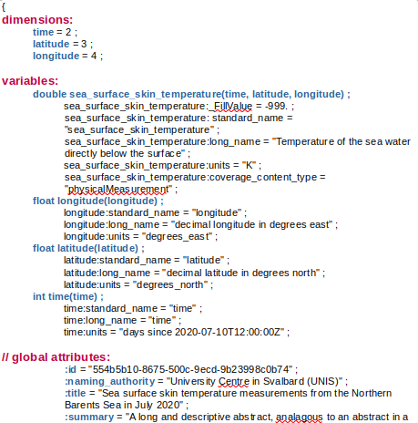
Dimensions:
3 points of latitude
4 points of longitude
2 points time
Variables:
Variable ‘lat’ has dimension lat
Variable ‘…temperature…’ has 3 dimensions
Variable attributes
Notes:
This is a NetCDF file that I have created.
There is a lot of information on the left, I’ll guide you with yellow boxes on the right.
You have dimensions at the top. These tell you about the shape of the data – so this says we have 3 points of latitude, 4 points of longitude, and 2 points of time. Note that this doesn’t tell me anything about what the values are for these.
The data values are stored in the variables. There are coordinate variables for latitude, longitidue and time. And in brackets, you can see that the variable latitude has the dimension latitude.
And we also have variables for our data parameters - so sea surface skin skin temperature has 3 dimensions, so I will have a 2 by 3 by 4 grid of values.
There are then metadata for each variable too, which we call variable attributes.

Slide 6
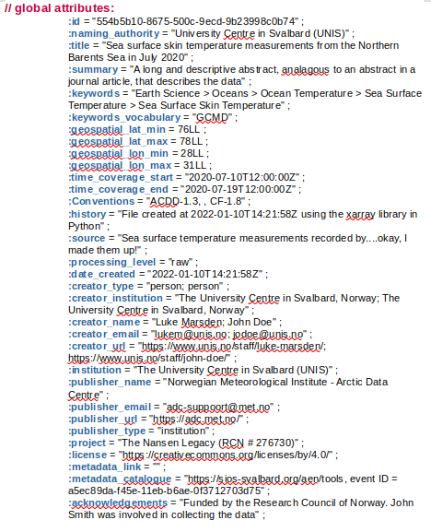
Conventions used:
Climate & Forecast
Attribute Convention for Data Discovery
Notes:
And finally below we have the global attributes, so these are metadata that describe the file overall, like the authors, the title, the time and spatial limits.
Perhaps most importantly it tells you (or a machine) the conventions that have been followed. So we have ACDD conventions that tell us which global attributes to include. And the CF conventions which tell us how to structure the data and a bit about the variable attributes.

Slide 7
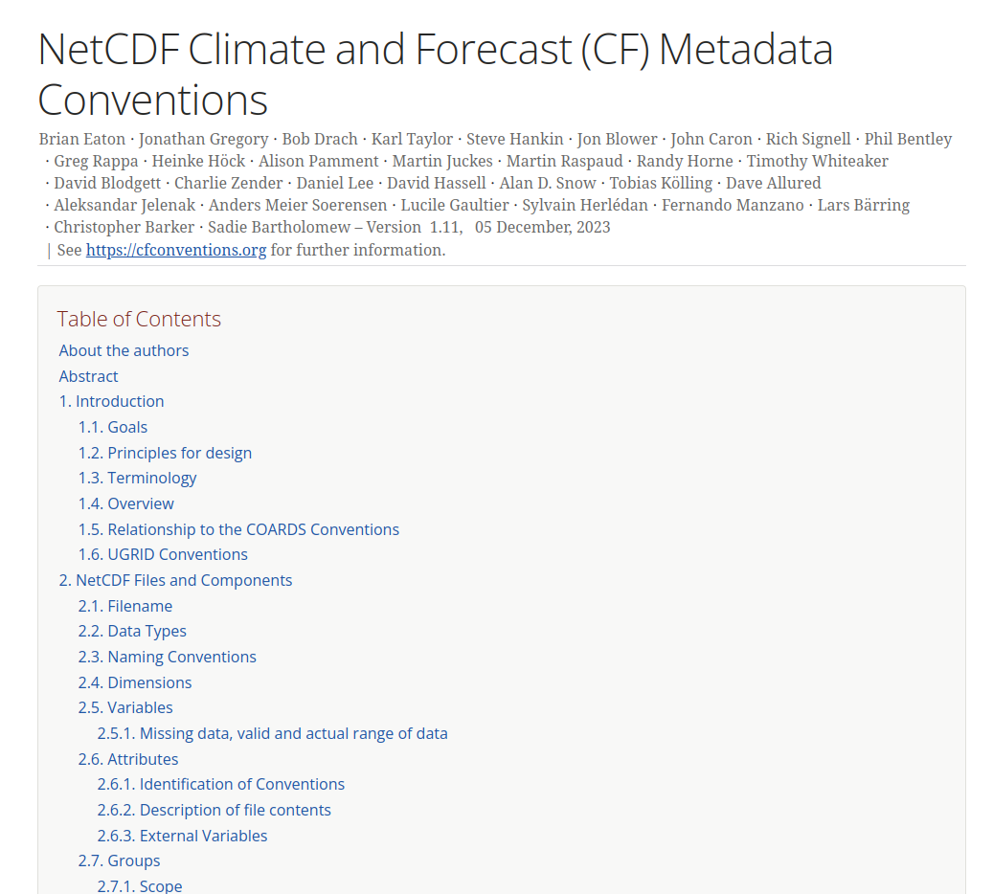
Climate & Forecast
Conventions
262 pages!
Notes:
These are the CF conventions – this is 262 pages, but of course you don’t have to read it all. You can think of this like a one-stop shop for all the information you might need about how to structure your data for it to be compliant with the CF conventions, and where you can find the answers to any questions you might have.
So the way I use this document is to just use the links in the contents to find sections that are relevant to the data you are working with.

Slide 8
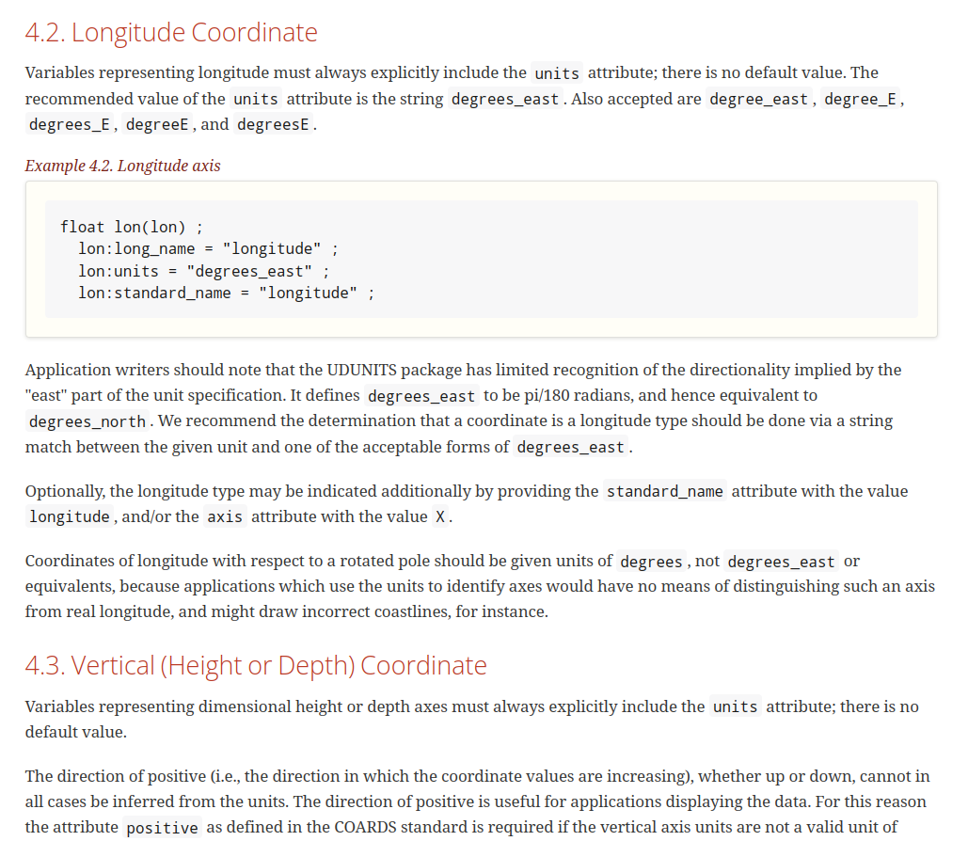
Climate & Forecast
Conventions
Notes:
So if you want to include a longitude coordinate in your CF-NetCDF file, there is all the information on how to encode this.

Slide 9
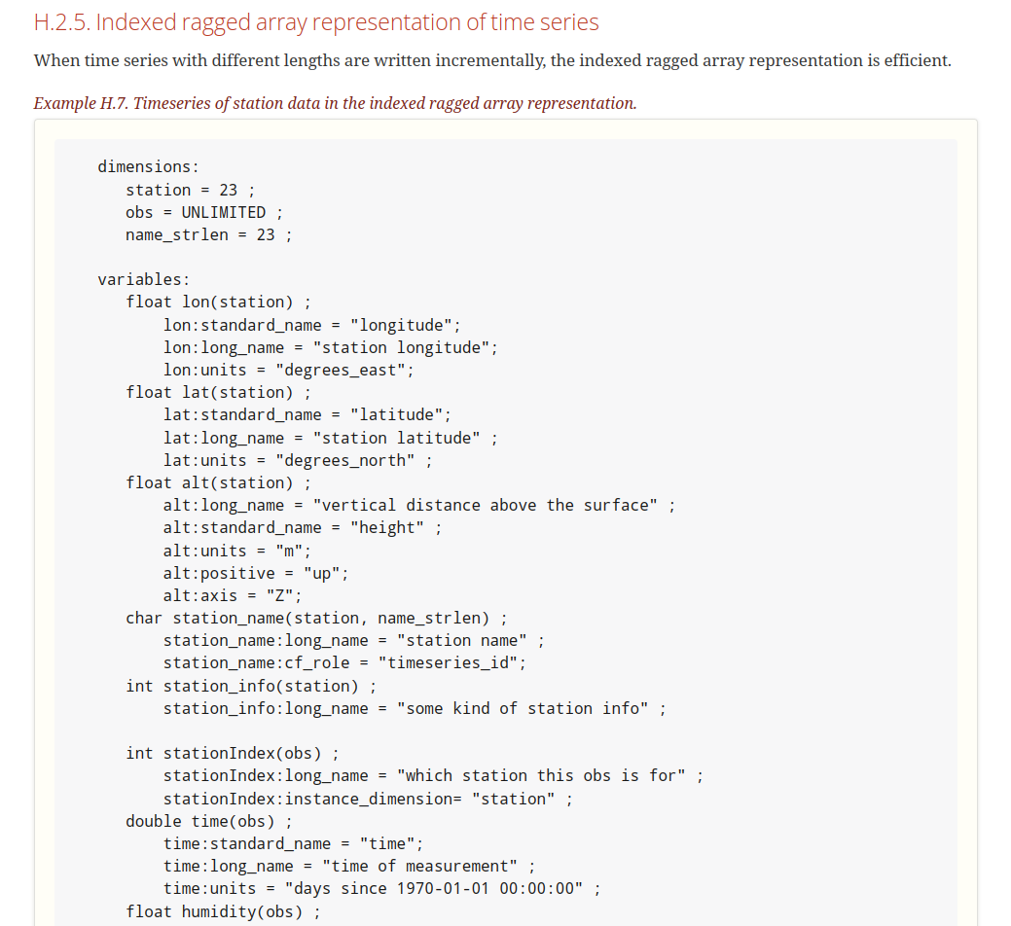
Climate & Forecast
Conventions
Notes:
There are lots of examples on how to encode specific types of data. This is actually quite a lot of examples now.

Slide 10
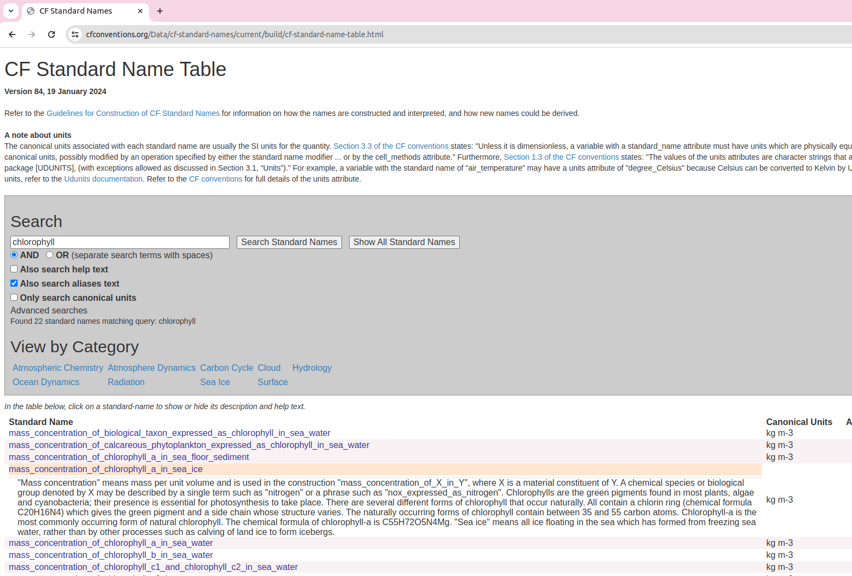
Climate & Forecast
Conventions
Notes:
And there is the CF standard names.
This is a controlled vocabulary of terms that you should assign to your variables.
So all datasets that include the same type of data should include the same standard name for that variable.

Slide 11
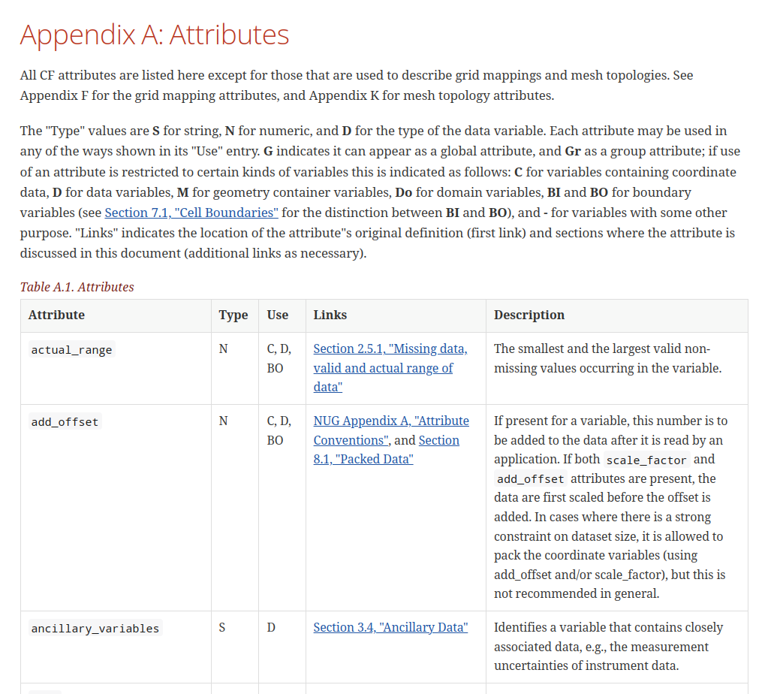
Climate & Forecast
Conventions
Notes:
And there is a section that tells you which attributes you can include – the metadata – and whether each term can be used as a global attribute or variable attribute.
So this is also a controlled vocabulary.

Slide 12
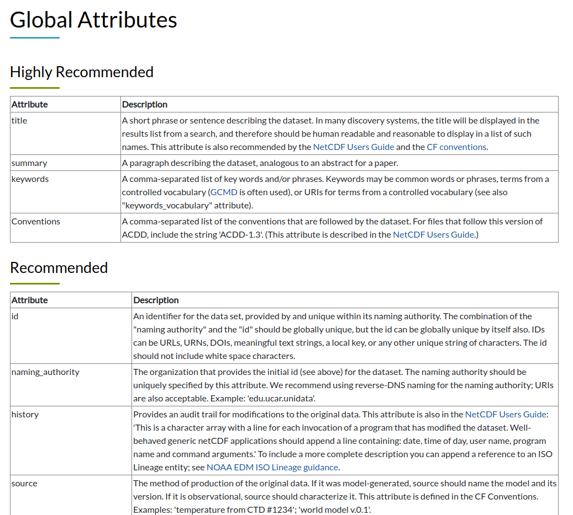
Attribute Convention for Data Discovery
Notes:
The CF conventions are quite light on global attributes, so we also recommend you use the Attribute Convention for Data Discovery – or the ACDD convention. And this is just a collection of different terms you can use as global attributes.
These are recommendations, but requirements more effective in encouraging consistency between datasets.

Slide 13
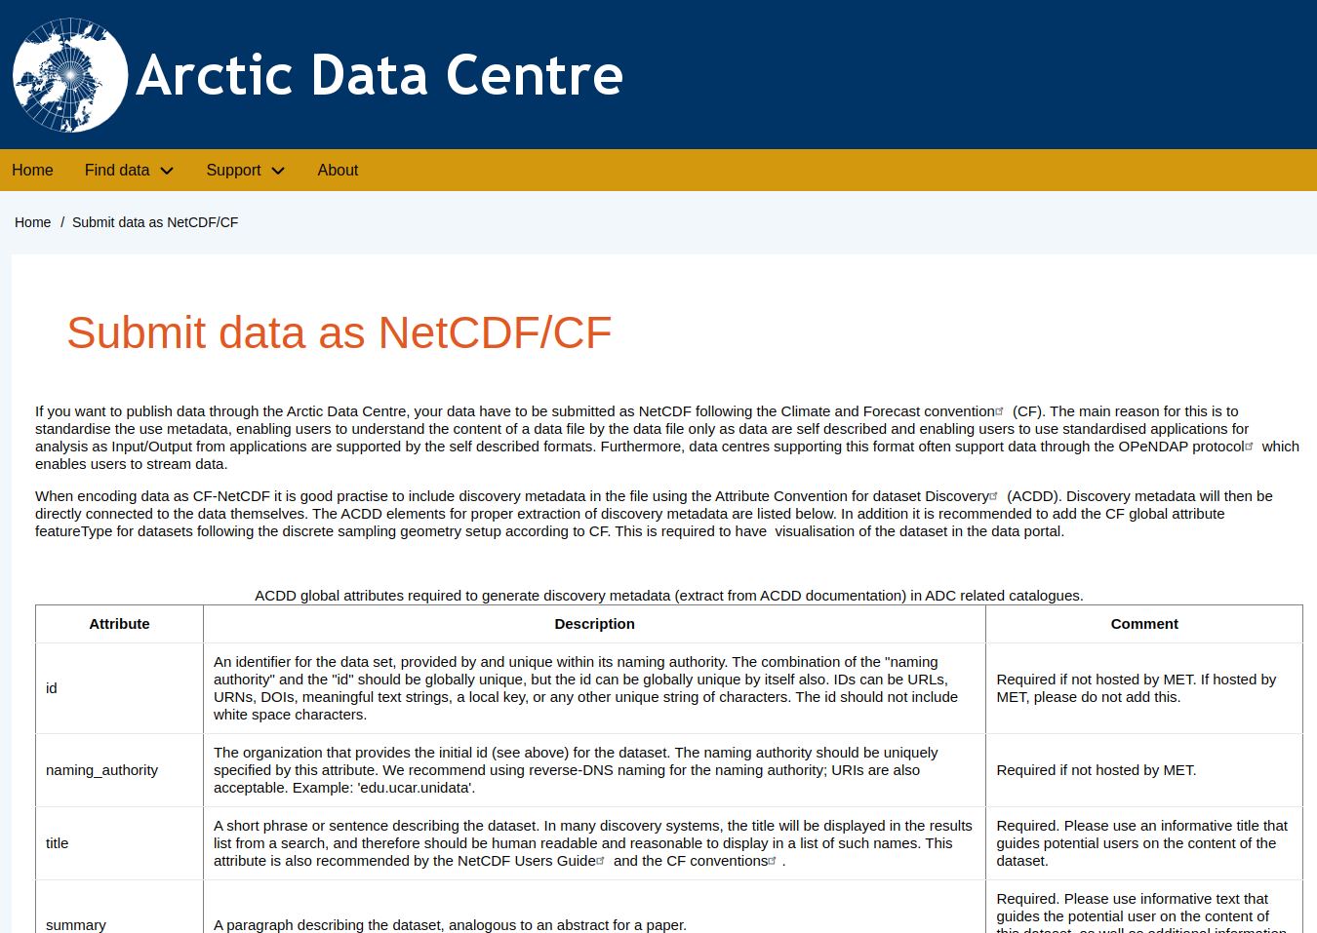


Attribute Convention for Data Discovery
Notes:
So at the arctic data centre we have some requirements for the global attributes – based on the ACDD convetions.
And we also recommend that people contributing data to SIOS follow these too.

Slide 14
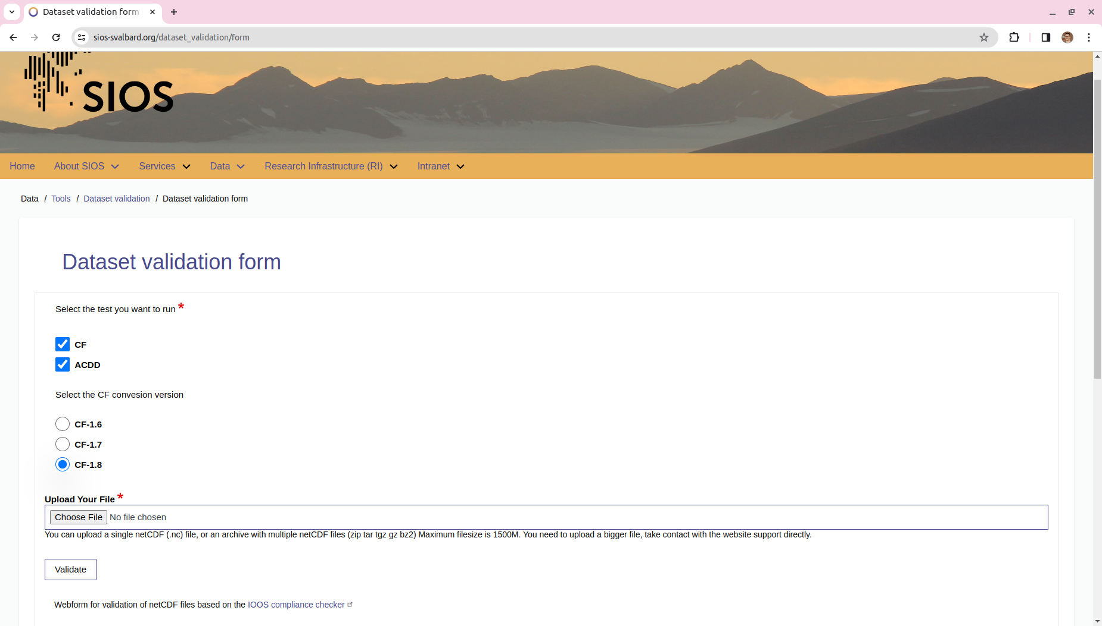
Notes:
If you are saying you are complying with certain conventions, you should be checking that you actually are.
SIOS hosts a compliance checker where you can upload your CF-NetCDF file and make sure you are compliant with the CF conventions and the Attribute Convention for Data Discovery.
And it will spit out some error messages your file is not compliant.

Slide 15

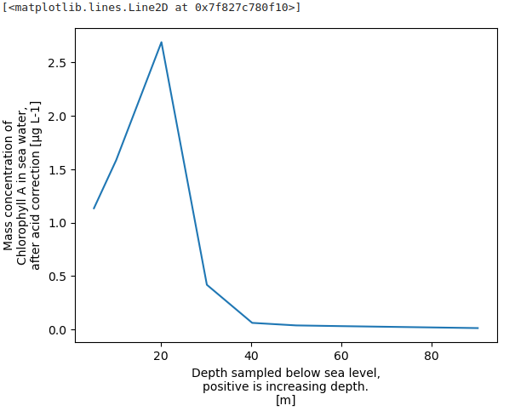
Notes:
We data managers often say that we can build services on top on FAIR data, or tools that you can use – but what do we mean by that?
This could be on-the fly visualisation of data, and I will show you here how easy it is to make a basic plot of data in a NetCDF file.

Slide 16
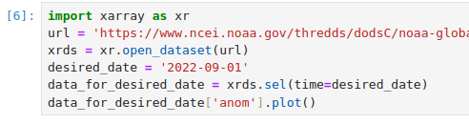
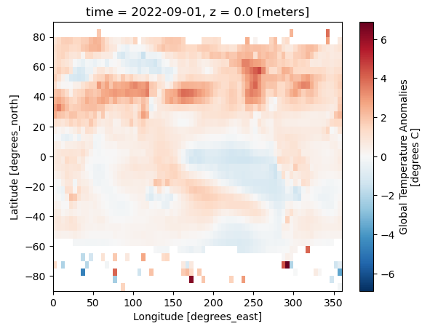
Notes:
This is also equally easy for data that we might want to plot on a map. This here is a file of global surface temperature anomalies per month.

Slide 17
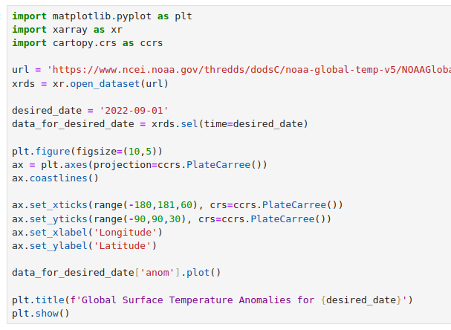
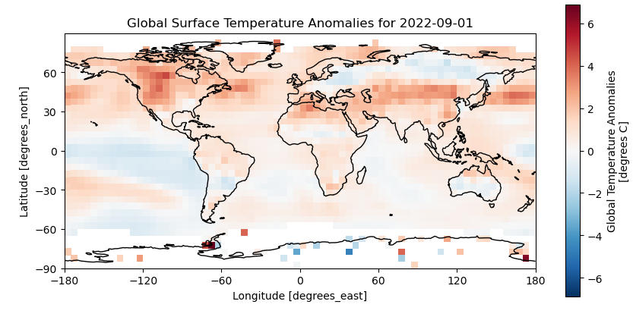
Notes:
And it is not much more work to start building something that looks quite nice.

Slide 18
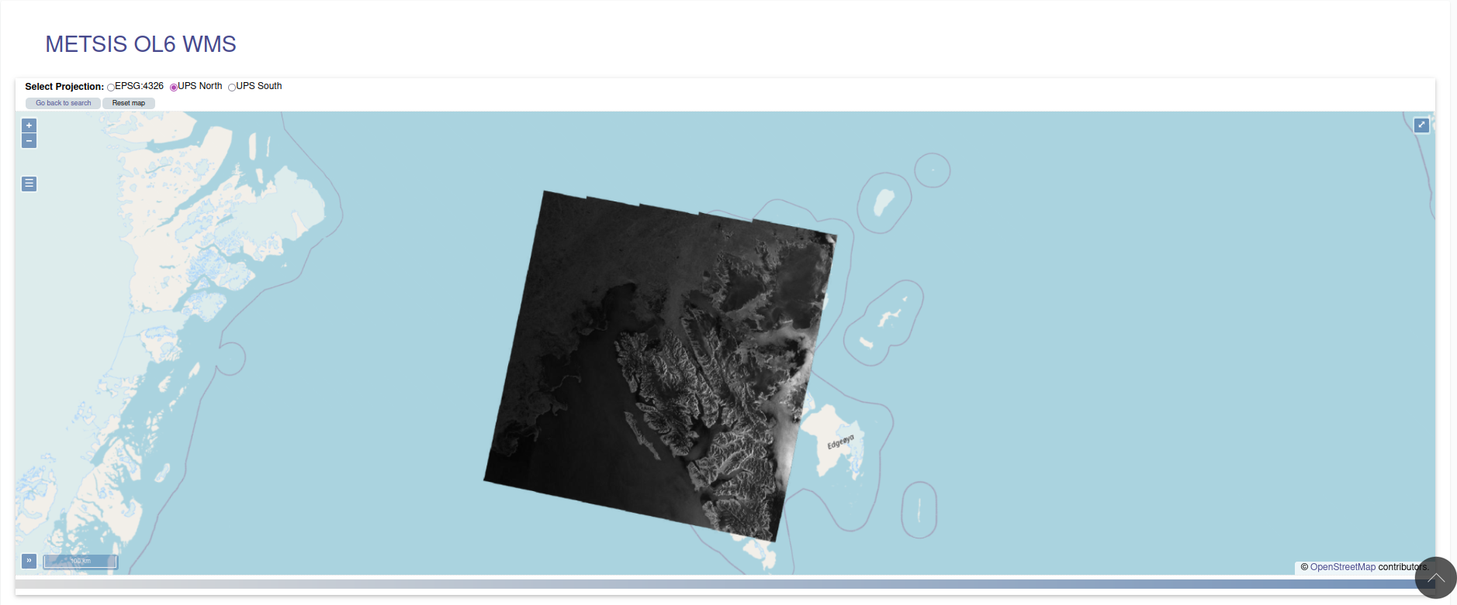

Visualisation through SIOS data access portal
Notes:
It is possible to do this on-the-fly visualisation of data on the SIOS data access portal, this here is an example of satellite data plotted over Svalbard.

Slide 19
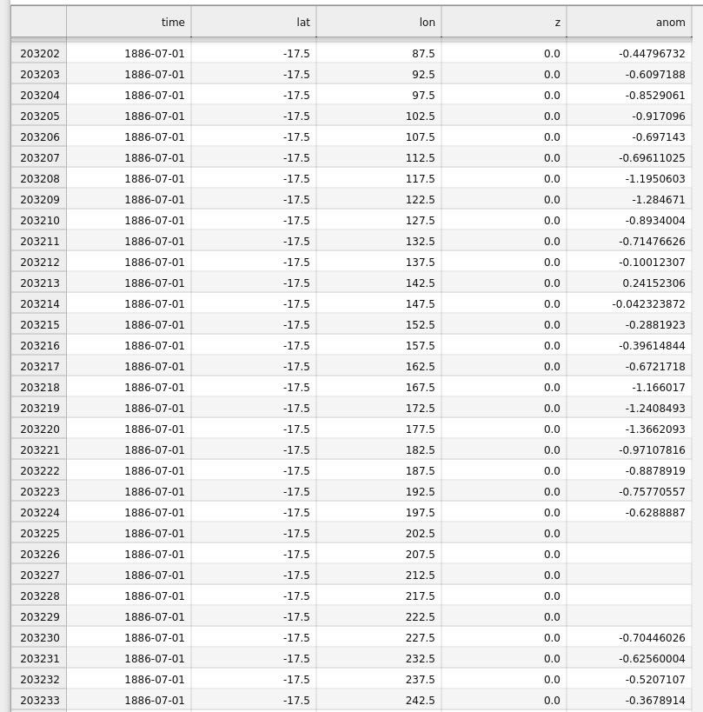
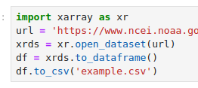
Notes:
And it is also easy to get data out of a NetCDF file and into a CSV file or XLSX file for example.
Just because you publish data in a NetCDF file it doesn’t mean someone has to download them in a NetCDF file. You can put a NetCDF file into a data centre and the user can get a CSV file out – but that doesn’t work the other way round.

Slide 20
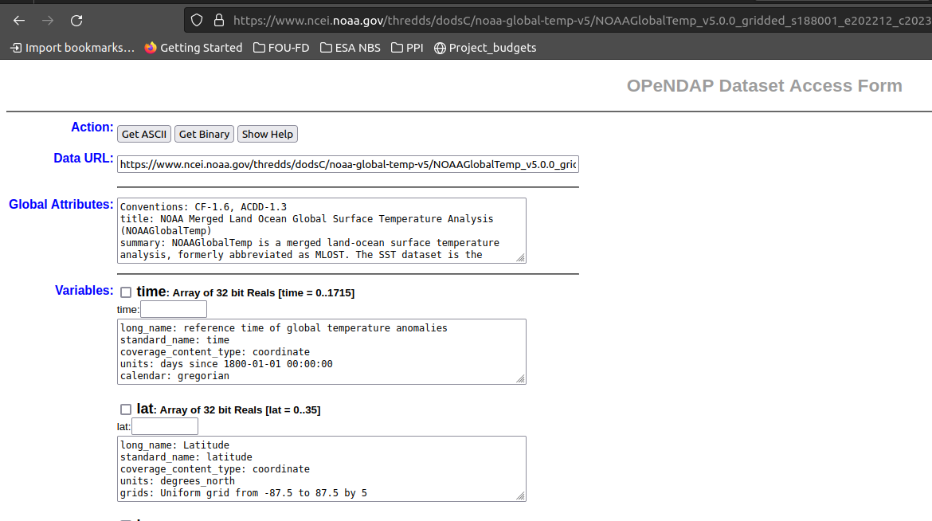
OPeNDAP
Notes:
Has anyone heard of OpeNDAP?
OpeNDAP basically allows you to read and access data over the internet without having to download it onto your own computer.
So if you paste this data_url into your Python, R or Matlab script, it will work in the same way as if that file was stored on your computer.
You can also read all the metadata about the file
Select which variables you are interested in
And even a subset of those variables, for example one time slice, by writing something in here.
And download them to an ASCII file or as a NetCDF file.
So OpeNDAP is great for building services with, but it is also by itself a useful service for people who are less familiar with NetCDF files to access the data in a different format.

Slide 21
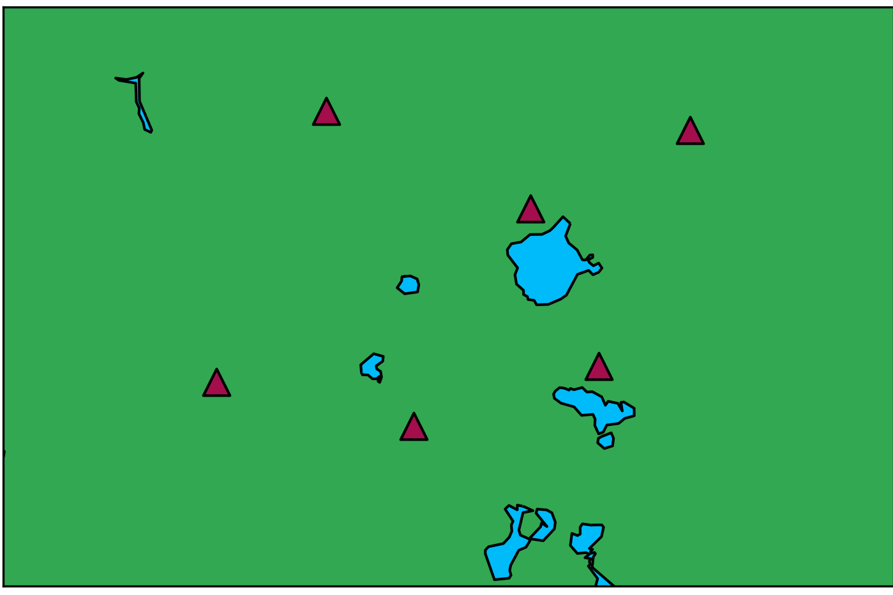
Granularity
Notes:
If I have time I want to talk a bit about granularity.
How should you organise your data? How many files should you create?
Imagine you are part of a project that is deploying some instruments – maybe weather stations or something like this.
You might be inclined to publish these altogether, maybe even in one file.

Slide 22
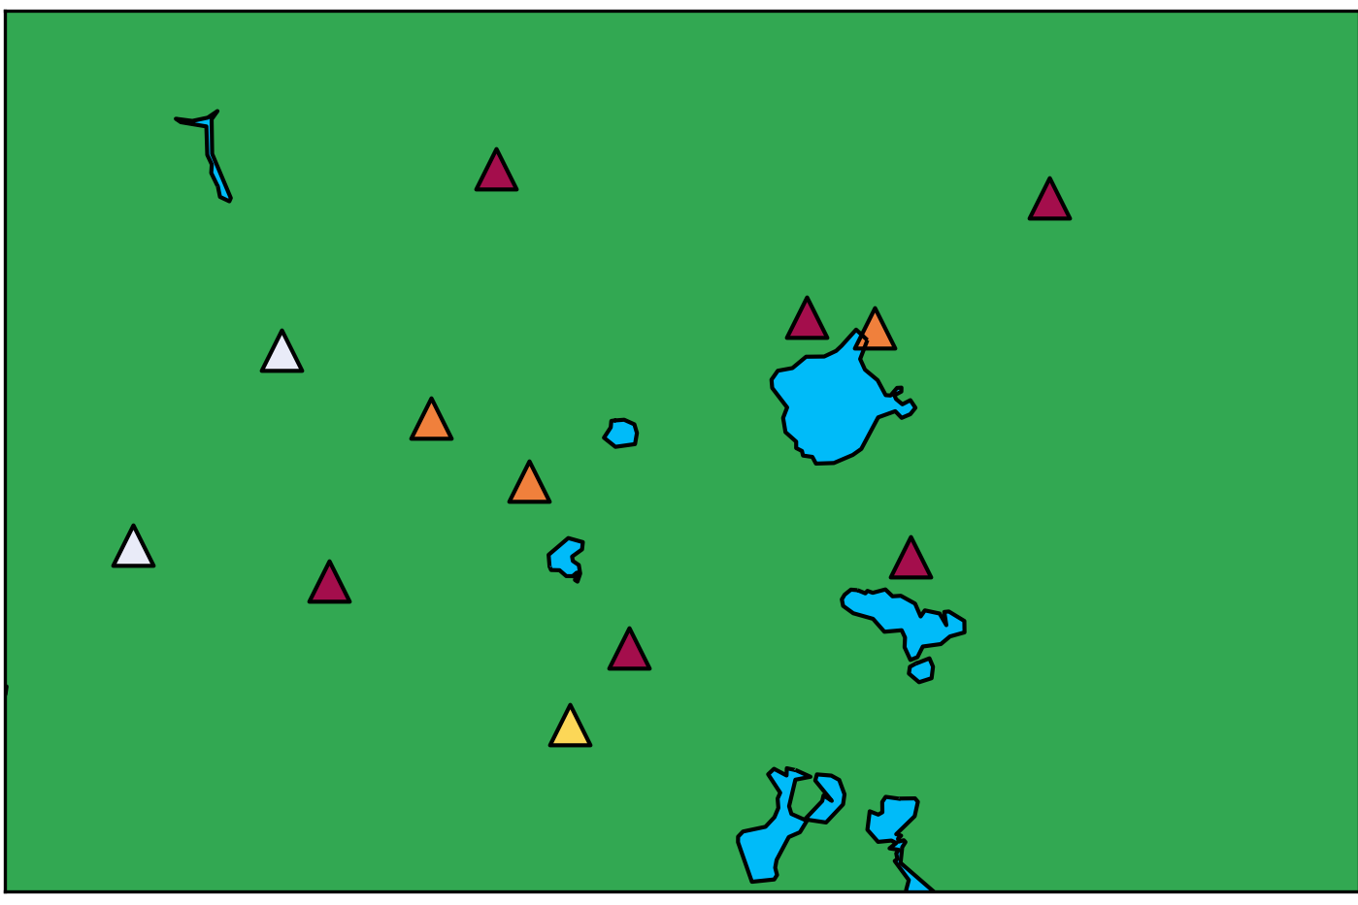
Granularity
Notes:
However, your data are a contribution to a much larger collection of similar data that someone might want to use altogether.
The data user might have never heard of your project. They want an easy way to combine all the data together, regardless of which project, or expedition, they were collected as part of.

Slide 23
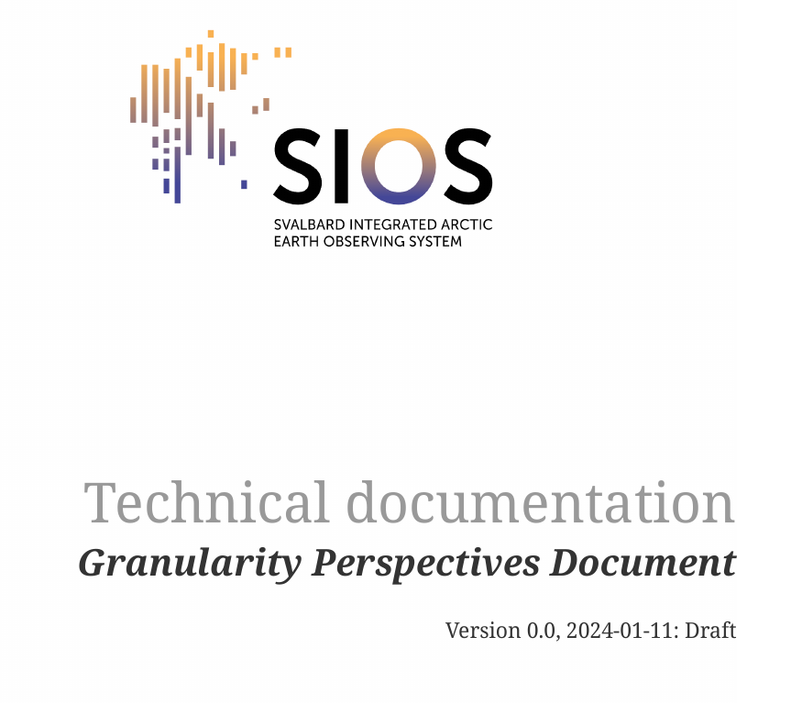
Granularity
Notes:
SDMS is actually developing a document that describes this. And what we recommend is that you publish each instrument, or each cast of a CTD, or whatever it is, individually in separate files.
Now… for some of you this might seem crazy, but let me explain why this is better for the data user.

Slide 24
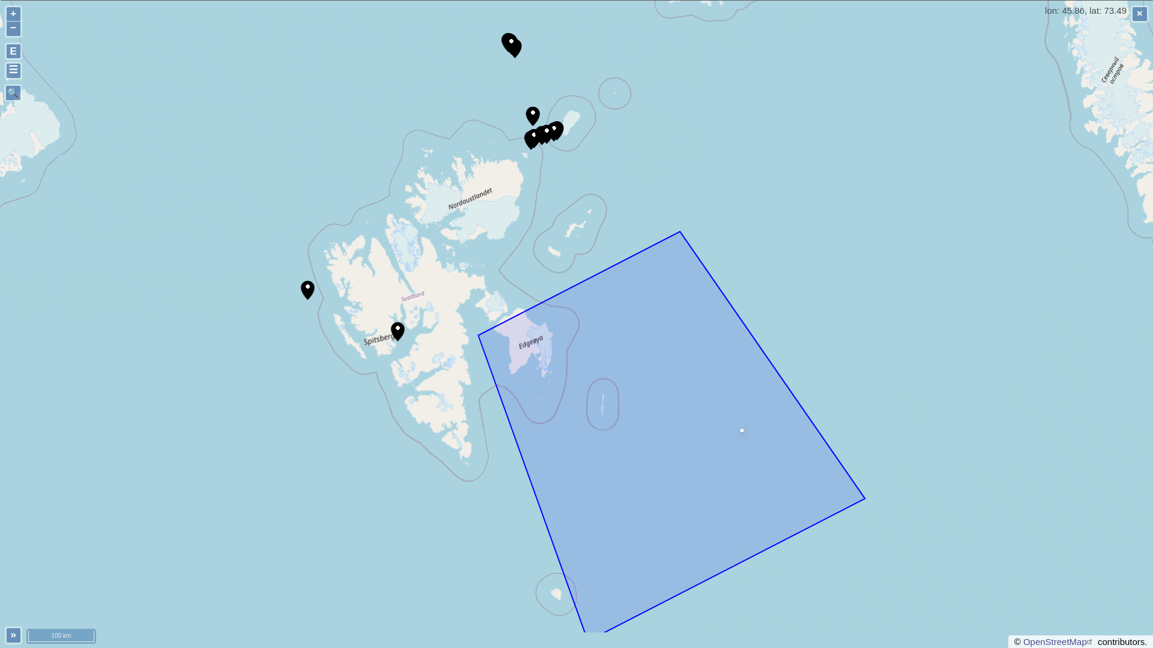
Advantages of finer granularity
Metadata
Notes:
Each file can be published with it’s own set of global attributes and discovery metadata on the landing page.
So the metadata can be tailored to each file.
If you publish data for a whole cruise, you provide only the coordinates of the bounding box as discovery metadata. It’s difficult for the data user to know which locations you’ve visited within this box without opening up the file.

Slide 25
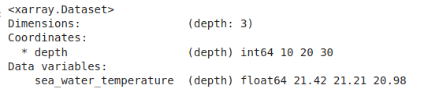
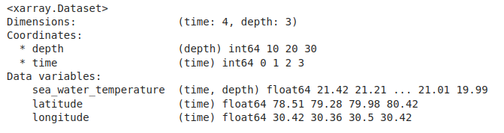
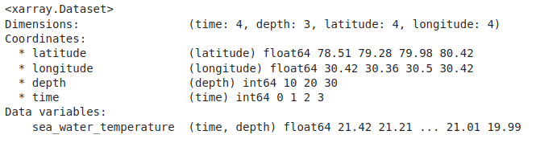
Advantages of finer granularity
Metadata
Simpler files
Notes:
Smaller files are simpler.
If you have one depth profile per file, you only need one dimension and coordinate variable.
If you include multiple depth profiles, you need 2 dimensions, time and depth, and separate coordinates variables for time, depth, latitude and longitude.
I also sometimes see the same data structured like this instead, with different dimensions for each coordinate variable – though I would discourage this approach, it can create some problems for the data users.

Slide 26
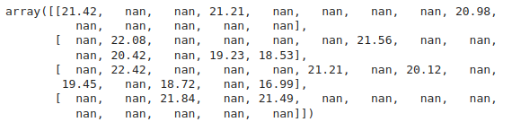
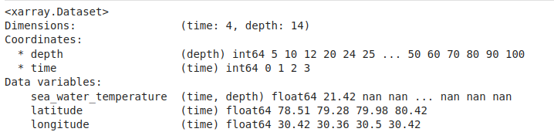
Advantages of finer granularity
Metadata
Simpler files
Less empty space
Notes:
Simpler files tend to include less empty space.
Imagine that for each of our 4 depth profiles we are sampling different depths.
The depth dimension and associated coordinate variable needs to encompass all of these profiles and therefore all your data variables have to be the same length for every profile.
So you can end up something like this, where most of the values are nan.

Slide 27
Advantages of finer granularity
Metadata
Simpler files
Less empty space
Easier to build services upon
Notes:
And so for all of these reasons, it is easier to build services upon data with a finer granularity.

Slide 28

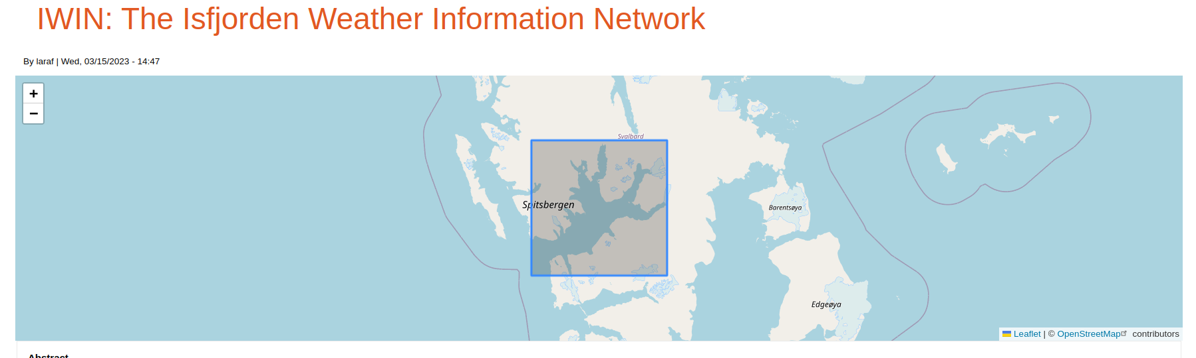
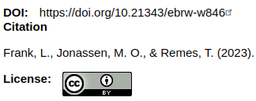

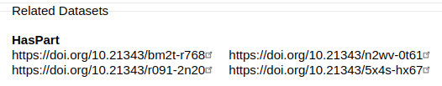
Parent & child
Notes:
You can still credit the project or expedition using parent child relationships. So this is the Isfjorden Weather Information Network that you can find via the SIOS data access portal
So the parent has one DOI and recommended citation –
and there is a number of child datasets, each with their own DOI and recommended citation.
And this is actually better for transparency of which data someone is using – you can cite a child or two if you only use a bit of the data, or cite the parent if you used most or all of it.

Slide 29
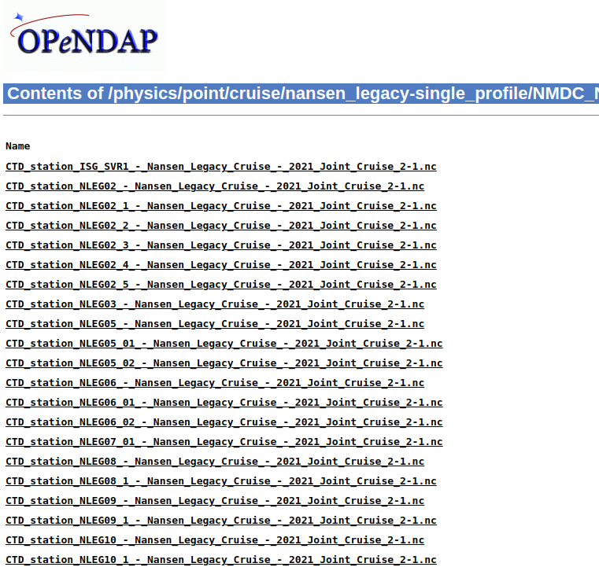
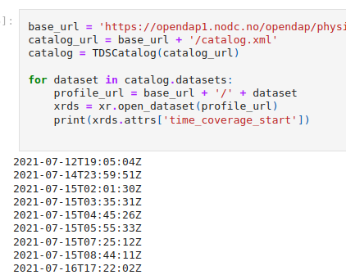
Accessing many files in one go (THREDDs)
Notes:
And the user doesn’t have to download all the files.
You can traverse through a THREDDS catalogue and open and use each file in turn without downloading anything to you computer.
This is just a simple example here where I loop through each file on the right, open the file and print out the time the data collection began.

Slide 30
Tips
Publish data at finest functional granularity possible
Never combine data with different temporal dimensions
Never combine data with different spatial dimensions
Divide time series (or other dimensions) up based on what is useful for the data users
Separate data variables into different files where sensible to do so
Notes:
And finally some final tips

