Slide 1


Technical Support - OKR REVIEW
Haft first year of 2023

Slide 2
Revenue Achievement
Maximize Efficiency
3. Customer Satisfaction
4. Internal Process Improvement
5. Personal Development
Objective
www.digi-texx.vn

Slide 3
O1
Revenue Achievement
KR1: Review project process + risk assessment
(TBD)
www.digi-texx.vn

Slide 4
O2
Maximize Efficiency
KR1: Apply automation process into 3 projects (work on DGS3)
Team | Project Name | PIC | Target | Actual | Description
OPS1 | 013_140128_SAGA_504606 | ttthao | 3 | 3 | Apply OMR and compare data between machine and human task to ensure the quality
OPS3 | Monitor and auto alert (096, 0738, 0805) | ntnhue |  |  | Auto alert when the instance stuck at the service/human task over the threshold
OPS3 | 096_190619_124_MVL_eClaim | ntnhue |  |  | Apply auto bypass verify step (expected 10% application reach to 100% quality target)
www.digi-texx.vn

Slide 5
O2
Maximize Efficiency
KR2: Perform the migration process for the listed projects as outlined in Key Result 1
Project Name | Target | Actual | Archived
042_170518_002_505304 | 14 | 9 | 64%
043_170518_002_505305
044_170518_002_505306
013_140128_SAGA_504606
049_150504_Saga_504952
102_190702_002_505654
029_060607_SAGA_503117
0872_230222_002_HSR_Italia
054_120530_SAGA_503549
www.digi-texx.vn

Slide 6
O3
Customer Satisfaction
KR1:Provide services with WOW factors by reducing negative feedback to 20% and increase positive feedback 10% compare to 2022
Type of FB | First 6 months 2022 | First 6 months 2023 | Target | Actual | Archived
Negative | 100 | 60 | 20% | 40% | 133%
Positive | 26 | 35 | 10% | 34.61% | 130%
www.digi-texx.vn

Slide 7
O4
Internal Project Improvement
KR1:The rate of projects designed by OPS increased 20% compared to 2022
Total new project in 2023 | Total new project work on DGS3 | Target | Actual | Archived
49 | 32 | 80% | 65.3% | 82%
www.digi-texx.vn

Slide 8
O4
Internal Project Improvement
KR2: Reduce incident bounce rate (90% of incident requests are adequate)
Note: apply from August 2023
Total Incident | Total Incident bounce | Target | Actual | Archived
5 | 0 | 90% | 100% | 100%
www.digi-texx.vn

Slide 9
O4
Internal Project Improvement
KR3: Reduce the number of incidents, reduced by 20%
Note: apply from August 2023
Total Incident in 2022 | Total Incident from August 2023 | Target | Actual | Archived
893 | 5 | 715 | 5 | 100%
www.digi-texx.vn

Slide 10
O4
Internal Project Improvement
KR4: Minimize the manual task of management team (reduce 30% compared to 2022)
Total Manual Task | Total Manual Task Remain | Target | Actual | Archived
7 | 3 | 20% | 57.14% | 167%
Project Name | Description
0807_220704_099_Audit_B | Control user's performance and project's time by workflow DGS3
Function Task/batch priority | Priority the tasks to complete whole batch to ensure the delivery time, user no need monitor to assign/unassign task
Web report for the quality report of project | Create web app, QA can get the report by themselves
Future Log (SAGA) | Auto generate the billing report from the workflow
www.digi-texx.vn

Slide 11
O4
Internal Project Improvement
KR5: Evaluate and implement at least 3 improvement ideas proposed by OPS teams (Project, Admin team)
Project Name | Description | Target | Actual | Archived
012_140128_SAGA_504684 | Apply process check duplicate value into the workflow, user no need to check directly in the output | 3 | 2 | 67%
0909_230612_293_LuxembourgCensus2023 | Apply auto classify into the process workflow
www.digi-texx.vn

Slide 12
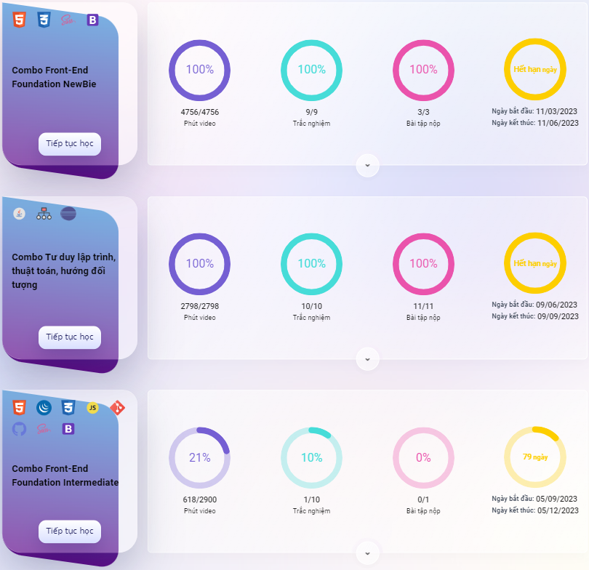
O5
Personal Development
KR1: Register for the courses and complete half of the curriculum
www.digi-texx.vn

Slide 13
O5
Personal Development
KR2: Complete the entire fullstack developer curriculum and receive a
certificate
(TBD)
www.digi-texx.vn

Slide 14
THANK YOU

