Slide 1
MMRF HACKATHON · 2026-11-05
ORION
AI Agents for Myeloma Research
Cited answers and live analysis, powered by a myeloma knowledge graph and safe AI agents.
Amazon Neptune
AWS Lambda
Amazon Bedrock AgentCore
Amazon S3
Amazon CloudWatch
Built in ~2 days | No real patient data anywhere in the system
Notes:
[~30 sec] Hi, we're presenting ORION: an AI agent platform for myeloma research. In the next eight minutes we'll cover the problem, our solution, the architecture before and after, a live demo, the technology and design decisions behind it including cost and performance, and where we'd take it next. Built in about two days, grounded entirely in public data — no real patient information anywhere in the system.

Slide 2
WHY THIS MATTERS
A Cancer That Keeps Coming Back
Multiple myeloma is a cancer of plasma cells in the bone marrow — common, aggressive, and still considered incurable. Most patients relapse and need a new treatment plan again and again. This project exists to help researchers and clinicians find that next right answer faster, for the patients counting on it.
36,000
new U.S. diagnoses every year
196,000+
new cases diagnosed worldwide each year
63.7%
5-year survival — still relapsing, still incurable
Every number above is a patient and a family counting on faster, better-connected research.
Amazon Neptune
AWS Lambda
Amazon Bedrock AgentCore
ORION | AI Agents for Myeloma Research | Built on AWS
2
Notes:
[~1 min] Multiple myeloma is a cancer of plasma cells in the bone marrow — common, aggressive, still considered incurable. ~36,000 new U.S. diagnoses and 196,000+ worldwide every year, and 5-year survival sits at 63.7% because most patients relapse and need a new treatment plan again and again. This is why the work matters: every one of those numbers is a patient and a family counting on research moving faster. Next slide shows the actual obstacle in that research today — the evidence those patients need is scattered across incompatible sources.

Slide 3
THE PROBLEM, VISUALIZED
One Question. Six Disconnected Sources.
Behind every question is a patient waiting on an answer. Today, a researcher trying to help them has to manually stitch together data that was never built to connect.
ORION Curated Facts
Hand-verified mechanism chains
ClinicalTrials.gov / PubMed
Trial & publication registry
Monarch Initiative
Gene – disease associations
🧑‍⚕️
DisMech
Disease mechanism YAML
A researcher, racing
to help a patient
Open Targets
Target & drug evidence
CIViC
Clinical variant evidence
ORION | AI Agents for Myeloma Research | Built on AWS
3
Notes:
DRAFT slide for experimentation. Shows the researcher at the center and the six real pipeline sources (ORION curated facts, Monarch, Open Targets, CIViC, DisMech, ClinicalTrials.gov/PubMed) radiating outward, disconnected from each other, to visualize the 'scattered data' problem before ORION joins them into one graph. Swap wording/visuals as needed.

Slide 4
SEE IT IN ACTION
Live Demo
Switch to the live agent and graph explorer here
[ Live demo — switch to agent chat / graph explorer ]
Ask a myeloma question, show the cited answer, then open the graph to see the evidence.
ORION | AI Agents for Myeloma Research | Built on AWS
4
Notes:
[~1.5–2 min, live] Hand off to the live system. Suggested beats: (1) ask the agent a myeloma question, (2) call out that the answer separates facts from interpretation and cites sources, (3) open the graph explorer and click a node to show the same evidence rendered for a human. Keep this tight — the goal is to prove the cited answers and live analysis are real.

Slide 5
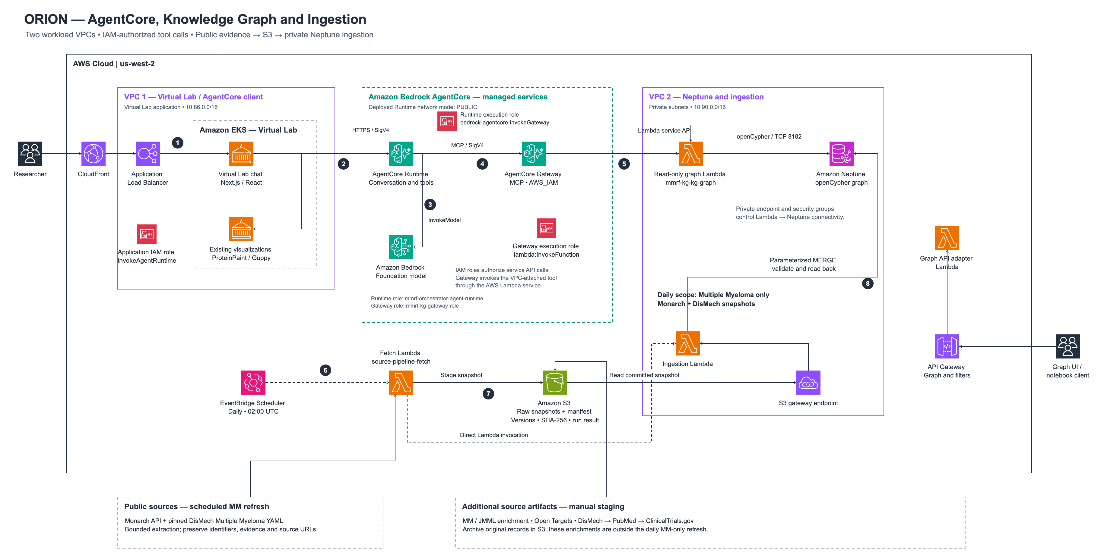
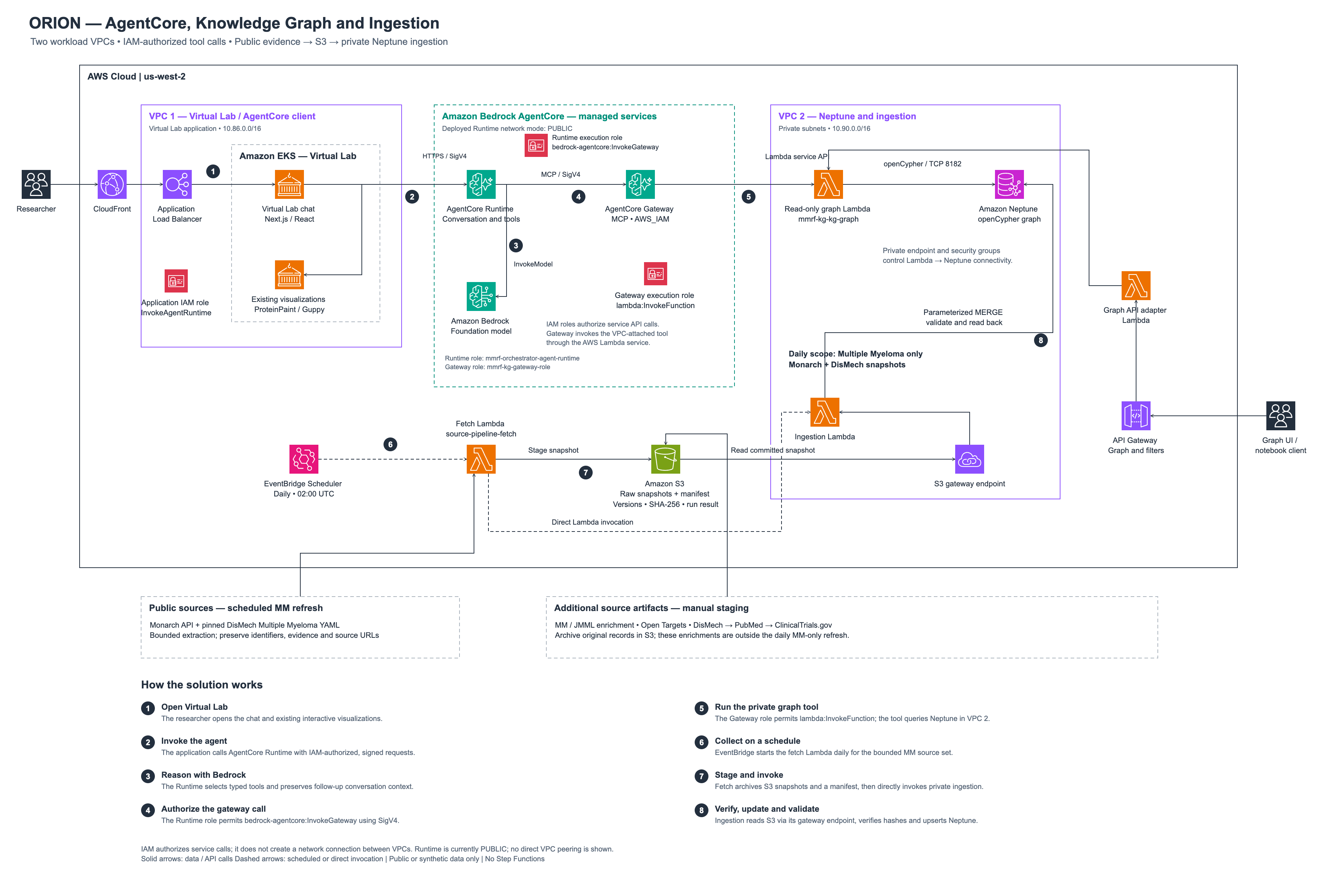
ARCHITECTURE
Architecture
ORION | AI Agents for Myeloma Research | Built on AWS
5
Notes:
[~1 min] And here's what's actually deployed today: a private, isolated network with no direct internet access; a graph database and two separate compute functions, one read-only and one read-write, both reached only through the agent gateway. A third, independent piece lets a human browse the same graph. Monitoring covers every part of the stack. [Narrate the live diagram once it's inserted.]
How the solution works (moved off-slide when the diagram was enlarged):
1. Open Virtual Lab — The researcher opens the chat and existing interactive visualizations.
2. Invoke the agent — The application calls AgentCore Runtime with IAM-authorized, signed requests.
3. Reason with Bedrock — The Runtime selects typed tools and preserves follow-up conversation context.
4. Authorize the gateway call — The Runtime role permits bedrock-agentcore:InvokeGateway using SigV4.
5. Run the private graph tool — The Gateway role permits lambda:InvokeFunction; the tool queries Neptune in VPC 2.
6. Collect on a schedule — EventBridge starts the fetch Lambda daily for the bounded MM source set.
7. Stage and invoke — Fetch archives S3 snapshots and a manifest, then directly invokes private ingestion.
8. Verify, update and validate — Ingestion reads S3 via gateway endpoint, verifies hashes and upserts Neptune.

Slide 6
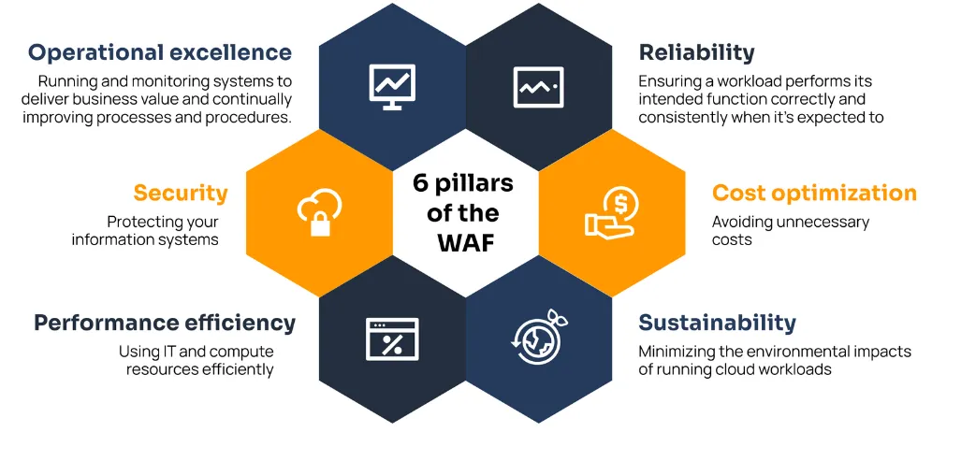
WELL-ARCHITECTED
6 Pillars, Built In
Operational Excellence
A daily pipeline snapshots source data to S3, checksummed, before writing to Neptune.
Security
No internet gateway into the VPC; Neptune storage is encrypted at rest.
Reliability
Lambda and query failures trigger CloudWatch alarms, routed to the team via SNS.
Performance Efficiency
Every graph query is capped at 100 rows and 5 hops before it runs.
Cost Optimization
Neptune Serverless scales 1-8 capacity units with demand, not a fixed size.
Sustainability
256MB Lambdas and a narrow Neptune capacity band — no idle headroom.
ORION | AI Agents for Myeloma Research | Built on AWS
6

Slide 7
APPENDIX
Additional Detail
Backup slides for Q&A.
Notes:
Backup slides only — use if a judge asks for more detail on a specific decision.

Slide 8
HOW IT'S BUILT
Technology & Design
Core technology
● Graph database for mechanism chains
● Serverless compute that scales to zero
● Agent gateway exposes tools safely
● Interactive visualizations render in chat
Built-in safety
● Read and write kept fully separate
● Only bounded, validated queries allowed
● Every claim traces back to a source
● Security checked before every deploy
ORION | AI Agents for Myeloma Research | Built on AWS
8
Notes:
[~1.5 min] Quick tour of the decisions. A graph database fits causal mechanism-chain traversal well. Compute scales to zero between calls, which fits bursty, agent-triggered traffic. The agent gateway gives us deterministic, named tools as the safe default. On safety: read access and write access are two fully separate paths with separate permissions, so a compromised read path physically cannot write; the one tool that takes a flexible query is still bounded and validated; and every claim an agent makes traces back to a cited source. Next slide goes deeper on cost and performance specifically, since that's where judges usually push.

Slide 9
WELL-ARCHITECTED
Cost & Performance
Cost efficiency
No idle network cost — The only path out of the private network is a free connection — a paid gateway was priced and rejected.
Database scales with demand — Compute automatically scales up and down with actual query load, not a fixed guess.
Compute scales to zero — No cost between calls — fits bursty, on-demand traffic far better than always-on servers.
Logs expire automatically — Storage is capped so monitoring cost doesn't grow unbounded over time.
Performance
Every query is bounded — Open-ended queries are capped on size and depth, so no single call can run away.
Read and write scale apart — The two paths scale independently, so heavy reads never slow down a write.
No custom scaling to maintain — The read path holds no local state, so built-in scaling is enough on its own.
Issues caught before launch — Every change is scanned for misconfiguration before it reaches production.
ORION | AI Agents for Myeloma Research | Built on AWS
9
Notes:
[~1.5 min] Two questions judges ask every team: why is this cost-efficient, and how is it optimized. On cost: there's no paid network gateway at all, the only egress is a free one, and that tradeoff was explicitly priced out and rejected. The database runs in a serverless mode, so compute scales 1 to 8 units with actual load instead of us guessing a fixed size. Compute scales to zero between calls, which matches bursty, agent-triggered traffic far better than an always-on service. On performance: the one open-ended query tool caps both result size and traversal depth; read and write paths scale independently so a batch load never slows down live agent reads; the read path is stateless so built-in scaling is sufficient; and every pull request is scanned for misconfiguration before it ships.

Slide 10
WHAT'S NEXT
Future Improvements
Roadmap
● Batch data loading for 10x+ scale
● Turn on stricter database-level authentication
● Add rate limits and per-tool access scoping
● Expose the full dataset through every tool
● Add a backup database instance for resilience
● Run the compliance plan only if patient data is ever introduced
ORION | AI Agents for Myeloma Research | Built on AWS
10
Notes:
[~1 min] Finally, where we'd take this next — and this isn't an improvised wish list, it's already written down and prioritized in our internal engineering review. Top of the list: batch the data loader, since that's the real scaling blocker, not database size. Then tighten database authentication, add gateway-level rate limiting and per-tool scoping, expose the full dataset through every tool, add a backup database instance for real high availability, and only execute our compliance readiness plan if a future data source ever introduces real patient identifiers.

Slide 11
ADDITIONAL DETAIL
Data Sources
Approach
Core dataset is a curated mechanism database with evidence citations — the only one with causal chains for our key research questions.
Gene-disease and variant evidence come from two free, public supplementary sources.
A small cross-reference source rounds out coverage.
Sources link together only through medical IDs, never by matching names.
Alternatives
Mechanism data alone — too thin on genes and drugs.
A general cross-reference graph as the primary source — too sparse for myeloma.
Two general biomedical graphs — no myeloma coverage, or licensing issues.
Status
1,738 entities and 2,894 relationships loaded from four sources.
Agent tools currently answer from a smaller subset of that graph — the rest is loaded but not yet wired in.
ORION | AI Agents for Myeloma Research | Built on AWS
11
Notes:
We picked our core dataset specifically because it's the only source with causal mechanism edges and cited evidence for the research questions we needed to answer. The supplementary sources are both free to use, but they don't carry mechanism paths, only associations and variant evidence. The honest gap to flag if asked: the agent tools only answer from part of the loaded graph today — the rest is loaded but not yet wired into tool responses.

Slide 12
ADDITIONAL DETAIL
Build Approach
Approach
Built the database and agent skeleton first, then core data, then the key research questions end to end, then supplementary sources.
Locked in one shared response format from day one, so no source-specific shape leaks to the interface.
Time-boxed the first milestones, with a fallback ready if the database took too long to provision.
Alternatives
Interface-first — can't demo the real research questions without the data.
Load everything first — pushes the riskiest unknown to the end.
A different database engine — no clear benefit over the preferred stack.
Status
Every milestone landed inside its time-box on the live database path.
The fallback plan sat unused — a safety net, not a plan B we had to run.
ORION | AI Agents for Myeloma Research | Built on AWS
12
Notes:
This decision is about managing build risk, not architecture: retire the biggest unknowns first, with named milestones, a time-box, and a scripted fallback in case the database provisioning stalled. In practice it worked within the time-box, so the fallback was a safety net we didn't have to use, not a plan B that shipped.

Slide 13
ADDITIONAL DETAIL
Integration Contract
Approach
Every tool returns one shared format: facts, interpretation, supporting evidence, known gaps, and a trace of what was called.
Two ways to query: safe named tools by default, plus one bounded, validated open-ended tool when needed.
Facts and interpretation stay visibly separate in every response.
Alternatives
A different shape per tool — fast to start, but gives the interface nothing stable to build on.
Open-ended queries only — hard to secure and hard to reproduce.
Named tools only — safe, but never tests the flexible path.
Status
Tool count has grown from 5 to 8 named tools since launch.
Proven against a real outside consumer: a separate team's agent renders our results with no coupling to the database underneath.
ORION | AI Agents for Myeloma Research | Built on AWS
13
Notes:
This is the single most defensible answer to 'what's original here' if asked: one typed response format let a graph-reasoning agent built by one team and a completely separate orchestrator agent, built by a different team, compose without either one knowing the other's backend exists. It wasn't just designed on paper — it was validated against a real, independently-built tool from the other team.

Slide 14
ADDITIONAL DETAIL
Network & Infrastructure
Approach
The knowledge graph runs in its own private network across two availability zones, with no direct path to the public internet.
The database sits in a private subnet reachable only by its own backend.
The only way out is a free, limited connection, used only to load new data in.
Shared team infrastructure stays untouched.
Alternatives
Reusing shared infrastructure via lookups — too brittle to rely on.
A public subnet for the database — a non-starter.
Editing shared infrastructure to fit this in — couples two teams' deployments.
A paid gateway for outbound access — priced out; the free option covers the one real need.
Status
Deployed in a different region than first planned, since corrected.
A planned extra compute function for supplementary sources was skipped; those sources load straight into the main database instead.
ORION | AI Agents for Myeloma Research | Built on AWS
14
Notes:
The headline design choice here is isolation: this system never touches shared team infrastructure, which is what let it deploy and tear down independently of the other team's work. Two corrections worth being upfront about if asked: the deployment region changed from what was originally planned, and a planned extra compute function was never built — those data sources load directly into the main database instead. Both are written down, not hidden.

Slide 15
ADDITIONAL DETAIL
Data Sensitivity & Compliance
Approach
No real patient data is in scope — every source is public, and any lab data is synthetic.
We recheck that boundary against every new data source we add.
A readiness plan is already agreed, so a production call later won't be made under deadline pressure.
Alternatives
Building full compliance controls now, with nothing to protect — more work than this scope needs.
Ignoring the question — risks starting a future production build on an unevaluated stack.
Status
Nothing in the plan is built yet, since no real patient data has entered scope.
Open item: whether the agent hosting platform meets healthcare-compliance requirements still needs checking.
ORION | AI Agents for Myeloma Research | Built on AWS
15
Notes:
This is a good sign of engineering maturity: rather than either ignoring compliance or over-building unused controls for a demo that never touches real patient data, the team wrote down the exact trigger condition and the exact plan that executes only if that line is crossed. Nothing in it is built today, and that's correct given no real patient data is in scope — the value is that the plan already exists and doesn't need to be invented later under deadline pressure.

