Slide 1
Nagios
Group 3:
Nguyễn Ngọc Trà My – 21520353
Lê Hoàng Oanh – 21521253
Bùi Hoàng Trúc Anh - 21521817

Slide 2
Table of contents
1
2
General information
Components
3
4
Operation
Demo
3
6
11
13

Slide 3
1
General information

Slide 4
General information
History and Development
Versatile Platform
Monitoring Capabilities
Notes:
Nagios, an influential open-source monitoring system, empowers organizations to preemptively identify and rectify IT infrastructure issues before they impact essential business operations. Since its inception, it has undergone significant development and refinement. Let's delve deeper into the key aspects of Nagios.
History and Development:
Originally released in 1999 as NetSaint, Nagios was developed by Ethan Galstad and subsequently refined by numerous contributors as an open-source project. Nagios Enterprises, a company based around the Nagios Core technology, offers multiple products, such as Nagios XI, Log Server, Network Analyzer and Fusion.
Versatile Platform:
Nagios is designed to run primarily on the Linux operating system but boasts compatibility with a variety of platforms, including Linux, Windows, and Unix-based operating systems. This flexibility makes it an ideal choice for organizations with diverse IT environments.
Monitoring Capabilities:
Nagios' monitoring capabilities extend across a broad spectrum of critical parameters, covering application, network, and server resources. It can vigilantly oversee memory usage, disk utilization, microprocessor load, the number of active processes, and log file statuses. Furthermore, Nagios excels in monitoring network services, including Simple Mail Transfer Protocol (SMTP), Post Office Protocol 3 (POP3), Hypertext Transfer Protocol (HTTP), and numerous other common network protocols.
Active and Passive Checks:
Nagios employs both active and passive checks to evaluate the health and performance of monitored elements. Active checks are initiated by Nagios itself, while passive checks are received from external applications integrated with the monitoring system. This dual approach ensures comprehensive monitoring and real-time feedback.
Advanced Features:
Nagios offers advanced features that set it apart. It supports the establishment of network host hierarchies, enabling a structured and efficient monitoring setup. Event handlers can be implemented to enable automated responses to detected issues, reducing the risk of service disruptions. Redundancy is a core feature, ensuring uninterrupted monitoring. Nagios also utilizes network topology analysis to determine dependencies, assisting in the swift identification of root causes when issues arise.
Scalability and User-Friendly Interfaces:
Nagios is known for its scalability, adaptability, and security. It proactively safeguards the stability, performance, and security of systems, networks, and services. Informative and visually appealing web interfaces enhance the user experience and streamline access to vital monitoring data.
In summary, Nagios stands as a versatile and powerful monitoring tool, offering organizations a proactive approach to maintain the reliability of their IT infrastructure. Its adaptability, scalability, and extensive feature set, coupled with an active open-source community, make it an invaluable asset for businesses seeking robust IT infrastructure monitoring solutions.

Slide 5
2
Components

Slide 6
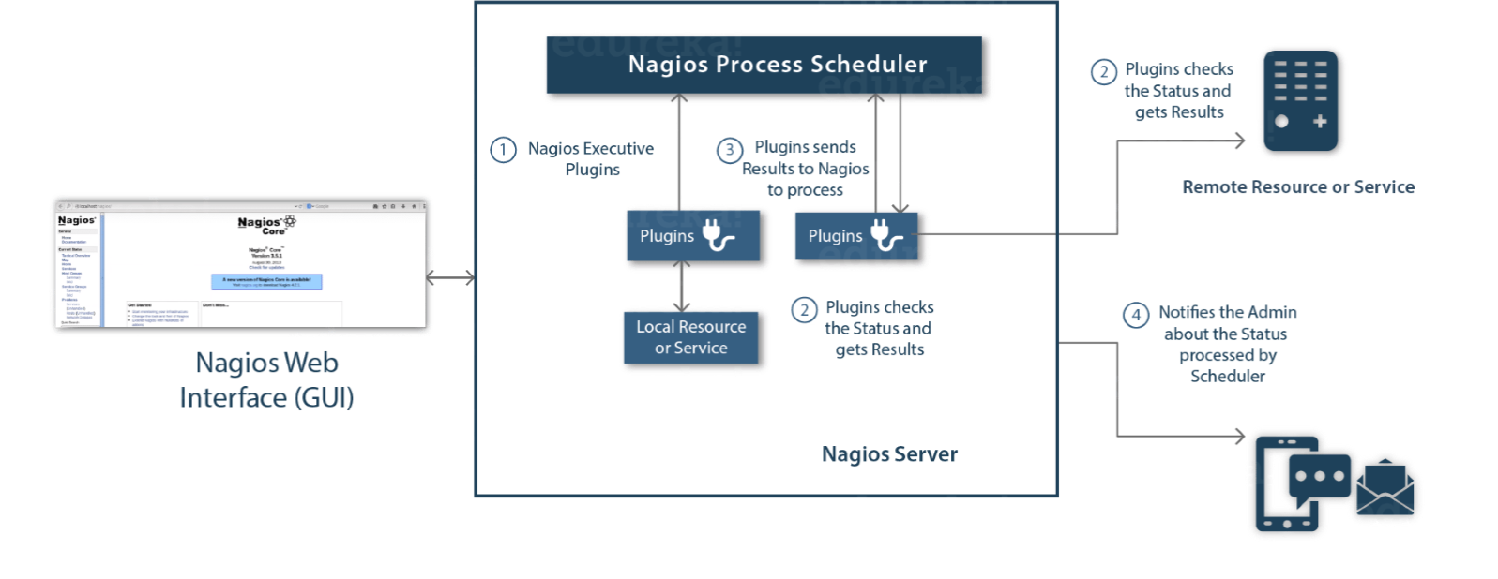
Components
Scheduler
1
Plugin
2
GUI
3
Notes:
The architecture of Nagios is built on the basis of server-client architecture. The server of Nagios usually run on a host and the plugins run on the remote server/ or remote host which are to be monitored. The plugins of Nagios collect the useful data and send them to the process scheduler, which displays the information over the graphical user interface . Following are the three main components in the architecture of Nagios application

Slide 7
Components
Scheduler
1
Plugin
2
GUI
3
Notes:
The scheduler in Nagios, also known as one of the critical components within Nagios Core, orchestrates /ˈɔːr.kə.streɪt/ the monitoring process. It serves as the server component, performs checks on plugins at specified time according to configuration settings. This component takes actions according to the results gathered from the plugins. These actions might involve alerting the staff or automatically triggering scripts to resolve issues.

Slide 8
Components
Scheduler
1
Plugin
2
GUI
3
Notes:
Nagios plugins provide low-level intelligence on how to monitor various aspects within the Nagios Core. These plugins operate as standalone /ˈstændəˌləʊn/ applications, designed specifically /spəˈsɪf.ɪ.kəl.i/ to be executed by Nagios Core. They gather crucial data, enabling the system to assess and understand the health and performance of monitored elements.

Slide 9
Components
Scheduler
1
Plugin
2
GUI
3
Notes:
Nagios offers a user-friendly web interface that visually shows monitoring information. It uses colors, graphs, and sounds to indicate the status of monitored items. If a soft alert repeats, it can turn into a hard alert, leading Nagios to notify administrators or relevant personnel.

Slide 10
3
Operation

Slide 11
Operation
Notes:
Scheduler sends signals to execute plugins on these remote hosts at the specified intervals. These plugins are tasked with gathering crucial status information from the target systems.
The Plugin, executed at the remote host, acts as the bridge between the Nagios server and the remote hosts. It runs the actual checks, collects data, and sends the acquired status information back to the Nagios server. This communication typically occurs over a network connection established between the remote host and the Nagios server.
Once the Plugin has collected the status information, it forwards this data to the Process Scheduler running on the Nagios server. The scheduler processes and updates the current state of the monitored resources, such as hosts or services, based on the received information.
As the process scheduler updates the internal state, it also ensures that the Nagios Graphical User Interface (GUI) reflects the latest monitoring status. Simultaneously, the process scheduler triggers notifications to be sent to designated administrators or support teams, informing them about the current state of the monitored resources. Notifications can be delivered through various channels, including email, SMS, or other communication methods, depending on the configured notification settings. By continually updating the GUI and sending notifications, Nagios enables administrators to promptly identify and respond to potential issues.

Slide 12
4
Demo

Slide 13
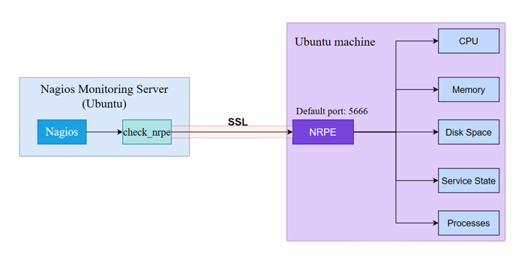
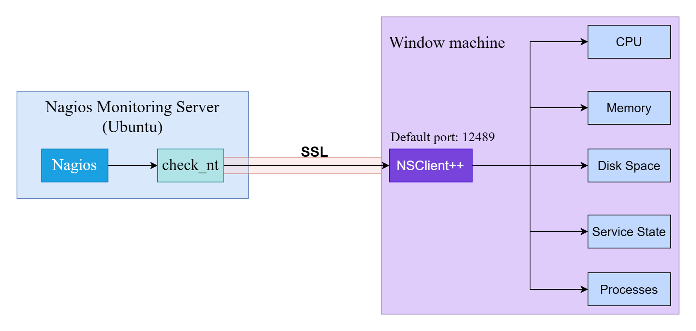
Topology
Windows Client
Linux Client

Slide 14
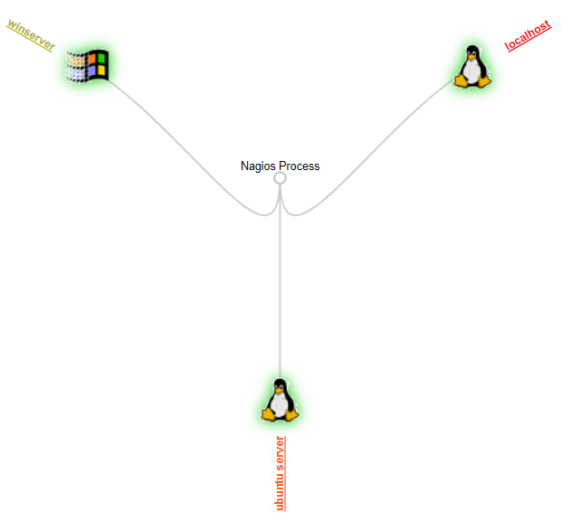
Topology
Name | Ip Address | Default Gateway | Installation
Nagios Monitoring Server (Ubuntu 16.04.7) | 192.168.12.137 | 192.168.12.1 | Nagios Core
Windows Client (Windows server 2019) | 192.168.1.2 | 192.168.1.1 | NSClient++
Linux Client (Ubuntu 16.04.7) | 192.168.12.135 | 192.168.12.1 | NRPE

