Slide 1



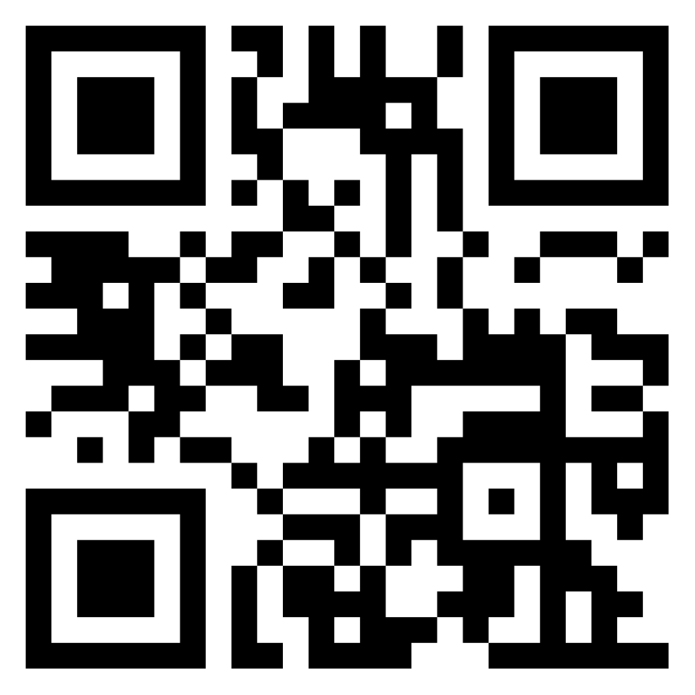
ReadySetGo!
readysetgo.herokuapp.com
Easily compete against other people and teams in fitness challenges you create
The Problem
Challenges Encountered
Limitations
Users participate in step challenges, but do not keep their data up-to-date
How to sync data from users with minimal overhead?
Data is synced every 24 hours
Only Jawbone device supported
Our Solution
Activity Data
A website that:
Supports a wearable device
Automatically calculates and compares points
Allows team captains to administrate teams
Future Development
Step Data
Facilitate more competition by supporting more types of data to compete with.
App will be used for inter- and intra-organizational competition
Requested Data
ReadySetGo!
User Database
Team API Connection Exception
Alice Chien, Jeremy Granger, Lisa Hobbs, Christopher Jordan, Domenic Murtari, Veric Nichols
Software Engineering Senior Project 2014 - 2015

