Slide 1
Welcome to CS50 Section!
Section 1 | Week 3 | Notes | 9/21/2014
Logistics
Norms/Support
Expectations
Notes:
Section is here, obviously, pre and post section surveys, problem sets 0 and 1
Norms/Support (what I’ll do: support you, answer questions, reach out to me, I’m here to help! What I expect you to do: use the resources available to you!)
Problem sets (Correctness, Scope, Style, Design, Comments!)

Slide 2
Useful Links/Resources
Section 1 | Week 3 | Notes | 9/21/2014
CS50.io debugger
Study50: https://study.cs50.net/
Reference50: https://reference.cs50.net/
CS50 discuss: http://newapps.cs50.net/cs50/@/portal
ALSO: Resources, section notes, shorts etc.

Slide 3
Agenda
Section 1 | Week 3 | Notes | 9/21/2014
1. Loops (for, while, do while)
2. Math in C (variables, typecasting, modulo, imprecision)
3. ASCII
4. Arrays (one-dimensional, multidimensional)
5. Functions (usage, command line arguments)

Slide 4

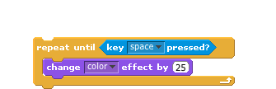
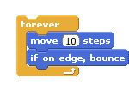
Loops
Section 1 | Week 3 | Notes | 9/21/2014

Slide 5

Loops-Example 1: simple repetition
Section 1 | Week 3 | Notes | 9/21/2014
for (int i = 0; i < 10; i++)
{
printf(”Hello\n");
}

Slide 6
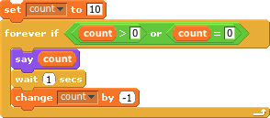
Loops-Example 2: counting down
Section 1 | Week 3 | Notes | 9/21/2014
int count = 10;
while (count >= 0)
{
printf("%i\n", count);
count--;
}

Slide 7
Loops-Example 3: prompt user until positive number entered
Section 1 | Week 3 | Notes | 9/21/2014
int input;
do
{
printf("Enter a positive number: ");
input = GetInt();
}
while (input < 1);

Slide 8
Numerical Variable Types
Section 1 | Week 3 | Notes | 9/21/2014
Math in C
Variable
int:
Float:
Double:
long long:
Size
4 bytes
4 bytes
8 bytes
8 bytes

Slide 9
problematic division
Section 1 | Week 3 | Notes | 9/21/2014
Math
// declare and initialize answer
float answer = 1 / 10;
// print answer to two decimal places
printf("%.2f\n", answer);

Slide 10
division (Fixes)
Section 1 | Week 3 | Notes | 9/21/2014
Math
1. Typecasting
// declare and initialize answer
float answer = (float) 1 / (float) 10;
2. Another Way
// declare and initialize answer
float answer = 1.0 / 10.0;

Slide 11
Floating Point Imprecision
Section 1 | Week 3 | Notes | 9/21/2014
Math
int main(void)
{
// initialize x and y
float answer = 1.0 / 10.0;
// print answer to two decimal places
printf("%.20f\n", answer);
}
Why????
Well, just like the decimal system can’t TRULY accurately represent numbers like 1/3 (1.33333 etc.), your computer works in binary, which can’t represent the number 1/10
Notes:
----- Meeting Notes (9/22/15 17:49) -----
make note about floating point values why

Slide 12
Math: Modulo
Section 1 | Week 3 | Notes | 9/21/2014
1. 55 % 10
2. 3 % 5
3. 8 % 8
4. 16 % 15
= 5
= 3
= 0
= 1

Slide 13
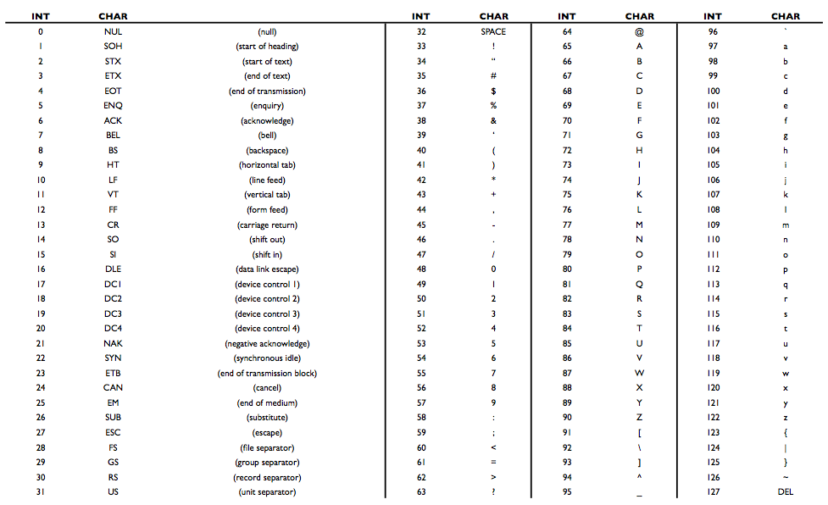
ASCII: mapping letters to values
Section 1 | Week 3 | Notes | 9/21/2014
Examples: ascii0.c, ascii1.c

Slide 14
Arrays – Examples
Section 1 | Week 3 | Notes | 9/21/2014
Section 1 | Week 3 | Notes | 9/21/2014
arrays0.c
arrays1.c
arrays2.c
arrays3.c
0
1
2
65
87
65

Slide 15
Arrays
Section 1 | Week 3 | Notes | 9/21/2014
<data type> name[<size>];
Example:
int temperature[3];
0
1
2
temperature[0] = 65;
65
87
30
temperature[1] = 87;
temperature[2] = 30;
OR
int temperature[] = { 65, 87, 30 };

Slide 16
Arrays – lots of ways to make them!
Section 1 | Week 3 | Notes | 9/21/2014
OK
int nums[3];
int nums[] = {63, 87, 30};
int nums[3] = {63, 87, 30};
string names_array[3] = { "Sam", "Jess", "Kim" };
string name = "Christopher”
NOT OK
int nums[3] = {63, 87, 30, 48};
int nums[];

Slide 17
Multi-Dimensional Arrays
Section 1 | Week 3 | Notes | 9/21/2014
Array of words
string words[] = [“my”, “name”, “is” , “leila”];
Array of letters
char letters[] = [“m”, “y”];
Multi-dimensional arrays
Words[0][0];

Slide 18
Multi-Dimensional Arrays Cont.
Section 1 | Week 3 | Notes | 9/21/2014
// print out all elements
for (int i = 0; i < 3; i++)
{
for (int j = 0; j < 3; j++)
printf("%c", board[i][j]);
printf("\n");
}

Slide 19
Functions
Section 1 | Week 3 | Notes | 9/21/2014
Inputs
Output
Why bother???
- Organization
- Simplification
- Reusability

Slide 20
Functions
Section 1 | Week 3 | Notes | 9/21/2014
int cube(int input)
{
int output = input * input * input;
return output;
}
function name
parameter list
return type

Slide 21
Function Examples
Section 1 | Week 3 | Notes | 9/21/2014
functions0.c
functions1.c
functions2.c
functions3.c

Slide 22
Command Line Arguments
Section 1 | Week 3 | Notes | 9/21/2014
int main(void)
int main(int argc, string argv[])

Slide 23
Command Line Practice
Section 1 | Week 3 | Notes | 9/21/2014
jharvard@appliance (~): ./copy infile outfile
1. What is argc?
2. What is argv[0]?
3. What is argv[1]?
4. What is argv[2]?
5. What is argv[3]?
6. What is argv[4]?

Slide 24
Command Line Examples
Section 1 | Week 3 | Notes | 9/21/2014
cmd0.c
cmd1.c

