Slide 1
Welcome to Section 2!
Section 2 | Week 4 | Notes | 9/28/2014
Logistics
  p-set feedback
  Section feedback

Slide 2
Section 2 | Week 4 | Notes | 9/28/2014
Agenda
Debugging
2. Asymptotic notation (O, Ω)
3. Binary search
4. Bubble, insertion, selection, merge sort
5. Using distribution code

Slide 3
Debugging
Section 2 | Week 4 | Notes | 9/28/2014
Printf statements
Cloud9 Debugger
  Running
  Break points
  Stepping through
  Tracking variables
  Debugger example: gdb0.c
Gdb
  Running: gdb <filename.c>

Slide 4
Asymptotic Notation
Section 2 | Week 4 | Notes | 9/28/2014
O : upper bound or worst case performance
  Suppress lower order terms and constants
  e.g. (n^2/2) + (n/2) → n^2
Ω : lower bound or best case performance
  Ω(1) : constant time (not necessarily only one operation)

Slide 5
Section 2 | Week 4 | Notes | 9/28/2014
Binary Search-
Does the array contain 7?
Lin
0
1
2
3
4
5
6
1
3
5
6
7
9
10
Notes:
We can apply the same logic to searching for a value in an array of sorted numbers.

Slide 6
Section 2 | Week 4 | Notes | 9/28/2014
Binary Search-
Start in the middle, is it there?
0
1
2
3
4
5
6
1
3
5
6
7
9
10
Is array[3] == 7?
Is array[3] < 7?
Is array[3] > 7?
Notes:
First, check the value stored at the middle index of the array.
We see that array[3] is 6, which is < 7. So, just as we tore off half the phone book, we can now disregard the entire left half of this array.

Slide 7
Section 2 | Week 4 | Notes | 9/28/2014
Binary Search-
Nope, cut the problem in half, is it in the new middle?
0
1
2
3
4
5
6
1
3
5
6
7
9
10
Is array[5] == 7?
Is array[5] < 7?
Is array[5] > 7?
Notes:
Next, check the value stored at the middle index of what's left of the array.
We can see that array[5] is 9, which is > 7. This time, we'll discard the right portion of what's left of the array.

Slide 8
Section 2 | Week 4 | Notes | 9/28/2014
Binary Search-
Nope, cut the problem in half, is it in the new middle?
0
1
2
3
4
5
6
1
3
5
6
7
9
10
Is array[4] == 7?
Is array[4] < 7?
Is array[4] > 7?
Notes:
array[4] == 7! We've found the value we were searching for!
This algorithm takes log n steps in the worst case. When there are only 7 array indices to check, n might not seem all that much bigger than log n. But if we have a 4 billion indices, the difference certainly matters. In that case, linear search would take 4 billion steps in the worst case, while binary search would only take 32.
Note however, that these arrays were presorted. We'll next cover sorting algorithms like bubble sort, merge sort, insertion sort, selection sort, and quick sort that can be employed if you're not lucky enough to start out with a sorted dataset!

Slide 9
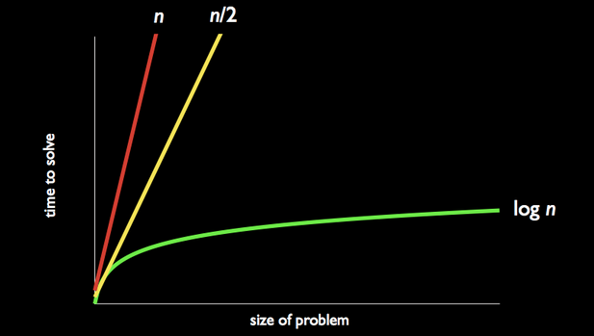
Binary Search
Section 2 | Week 4 | Notes | 9/28/2014
Worst case O(log n)
Best case Ω(1)
CAVEAT: the list needs to be sorted
Binary search example

Slide 10
Sorting
Section 2 | Week 4 | Notes | 9/28/2014
Bubble Sort Algorithm
1. Step through entire list, swapping adjacent values if not in order
2. Repeat from step 1 if any swaps have been made

Slide 11
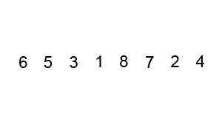
Bubble Sort Example
Section 2 | Week 4 | Notes | 9/28/2014
"Bubble-sort-example-300px" by Swfung8 - Own work. Licensed under CC BY-SA 3.0 via Commons - https://commons.wikimedia.org/wiki/File:Bubble-sort-example-300px.gif#/media/File:Bubble-sort-example-300px.gif

Slide 12
Bubble Sort Pseudo Code
Section 2 | Week 4 | Notes | 9/28/2014
initialize counter
do
{
set counter to 0
iterate through entire array
if array[n] > array[n+1]
swap them
increment counter
}
while (counter > 0)

Slide 13
Section 2 | Week 4 | Notes | 9/28/2014
Bubble Sort Performance
Bubble Sort
Insertion Sort
Selection Sort
Merge Sort
O
n²
Ω
n
Θ
  Bubble sort example: bubble-sort0.c
Notes:
Here's a comparison of the runtimes of bubble sort to the runtimes of other sorting algorithms covered in CS50.

Slide 14
Insertion Sort Algorithm
Section 2 | Week 4 | Notes | 9/28/2014
For each unsorted element in the list:
1. Determine where in sorted portion of the list to insert n
2. Shift sorted elements rightwards as necessary to make room for n
3. Insert n into sorted portion of the list

Slide 15

Section 2 | Week 4 | Notes | 9/28/2014
Insertion Sort Example
"Insertion-sort-example-300px" by Swfung8 - Own work. Licensed under CC BY-SA 3.0 via Commons - https://commons.wikimedia.org/wiki/File:Insertion-sort-example-300px.gif#/media/File:Insertion-sort-example-300px.gif

Slide 16
Section 2 | Week 4 | Notes | 9/28/2014
Insertion Sort Pseudo Code
for (i = 0 to n – 1)
element = array[i]
j = I
while (j > 0 and array[j - 1] > element)
array[j] = array[j - 1]
j = j – 1
array[j] = element

Slide 17
Section 2 | Week 4 | Notes | 9/28/2014
Insertion Sort Performance
Bubble Sort
Insertion Sort
Selection Sort
Merge Sort
n²
O
n²
Ω
n
n
  Insertion sort example: Insertion-sort0.c

Slide 18
Section 2 | Week 4 | Notes | 9/28/2014
Selection Sort Algorithm
1. Find the smallest unsorted value
2. Swap that value with the first unsorted value
3. Repeat from Step 1 if there are still unsorted items

Slide 19
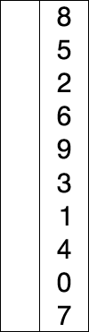
Section 2 | Week 4 | Notes | 9/28/2014
Selection Sort Example
"Selection-Sort-Animation" by Joestape89 at the English language Wikipedia. Licensed under CC BY-SA 3.0 via Commons - https://commons.wikimedia.org/wiki/File:Selection-Sort-Animation.gif#/media/File:Selection-Sort-Animation.gif

Slide 20
Section 2 | Week 4 | Notes | 9/28/2014
Selection Sort Pseudo Code
for (i = 0 to n – 2)
min = i
for (j = i + 1 to n – 1)
if array[j] < array[min]
min = j;
if min != i
swap array[min] and array[i]

Slide 21
Section 2 | Week 4 | Notes | 9/28/2014
Selection Sort Performance
Bubble Sort
Insertion Sort
Selection Sort
Merge Sort
O
n²
n²
n²
Ω
n
n
n²
  Selection sort example: selection-sort0.c

Slide 22
Section 2 | Week 4 | Notes | 9/28/2014
Merge Sort Algorithm
On input of n elements:
If n < 2
Return.
Else
Sort left half of elements.
Sort right half of elements.
Merge sorted halves.

Slide 23
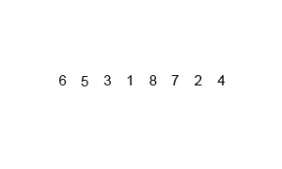
Section 2 | Week 4 | Notes | 9/28/2014
Merge Sort Example
"Merge-sort-example-300px" by Swfung8 - Own work. Licensed under CC BY-SA 3.0 via Commons - https://commons.wikimedia.org/wiki/File:Merge-sort-example-300px.gif#/media/File:Merge-sort-example-300px.gif

Slide 24
Section 2 | Week 4 | Notes | 9/28/2014
Merge Sort Pseudo Code
sort (int array[], int start, int end)
{
if (end > start)
{
int middle = (start + end) / 2;
sort(array, start, middle);
sort(array, middle + 1, end);
merge(array, start, middle, middle + 1, end);
}
}

Slide 25
Section 2 | Week 4 | Notes | 9/28/2014
Merge Sort Performance
Bubble Sort
Insertion Sort
Selection Sort
Merge Sort
O
n²
n²
n²
nlogn
Ω
n
n²
nlogn
n
  Merge sort example: merge-sort0.c

