Slide 1
DATa Science Capstone
Opening a new Cafe in Kassel

Slide 2
Business Problem
If I want to open one as an investor, where do I do it best where is the density not so high?
Where is the best place?

Slide 3
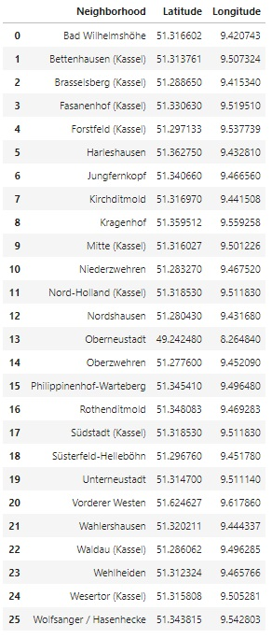
Neighborhood of Kassel
Extract the neighborhood with coordinates using geocoder

Slide 4
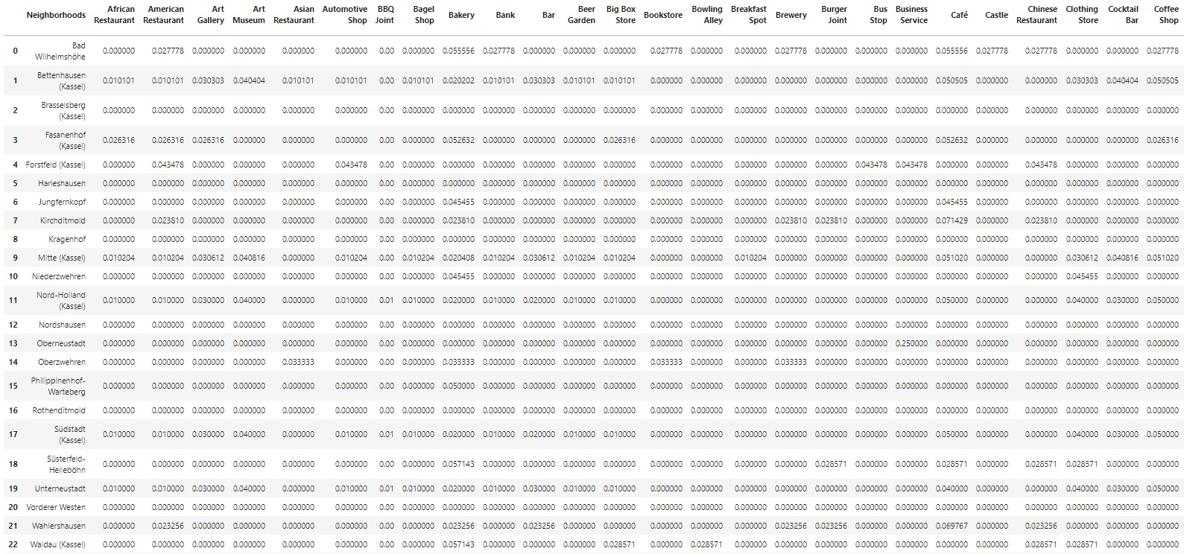
Venues in Kassel via Foursquare
Different Venues via Foursquare

Slide 5
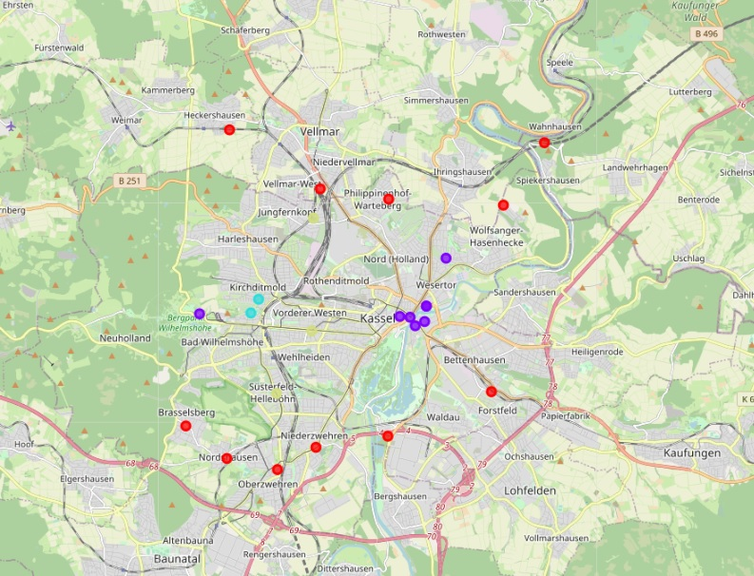
Clustering
moderate number of Cafes/Coffeeshop (mint green dot)
low number of Cafes/Coffeeshop (red dot)
high number of Cafes/Coffeeshop (purple green dot)

Slide 6
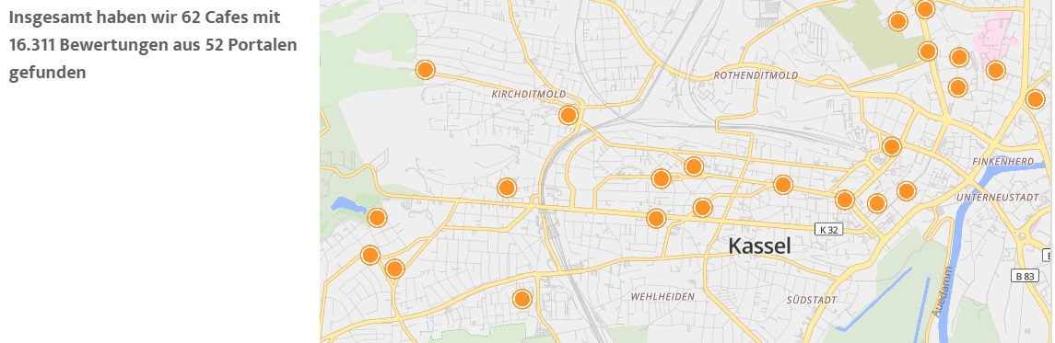
Conclusion
Results are not correct the Prpblem ist the POOR data Qualitiy from Foursquare for Kassel, Germany. Don‘t trust blind your data check you data qualitiy !!!

