Slide 2


WARNING!
Pay attention to your surroundings!
Ok

Slide 3

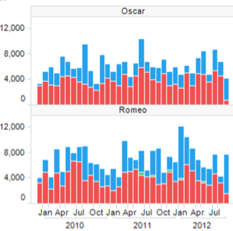
Robot Company XYZ
WELCOME CREW_1
Info: Robot_2
Route me!
AR Assist

Slide 4
Robot Company XYZ
WELCOME CREW_1
Current Job
Robot_2
1515 Home Rd NW, Calgary, AB T3B 0V8
Start Navigation
Robot_2 Info

Slide 5

Robot Company XYZ
Layers
Info
Notes:
https://store.storeimages.cdn-apple.com/4981/as-images.apple.com/is/image/AppleInc/aos/published/images/H/LJ/HLJ12/HLJ12?wid=572&hei=572&fmt=jpeg&qlt=95&op_usm=0.5,0.5&.v=1502920104292

Slide 6
Robot Company XYZ
Layers
Info
Layer 1..
Layer 2..
Layer 3..

Slide 7
Robot Company XYZ
Menu
Current Job
Map (Current Job)
AR (Current Job)

Slide 8
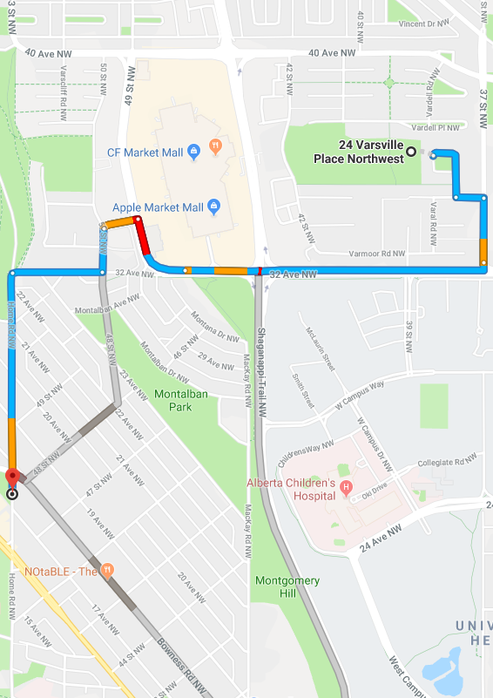
Robot Company XYZ
Info

