Slide 1

CANDY RECOMMENDATION
Notes:
Image: https://www.vecteezy.com/vector-art/155578-free-grainy-candy-vector

Slide 2


MANAGEMENT SUMMARY
PROBLEM
SOLUTION
Data explanation via descriptive statistics
REVIEW
The market research data are available, and a data-driven approach is required.
The task is to present a recommendation of new candy product, which is driven from the data as a statistical solution.
The Lidl purchasing group wants to expand our candy offering. The idea is to create a brand-new product.
Designed possible approaches and strategies
Applied multiple linear regression
Proposed a solution

Slide 3

PROCEDURE & ASSUMPTIONS
MULTIPLE LINEAR REGRESSION
is a statistical technique that uses several explanatory variables to predict the outcome of a response variable.
$$y_{i}=β_{0}+β_{1}x_{i1}+β_{2}x_{i2}+ …+β_{n}x_{in}+ε$$
The model performance is evaluated based on AIC and R² statistics. Also mean squared error is observed.
ASSUMPTIONS
It is more crucial to correctly describe the behaviour for the more popular candies than for the less liked.
Recommendation should consider trends published in the candy market research.
Lets assume the quality of each ingredient in the characteristics is equal. In other words, the difference in product’s prices does not come from different qualities of chocolate, nougat, etc.
Notes:
https://www.mordorintelligence.com/industry-reports/candy-market

Slide 4
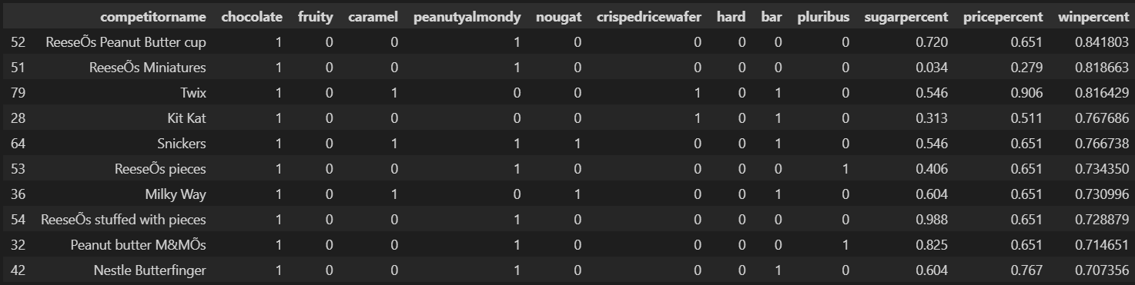
DATA HIGHLIGHTS
The DATA consist of 85 observations, which include attributes for each candy along with its ranking.
Data are available here. In the following table, TOP10 observations with their attributes are listed:
All of them have attribute chocolate, none of them have attribute fruity.
Average value of sugarpercent in TOP10 is 0.50, for pricepercent it is 0.60.

Slide 5
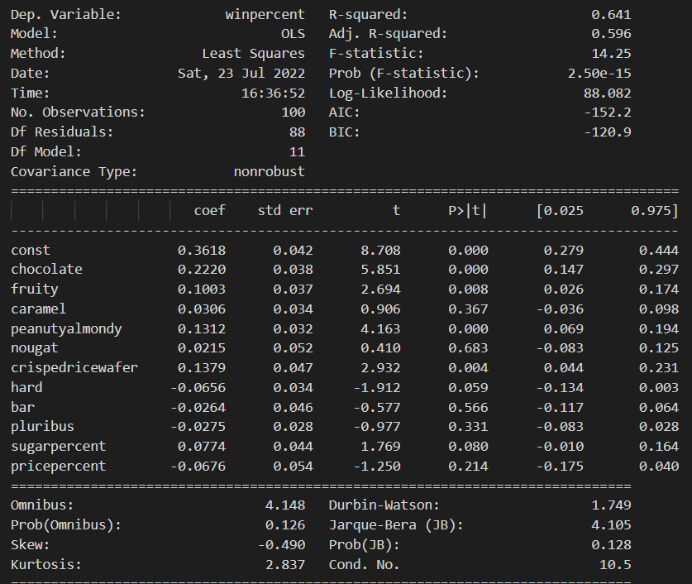
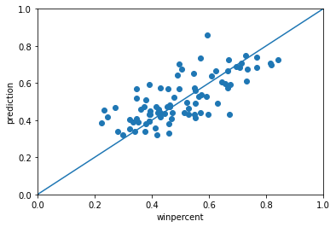
MODEL

Slide 6
MODEL

