Slide 1

CANDY RECOMMENDATION Anežka Lhotáková
Notes:
Image: https://www.vecteezy.com/vector-art/155578-free-grainy-candy-vector

Slide 2


MANAGEMENT SUMMARY
PROBLEM
SOLUTION
Data explanation via descriptive statistics
REVIEW
The data lack further context such as quality of the ingredients, the earnings of the product, the price ad sugar content were relativized etc.
The results (including comparison) are simplified due to already mentioned lack of context and imperfect translation between real and predicted value.
The market research data are available, and a data-driven approach is required.
The task is to present a recommendation of new candy product, which is driven from the data as a statistical solution.
The Lidl purchasing group wants to expand our candy offering. The idea is to create a brand-new product.
Designed possible approaches and strategies
Applied multiple linear regression
Proposed a solution

Slide 3

PROCEDURE & ASSUMPTIONS
MULTIPLE LINEAR REGRESSION
is a statistical technique that uses several explanatory variables to predict the outcome of a response variable.
$$y_{i}=β_{0}+β_{1}x_{i1}+β_{2}x_{i2}+ …+β_{n}x_{in}+ε$$
The model performance is evaluated based on AIC and R² statistics. Also mean squared error is observed.
ASSUMPTIONS
It is more crucial to correctly describe the behaviour for the more popular candies than for the less liked.
Recommendation should consider trends published in the candy market research.
rising demand for sugar-free candies
decline in gums and mint-candy
Let's assume the quality of each ingredient in the characteristics is equal. In other words, the difference in product’s prices does not come from different qualities of chocolate, nougat, etc.
Notes:
https://www.mordorintelligence.com/industry-reports/candy-market

Slide 4
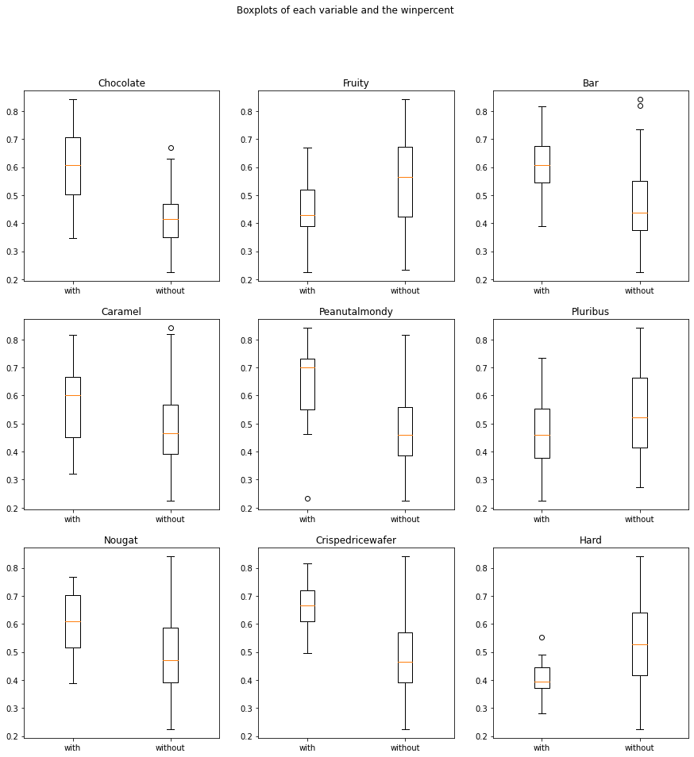
DATA HIGHLIGHTS
The DATA consist of 85 observations, which include attributes for each candy along with its ranking.
Data are available here.
variable | description
chocolate | Does it contain chocolate?
fruity | Is it fruit flavored?
Caramel | Is there caramel in the candy?
peanutalmondy | Does it contain peanuts, peanut butter or almonds?
nougat | Does it contain nougat?
crispedricewafer | Does it contain crisped rice, wafers, or a cookie component?
hard | Is it a hard candy?
bar | Is it a candy bar?
pluribus | Is it one of many candies in a bag or box?
sugarpercent | The percentile of sugar it falls under within the data set.
pricepercent | The unit price percentile compared to the rest of the set.
winpercent | The overall win percentage according to 269,000 matchups.
Fig 1.: Boxplot of each ingredient. Axis y represents target variable ‚winpercent‘.

Slide 5
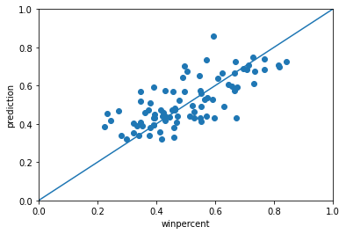
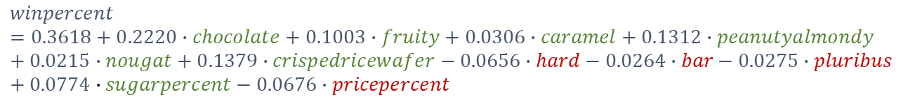
MODEL
While building a multiple linear regression model, the dataset was modified in order to put more weight to the best ranked candies. By doing so, we can bring more attention to the well-ranked observations and the linear fit will be well adjusted to the prediction of good candy, at the expense of the accuracy in the less liked candies.
FINAL MODEL
$$winpercent=0.3618+0.2220∙chocolate+0.1003∙fruity+0.0306∙caramel+0.1312∙peanutyalmondy+0.0215∙nougat+0.1379∙crispedricewafer−0.0656∙hard−0.0264∙bar−0.0275∙pluribus+0.0774∙sugarpercent−0.0676∙pricepercent$$
R² = 0.641
R²_{adj} = 0.596
MSE = 0.015

Slide 6
CANDY RECOMMENDATION
TOP3 | winpercent
Reese‘s Peanus Butter cup | 0.84
Reese‘s Miniatures | 0.81
Twix | 0.81
Pure data-driven candy recommendation
Choose the positive effect as 1 and negative effect as 0.
chocolate | fruity | caramel | peanutyal. | nougat | crispedrice. | hard | bar | pluribus | sugarpercent | pricepercent | winpercent
1 | 1 | 1 | 1 | 1 | 1 | 0 | 0 | 0 | 1 | 0 | 1.00
Low-sugar candy recommendation
Choose the positive effect as 1 and negative effect as 0. Let's set the sugarpercent as the value of 25th percentile in the original data and pricepercent as the mean value.
chocolate | fruity | caramel | peanutyal. | nougat | crispedrice. | hard | bar | pluribus | sugarpercent | pricepercent | winpercent
1 | 1 | 1 | 1 | 1 | 1 | 0 | 0 | 0 | 0.22 | 0.46 | 0.91
Affordable candy recommendation
Choose the positive effect as 1 and negative effect as 0. Let's set the pricepercent as the value of 25th percentile in the original data and sugarpercent as the mean value.
chocolate | fruity | caramel | peanutyal. | nougat | crispedrice. | hard | bar | pluribus | sugarpercent | pricepercent | winpercent
1 | 1 | 1 | 1 | 1 | 1 | 0 | 0 | 0 | 0.46 | 0.25 | 0.94

Slide 7
THANK YOU FOR YOUR ATTENTION

Slide 9
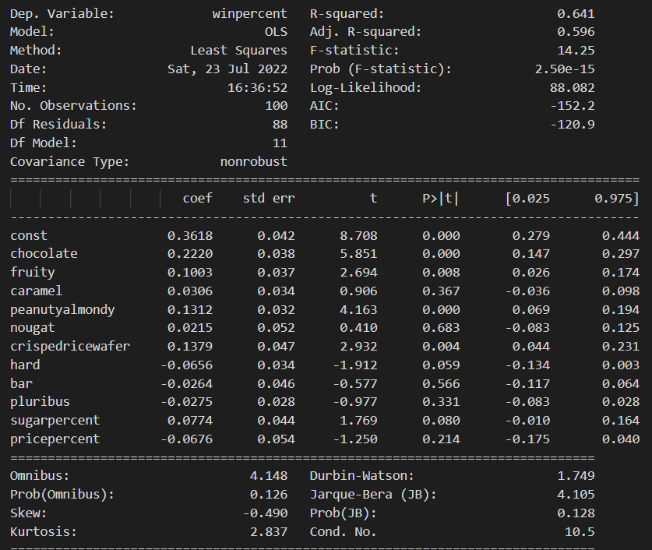
MODEL

