Slide 1
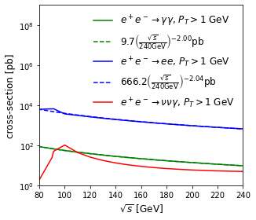
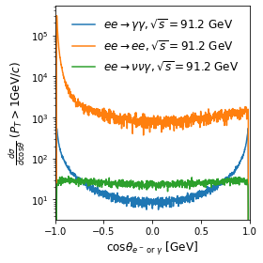
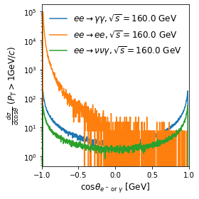
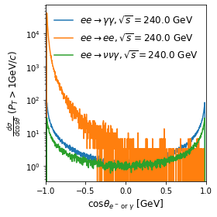

For energy above 91.2GeV and particular region of $cosθ$, $ee→γγ$ has largest x-section.
$ee→γγ$ has advantage over $ee→ννγ$ except for energy near 91.2GeV. (However, I think the x-section will drop down for $ee→ννγ$ if there is an energy cut for $γ$.)

