Slide 1







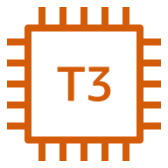





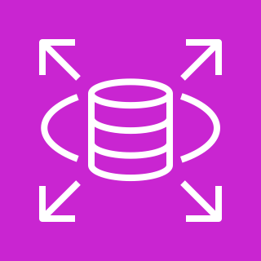



AWS Cloud
VPC (dev-vpc)
Internet gateway
ap-northeast-2
Public subnet
Visit Web site & Request Analysis
Upload Data
Response Analysis result
User
Rendering Analysis result
Amazon EC2
Amazon ECS
Validation
Insert
Analysis result
AWS Lambda
Preprocessing
Task
Modeling Task
Amazon RDS
Amazon S3
Object
AWS Fargate
Amazon ECR
Amazon CloudWatch

