Slide 1
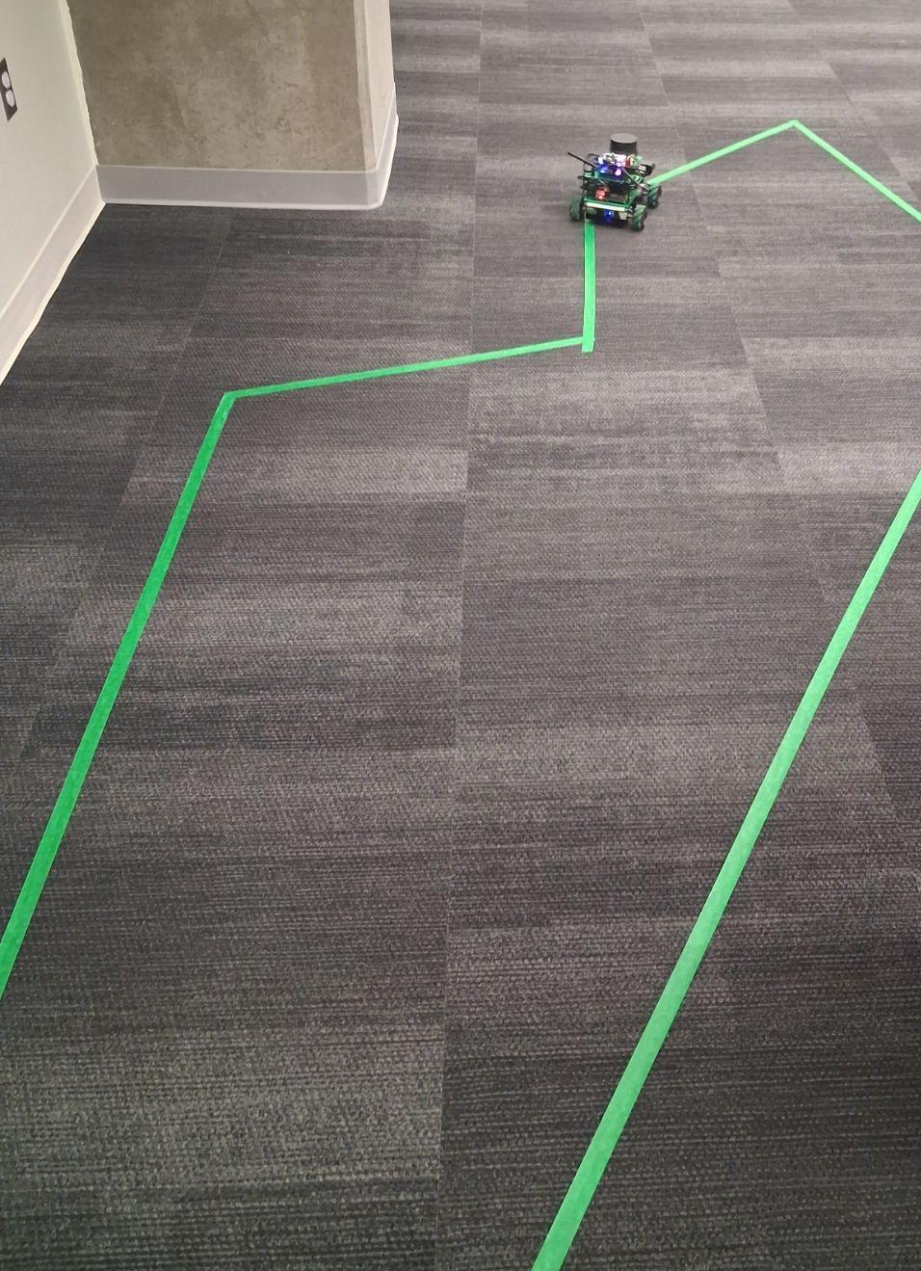
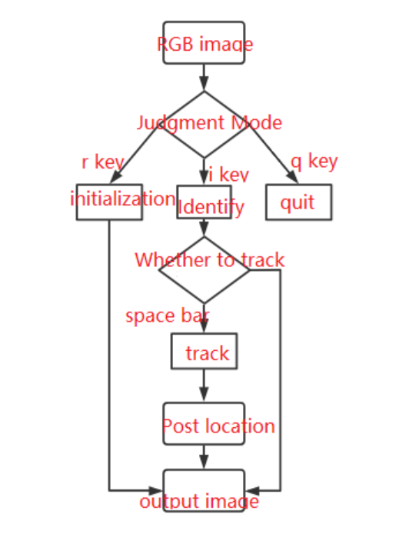
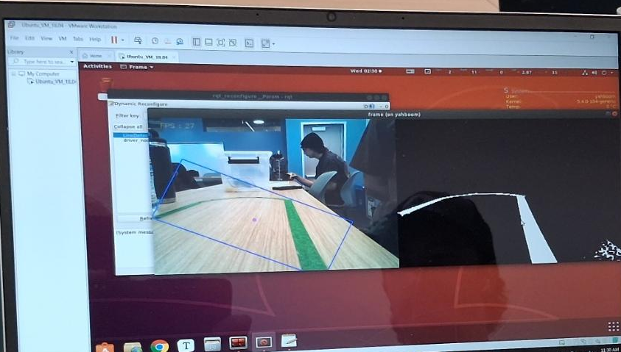

Path Following and Sign Recognition in Autonomous Vehicles
Dominic Torbati, Benjamin Martin, Ha Long Truong, Linda Onyango, Nitish Reddy Dyapa, Vignesh Anandama
Our Objective:
This project aims to develop an autonomous navigation system for the ROSMASTER X3 that combines path planning and street sign recognition. The robot will use onboard sensors and a camera to navigate through a road-like environment while detecting signs such as stop, turn, and speed limit indicators.
Our Approach:
We use Computer Vision and the Depth Camera on the Rosmaster to track and follow a certain color it is coded to recognize. The Rosmaster is also trained to recognize and react according to which ever sign is given, such as a Stop Sign
Our Accomplishments:
Depth Camera can recognize colors and signs for tracking/stopping
Rosmaster can follow and repeat a path mapped on the ground
Rosmaster reacts and moves accordingly to signs that is shown to them
What the Depth Camera sees through Computer Vision
Rosmaster Following the Path Made with Tape
Flowchart of Decision Making for Sign Recognition
Our Challenges:
Limited Autonimous Vehicle Experience
Outdated Software in Rosmaster X3
Path angles are too sharp for Rosmaster to recognize
Training to Rosmaster to recognize the signs
Future Optimization:
The Introduction of SLAM to remember environments, instead of following pats:
Object recognition and avoidance, which allows for unpredictable obstacles to be avoided.

