Slide 1
Q2 Business Review
Performance metrics, trends, and outlook — June 2026
Key Highlights
CONFIDENTIAL
Executive Summary

Slide 2
Performance KPIs
Q2 2026
REVENUE
ACTIVE USERS
CHURN RATE
$1.28M
24,370
3.2%
▲ +18%
▲ +7%
▼ +0.4pp
98.7%
4.2s
$42
System Uptime
Avg Response Time
CAC
30-day rolling average
p95 latency
Customer acquisition cost

Slide 3
Product Revenue Breakdown
Product
Q1 Revenue
Q2 Revenue
Growth
Status
Alpha Suite
$420K
$510K
+21%
On track
Beta Platform
$280K
$295K
+5%
At risk
Gamma API
$190K
$240K
+26%
On track
Delta Service
$95K
$88K
-7%
Behind
Epsilon SDK
$60K
$75K
+25%
On track

Slide 4
Revenue Trend Analysis

Slide 5
Roadmap & Status
Backlog
Priorities
Checklist
Redesign onboarding flow
1.
Define OKRs for H2
✓
Deploy rate limiting
Launch mobile app v2
2.
Security audit complete
○
Fix dashboard load time
Integrate SSO providers
3.
Migrate to GCP Cloud Run
✓
Update privacy policy
Expand API docs
4.
Enable A/B testing framework
○
Archive legacy endpoints
○
Notify affected users

Slide 6
Notices & Insights
INFO Database migration scheduled for July 4 — expect 2 min downtime.
⚠ WARNING Churn has increased 0.4pp — review retention playbook this sprint.
✓ SUCCESS Uptime target of 99.5% achieved for third consecutive month.
✕ ERROR Payment gateway timeout rate exceeded SLA threshold on June 12.
“The goal is not to build more features — it's to make existing ones indispensable.”
— Product Review, May 2026

Slide 7
Sprint Progress
Week 24
Authentication service migration
85%
API v3 rollout
62%
Data warehouse rebuild
40%
Mobile parity features
91%
Legacy cleanup
20%
Operational
Degraded
Outage
Healthy

Slide 8
Executive Dashboard
Composite layout — all components composed
MRR
NPS
CAC
LTV
$128K
72
$42
$890
▲ +12%
▲ +4pts
▲ -8%
▲ +6%

Slide 9
React Pattern Adaptations
Tabs + Steps
TabsPanel (inspired by Radix/shadcn Tabs)
Overview
Analytics
Risks
Decisions
Q2 analytics summary: Revenue is up 18% YoY, activation improved by 6%, and churn remains above target in two enterprise segments.
StepFlow (inspired by Ant Design Steps)
✓
✓
3
4
5
Discovery
Prototype
Validation
Launch
Scale

Slide 10
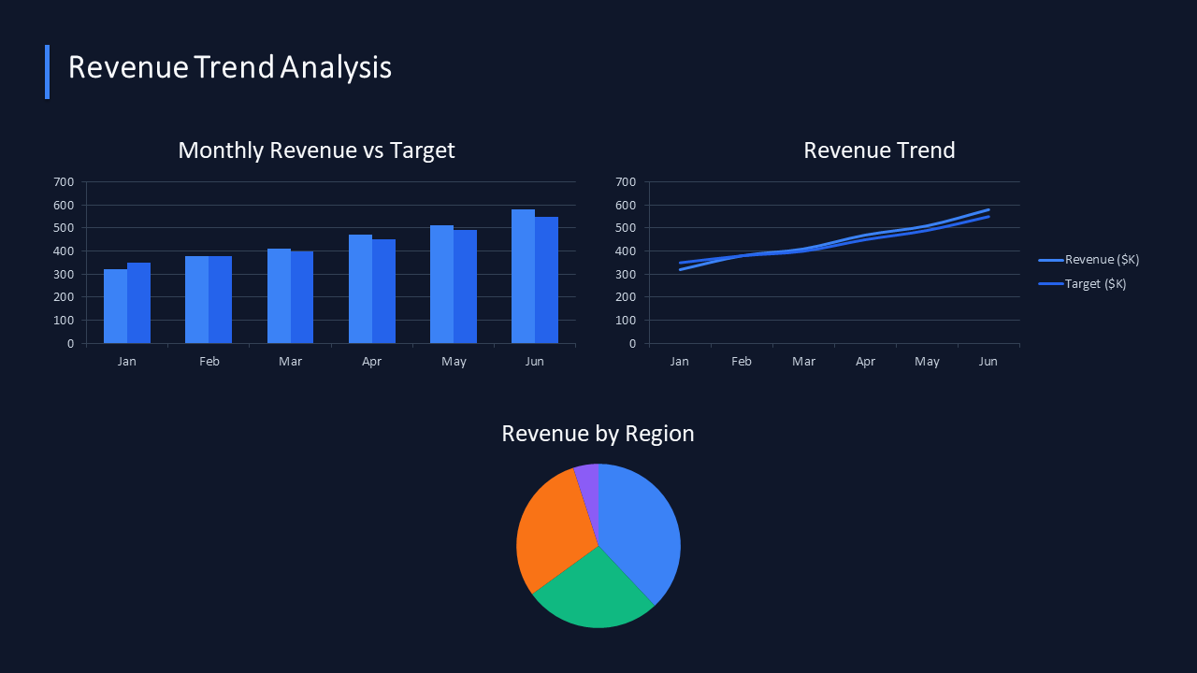
Phase 1 Additions
Image + Legend + KPIGrid
Region Color Legend
APAC
EMEA
Americas
Other
NEW LEADS
CONVERSION
PIPELINE VALUE
1,284
14.2%
$3.4M
▲ +9%
▲ +1.1pp
▲ +6%
WIN RATE
SALES CYCLE
UPSELL MRR
31%
27 days
$48K
▼ -2pp
▲ -3 days
▲ +12%

Slide 11
Phase 1 Additions
SparklineCard
NET REVENUE
PIPELINE
WIN RATE
$1.28M
$3.4M
31%
+18%
+12%
+2pp
TICKET BACKLOG
ACTIVATION
CLOUD SPEND
42
68%
$184K
-21
+7pp
-3%
SparklineCard combines a primary KPI, change signal, and compact trend view in one surface. Use it when a standard metric card is too static for dashboard storytelling.

Slide 12
Phase 2 Additions
Timeline + Comparison
Program Roadmap (MUI Timeline inspired)
Q1
Q3
Q1 '27
Discovery
Enterprise Rollout
Scale + Expansion
Q2
Q4
Pilot Launch
Automation Phase
Decision Matrix (shadcn composable style)
Build In-House
Buy Platform
•
Full control over roadmap
•
Fastest path to launch
•
Can optimize for existing stack
•
Vendor support included
•
Higher upfront engineering cost
•
Recurring license cost
•
Longer time-to-market
•
Less flexibility on edge cases

Slide 13
Phase 3 Additions
Heatmap + Range
Feature Adoption Score by Platform & Quarter (%)
Q1
Q2
Q3
Q4
Mobile
87
91
78
95
Web
72
68
81
74
API
95
97
93
99
Reports
61
55
70
63
API Latency (ms)
210
Error Rate (%)
2.1
Uptime (%)
98.5
OK
Warn
Critical
OK
Warn
Critical
Below SLA
Degraded
Healthy

Slide 14
Phase 3 Additions
Code + Annotations
Python
Use SlideBuilder to compose slides with rows, columns, and grids.
1
import pptx_components as pc
2
3
builder = pc.SlideBuilder(prs)
4
builder.add(pc.SectionHeader("My Slide", badge_text="v1.0"))
5
builder.skip(0.2)
6
builder.add_row(
add_row() automatically distributes width equally.
7
pc.MetricCard("Revenue", "$1.2M", "+12%", True),
8
pc.MetricCard("Churn", "3.1%", "+0.2pp", False),
9
h=1.5,
10
)
11
builder.add(
12
pc.BarChart(months, data, title="Monthly Trend"),
set h= to control the rendered height of each component.
13
h=2.8,
14
)
Mismatched weights cause rendering issues — validate inputs.

Slide 15
Revenue Bridge — H1 2026
WaterfallChart
Revenue Contribution by Category ($K)
-35
+120
+40
-60
650
+85
+500
Base
New Logos
Upsell
Expansion
Churn
Discounts
Net Revenue

Slide 16
Additional React Patterns
Accordion + Features
Accordion (FAQ Pattern / MUI inspired)
How do we scale headcount?
−
Hiring plan targets 40% growth in engineering and product through Q4 2026. Focus on mid/senior IC roles and two new manager positions.
What's our go-to-market strategy?
+
How do we reduce churn?
+
FeatureGrid (Product Showcase Pattern)
⚡
🔒
📊
Real-time Sync
Enterprise Security
Rich Analytics
🌍
🤝
💬
Global Scale
API-First
24/7 Support

Slide 17
Phase 4: Advanced Charts
ScatterPlot
Algorithm Performance Landscape
Accuracy (%)
Best (Simple & Accurate)
High Effort
Best performer
High complexity
Avoid
Feasible
Low cost
Mid-range
Simple
Implementation Complexity

Slide 18
Phase 4: Hierarchical Data
GroupedTable
Revenue by Region & Country
Region
2025 Revenue
2026 Revenue
YoY Growth
NORTH AMERICA
$580M
$715M
+23%
USA
$500M
$620M
+24%
Canada
$80M
$95M
+19%
SubtotalNA
$580M
$715M
+23%
EMEA
$350M
$425M
+21%
UK
$200M
$245M
+22%
France
$150M
$180M
+20%
SubtotalEMEA
$350M
$425M
+21%
APAC
$220M
$285M
+30%
India
$120M
$165M
+38%
Australia
$100M
$120M
+20%
SubtotalAPAC
$220M
$285M
+30%

Slide 19
Phase 4: Chart Extensions
Donut + Radar
72% Enterprise
These chart variants round out the standard chart set: DonutChart emphasizes a headline metric in the center, while RadarChart compares capability balance across multiple axes.

Slide 20
Phase 4: Planning Views
Funnel + Gantt
Demand Funnel
Cross-Functional Delivery Plan
Visitors 12,840
Kickoff
Wk 3
Wk 6
Wk 9
Launch
Platform
Observability
Data Contracts
Failover
Product
Admin UX
Usage Alerts
Self-Serve
Qualified 4,820
GTM
Messaging
Pricing Test
Partner Pack
Ops
SLA Review
Headcount Plan
Vendor Audit
Pipeline 1,615
Closed Won 412

Slide 21
Phase 5: Long-form Storytelling
Narrative
Executive Narrative - Structured View
Page 1/1
Narrative in one slide with decision support rail.
Q2 performance stabilized after concentration risk mitigation and onboarding process redesign. Margin expansion creates room for selective reinvestment, but service quality and migration complexity still require focused execution through Q3.
Decision Lens
- Protect margin gains - Reduce support load - Prioritize retention levers - Tighten ownership by workflow
Next review: validate churn trend by segment.

Slide 22
Executive Narrative - Auto Paginated
Page 1/3
Long text automatically split into multiple slides.
Q2 opened with concentrated enterprise exposure: two strategic accounts represented 28% of net new ARR and introduced procurement timing risk. The commercial team reduced dependency by improving mid-market coverage, tightening qualification standards, and rebalancing outbound sequences toward faster-velocity segments. (continued on next slide)
Steering Notes
- Watch enterprise concentration - Keep onboarding gains sticky - Fund observability upgrades - Track p95 latency weekly
Auto-generated narrative section

Slide 23
Executive Narrative - Auto Paginated
Page 2/3
Long text automatically split into multiple slides.
Execution improved in the operating model. Onboarding cycle time dropped 19% after workflow simplification and proactive implementation playbooks. At the same time, migration volume increased support load, highlighting where product instrumentation and self-service diagnostics were still too shallow. (continued on next slide)
Steering Notes
- Watch enterprise concentration - Keep onboarding gains sticky - Fund observability upgrades - Track p95 latency weekly
Auto-generated narrative section

Slide 24
Executive Narrative - Auto Paginated
Page 3/3
Long text automatically split into multiple slides.
Financially, gross margin improved by 2.3 points due to infrastructure right-sizing and contract renegotiation in third-party services. This gain is expected to partially normalize in Q3 while regional failover hardening and observability upgrades are in flight. The second-half plan focuses on durable retention drivers, expansion motion enablement, and service-quality stabilization. Decision velocity and cross-functional accountability are now the central execution constraints, not strategy clarity.
Steering Notes
- Watch enterprise concentration - Keep onboarding gains sticky - Fund observability upgrades - Track p95 latency weekly
Auto-generated narrative section

Slide 25
Theme Cascade QA
Section Overrides
Local theme patch: editorial warm palette.
Local theme patch: corporate blue palette.
Warm Section
Cool Section
RETENTION
UPTIME
94%
99.97%
▲ +2pp
▲ +0.04pp
Both cards inherit the slide theme, then apply container-scoped token patches. Use this slide to check contrast, spacing, and callout consistency across local overrides.

