Slide 1
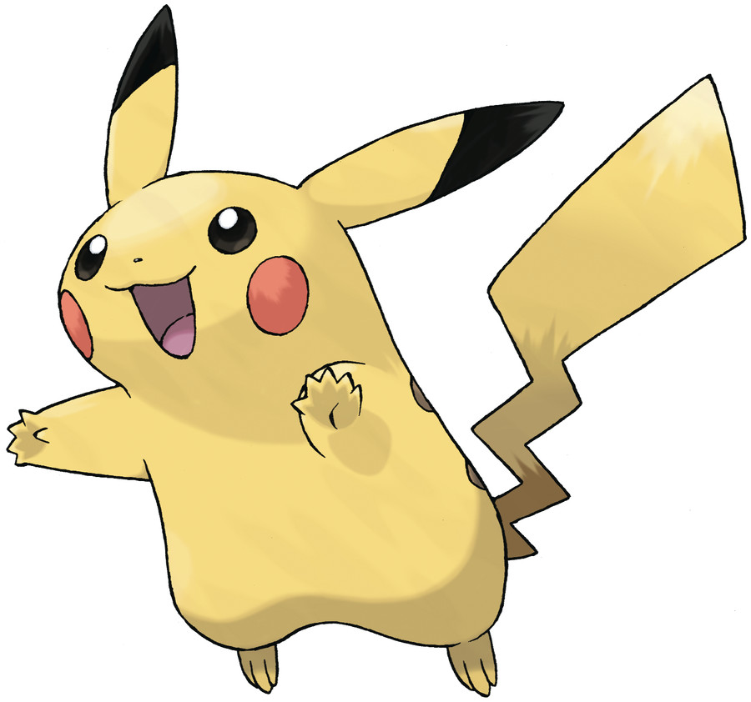
Pikachu — Species Profile
Source: Wikipedia · pokemondb.net · pokumon.com
April 2026

Slide 2
Who is Pikachu?
First introduced in Pokémon Red & Blue (1996); created by Atsuko Nishida.
Name combines "pika" (sparkle) and "chū" (mouse squeak) in Japanese.
Evolved from Pichu (high Friendship) → Pikachu → Raichu (Thunder Stone).
Voiced by Ikue Ōtani in virtually every appearance since 1997.

Slide 3
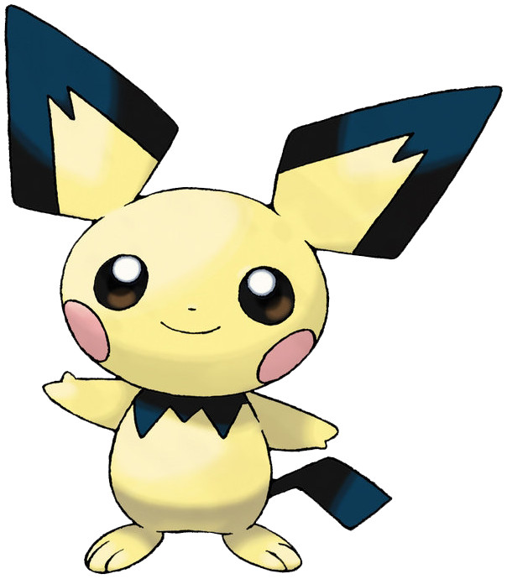
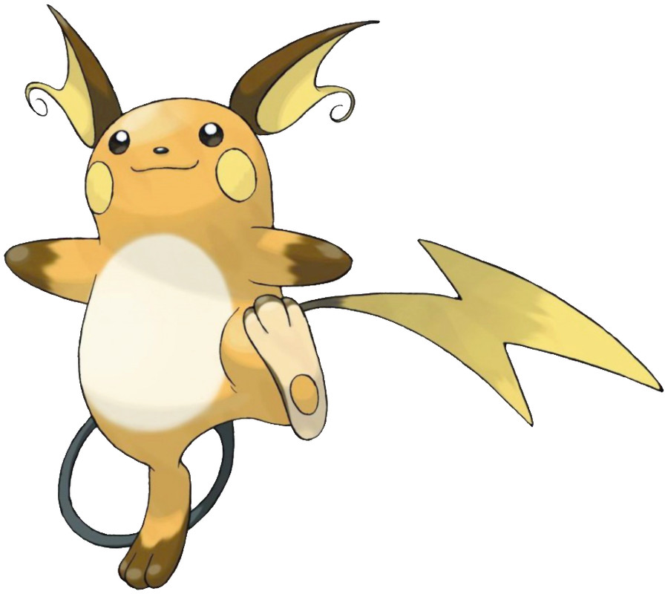
Evolution Chain
Pichu
Pikachu
Raichu
Baby Electric-type · Evolves via high Friendship
Mouse Pokémon #025 · 0.4 m · 6.0 kg · Electric
Mouse Pokémon #026 · Evolves with Thunder Stone

Slide 4
Base Stats (pokemondb.net)

Slide 5
At a Glance
POKÉDEX NO.
BASE STATS
#025
320
▲ Gen I
▲ total
SPEED TIER
CATCH RATE
90
190
▲ base
▲ / 255

Slide 6
Pokémon Franchise Revenue Growth

Slide 7
Notable Facts (Wikipedia)
First introduced in Pokémon Red & Blue (1996); created by Atsuko Nishida.
Name combines "pika" (sparkle) and "chū" (mouse squeak) in Japanese.
Evolved from Pichu (high Friendship) → Pikachu → Raichu (Thunder Stone).
Voiced by Ikue Ōtani in virtually every appearance since 1997.
Ranked 2nd "Person of the Year" by TIME magazine in 1999.
Appeared in all 5 Super Smash Bros. games as a playable fighter.
"Surprised Pikachu" became one of the internet's most widely used memes.
Gigantamax form (Sword & Shield) revisits the original "Fat Pikachu" design.

Slide 8
Pikachu Through the Years (pokumon.com)
Feb 1996
Sep 1998
Nov 1998
Jul 2016
Nov 2019
Pokémon Red & Green launch in Japan
Pokémon Red & Blue launch in North America
Pokémon Yellow — Pikachu walks with you
Pokémon GO global launch
Pokémon Sword & Shield — Gigantamax form
Apr 1997
Jul 1998
Nov 1999
May 2019
Apr 2026
Anime series premieres; Pikachu stars
First Pokémon movie (Mewtwo Strikes Back)
Generation II (Gold & Silver) launches
Detective Pikachu live-action film
Still the world's most recognised Pokémon

