Slide 1

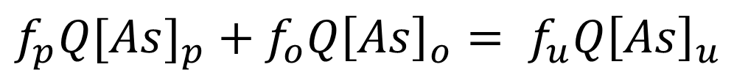
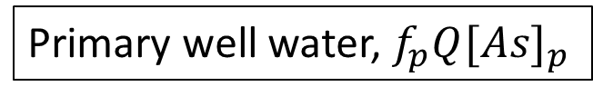
$${As}_{in}= {As}_{out}$$
$$f_{p}Q{[As]}_{p} + f_{o}Q{\left[As\right]}_{o}= f_{u}Q{\left[As\right]}_{u}$$
Primary well water, $f_{p}Q{[As]}_{p}$
Other well water, $f_{o}Q{\left[As\right]}_{o}$
Urination, $f_{u}Q{\left[As\right]}_{u}$
Notes:
We can similarly construct an arsenic mass balance on an individual, where the arsenic entering the body equals the arsenic leaving the body. In this simplified version of the mass balance, arsenic enters the body through an individual’s primary well water, through water from other wells throughout the study area, and leaves the body through urination. Evaporative processes aren’t really a pathway by which arsenic leaves the body.
These arsenic fluxes can be calculated by multiplying the flux of water entering or leaving the body by the concentration of arsenic in that water. So, for example, the flux of arsenic entering the body is the flux of water entering the body, fpQ, from our water balance equation, multiplied by the arsenic concentration in that water. And analogously for the other fluxes.
So, now we have a mass balance on arsenic for an individual.

Slide 2
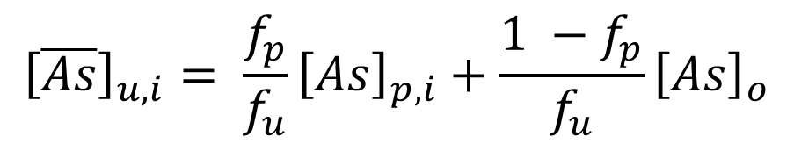
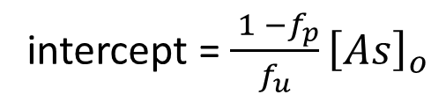
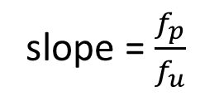
$${\left[\overline{As}\right]}_{u,i}= \frac{f_{p}}{f_{u}}{\left[As\right]}_{p,i}+\frac{1 −f_{p}}{f_{u}}{\left[As\right]}_{o}$$
Urinary Arsenic (µg/L)
slope = $\frac{f_{p}}{f_{u}}$
intercept = $\frac{ 1 −f_{p}}{f_{u}}{\left[As\right]}_{o}$
Primary Well Arsenic (µg/L)
Notes:
The expected value for urinary arsenic ${[\overline{As}]}_{u,i}$ of an individual can be calculated as a function of the primary household well arsenic ${[As]}_{p,i}$ for that individual i by assuming statistical independence with and among the other variables, taking expected values, and rearranging the equation to solve for ${[\overline{As}]}_{u,i}$. The other variables are now understood to average values across the population.
Intercept represents arsenic entering a person’s body even with no primary well arsenic.
Slope represents relationship between increase in primary well arsenic and increase in urinary arsenic. This can be affected by how much arsenic is concentrated in a person’s urine compared to its concentration in the water they drink.

Slide 3
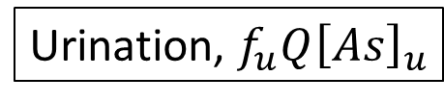


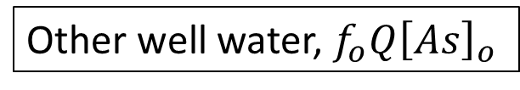

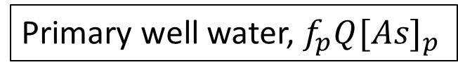

${As}_{in}= {As}_{out}$ $+ {As}_{stored}$
$f_{p}Q{[As]}_{p} + f_{o}Q{\left[As\right]}_{o}+M_{f}= f_{u}Q{\left[As\right]}_{u}$ $+ M_{d}+$ $M_{b}$
Primary well water, $f_{p}Q{[As]}_{p}$
Urination, $f_{u}Q{\left[As\right]}_{u}$
Other well water, $f_{o}Q{\left[As\right]}_{o}$
Defecation, $M_{d}$
Food, $M_{f}$
Body sink,${ M}_{b}$
Notes:
$M_{f}$ is the mass of arsenic consumed via food, $M_{d}$ is the mass of arsenic lost per time to defecation and $M_{b}$ is the mass of arsenic lost per time to a sink in the body

Slide 4
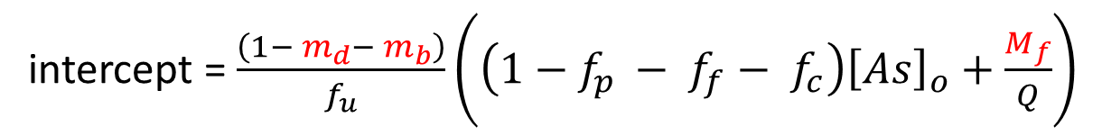
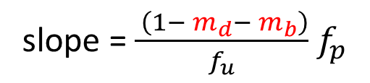
$${\left[\overline{As}\right]}_{u,i}= {{\frac{\left(1− m_{d}− m_{b}\right)}{f_{u}}f}_{p}\left[As\right]}_{p,i}+ \frac{\left(1− m_{d}− m_{b}\right)}{f_{u}}\left(\left(1−f_{p }− f_{f}− f_{c}\right){\left[As\right]}_{o}+\frac{M_{f}}{Q}\right)$$
Urinary Arsenic (µg/L)
slope = $\frac{ \left(1− m_{d}− m_{b}\right)}{f_{u}}$ $f_{p}$
intercept = $\frac{\left(1− m_{d}− m_{b}\right)}{f_{u}}\left(\left(1−f_{p }− f_{f}− f_{c}\right){\left[As\right]}_{o}+\frac{M_{f}}{Q}\right)$
Primary Well Arsenic (µg/L)

