Slide 1
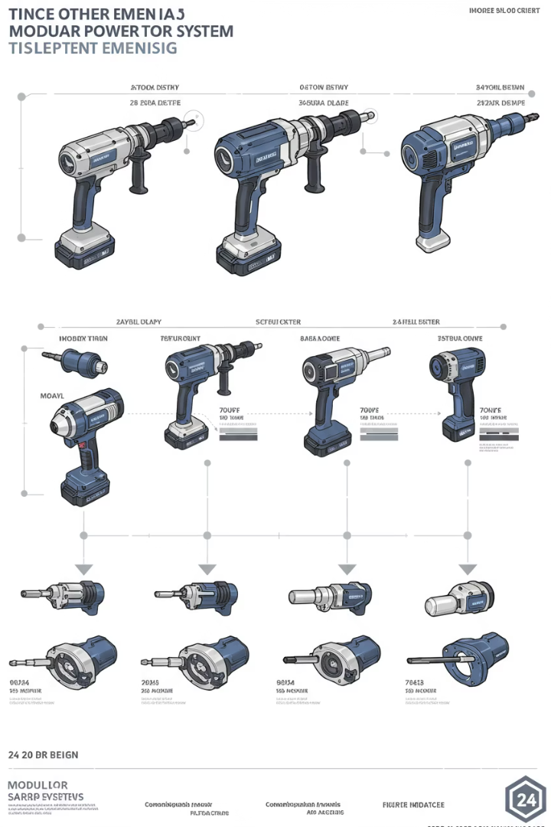




Product Innovation Roadmap
Phase 1: Foundation (0-6 Months)
Launch modular tool platform MVP with interchangeable heads. Establish feedback channels with early adopters.
Create intuitive tutorials for optimal tool combinations.
Phase 2: Smart Integration (6-12 Months)
Introduce Bluetooth connectivity and usage alerts. Rebrand as "DIY System" ecosystem.
Release 3-in-1 combo kits pending R&D approval.
Phase 3: Expansion (12-24 Months)
Develop community-driven add-ons. Launch specialized tool lines for targeted applications.
Implement loyalty program with exclusive benefits.
by Наталія Петришак

