Slide 1
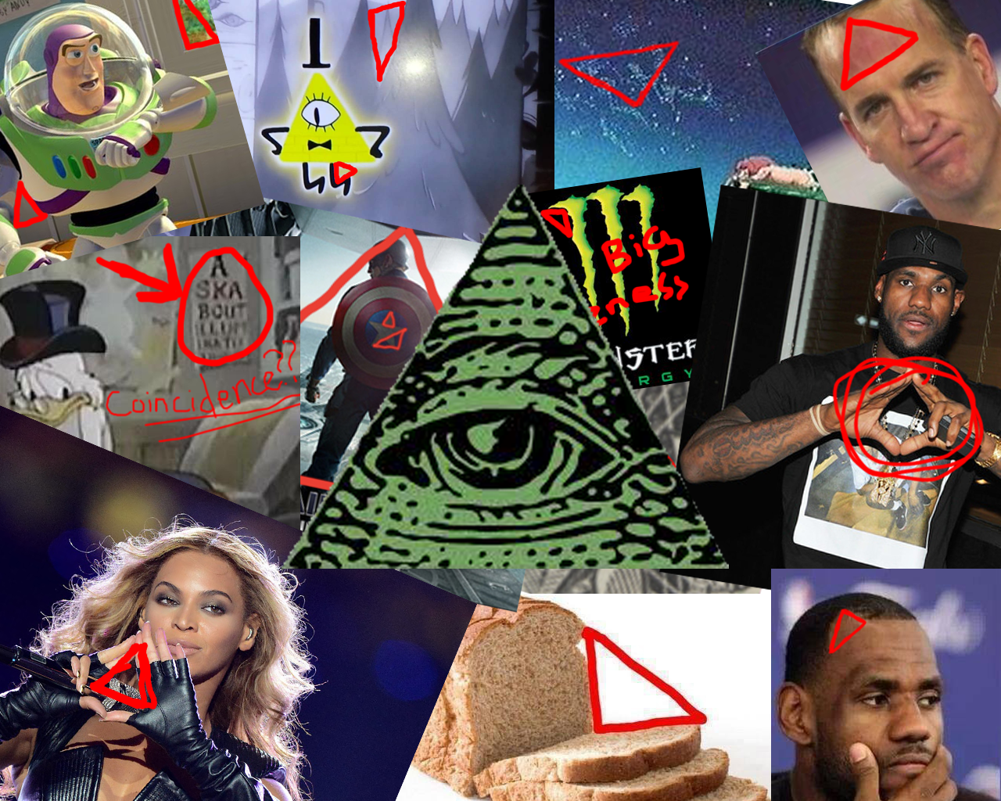
TriviaMaze Game
By: Illuminati

Slide 2
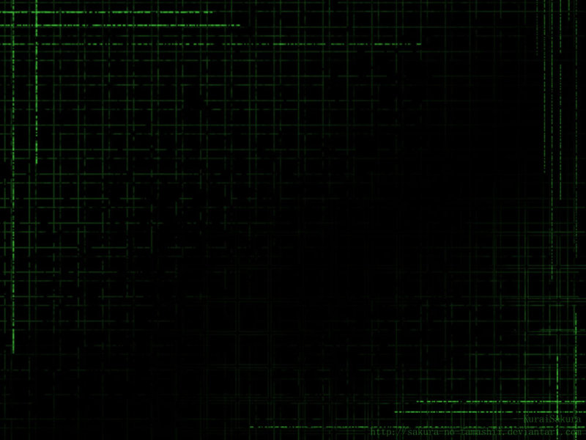
DATABASE
A separate Class handles accessing the database using SQLite Queries
The database itself is a .db file included
It can be altered at a later date if anyone wishes to add questions to the game through an administrative tool at the main menu
Each method returns a Question object, which can be used in the main game loop to display a question, its answers, and check the correct answer

Slide 3
Game Loop
Uses a Maze Generator at the start of each game to create a new maze
Uses the Database to randomly generate questions for each door
Shows one room at a time to the player and a menu that allows them to move North, South, East, or West
Once a question is answered, if it is correct the player can progress through the door. If wrong, the door is locked.
Each time a player goes through a door they must answer a question, even if they have already been through that door.

Slide 4
Maze Generator
Uses backtracking to create spanning trees.
Supports the creation of mazes of size > 0 in O(N^2) worst case, being N the maze size
Each generated maze has a size NxN of Block objects
The Bocks define the open and closed walls for each other adj. Block in a matrix

Slide 5
UML
Class Diagram
Sequence Diagram
Conceptual Model
Use Case Diagram
State Machine Diagram

Slide 6
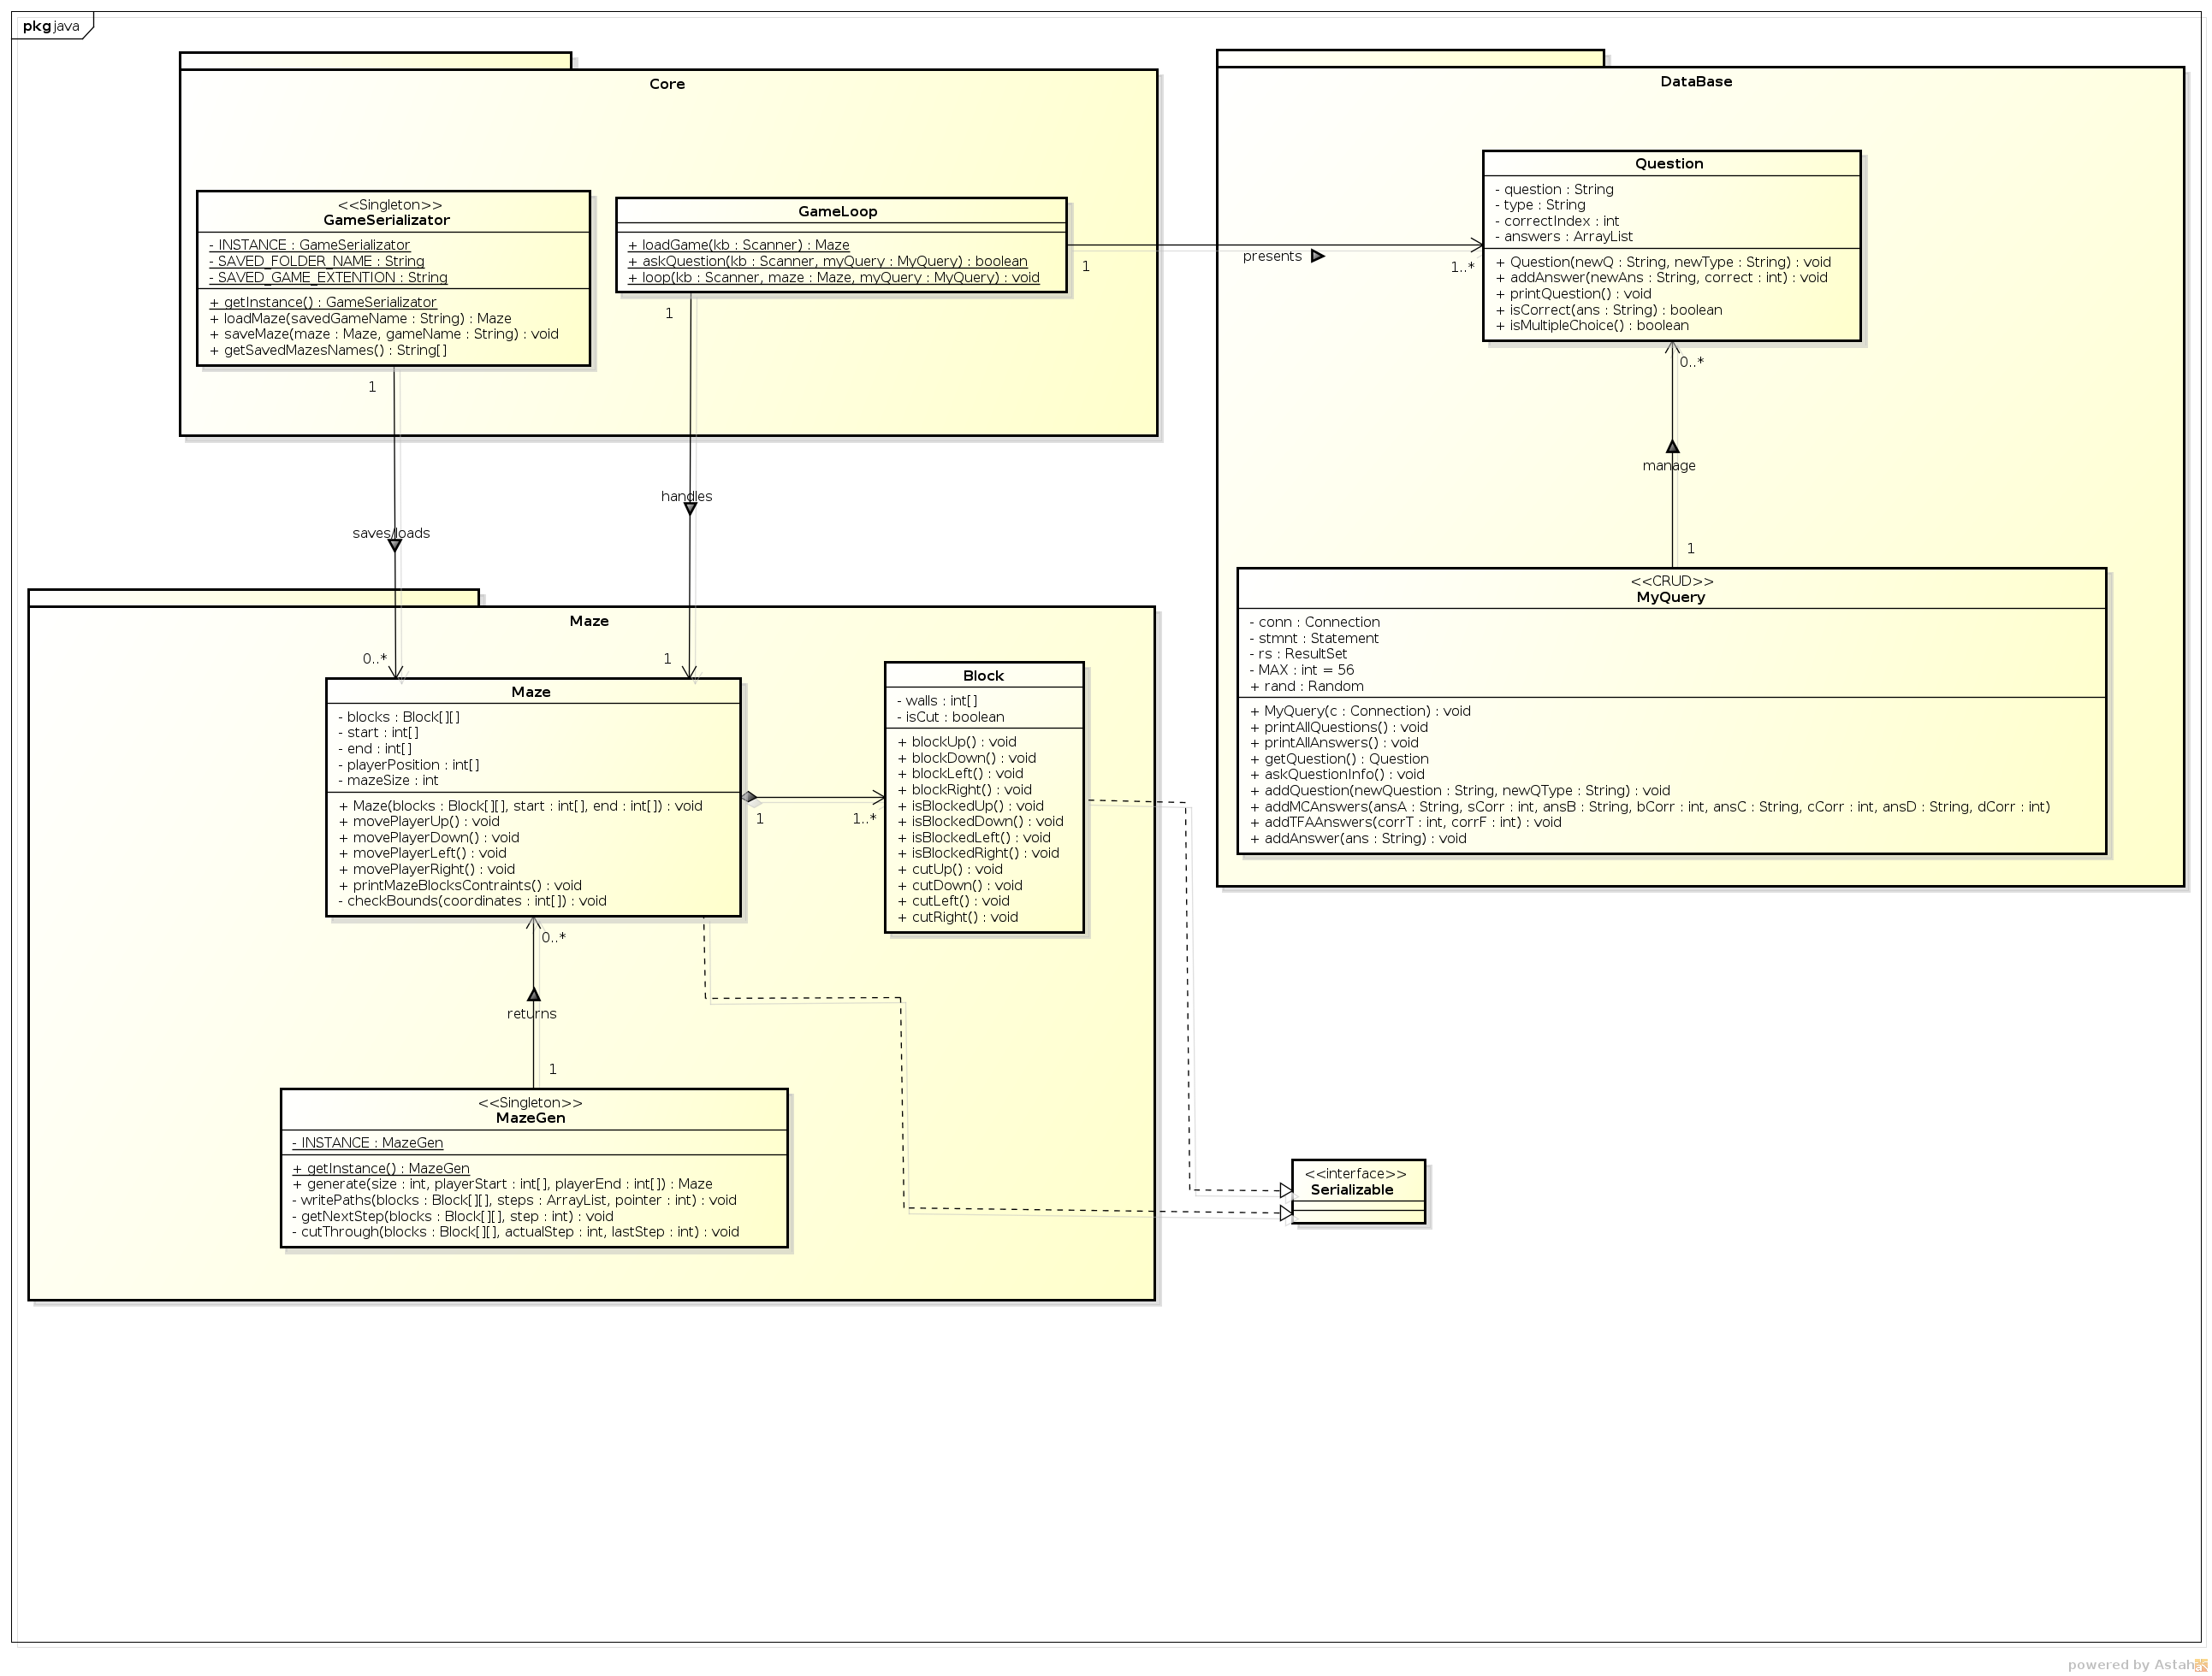

Slide 7
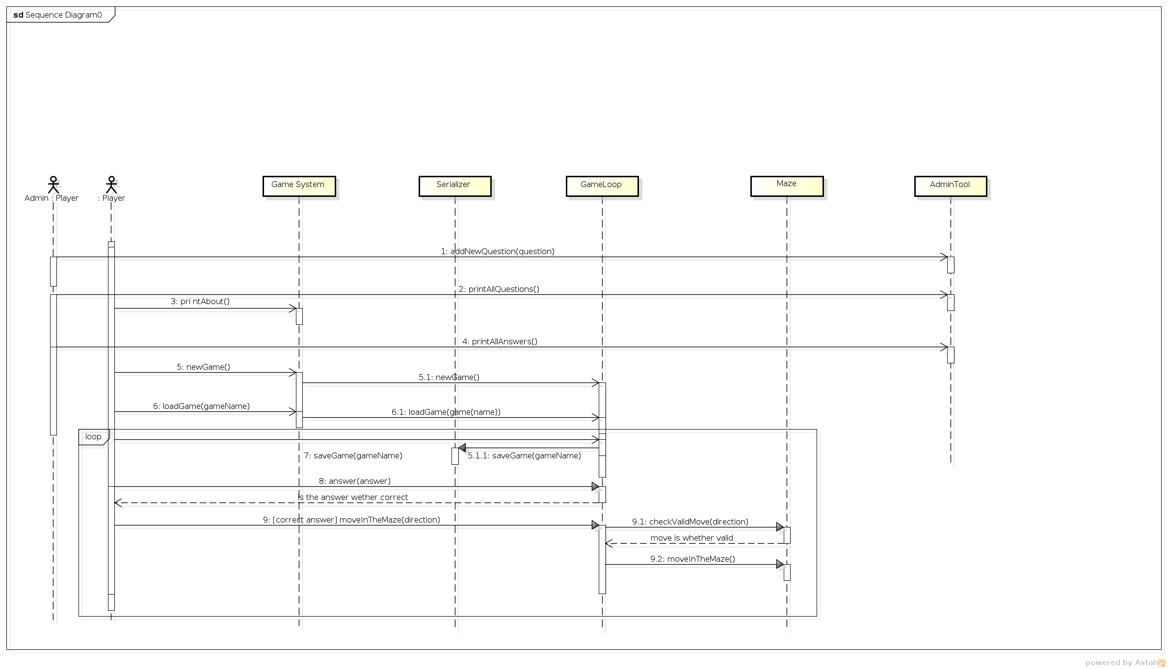

Slide 8
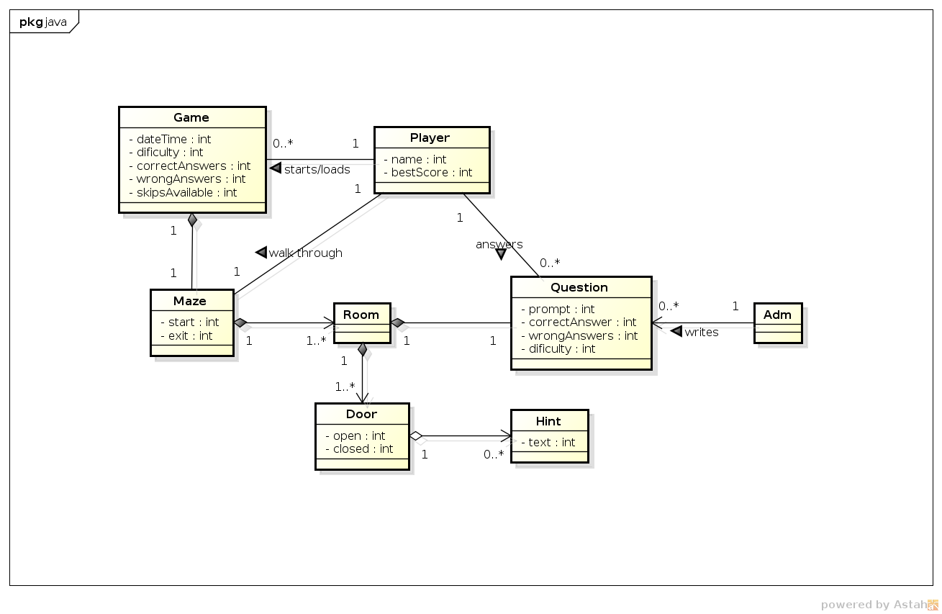

Slide 9
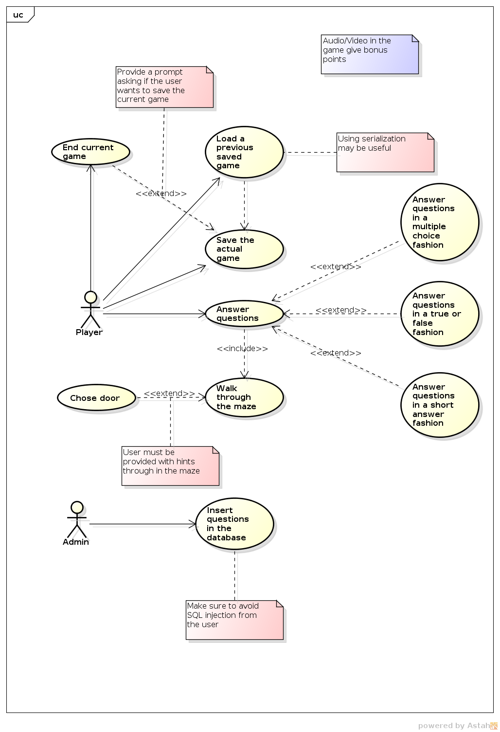

Slide 10
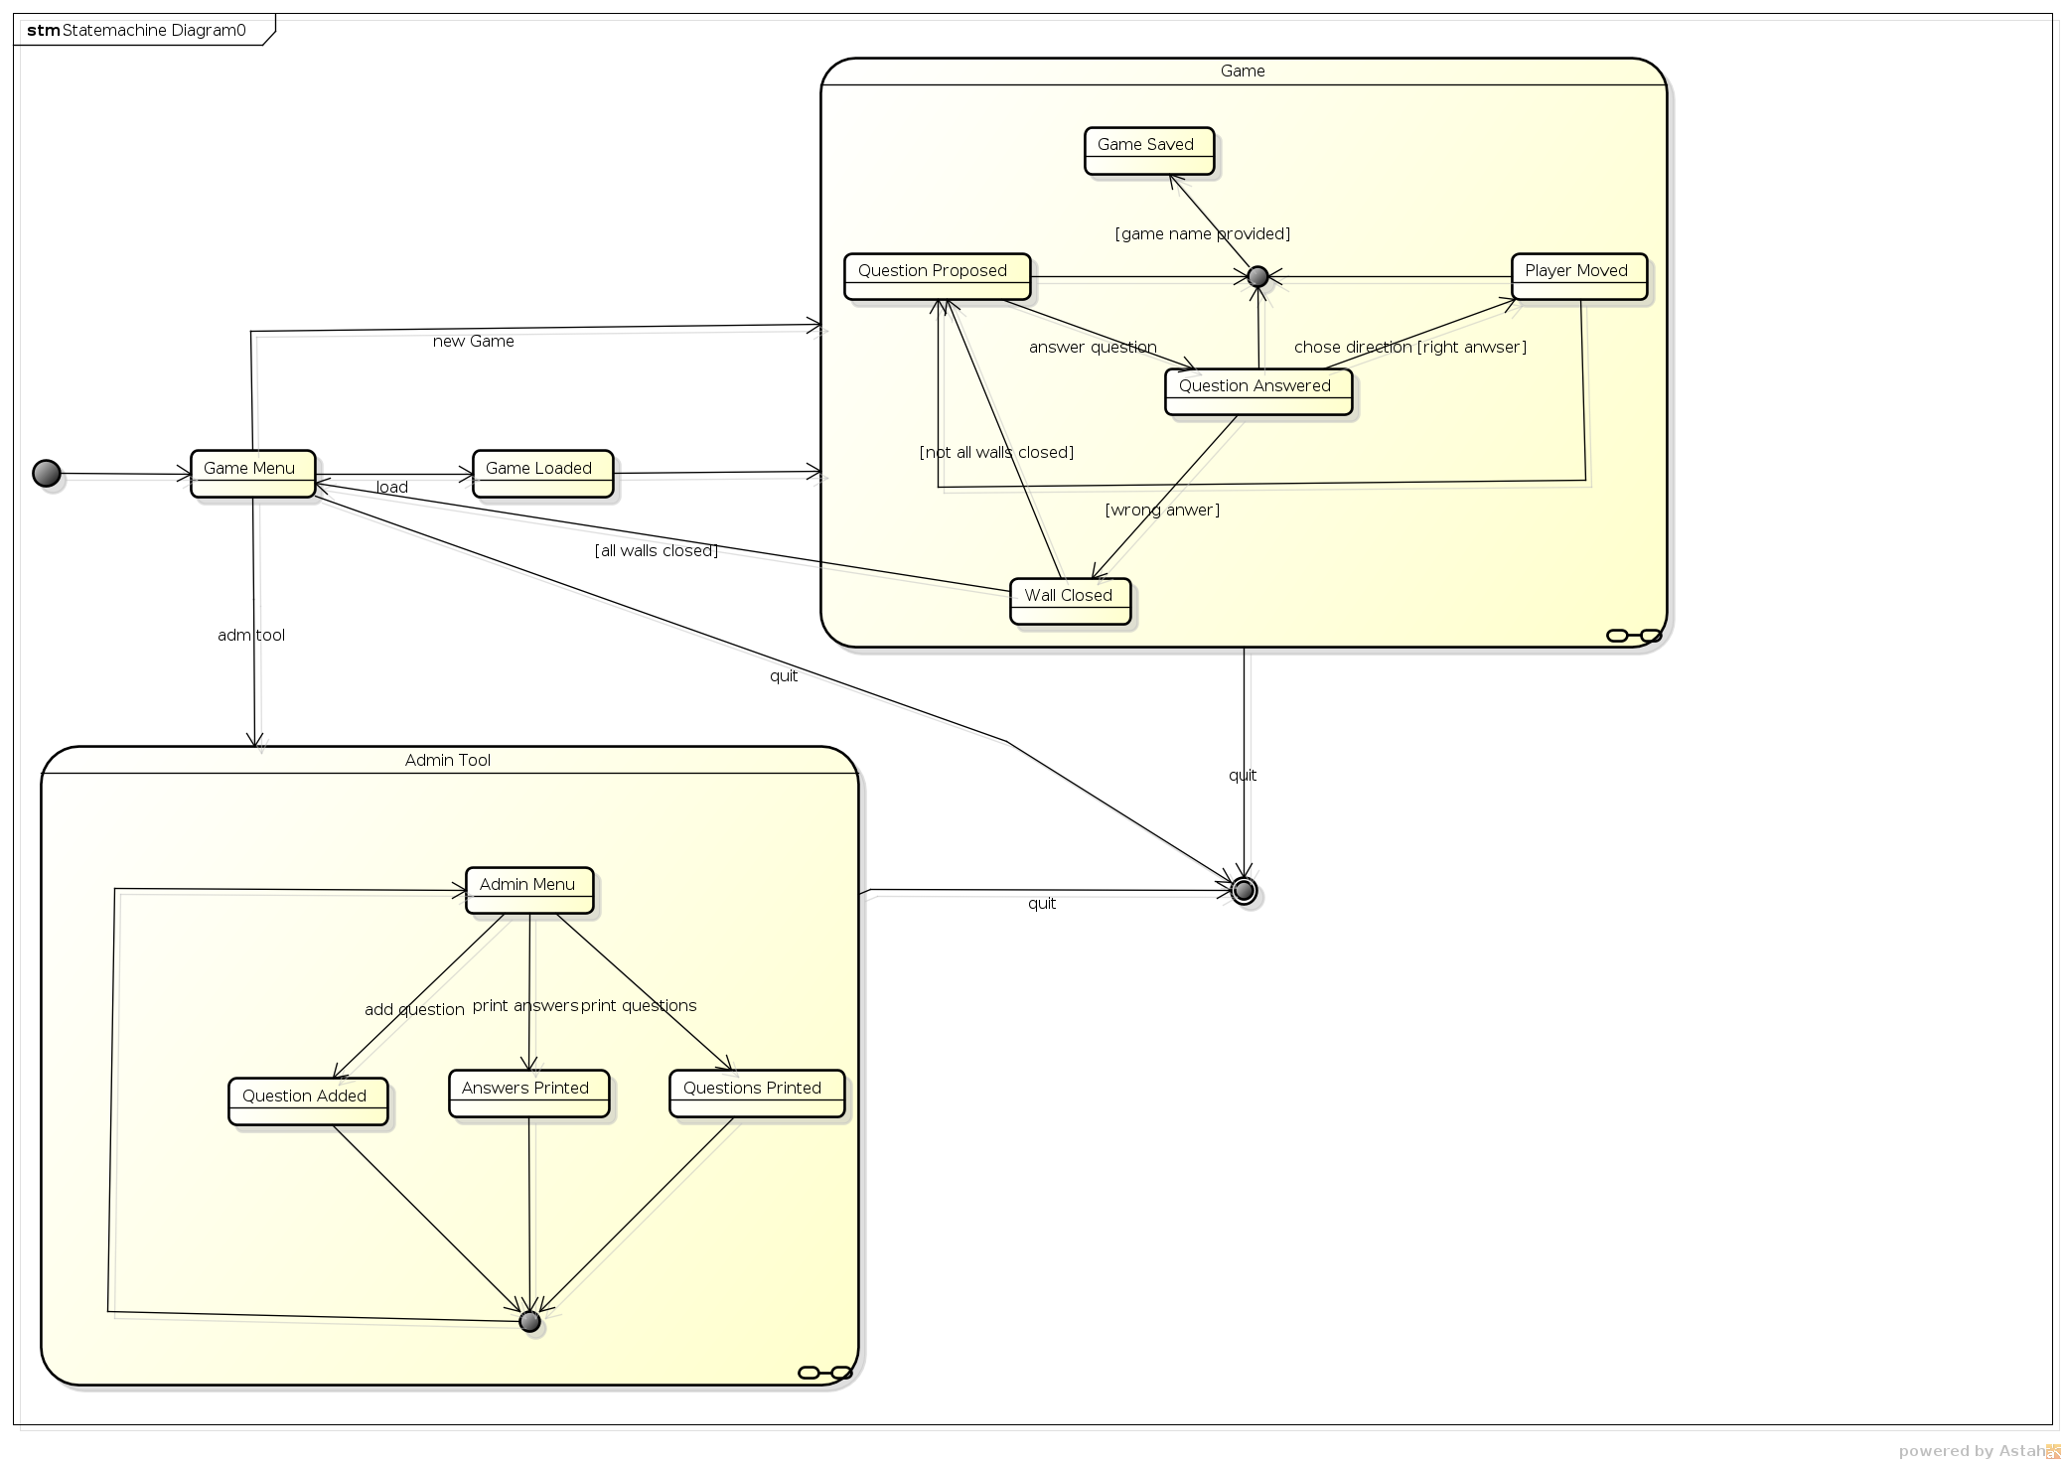

Slide 11
Thank You!
Have you all an Amazing Summer!

