Slide 1
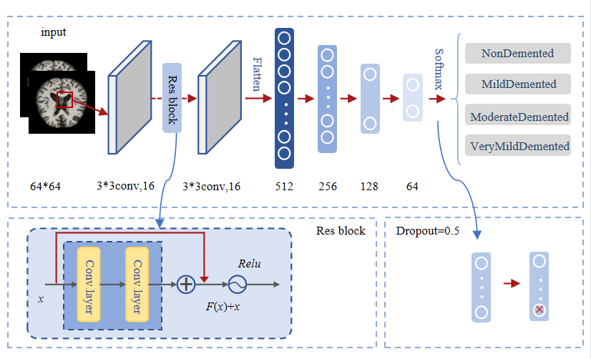
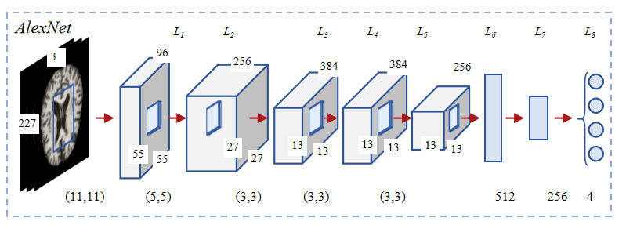
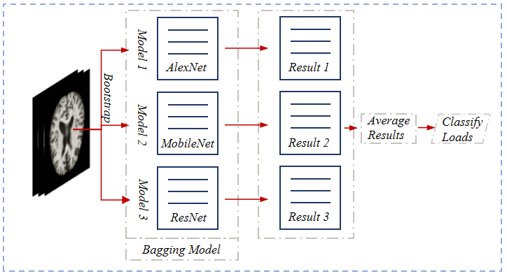
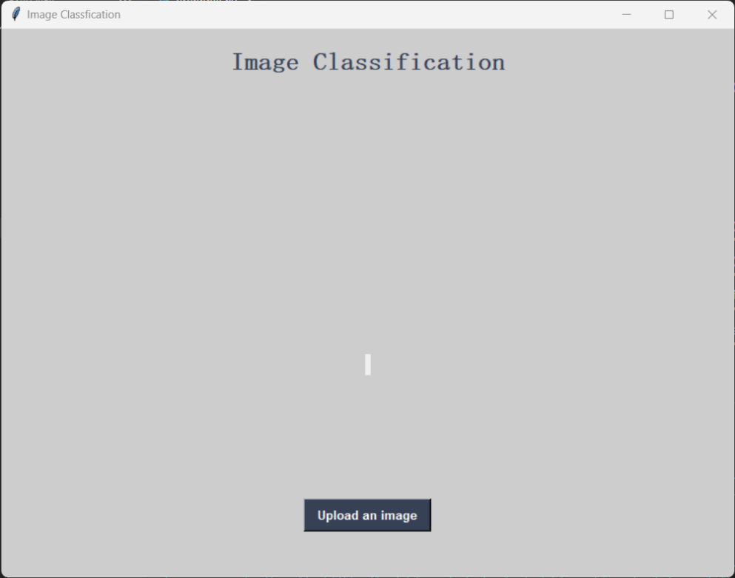
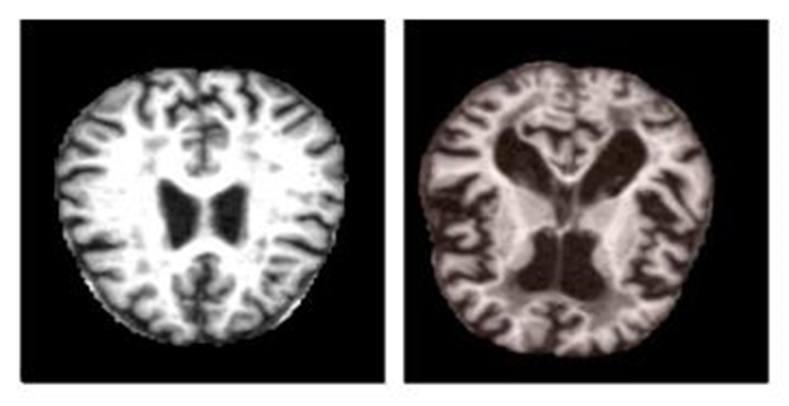
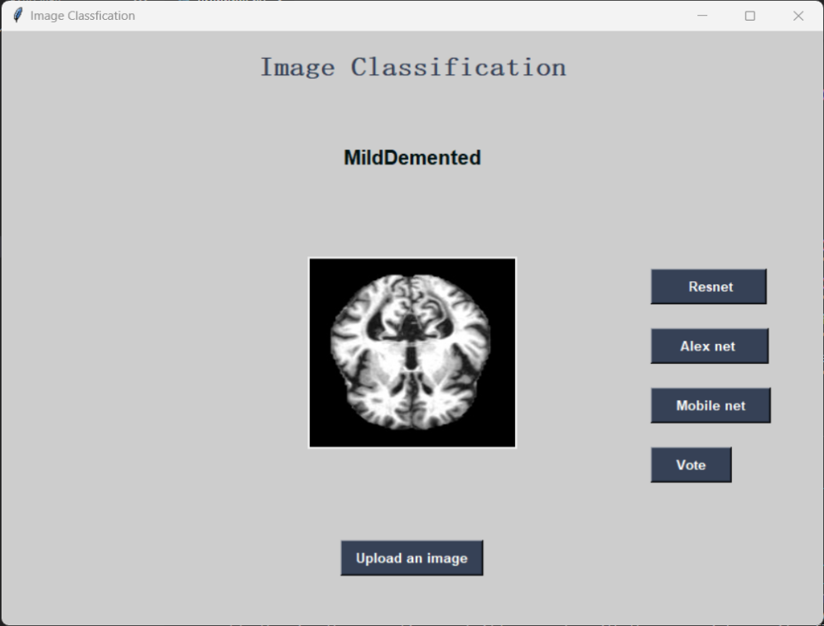
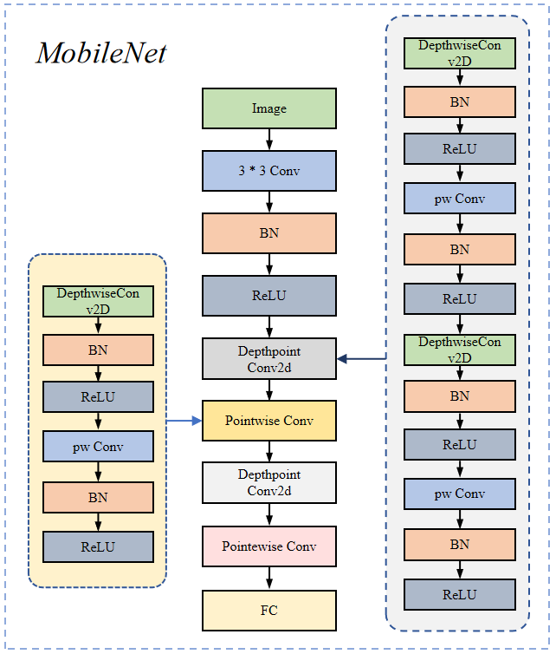
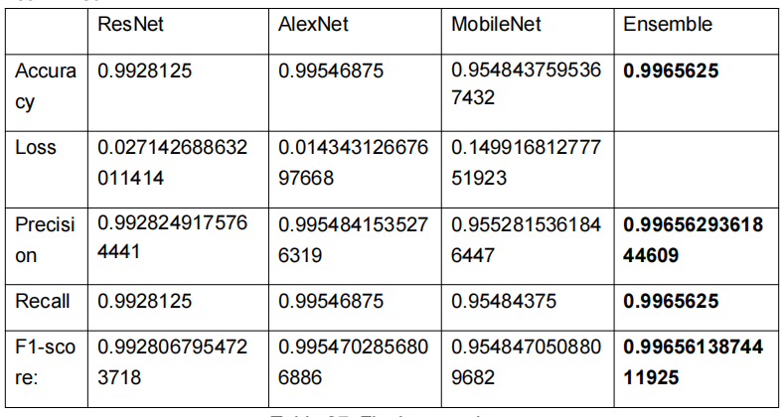
Liu Yue 201918020206
Ensemble learning for the classification of Alzheimer disease
Oxford Brookes University & Chengdu University of Technology, BSc (Hons) Software Engineering Programme
Supervised by: Grace Ugochi. Nneji
ABSTRACT
The MobileNet structure uses depthwith separable convolution to replace the standard convolution operation, and calls these two structures repeatedly to reduce the amount of model parameters and increase the amount of model calculation. Each layer is followed by a batchnorm and a ReLU nonlinear layer. Finally, the Flatten layer and the full connection layer are used to classify the images. Point convolution and deep convolution structure are the core of MobileNet, which makes MobileNet more efficient and more suitable for mobile devices. Point convolution is mainly responsible for integrating the information in the feature map, while depth convolution is responsible for extracting features. The Finetuned MobileNet Architecture used in this project is shown in Figure 2.
DISCUSSION
Alzheimer's disease is the most common type of dementia and the majority of sufferers are elderly. With the global aging process, the number of people with Alzheimer's disease is growing rapidly worldwide, and with this comes the pressure on the healthcare economy due to the increased cost of treatment. The use of magnetic resonance imaging (MRI) for the early diagnosis of Alzheimer's disease is therefore a key part of the solution to this problem. This project uses ensemble learning to combine three models which are ResNet, AlexNet, and MobileNet to avoid the potential failures of individual models and to combine the benefits of individual models. The project will assist medical practitioners in applying automated systems in the identification of Alzheimer’s disease, thus saving more lives, practitioners’ time, and medical resources in medical centers.
Ensemble learning has a wide application prospect in MRI image recognition of Alzheimer's disease. In the future, the integrated learning algorithm can be further optimized to achieve higher accuracy of MRI image recognition for Alzheimer's disease. In addition, with growing medical data sets, more data and more advanced deep learning models can be used to further improve predictive performance. Ultimately, MRI image recognition for Alzheimer's disease could provide clinicians with better diagnostic and treatment options to help patients better manage and control the disease.
Figure 3: The Finetuned ResNet
The residual network(ResNet) is constructed from Residual Building Blocks, it does not increase the complexity of the network while increasing the depth of the network. The quick connection of ResNet makes the network easier to optimize. The internal residual block uses a skip connection, which alleviates the problem of gradient disappearance caused by increasing depth in the deep neural network.
CONCLUSION
After the project, integrated learning improved the accuracy of MRI image recognition in Alzheimer's disease. Three models were used in this study :ResNet, MobileNet and AlexNet. By combining their predictions, a more reliable and accurate diagnosis can be made. By comparing the performance of single model and ensemble learning model, it is found that ensemble learning has significant advantages, and the accuracy rate is as high as 99.54%. In addition, this study further completed the fine tuning of ResNet, MobileNet and AlexNet models for the four-classification recognition of MRI images of Alzheimer's disease, proving the superiority of multi-index integrated learning. Taken together, the results of this project show that identifying MRI images of Alzheimer's disease using integrated learning algorithms can improve diagnostic accuracy and accuracy, and that ResNet, MobileNet, and AlexNet are all reliable model choices.
AlexNet has an eight layer structure. The first five layers are convolutional neural networks, and the sixth to eighth layers are traditional neural networks. It uses the ReLU activation function to prevent the gradient from disappearing and the Dropout to prevent over fitting. The whole network can be seen as the input layer is operated by convolutional layers, followed by a series of fully connected layers, and finally the output layer is used to obtain the prediction result.
INTRODUCTION
The project aims to effectively classify Alzheimer's disease using a set model, achieving four classifications: NonDetermined, MildDetermined, ModerateDetermined, and VeryMildDetermined, in order to take early measures to reduce mortality and reduce medical resource costs.
DATASET
ARCHITECTURE
Figure 4: The Finetuned AlexNet
This dataset is gotten from Kaggle dataset and it contains 33984 cross-sectional MRI images of the brain with Alzheimer's disease. 8960 MRI images contains mild dementia, 6464 MRI images is moderate dementia, 9600 MRI images is non-dementia, and 8960 MRI images is the very mild dementia. The split ratio for the training set, validation set, and test set is close to 6:2:2.
GUI
Figure 5: The Ensemble structure
This project classifies image files through three pre-training models, fine-tuned ResNet, AlexNet and MobileNet, and uses a voting scheme combined with the output of the three models to determine the prediction classification. After the adjustment of the image size, three models were used to predict the probability distribution of the image belonging to the four predefined categories. Each model will generate the probability distribution of four categories, calculate the number of votes for each category label and update the voting list, completing the multi-model voting integration.
Figure 1: Sample of Alzheimer’s image in dataset
RESULT
METHODOLOGY
Figure 6-7: The GUI
REFERENCES
LeCun, Y., Bengio, Y., & Hinton, G. (2015). Deep learning. Nature, 521(7553), 436-444.
Goodfellow, I., Bengio, Y., & Courville, A. (2016). Deep learning. MIT press.
Schmidhuber, J. (2015). Deep learning in neural networks: An overview. Neural networks, 61, 85-117.
Table : Final comparison
Figure 2: The Finetuned MobileNet
The table shows the best results of three individual models after adjustment and training. Compared with the ensemble project, the integrated strong learner obtains higher evaluation data than the single model, and the ensemble effect of the project is confirmed.

