Slide 1
Ensemble learning for the classification
of Alzheimer disease
By LIUYUE (Leslie)
Student No: 201918020206
Supervisor: Grace Ugochi. Nneji

Slide 2
Background
Annual growth
According to the World Health Organization, 5 million people worldwide suffer from Alzheimer's disease every year, making it one of the most common causes of death among elderly people.
500,000
2018
According to the estimated global Alzheimer's cases in 2018, approximately 50 million people worldwide suffer from Alzheimer's disease. The incidence rate of Alzheimer's disease will further increase with the increasing degree of population aging
%
Percentage
500,000,000
The prevalence rate is as high as 10% among people aged 64 and above, and even higher at 25% among those aged 70 and above
Annual expenses
$818 billion
The annual medical and care costs caused by Alzheimer's disease worldwide reach $818 billion, and this number is expected to continue to increase in the future.

Slide 3
Aim
The project aims to effectively classify Alzheimer's disease using a set model, achieving four classifications: NonDetermined, MildDetermined, ModerateDetermined, and VeryMildDetermined, in order to take early measures to reduce mortality and reduce medical resource costs.

Slide 4
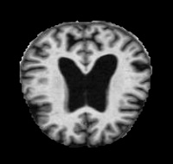
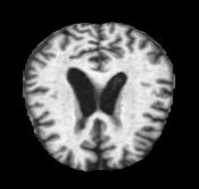
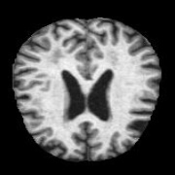
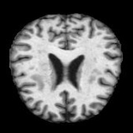
Dataset
This dataset is gotten from Kaggle dataset and it contains 33984 cross-sectional MRI images of the brain with Alzheimer's disease. 8960 MRI images contains mild dementia, 6464 MRI images is moderate dementia, 9600 MRI images is non-dementia, and 8960 MRI images is the very mild dementia. The split ratio for the training set, validation set, and test set is 6:2:2.
MildDetermined
ModerateDetermined
https://www.kaggle.com/datasets/uraninjo/augmented-alzheimer-mri-dataset-v2
NonDetermined
VeryMildDetermined

Slide 5
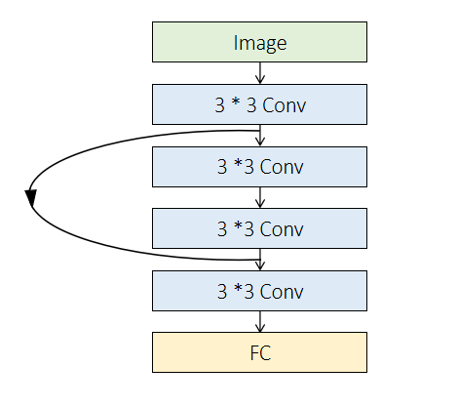
ResNet
Load the dataset from a specified path and adjust its size to 64 x 64 pixels.
Divide the dataset into a training set and a validation set.
Define the ResNet architecture using convolutional and dense layers.
Compile the model using the Adam optimizer and the classification cross entropy loss function.
Train the model using the training set, with a batch size of 128 and a total of 20 periods.
Evaluate the model on the test set and measure its performance using accuracy metrics.
Visualize the performance of the model using two graphs for accuracy and losses.
Save the model to a file for future use.
Solving the problem of gradient dissipation and degradation

Slide 6
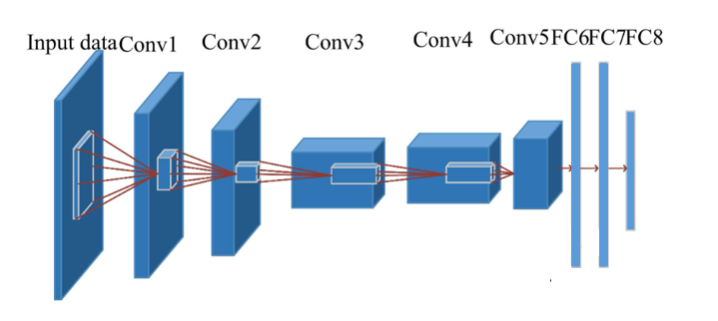
AlexNet
AlexNet has an eight layer structure. The first five layers are convolutional neural networks, and the sixth to eighth layers are traditional neural networks. It uses the ReLU activation function to prevent the gradient from disappearing and the Dropout to prevent over fitting. The whole network can be seen as the input layer is operated by convolutional layers, followed by a series of fully connected layers, and finally the output layer is used to obtain the prediction result.
Learning the characteristics of datasets.

Slide 7
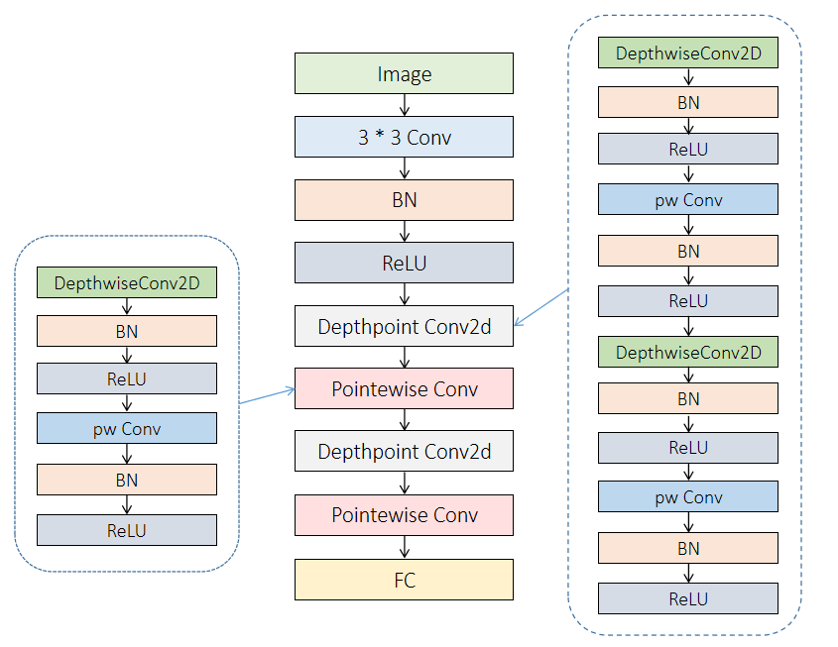
MobileNet
The model takes in 64x64x3 images and begins with a convolution layer of 32 filters and a 3x3 kernel, followed by batch normalization and ReLU activation. Multiple depthwise separable convolutions are applied, with increasing then decreasing depths. The model ends with a fully connected layer with 4 units and a softmax activation function. The model is trained for 30 epochs with a batch size of 32 and SGD optimizer with learning rate 0.002, using validation data to track accuracy and loss. The model and training history are saved to files.
Lightweight, high efficiency

Slide 8
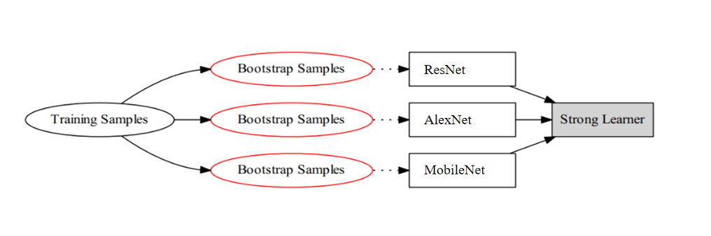
Ensemble Model
For a given training sample S, M training samples were drawn from the training sample S in each round using Booststraping, and n rounds were conducted to obtain a total of n sets of samples. After obtaining the sample sets, one prediction model is obtained each time using one sample set, for n sample sets, a total of n prediction models can be obtained. The classification results are then obtained by applying voting to the previously obtained n models. The models used in this project are ResNet, AlexNet, and MobileNet.

Slide 9
Algorithm
Bagging:
To obtain an integration with strong generalisation performance, the ensemble learning in the integration should be as independent of each other as possible, or try to make the base learners as undifferentiated as possible. Given a training dataset, one possible approach is to sample the training samples to produce a thousand different subsets, and then train a base learner from each subset of the data. This is expected to result in a large variation in the base learners due to the different training data, however, in order to obtain better integration, it is also desirable that individual learning is not too poor, and if each subset sampled is completely different, then each learner uses only a small fraction of the training data, not even enough to learn effectively, neither of which is clearly guaranteed to produce a better base learner. Therefore, to solve this problem, consider using sampled subsets that are overlapping with each other.

Slide 10
Vote
Vote can be used to classify a specified image into one of four categories, which is the identification of dementia in this project.
Firstly, read the image file in the specified path; Afterwards, convert the image file into an image array of (64,64) size, extend the image array by one dimension, and convert it into a Numpy array; Use three pre trained models to classify and predict images; Finally, calculate the predicted results for each category, select the most likely result to predict correctly, and return the classification label for that result; Then output the predicted results and display them on the screen.

Slide 11
Evaluations
Indicators | Formulas | Meaning
Accuracy |  | The proportion of all correctly judged results to total observations in the classification model
Precision |  | The proportion of model prediction pairs among all results where model observation is positive
True positive rate, TPR, Sensitivity, Recall |  | The proportion of model prediction pairs among all results where the true value is positive
Specificity |  | The proportion of model prediction pairs among all results where the true value is negative
F1-Score |  | F1 is defined as harmonic mean based on the harmonic mean of the accuracy and recall rates.

Slide 12
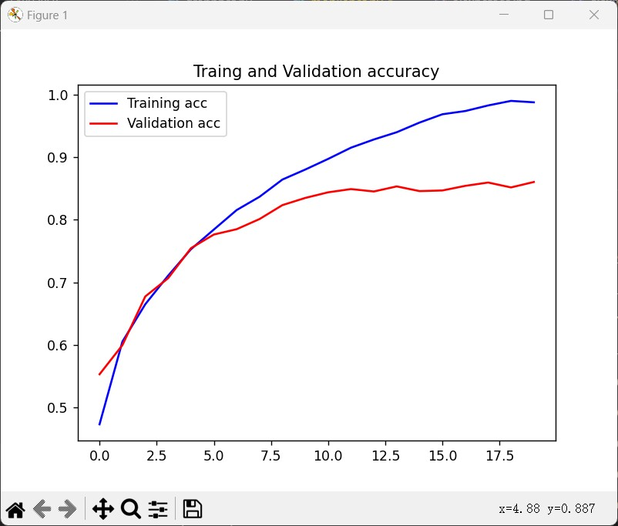
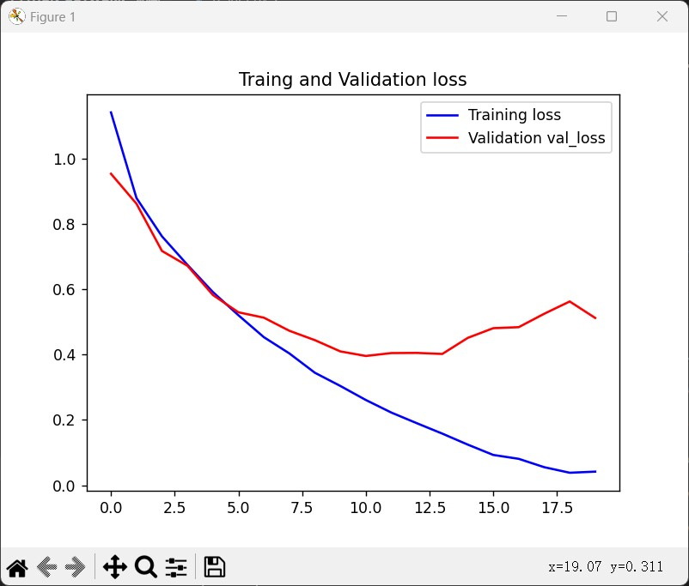
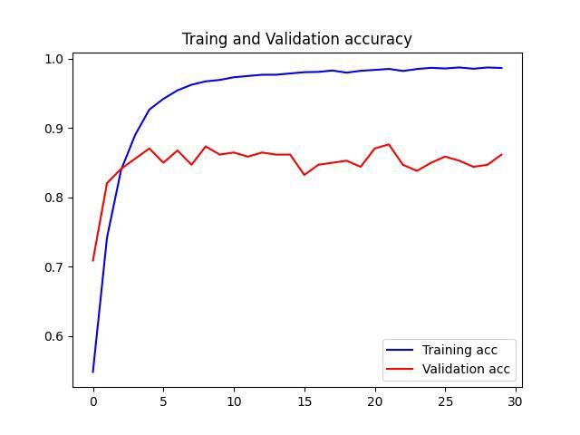
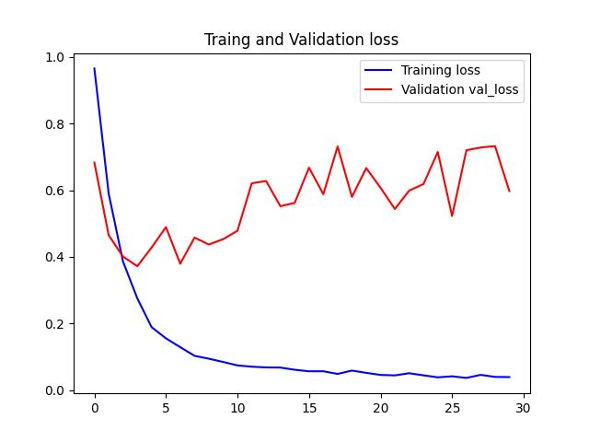
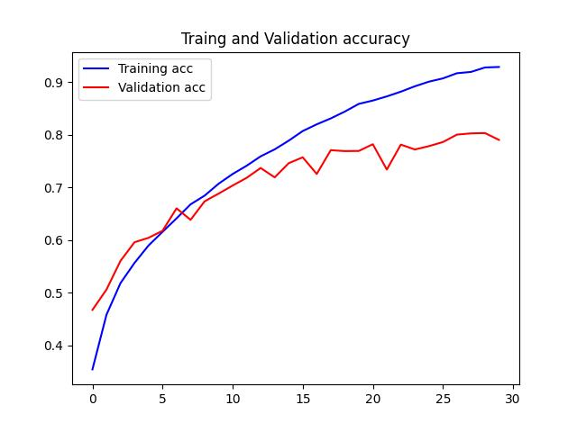
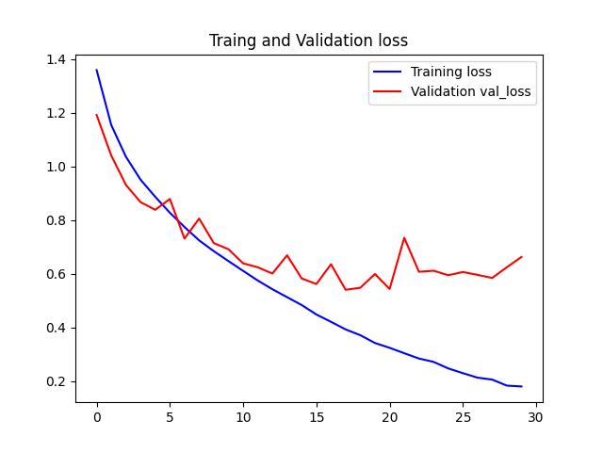
Result
A.
C.
B.
A. | ResNet
B. | MobileNet
C. | AlexNet

Slide 13
Result
 | Precision | Recall | F1score | Test loss | Test accuracy
ResNet | 0.9984 | 0.9984 | 0.9984 | 0.0078 | 0.9984
MobileNet | 0.9389 | 0.9376 | 0.9378 | 0.1696 | 0.9376
AlexNet | 0.9919 | 0.9918 | 0.9918 | 0.0284 | 0.9918

Slide 14
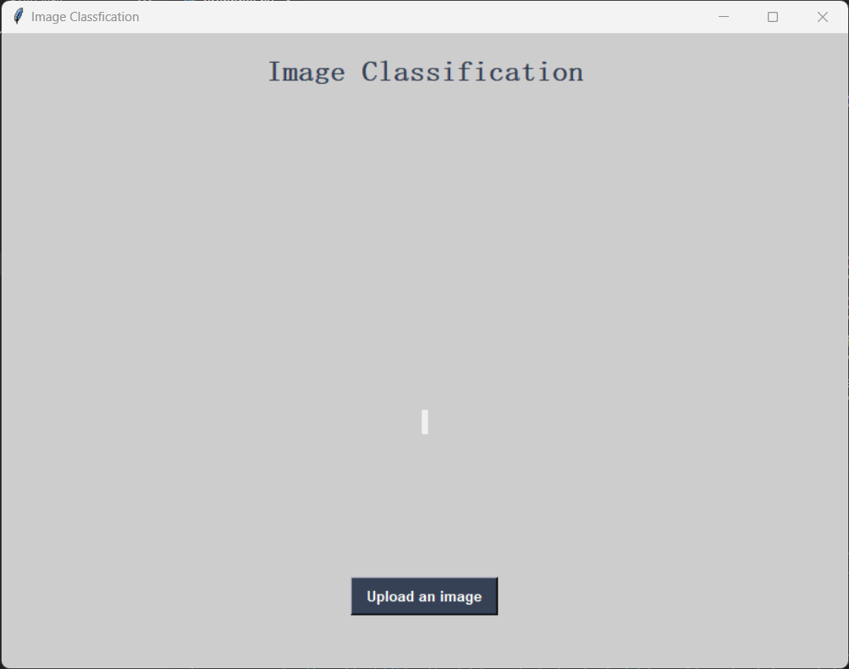
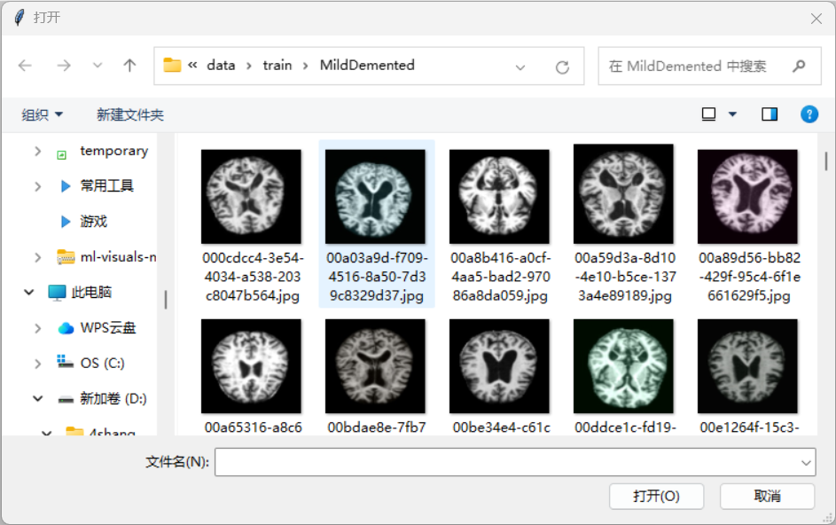
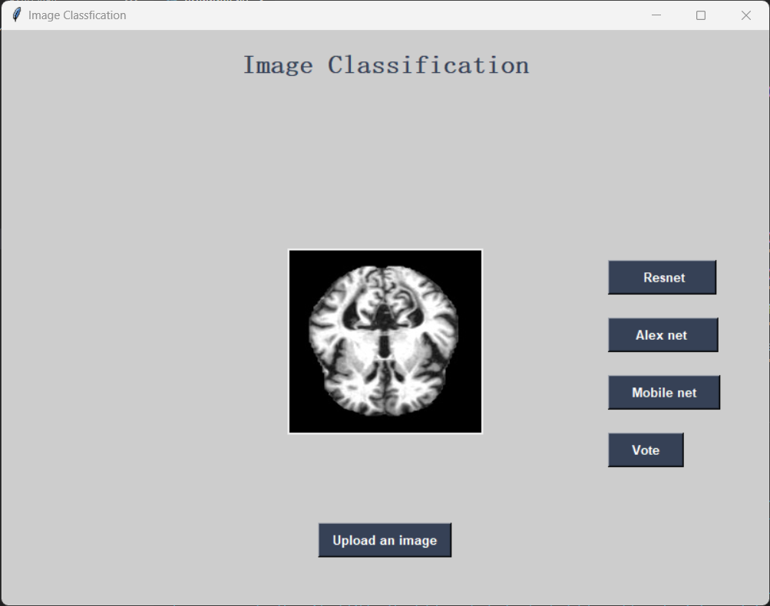
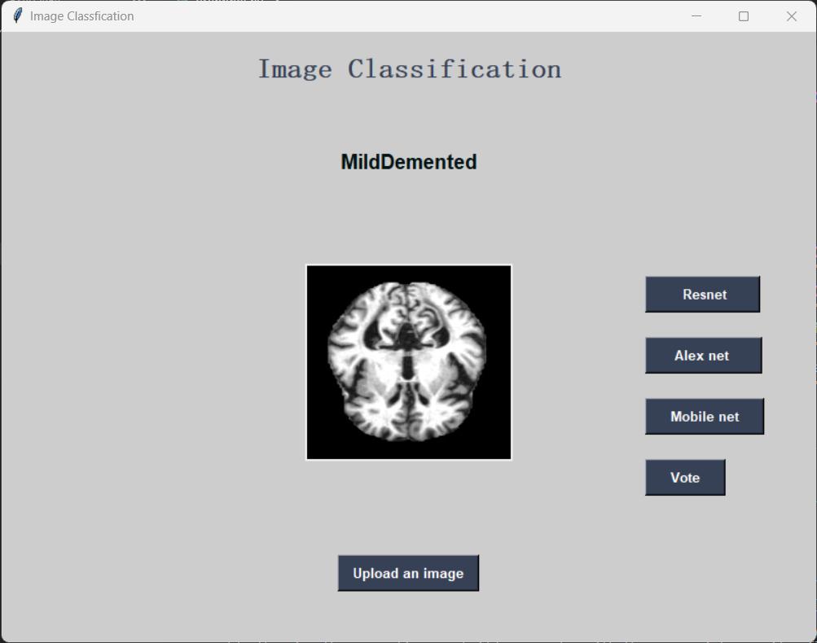


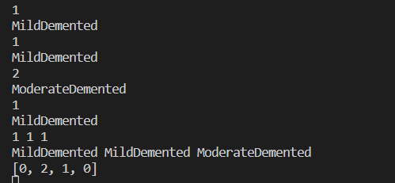
GUI
ResNet
MobileNet
AlexNet
Vote
Code

Slide 15
Thanks

