Slide 1
Factory Machine Classification
Supervised Learning AIML CA1
Modelling objective:
To develop a useful and accurate model to perform Binary Classification on the status of Factory Machines, whether the machines fail or not.
Lim Hur 2112589
DAAA2A02

Slide 2
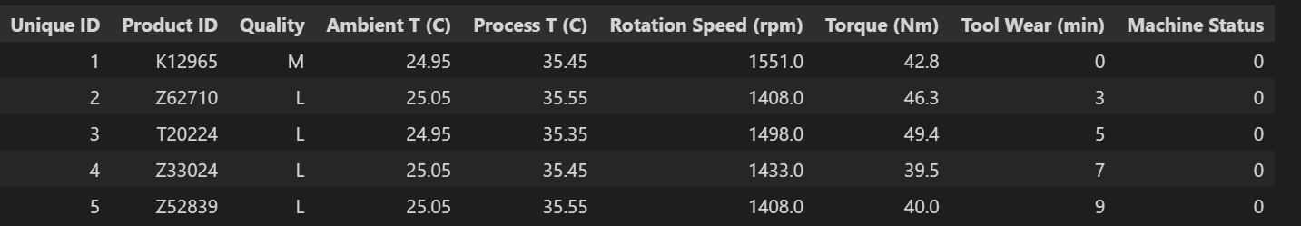
Prediction task and background research
Can we utilize machine learning to help indicate which machine/component will fail before it actually fails?
Dataset – Collected from manufacturing company, with Machine Status as target variable ( 0 as Normal, 1 as Fail)
Given a set of features, our goal is to correctly classify whether machine status is ‘normal’ or ‘failure’ accurately.

Slide 3
Understanding the financial cost of machine downtime in manufacturing
Natural for manufacturing companies to have their functioning machines working at full efficiency, such that productivity is maximised, leading to increase in profits.
However, machine downtime is the biggest concern in every manufacturer’s mind.
Negative impacts include impact in production, jeopardizing the safety of workers, etc.
Research shows that average manufacturer deals with 800 hours of downtime per year, and considering an average manufacturer losing $22,000 per minute of downtime. This is very shocking.
A Study was conducted on major manufacturing firms – found that large facilities lose ‘27 hours a month to machine failure, on the cost of $532,000 for each hour of machine downtime.
Given the drastic impact machine failure can have, and that ignoring the financial costs of machine downtime is not a viable option, we need to recognise the significance of machine failure

Slide 4
Integrating the idea of predictive maintenance
By leveraging on labelled data to build predictive models, companies can efficiently carry out maintenance before it actually fails. (prevent failure by providing early warnings)
This helps to maximise machine uptime and operational efficiency, as well as minimising loss
Also to discover factors that contribute to machine failure
Interpretability of the model
Ultimately, we want a model that exposes its feature importance, so that we can better relate the features and target variable

Slide 5
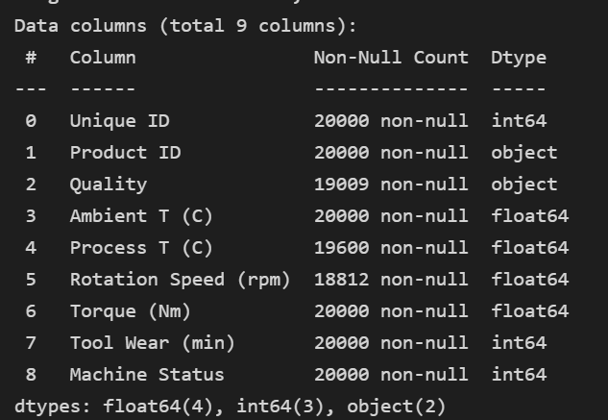
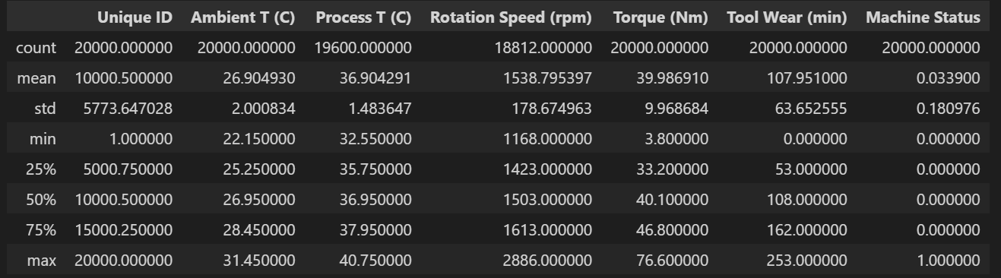
Exploratory Data Analysis
Null values observed from ‘Quality’, ‘Process T (C)’, ‘Rotation Speed (rpm)’ columns.
Unique ID – representation of each row, likely does not provide any information towards the target variable.
Product ID – may not directly provide any information, but may be useful later on. (contain duplicates as well)
Other columns – All other columns except Quality, and ProductID are numerical in nature
Drastic jump in values for Torque and rotation speed from 75th percentile to max, suggests presence of outliers.
Machine Status – Target Variable we are trying to predict.

Slide 6
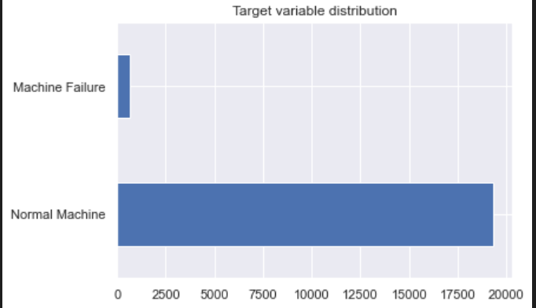

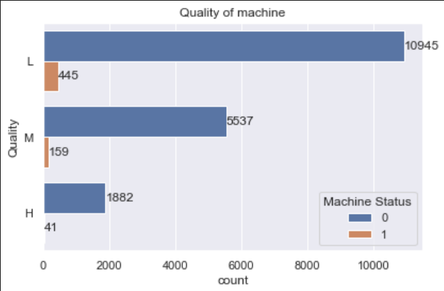
Exploratory Data Analysis
Target variable encoded in its binary form
Imbalanced target variable
Disproportionate ratio of observations for ‘Machine Status’.
We can address via techniques like over sampling, stratification or a more nuanced performance metrics.
Ultimately, we do not want the model to be severely limited in predicting the minority class.
Quality is a categorical variable that has a clear ordering of {L : Low, M:Medium, H:High}.
Highest number of low quality machines.
More normal machines than faulty machines for all 3 classes.

Slide 7
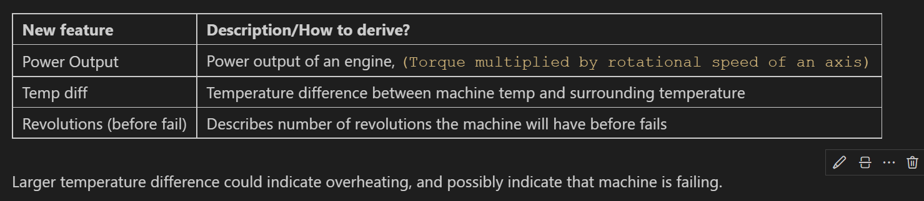
Feature Engineering
For feature engineering, we will create 3 new features, that can provide more information towards model.
Power is probably useful for differentiating between faulty and normal machines, as power can be referred to the rate of doing work
Small power output may indicate a faulty machine.
Next, temperature difference is derived from the diff between machine temp and surrounding temp. Larger temp diff could mean overheating, possibly indicating a failing machine.

Slide 8
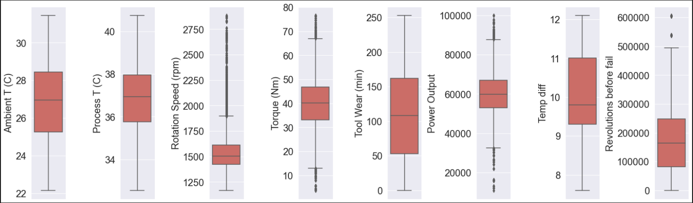
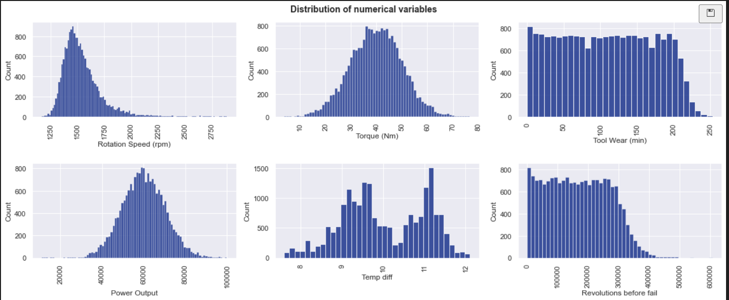
Exploring continuous/discrete features
Tool wear/Power output – Uniform distribution
Rotation speed – positively skewed (may contain outliers, need investigate)
Torque follows normal distribution – most machines have turning force of around 37-40 Newtonmeter
From boxplots, outliers exist in rotation speed, torque and power output and revolutions.
Multimodal distribution for temp diff.

Slide 9
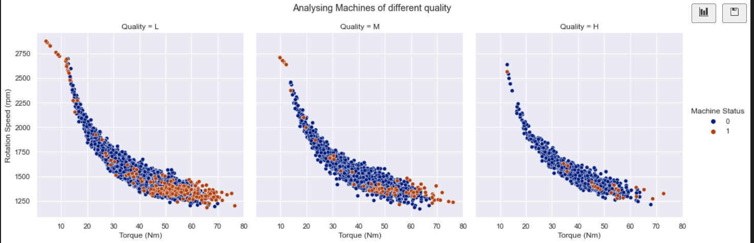
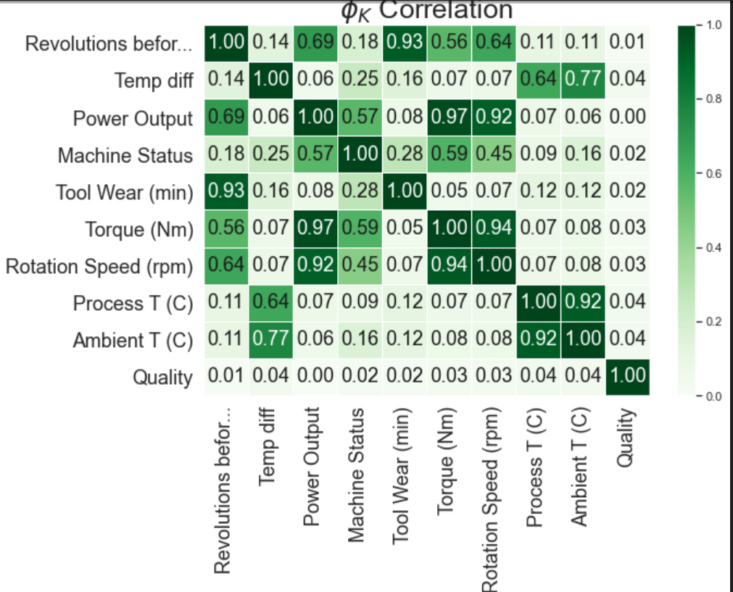
Exploratory Data Analysis
Observe moderately strong correlation between torque and rotation speed
Presence of outliers which are mostly machines that fail, we will not drop them as it will reduce the minority class even more, leading to greater imbalance dataset, severely limiting the model to predict observations from minority class.
Phik correlation works well with numerical and categorical values.
Several highly correlated features suggest presence of multicollinearity. Such as Process T and Ambient T (0.92), Torque and rotation speed (0.94)
May contain redundant information, hence feature selection may benefit us.
Power output, torque and rotation speed are highly correlated with machine status, which is logical as they could determine if a machine is functioning.

Slide 10
Preprocessing
Drop Product ID ( does not provide info towards target variable)
Directly dropping rows with NULL values may introduce a larger imbalance dataset. Hence we recognize the need to retain precious data, we will carry out imputation. Furthermore, dropping will lead to a loss of more than 10% of dataset.
Can consider {KNNImputer, IterativeImputer,SimpleImputer}
Imputation SHOULD NOT distort original distribution
Separating features from target variable, and using train_test_split so that training set have no idea of test set. 80:20
Test set is to used for final evaluation, train set is used for training

Slide 11
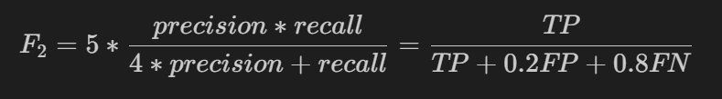
Model Evaluation metrics (Why F2 is better than the General F1)
We will use f2 scores as our main metric.
Due to the fact that we consider it much worse to miss a possible faulty machine than give a false alarm of a normal machine. This is due to the negative productivity loss, as well as the exorbitant revenue loss if we do not detect.
Want a model with high positive predictive power
Hence, we are placing more importance on correctly classifying the positive class/ classifying machines that fail. (More emphasis on recall scores)
Penalize model if makes large errors predicting positive class
More useful indicator to measure the value of a model
We also need to keep in mind the imbalanced dataset (minority machines fail) – which highlights the relevance of this metric

Slide 12
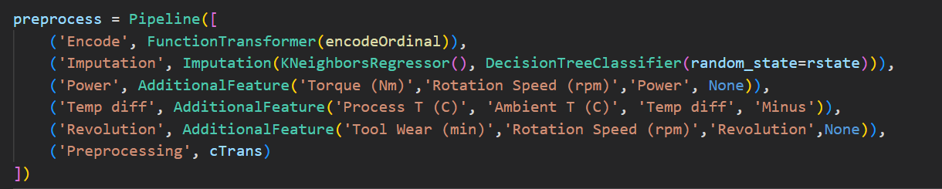
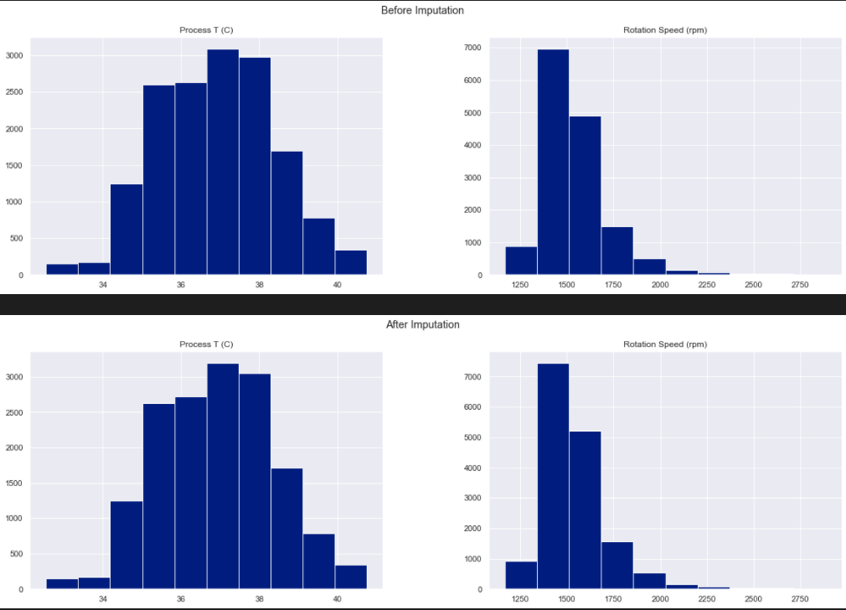
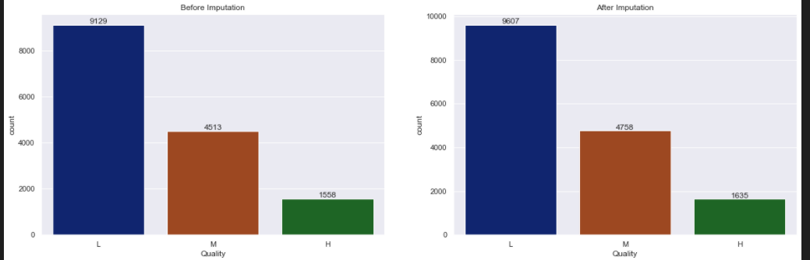
Preprocessing in a pipeline to prevent data leakage
Use of sklearn ColumnTransformer and FunctionTransformer
KBinsDiscretizer to perform binning on Tool Wear (min).
Help model to be more robust and data be more regularized. (also handles outliers)
OrdinalEncoder to encode Quality.
IterativeImputer() (multivariate approach) to impute continuous features, and classification model to impute Quality.
Will not use machine status to impute as it leads to data leakage
Imputation did not distort the original distribution, which is a good thing.

Slide 13
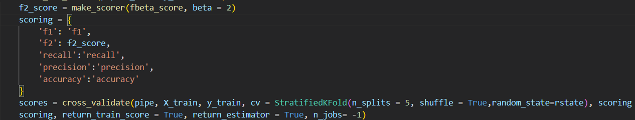
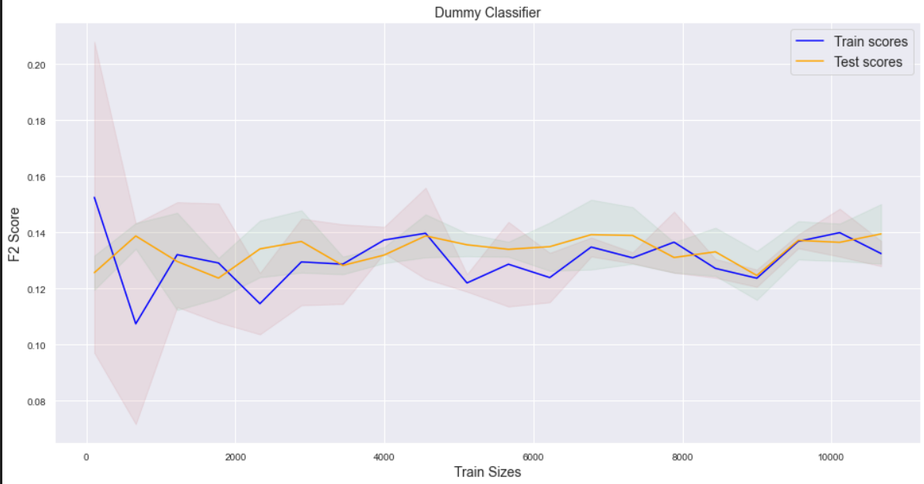
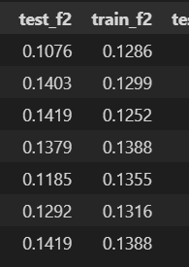
Modelling
Dummy Classifier
We want to pick a model that helps us relate features to target variable as well as possessing a high metric score
Use of learning curve and stratified k fold cross validation on train set to understand the model’s performance, to select models. Stratified Kfold is used instead of normal to preserve percentage of samples for each class, We do not have to worry about any splits containing very few or none of the minority class, as StratifiedKfold tackles that problem for us. (Important for imbalanced)
Strategy = ‘uniform’,
Dummy Classifier does not perform well but poorly with unimpressive F2 scores and have high bias, underfitting the data.

Slide 14
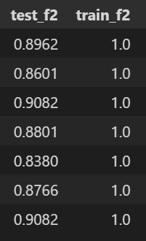
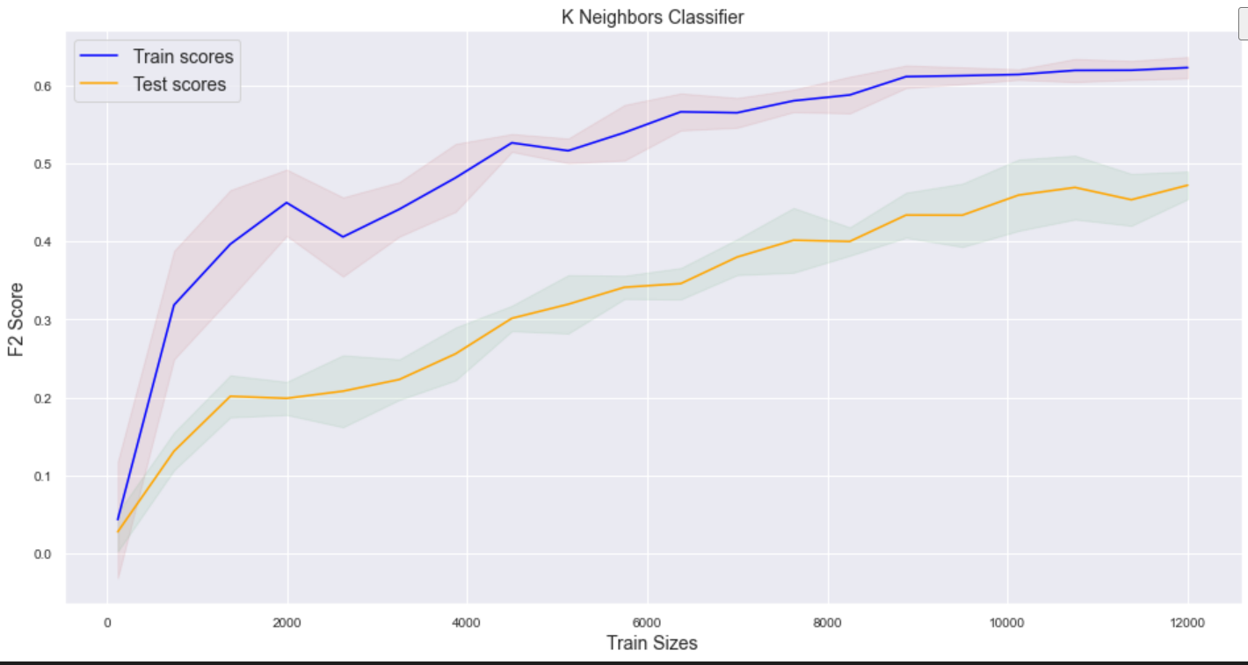
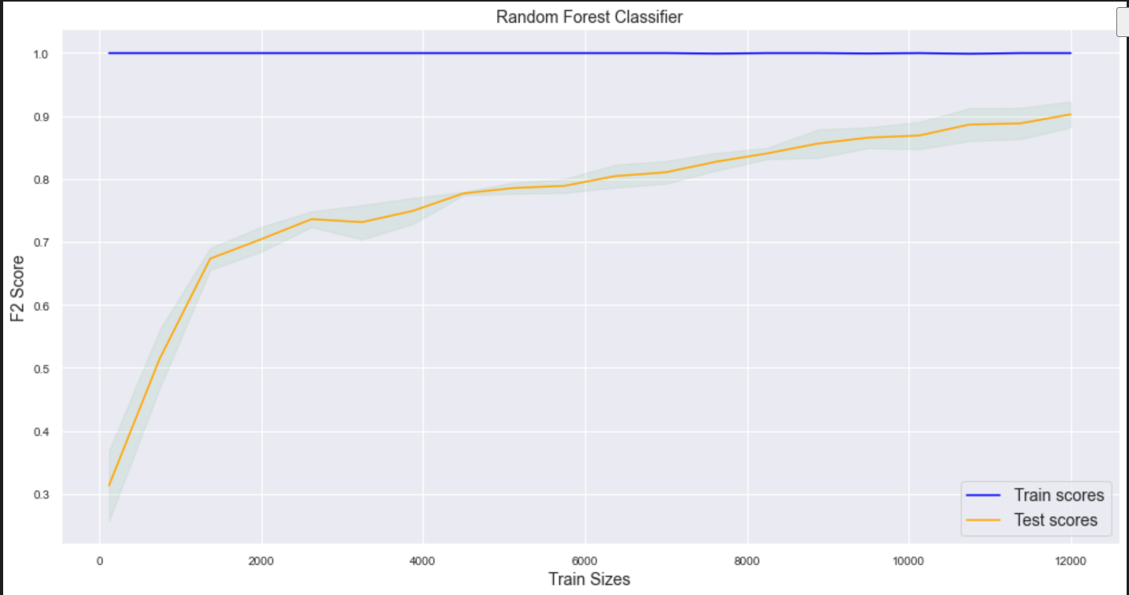
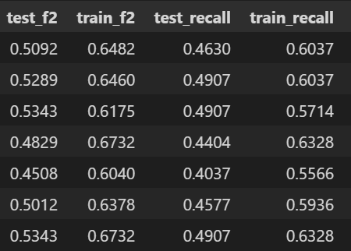
Modelling
Random Forest classifier works very well with consistent perfect F2 Scores for Train sets, However, test scores indicate that the model might be slightly overfitting. This however, can be addressed via hyperparameter tuning. All in all, RF is generally an optimal model, with low bias
K Neighbors classifier does not perform very well and it seems that it has pretty high bias, seems like underfitting. It also has pretty bad recall and F2 scores. Larger gap between train and cv scores suggest slight overfitting

Slide 15
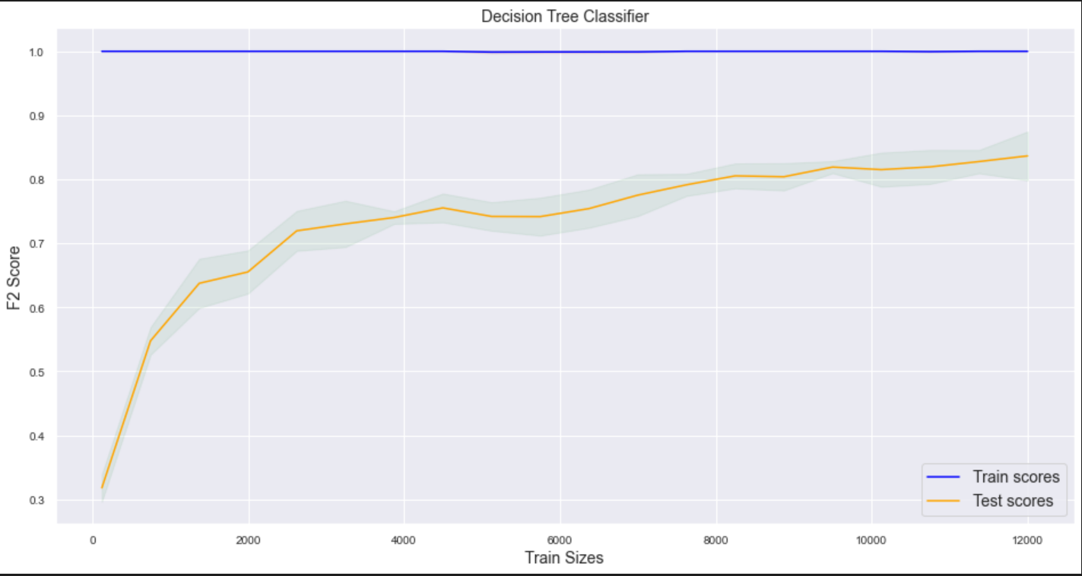
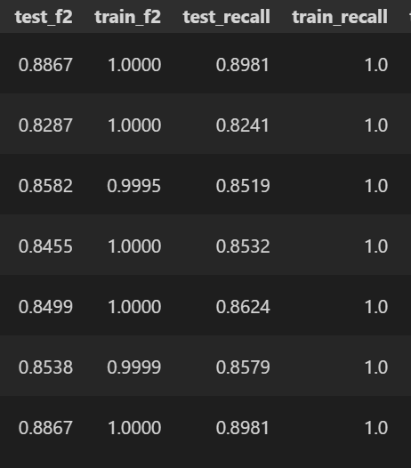
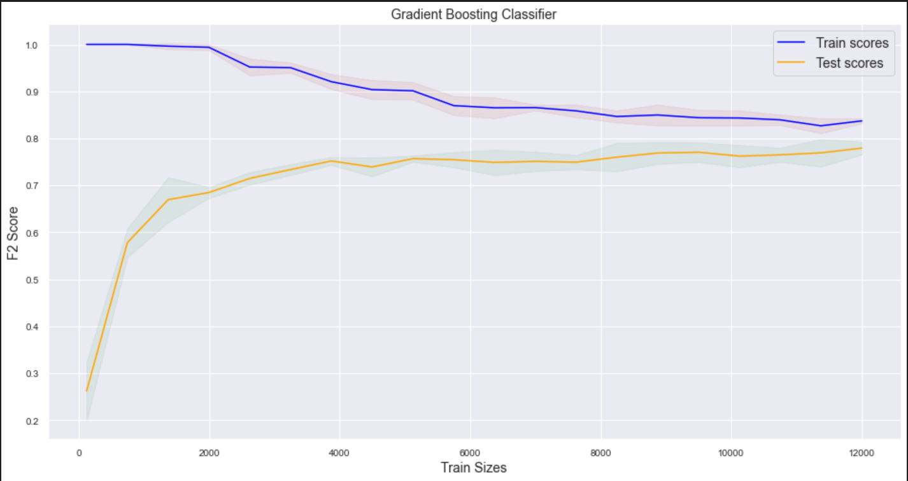
Modelling
Dectree has Decent f2 scores, however recall scores are not great
Seen from curve, decision tree is overfitting, with high variance
Slightly inferior compared to RForests.
GBC performs pretty well.
As seen by the close gap seen from the training and validation folds, model doesn’t overfit train set
The model has low variance, but however, it does not perform as well as Random Forest, with a decent F2 score.

Slide 16
Thorough Model Evaluation
Gradient boosting performs well with low variance and moderate bias, but it has an unimpressive metric f2 score through cross validation
(Distanced based models) - KNeighborsClassifier has a bad F2 score as compared to the ensembles, and is underfitting.
Tree based model (DC) performs quite well. However, decision tree still lacks in terms of F2 score, and slightly overfits more than other ensembles.
Ensembles like Random Forests seems to be the best model, however slightly overfitting.
Moreover, random forest posses a very high recall score and generally the highest F2 scores through cross validation, which is important in our scenario.
Given this, it is pretty evident that random forest is the best choice.
Along with its feature importances available, we can really understand how features relate to target variable.

Slide 17
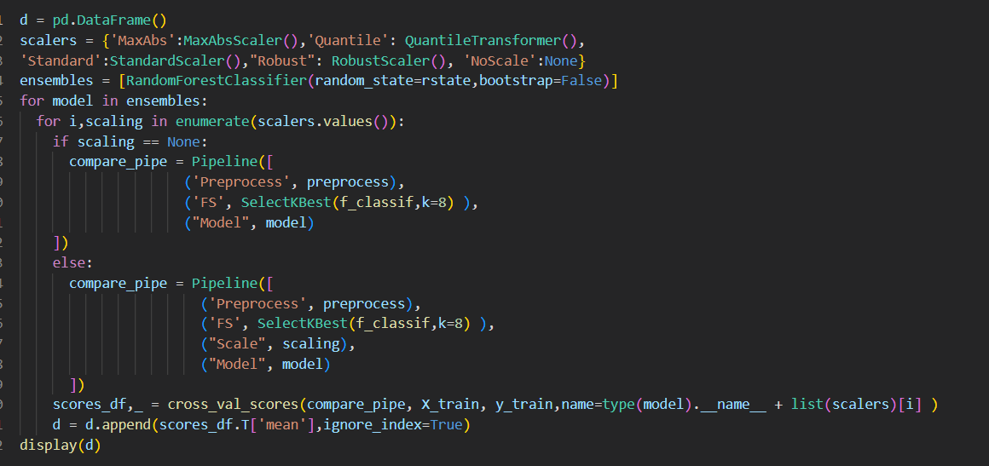
Model Improvement (Feature Scaling)
Model Improvement
(Feature Selection)
Use of SelectKBest (a filter based feature selection) to perform feature selection to remove less important predictors from the data to prevent the model from overfitting to noise from less relevant features. With this in mind, it can also ease the problem of multicollinearity as well. (use with f_classif)
K=8, effectively removing Process T (C)
We cannot remove anymore given the small number of features in the dataset. Reducing further will lead to underfitting.
Through thorough evaluation of some feature scaling methods, even with No scaling, StandardScaler is the best for the model, with the highest F2 scores.

Slide 18
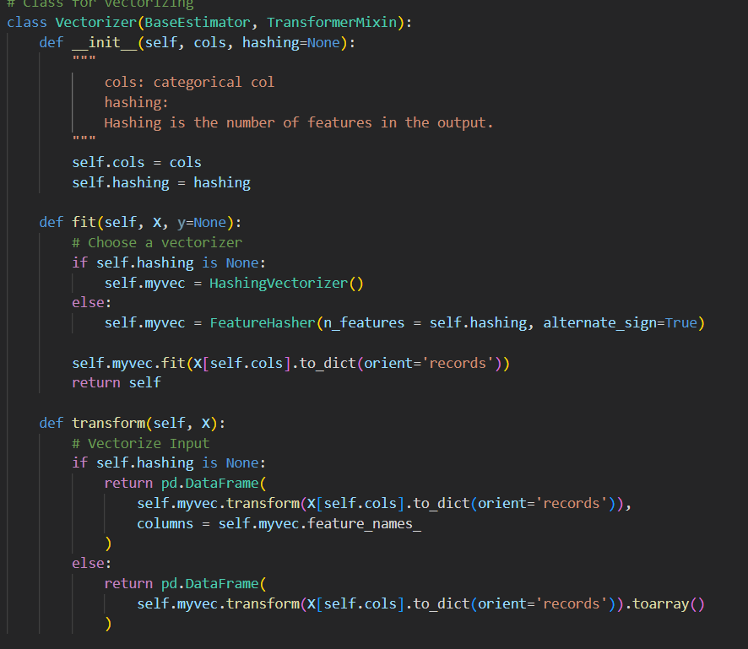
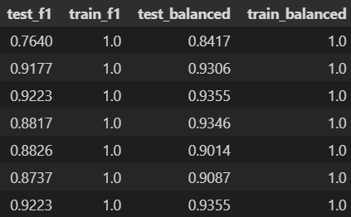
Model Improvement (Feature Engineering)
Attempt to perform some feature engineering to see if utilizing Product ID will help the model
Attempt to perform the Hashing Trick on Product ID.
Use of FeatureHasher to convert into a vector of features
Scores however did not improve.
Attempt to handle imbalanced dataset problem by over sampling.
After analysing the f1 and balanced accuracy scores, I noticed there was not much of an improvement, hence we will proceed to hyperparameter tuning

Slide 19
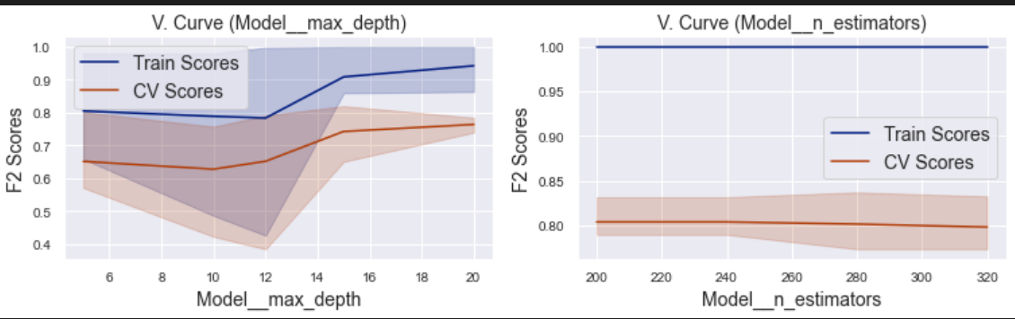
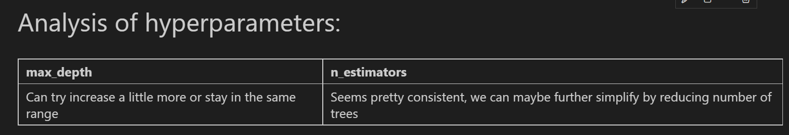
Validation Curve (Model evaluation)
Done using TRAIN SET to check validity of hyperparameters.
Plot VC to visualize model performance over a range of hyperparameters.
Visualise n_estimators and max_depth
Can increase max depth a little more, too much may result in overfitting.
Proper tuning of max depth needed to balance bias and variance.
Can further reduce n_estimators to simplify model

Slide 20
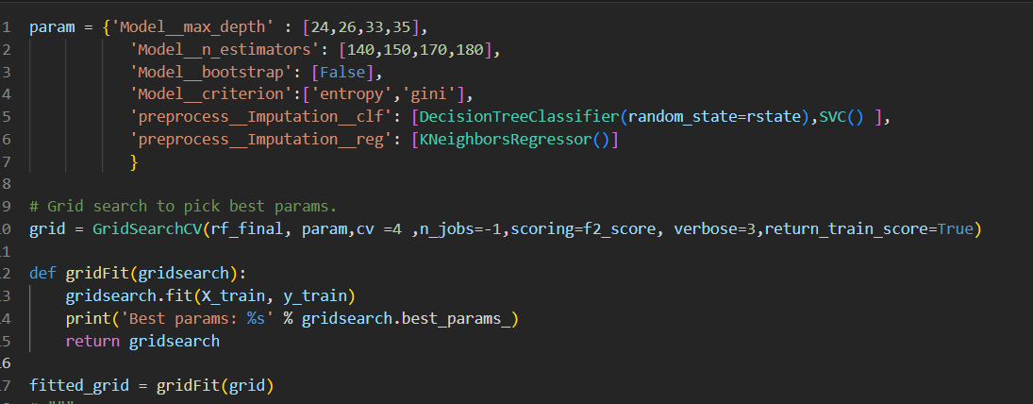
Model Improvement (Hyperparameter tuning)
Tuning the hyperparameters of the model through GridSearchCV to prevent the model from being too complex
I made sure to carefully pick the number of n_estimators, as generally too many will lead to diminishing returns which we want to avoid.
Max_depth parameter is also tuned to reduce the overfitting.
Gini and entropy criterion also included.
Bootstrap is also set to false, due to an imbalanced dataset. Setting to true may result in samples not containing the minority class, severely limiting model ability to predict for minority class.

Slide 21
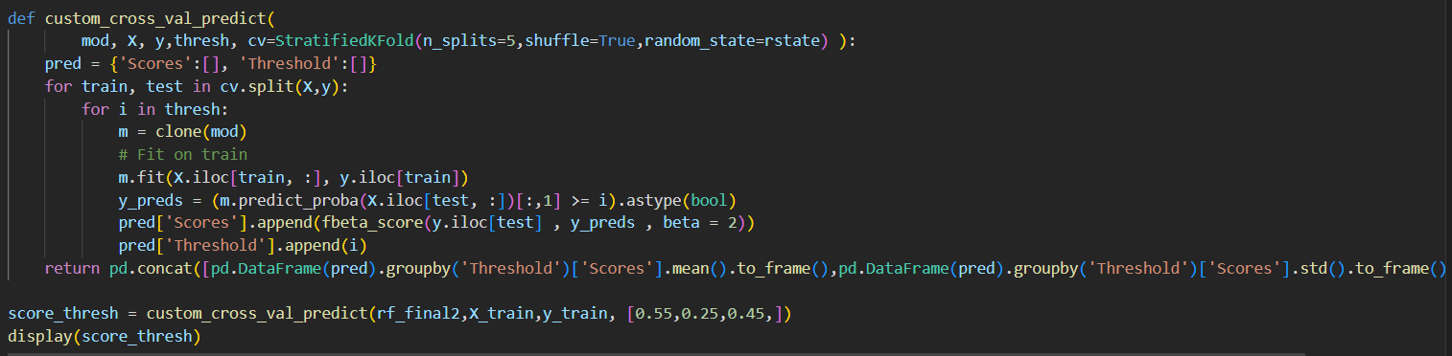
Model Improvement (Threshold Tuning)
Since our dataset is imbalanced, the original threshold may not work well, we will attempt to select the optimal threshold value.
Perform stratifiedKfold CV to select optimal threshold.
Predict_proba to get probabilities of prediction
Through this, we have discovered that the optimal threshold is 0.45. (small score improvement)
Further reducing the threshold may limit model to generalize to new instances (especially majority class), as the probability decreases.

Slide 22
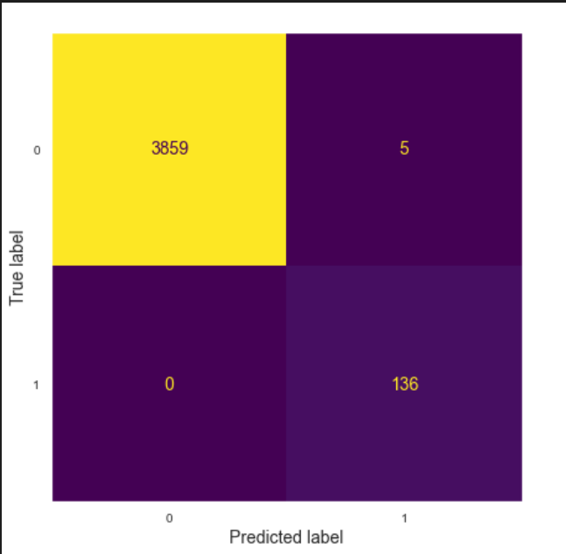
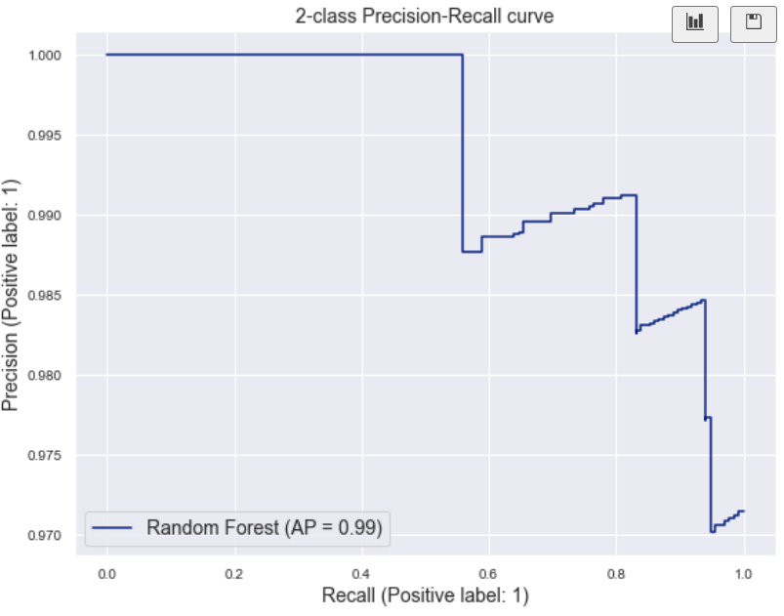
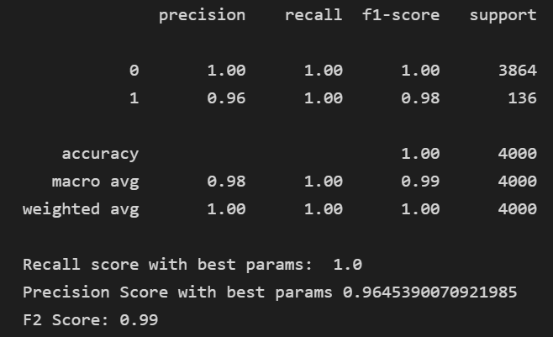
Random Forest Classifier Evaluation
Using an independent unseen test set, to evaluate the final classification model.
Use of newly selected threshold of 0.45
Both confusion matrix and classification report helps us to have a deeper understanding of how the model performs.
Confusion matrix – Tells us the correct and incorrect classifications.
Values on diagonal represents no. of times where predicted label matches true label, Values in other cells indicate instances where model misclassified observations
For errors, the model predicts machine of failure status, but actually the machine is normal. ( 5 FP)

Slide 23
Random Forest Classifier Conclusion
Managed to balance the Precision/recall trade off (excellent recall).
F2 score of 0.99
Model is able to accurately Predict machines that fail and able to generalize well
Rest assured that model is NOT
Finding shortcuts, (predicting every
Thing as observations of majority class)

Slide 24
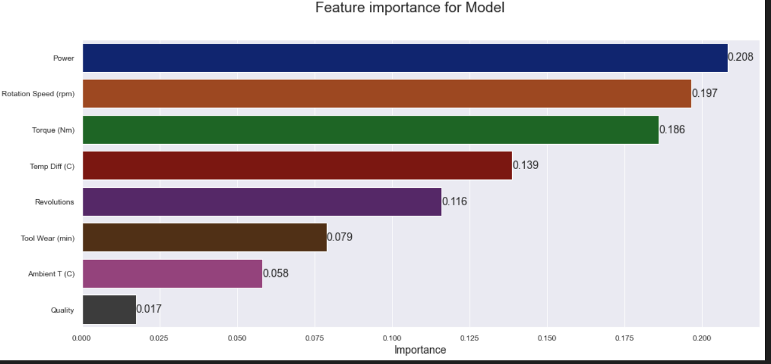
Feature importances
RandomForest Classifier does provide its importance of features which is important for interpretability.
We can see that rotation speed and power are the best features given its high feature importance, which suggests its high relevance by the model, showing that feature engineering was useful.
Insight: Power, rotation speed and torque are very relevant in deciding the status of factory machines
`Quality` is not very important as suggested by model

Slide 25
Conclusion
We have successfully developed a binary classification model. Moreover, a model with high bias is limited from learning the true trend, hence underfitting, while high variance overfits the training data. With this, we managed to overcome the bias-variance trade-off and our model sits somewhere between the 2 extremes. Moreover, along with extensive feature engineering and model improvement attempts, we managed to obtain a relatively near perfect F2 score. Through extensive research about common problems about classification problems, i have also managed to gain more insights on imbalanced datasets, and how to handle them.
1. https://tulip.co/blog/machine-learning-in-manufacturing-an-introduction-to-industrial-ai/
2. https://limblecmms.com/blog/equipment-failure/
3. https://www.assemblymag.com/articles/96518-equipment-failure-is-costly-for-manufacturers
4. [API design for machine learning software: experiences from the scikit-learn project](https://scikit-learn.org/stable/), Buitinck et al., 2013.
5. https://towardsdatascience.com/how-to-implement-machine-learning-for-predictive-maintenance-4633cdbe4860

