Slide 1
PC Price Regression
Supervised Learning AIML CA1
Modelling objective:
To build an optimal and accurate model to estimate computer prices, by using Root Mean Squared Error (RMSE) as our main metric for evaluation
Lim Hur 2112589
DAAA2A02

Slide 2
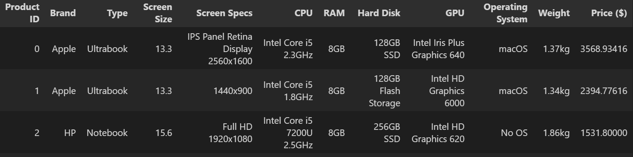
Prediction task and background research
Can we utilize machine learning to help potential PC buyers determine the price of a computer given its specifications and components?
Dataset – Collected from a PC website, with Price ($) as the target variable. (continuous)
Given a set of specifications and components about each PCs, our goal is to accurately predict the price of PCs.

Slide 3
Prediction task and background research
1. Our task is to develop a regression model by leveraging on labelled data to assist potential PC buyers/and or sellers, to accurately predict the price of PCs.
2. We also want to gain further insights on factors that affect the PC prices, (that is the most important component/aspect.)
Recognizing the importance of good decision making
1. For many individuals, the price of a laptop plays a large decisive role. When we purchase PCs, each of us would attempt to get the best equipment at the lowest possible price. However, we may overlook some specifications/components when picking the ideal PC. For instance, getting a PC of a famous/luxurious brand with exorbitant costs, may not necessarily suit oneself which will lead to regrets.
2. Given the difficult dilemma of selecting a perfect PC, we need to decide what is the purpose of purchasing the PC.
PCs are used in a variety of settings, such as at work, educational purposes, gaming, web browsing, personal multimedia, or for general home computer use.
3. In most cases, getting a PC with an average CPU performance and integrated video card is sufficient. However, a more robust and efficient CPU may be needed for other purposes such as gaming.

Slide 4
Predictive pricing
1. Benefits both retailer and customer.
2. Do not have to go through inconvenience of scrutinizing each component/aspect to determine its price.
3. By utilizing machine learning to help assess the specifications, manufacturers will be able to set a competitive price that appeals to customers, which will help maximize profits.
4. From the customers' perspective, predictive models can prevent them from overspending as well as getting scammed.

Slide 5
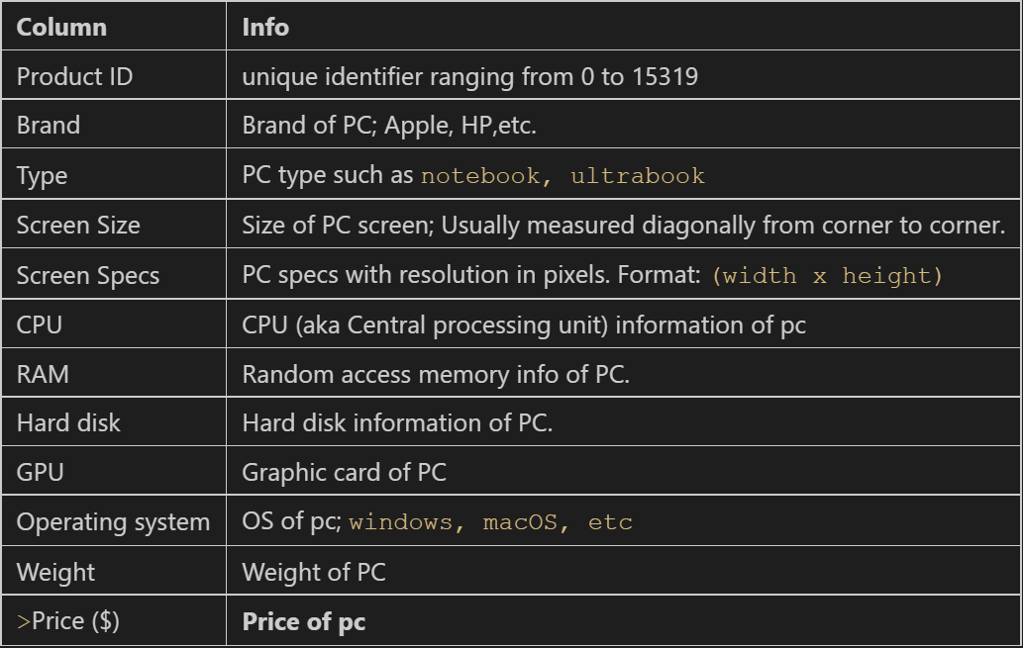
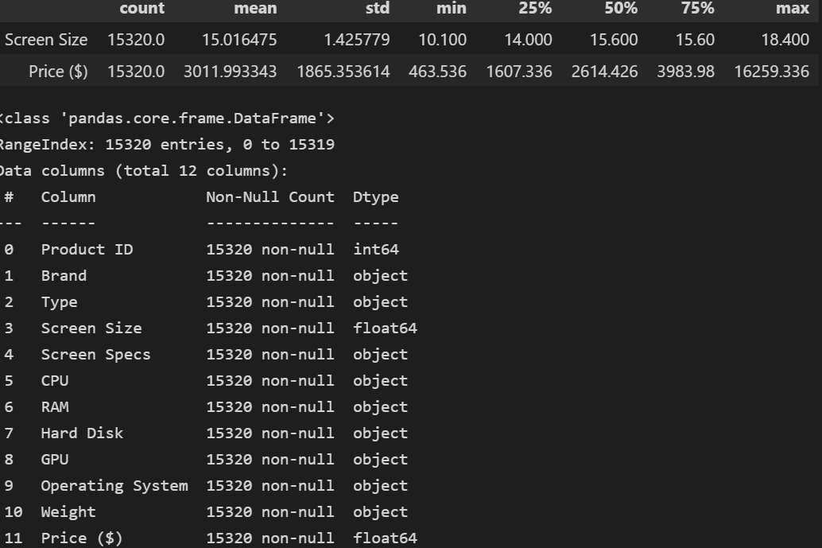
Exploratory Data Analysis
Dataset has 15320 rows and 12 columns
No Null values observed
- Standard deviation is very high for PC prices, suggests that the prices will vary significantly
- Median pc price is (2616) while maximum is 16k, suggests a right skewed distribution of prices. (observed from each quantiles as well)
- Possibly existance of outliers given such a distribution
Median looks like a better central tendancy for PC prices in this case.
Product ID (does not provide info toward target variable)
- Screen sizes are generally consistent, with similar mean and median, may be a categorical variable given that the percentiles are similar.
May need to ‘unpack’ from some of the features through feature splitting/subsetting

Slide 6
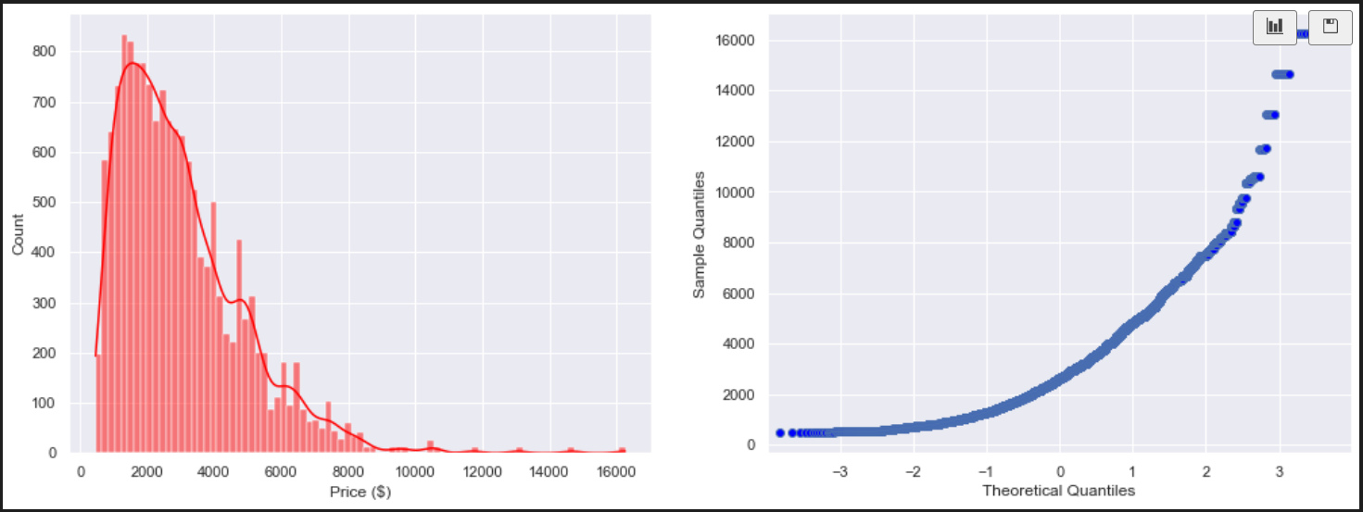
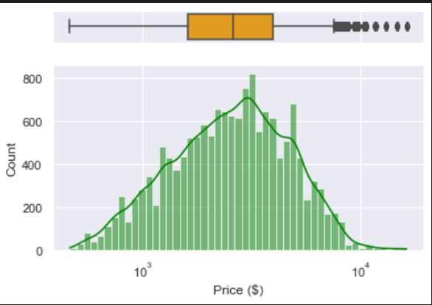
Target variable Analysis
Price is positively skewed to the right, with the existance of outliers. (shown via qqplot and histogram)
Posses a high Interquartile range
Outliers exist in the form of costly computers of over $10k
Median may be a better central tendency for price
Log transformation can help to convert skewed distribution to a near normal distribution
Can also help to treat outliers instead of removing outliers (valuable data).
This idea may help the model later on

Slide 7
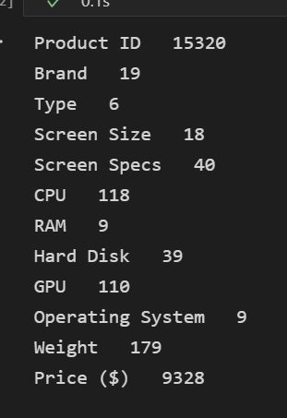
Feature Subsetting Motivation
No. of unique values
Perform feature subsetting
Some features like CPU have very large number of unique values, directly one hot encoding may result in the creation of excessive dimensional spaces, which may lead to the problem of Curse of dimensionality, where it may affect the model’s performance.
Purpose To perform EDA as well.
Need to unpack data.

Slide 8
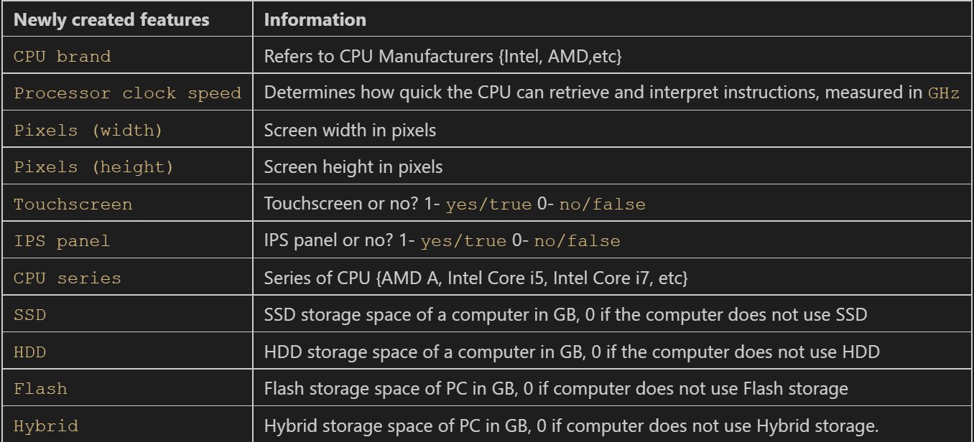

Feature Subsetting/ Data Preparation
Introduce some new features on the right.
Use of python re module, and pandas regex to subset new features.
Remove KG, GB from weight and ram.
Extracting processor clock speed.
Extracting height and width of screen in pixels from Screen Specs.
‘Custom One hot encode’ Hard drive, into columns like SSD and HDD, Flash, hybrid after removing ‘+’. Such that a PC with 128 SSD space is represented like this:
Extract IPS panel and touchscreen

Slide 9
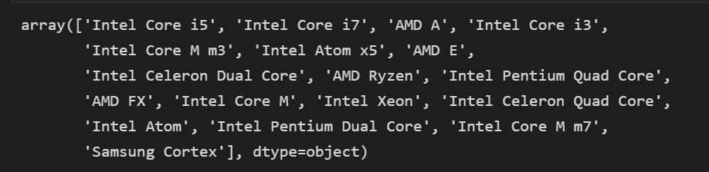
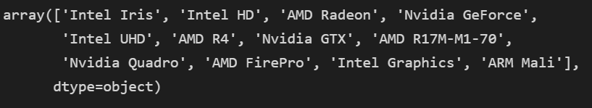
Feature Subsetting/ Data Preparation
CPU has pretty high cardinality, with large amount of unique values. Directly one hot encoding is not ideal, creating excess dimensional spaces.
We will extract some useful information from CPU, extract CPU series
Extract CPU brand from CPU
Replacing some duplicate names such as intel M m3 and intel M M3 to similar name.
Extracting GPU type.
Dropping processed features.

Slide 10
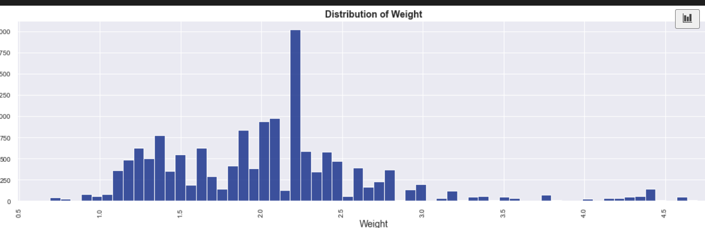
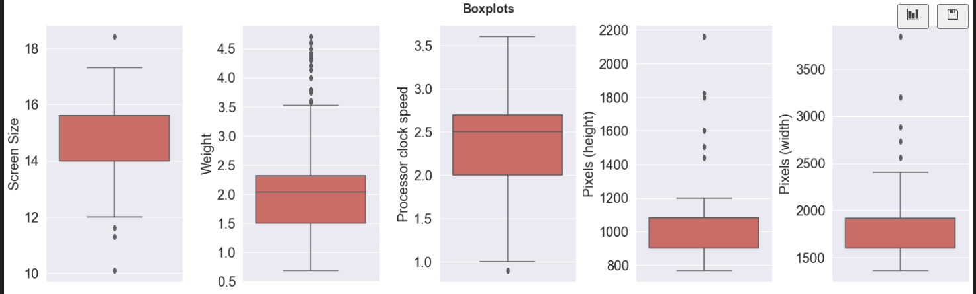
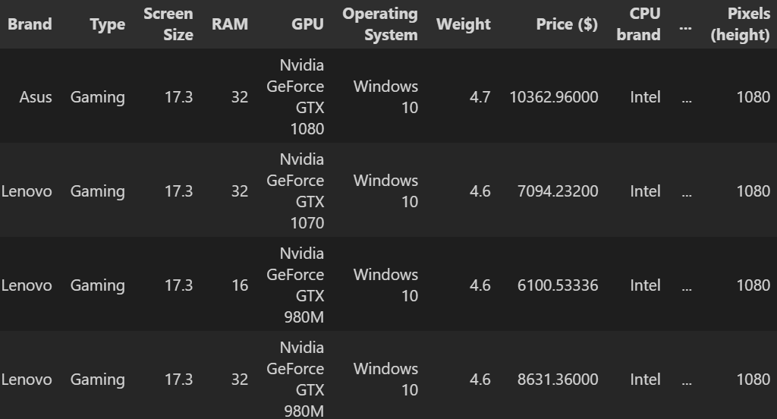
Exploratory Data Analysis
For weight, we can see a non guassian distribution with most PCs weighing around 2.2KG.
Presence of outliers, with PCs weighing above 4.5kg.
Diving deeper, we can see that those PC above 4.5 kg are generally used for gaming purposes, which can explain their heavy weight.
Screen size, processor clock speed generally follows a normal distribution, with little outliers.
Prescense of univariate outliers from ['Weight', 'Pixel']

Slide 11
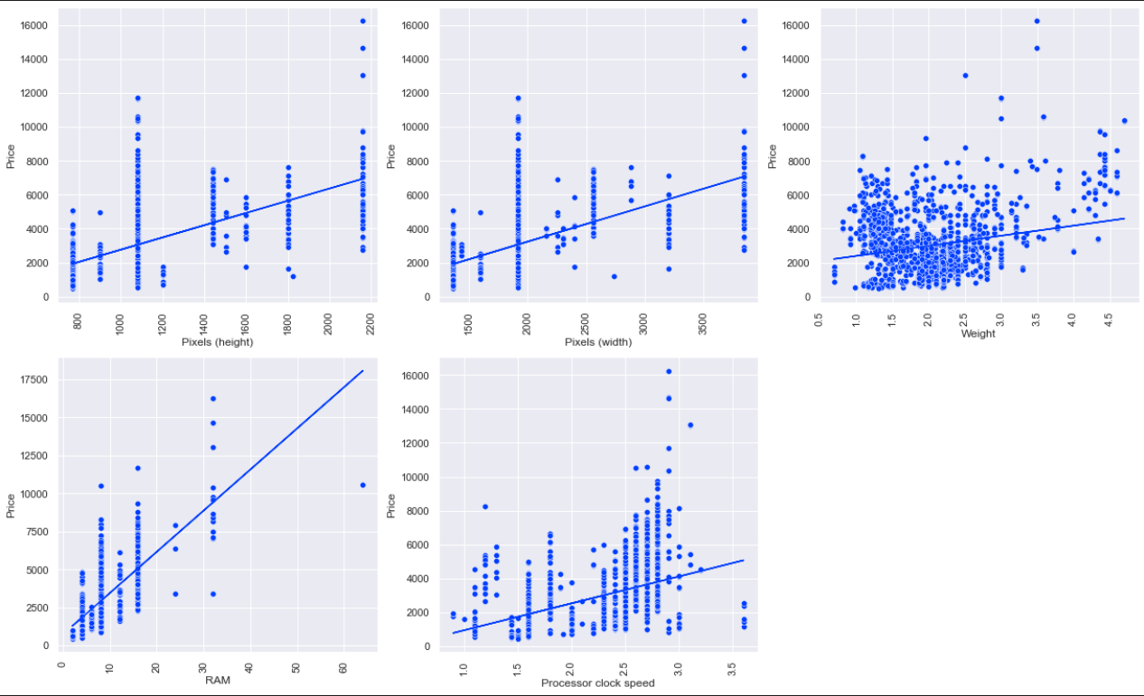
Bivariate analysis
Bivariate outliers observed between price and RAM
Generally there are not many extreme outliers between the variables
We note that there is an extreme outlier observed, with 64GB ram
We observe that PCs with 64gb ram are mainly high end PCs, that are running a more expensive GPU, as well as slightly big screen size. We will not drop as these PCs are the only instances of 64GB, dropping them may limit the model to be familiar with such observations in the future during deployment
Generally most values that are 'outliers' possess a very high price, hence we may be able to utilize Log transformation to help our model later.
Several outliers observed under `processor clock speed`. however, they are not very extreme, hence we do not need to worry

Slide 12
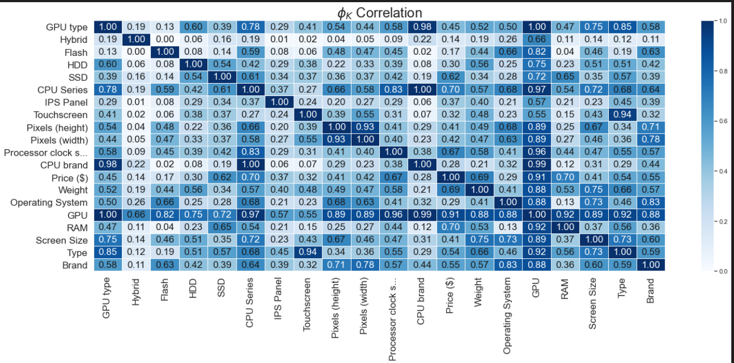
Phik Correlation Matrix
(𝜙k) is a correlation coefficient that works consistently between numerical, ordinal variables. This is very useful for this current dataset.
We notice that some features are highly correlated in our model, which may pose a slight problem for our model.
- Features like pixel (width) and pixel (height) are highly correlated. (May result in an unstable model.)
- This may suggest that there are redundant information and noise in the data, and feature selection can be useful and can benefit our model.
- Features like ['Weight', 'RAM', 'CPU Series'] are highly correlated with target variable (price ($) ).
- This is logical as these are the specifications many would look out for in buying a PC. For example, higher RAM(random access memory) may indicate a higher end product, with more efficient processing speeds which are generally more costly.

Slide 13
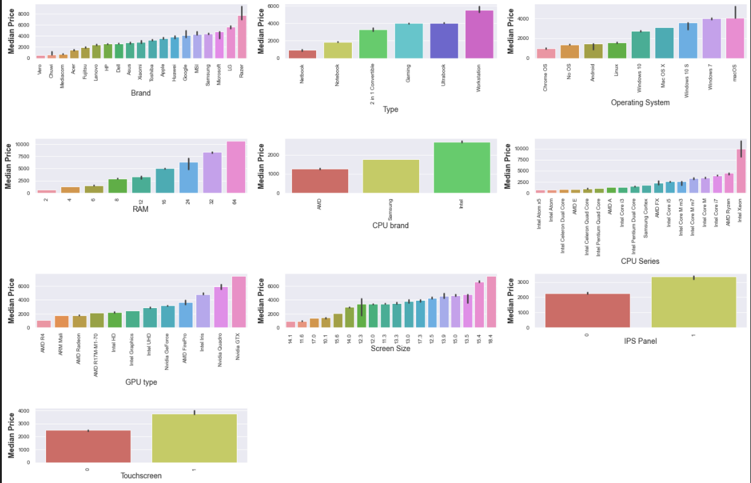
Comparing price against PC components/aspects
Razor is the most expensive brand of PCs, this would be logical as they specialise in high end gaming laptops, with good performances.
Generally less well known brands such as Chuwi & Vero costs cheaper.
Workstation type PC are most expensive, likely as they are used for high end computers that are used for scientific or any other heavy usage application.
Generally, we can see a direct relationship between RAM and price, with 64GB PCs being the most expensive, while 2GB PCs costing very little.
Intel brand of CPU costs the most expensive.
Intel Xeon CPU series is the most expensive category with prices over 10000, perhaps it has top tier and premium in performance, and are usually used by businesses as server class chips.
For GPU, Nvidia GTX costs very expensive as well, while the cheapest is AMD R4.
With Touchscreen or IPS Panels generally cost more than without as panels are expensive to make.

Slide 14
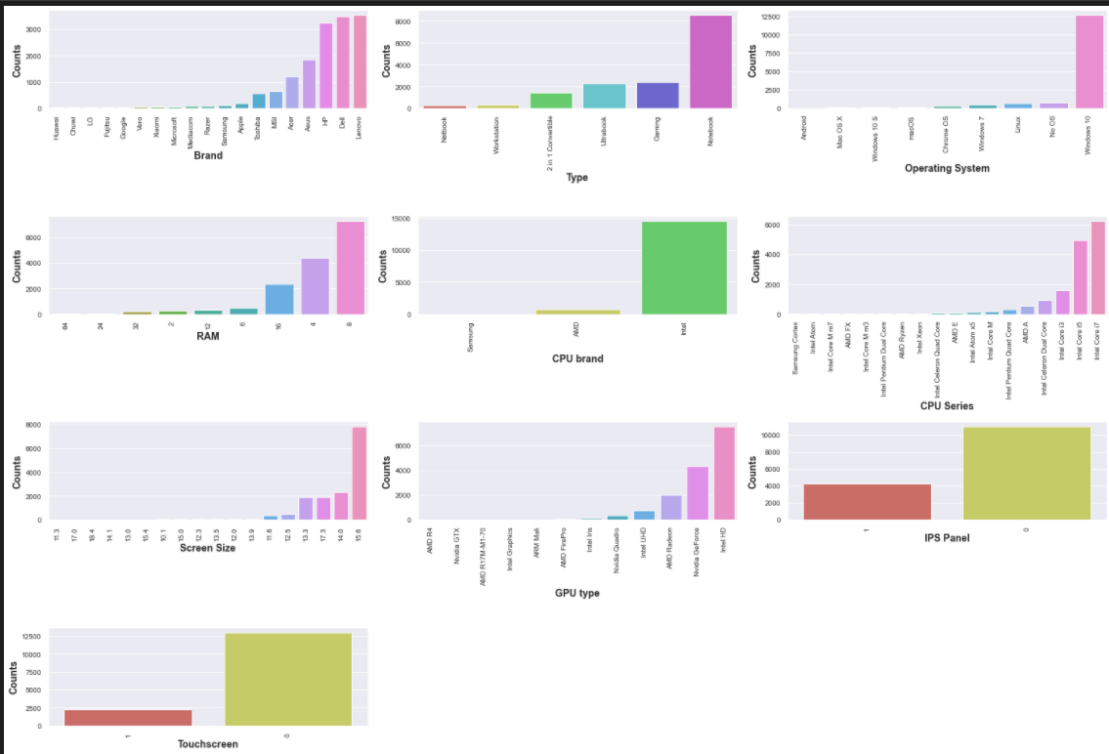
Exploring general features
In constrast to the previous plot, we note that the most expensive one is not always the most common. From the data, there are very little PCs with 64GB, which may explain the exorbitant costs. (Similar case with Intel Xeon.)
This may be because the PC website may generally cater to general public, hence such specialised components may not listed, hence may be more uncommon, which explains the low counts.
More common CPU sub categories or components like Intel Core i7 are listed, as well as common OS like Win10, which is the OS for majority of PCs.
Less touchscreens and IPS panels PCs
For brand, there are several categories with very low counts, Lenovo being the most popular with highest counts

Slide 15
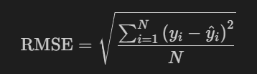
Preprocessing Evaluation Metrics
Why RMSE?
Can consider metrics like MSE, MAE, where MSE penalize errors, by squaring the errors, and MAE do not really penalize the model for making large errors.
RMSE is better indicator to reflect how well our model deals with outliers, large error values.
RMSE tells us how accurate our predictions are, and the amount of deviation from actual values.
Since our goal is to predict PC prices for buyers who may not be familiar with market price,
We want to be penalized due to large errors made by the model.
This is to ensure that our final model is very robust and accurate. Ultimately, we do not want our model to predict prices that are very far off/inaccurate, causing potential PC buyers to overspend
Drop Product ID as it does not provide information towards target variable
Train_test_split to create hold out sets. Test set used to determine how good model generalizes.

Slide 16
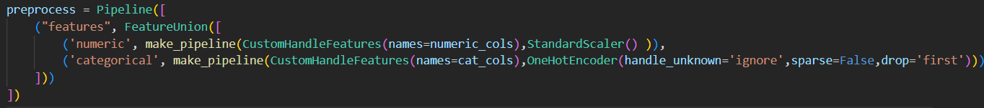
Preprocessing data pipeline to prevent data leakage during CV
Use of FeatureUnion
For numerical features, they are of different scales hence, StandardScaler() is used to standardize values.
Perform One Hot Encoding on categorical attributes as there is no clear hierarchy among the different categories, set param drop=‘first’ to prevent highly correlated encoded features.

Slide 17
Modelling
K Fold cross validation to evaluate models through RMSE scoring.
Plotting learning curves to analyse the bias and variances of model.
And determine if model is overfitting and underfitting.
Finally, we will propose some improvement approaches that we could take.

Slide 18
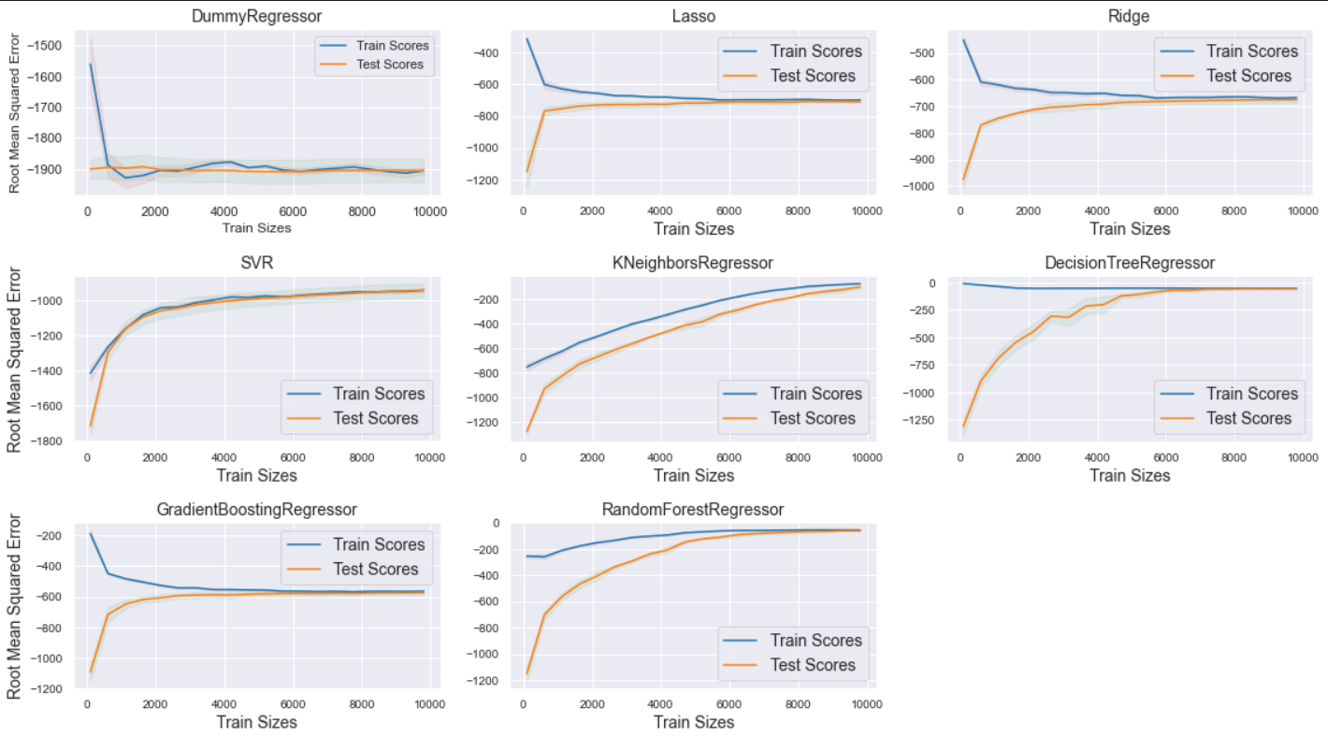
Modelling
1. Dummy Regressor: Baseline model: severely underfitting with high bias.
2. Linear Models: Lasso & Ridge regression generally do not overfit, and have pretty low variance given the small difference in CV and train scores.
They do however underfit as they may not be complex enough and generally performs poorly, (high bias)
- These models pale in comparison to ensemble models or like Decision Trees in terms of RMSE
> One possible improvement is to introduce `PolynomialFeatures()` which generate polynomial and interaction features
3. Distance based models
- `KNeighborsRegressor` might be suffering from slight underfitting, and has a decent average RMSE score
- Slightly overfitting given the larger difference in errors in CV and training sets
- Generally performs better than the linear models
> One improvement approach to take could be changing the scalers

Slide 19
Modelling
> 4. Tree models
Dec tree performs exceptionally well, possessing a low bias and variance, given its similar train and CV scores.
- Does not seem to be overfitting, hence we can consider this to be our model
- Possess excellent RMSE scores (lowest) for train and CV.
> One improvement could be further tuning model by optimizing hyperparameters > 5. SVM
- Possess similar train and CV scores
- Generally does not perform well with high RMSE, though it has low variance.
- Suffers from high bias, indicated by the high errors from train and CV scores.
> One improvement is to select the regularization parameter C.
6. Ensembles
- `Gradient Boosting` and `Random forests` perform very well, suffering from slight overfitting.
- RandomForest posses low biases, indicated by low errors from CV sets.
- Gradient boosting generally have pretty high bias, which seems like it is underfitting.
- One improvement approach to take is to tune hyper parameters, such as `max_depth` or `learning_rate` for gradient boostings.

Slide 20
Modelling
Generally, Decision Trees performed the best with a lowest mean absolute percentage error, as well as lowest RMSE.
Does not overfit like distanced based models, and hits the sweet spot.
Does not underfit as well
Even outperformed models like Random Forests in terms of cross validation scores.
To summarise, Decision trees is a promising and simple candidate, and we will use this model.

Slide 21
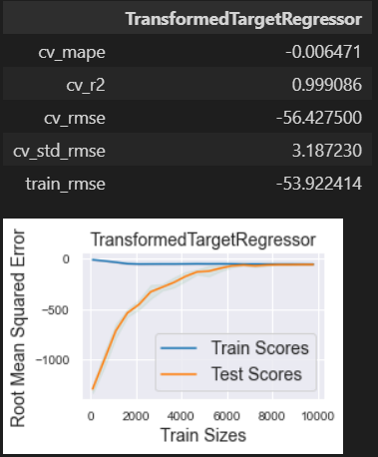
Model improvement
We want to further balance and reduce the bias and variance of our model
Log transform target variable.
Price follows a positively skewed distribution.
Skewness, which indicates the lack of symmetry in data, could adversely affect regression model.
Log transformation can help ease the skewness, as well as enable the model to be more robust, by transforming the target variable to follow a normal distribution.
Use of TransformedTargetRegressor
Performed slightly better, and also lowered the variance of our model.

Slide 22
Feature selection
From correlation matrix, several features are highly correlated, which may pose a problem for the model, which may suggest redundant features.
We recognize that since we are one hot encoding our categorical variables, and since the dimension of the input space increases with the cardinality of our encoded variable, we may face a problem of the curse of dimensionality where model performance decreases, and may result in overfitting hence not generalizing well to new examples.
We can perform Feature Selection on our data since we have 172 features, with the goal of removing less relevant features from the data, to avoid our models overfitting to noise as well as attaining a simpler model.
We can try a few methods such as `PCA` or filter based feature selection like `SelectKBest`, or RFE.

Slide 23
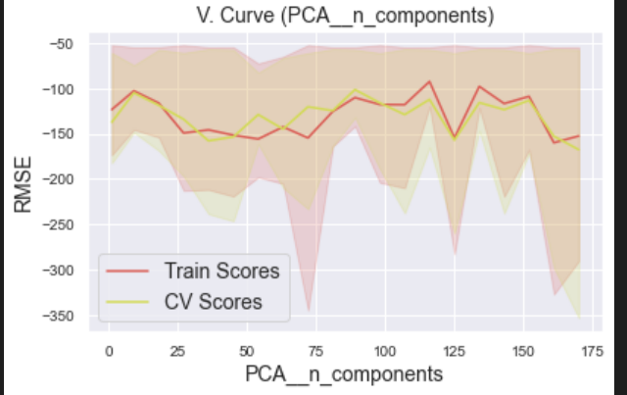
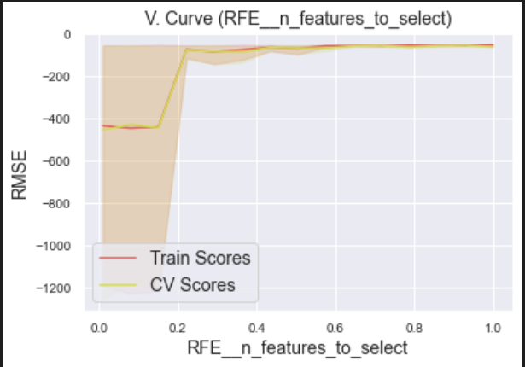
Feature selection (PCA/RFE)
Using PCA, we note an unstable trend when changing the PCA n_components parameter.
Higher RMSE, which is not very ideal for the model.
It also has very high standard deviations for train and CV scores.
RFE is better, with a more consistent trend, and lower RMSE errors for both train and cv sets.
- Wrapper type algorithm that select features that are the most relevant in predicting target variable, which can be more efficient than a filter based feature selection method.
- Works by searching for a subset of features by starting with everything in the training set and slowly removing features until the number we specify.
RFE further simplifies our model. We will keep 40% of features, given its lower standard deviation for train and cv sets at 40%.

Slide 24
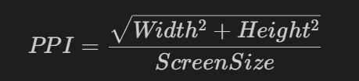
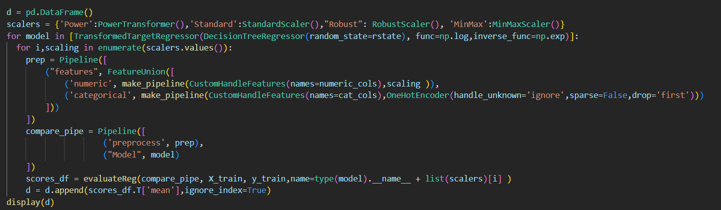
Model improvement (Scaling & Feature Engineering
Create new feature Pixels Per inch
refers to individual pixels are displayed in one inch of a digital image
Scores improved a little, and also furthered maintain the variance.
Scaling methods:
Testing out a few scaling methods, such as PowerTransformer, StandardScaler, Robust, MinMaxScaler.
To make sure features of higher magnitude do not control the model.
StandardScaler helped us the most, hence we will use standard scaler.

Slide 25
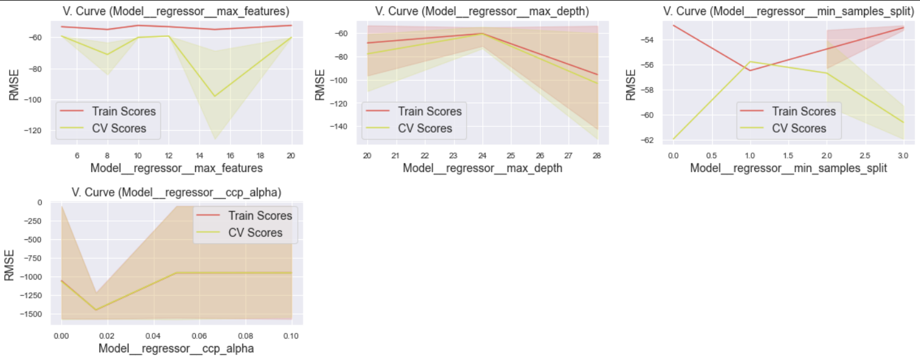
Model improvement (Hyperparameters)
We will plot validation curves and see how the model fares under a range of hyperparameters.
Similarly, we will check the validity of hyperparameters.
So that we know which range for the hyperparameters to test in gridsearchcv
Max depth -> lower variance as depth increase. (valid hyperparameter)

Slide 26
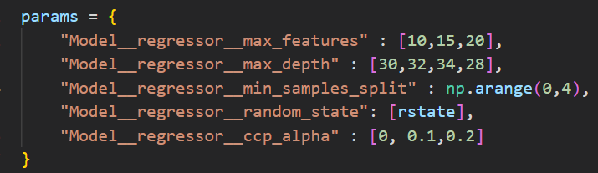
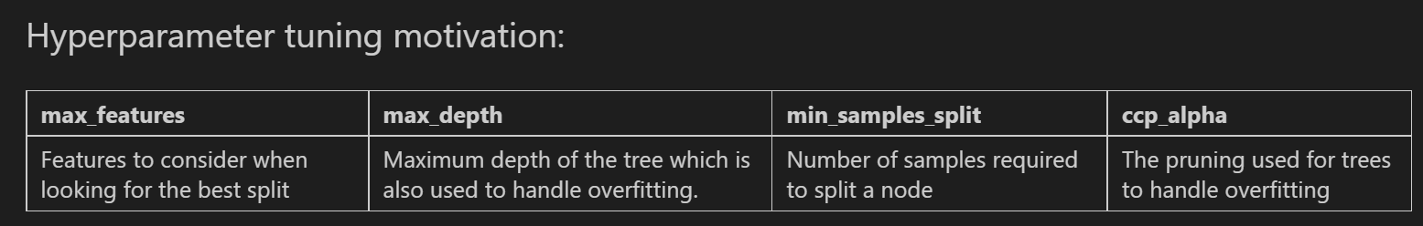
Model improvement (Hyperparameter tuning)
Tune hyperparameters to attempt to simplify model.
Best params: 0 pruning, maxdepth :30, max_features:20, min samples split:3.

Slide 27
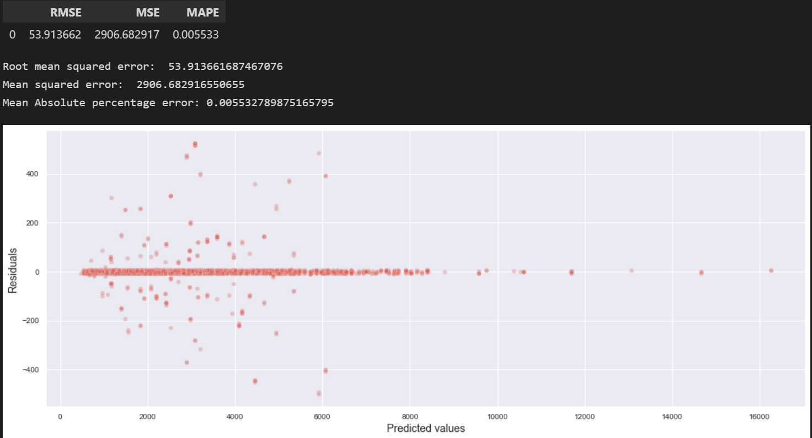

Decision Tree evaluation
Evaluation on unseen test set.
RMSE of 53, MAPE of 0.005
We can say that our model does generalize well to new examples as it does not severely overfit, or severely underfit.
Determine whether a model is appropriate in modelling the given data
We can see that from the residual plot, some points are scattered randomly from the y=0 line, we can conclude that the model is very approriate in our scenario. However if the residual plots follow a pattern, then it would not be a good model.
Our mean residuals is shown above, and since the residuals are positive, means the model has slighly underpredicted the price of PCs

Slide 28
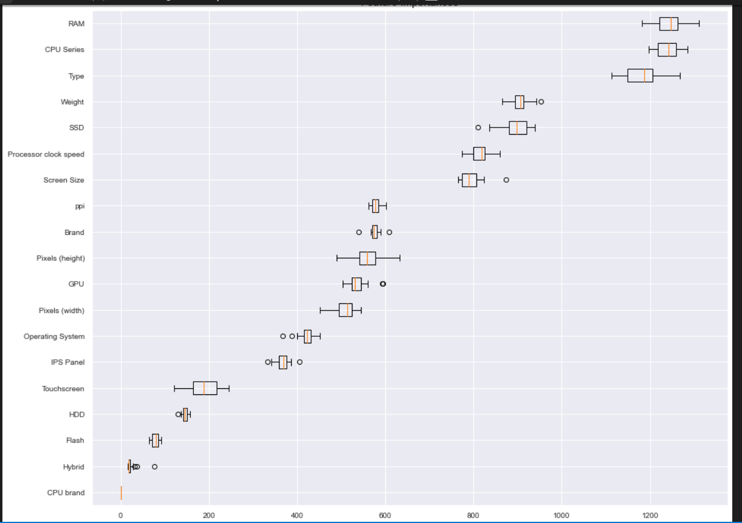
Feature importance
We will use `permutation_importance` to provide us with feature importances.
Permutation feature importance refers to be the decrease in a model score when a single feature value is randomly shuffled, the drop in the model score is indicative of how much the model depends on the feature.
RAM & CPU Series deemed as most relevant and important by model.
CPU Brand not very relevant denoted by its low placement.

Slide 29
Conclusion
We have managed to perform extensive feature subsetting and data preparation on PC components/aspects to obtain a model with relatively good $RMSE$ scores at the same time avoiding the curse of dimensionality. Through thoroughly evaluating each different regression model categories by analysing its pros and cons, we have ended up with DecisionTreeRegressor as our best model.
Moreover, we have managed to utilize feature selection techniques to select the most relevant features for our model. Apart from this, we have also managed to overcome the bias variance trade off through extensively performing hyperparameter tuning by reading up more about pruning, and other relevant hyperparameters.
Finally, our model sits between the 2 extremes of overfitting and underfitting and we have more or less fulfilled our objective.
References:
https://www.hp.com/us-en/shop/tech-takes/what-are-typical-monitor-sizes
https://dlabs.ai/blog/price-prediction-how-machine-learning-can-help-you-grow-your-sales/

