Slide 1
Reinforcement Learning
CA2
Defining Objectives
1. Develop and evaluate reinforcement learning algorithms to land an agent successfully on the lunar lander gym environment
2. Investigate applications of reinforcement learning algorithms
Lim Hur 2112589 Yee Hang 2112675
DAAA2B02

Slide 2
Background Info and research
Reinforcement learning is one of the popular research topics under the field of artifical intelligence. The underlying idea behind RL is the study of agents and how they learn in an interactive environment by trial and error. It formalizes the idea that rewarding or punishing an agent for its behavior makes it more likely to repeat or forego that behavior in the future. RL algorithms can be thought of as trying to find a balance between exploration and exploitation (Covered in detail later). Exploration is a type of decision where the agent chooses to pick an action that it would not have done, this improves their knowledge about each action, thus learning more (long term benefits). In contrast, exploitation is a greedy approach when the agent follows what it has always done. Overall, the ultimate goal is to find a suitable action model that would maximize the total cumulative reward of the agent.
Supervised learning vs Reinforcement learning
- Supervised learning - the feedback provided to the agent is correct set of actions for performing a task.
- Reinforcement Learning - uses rewards as indication for positive or negative behaviours.

Slide 3
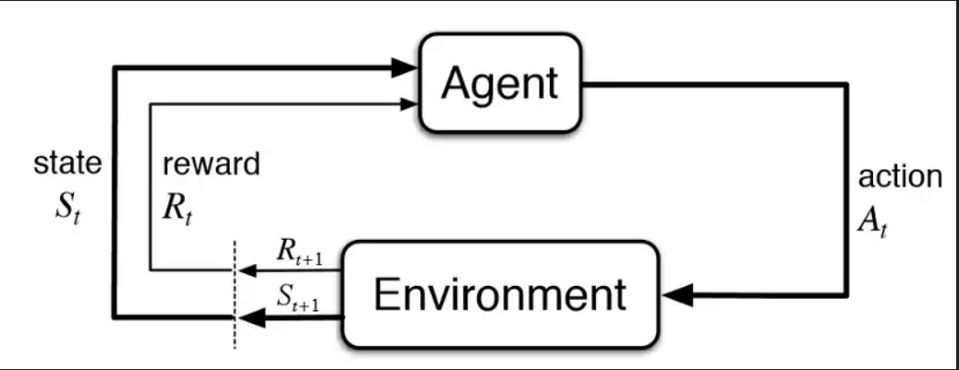
Problem Understanding
- The diagram below depicts the agent-environment interaction loop of a typical RL algorithm.
- In a typical RL problem, we would have the following:
- Agent: An agent in RL is an entity that tries to learn the best way to perform a task
- Actions: What the agent does at each time step
- Environment: We would also have an *environment* where the agent interacts with
- State: Then, we have the state which is the current situation of the agent.
- Rewards: Environment would provide feedback to the agent in the form of rewards. For example, if the action of the agent is good, then a positive reward can be given
- Policy (Impt**) to map agent state to actions
- The [process](https://pylessons.com/LunarLander-v2-PPO) is typically defined as follows: The agent observes the current state of our environment and, based on some policy, decides to take a particular action. This action is then relayed back to the environment, which moves forward by one step. This generates a reward that indicates whether the action taken was positive or negative in the context of the game being played. Using this reward as feedback, the agent tries to figure out how to modify its existing policy to obtain better rewards in the future. [4]
- Ultimately, the purpose of reinforcement learning is for the agent to learn an optimal, or nearly-optimal, policy that maximizes the "reward function"

Slide 4
Practical Applications of RL algorithms and its success
- It has enjoyed a wide variety of successes, such as the latest language models like ChatGPT. Such a model like ChatGPT makes use a combination of both Supervised Learning and Reinforcement Learning for fine tuning. As a result, ChatGPT is able to generate text with incredible precision, coherence and detail. Through a quick research, ChatGPT model was fine-tuned on using several iterations of [Proximal Policy Optimization (PPO) algorithm](https://arxiv.org/pdf/1707.06347.pdf). More specifically, chatGPT uses PPO to optimize its prompts on a reward signal given by another trained model.
- It has also famously been used to create breakthrough AIs for sophisticated strategy games, such as [Dota or Go](https://openai.com/blog/openai-five/)
- The realm of reinforcement learning has also brought itself closer to the future of **self-driving cars**, the concept of operating cars to travel without any human input. In such a scenario the car would be an agent, where the environment would be the road surroundings, other vehicles, etc. Given further advancements, self driving cars may be a common sight around us.

Slide 5
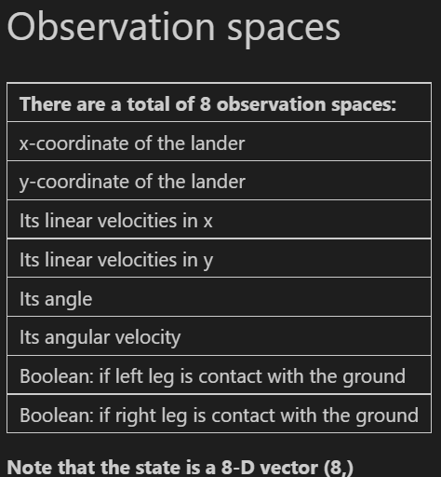
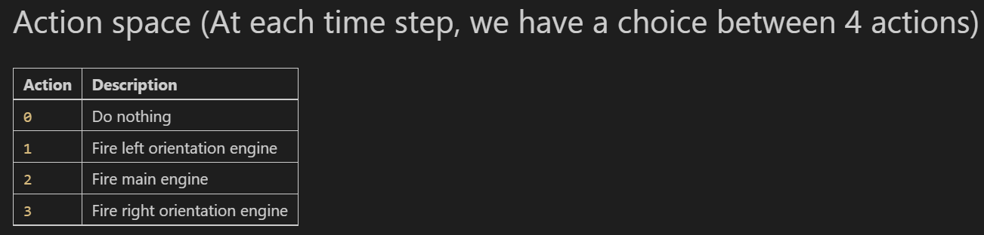
Lunar Lander problem
Lunar Lander is one of OpenAI's gym environment, part of the Box2D environment. This environment is a classic rocket trajectory optimization problem. There are two environment versions: discrete or continuous. For this study, we will be using discrete version. The landing pad is always at coordinates (0,0). The coordinates are the first two numbers in the state vector. Fuel is infinite, so an agent can learn to fly and then land on its first attempt.
(Ideally, we should land the lunar lander between the 2 yellow flags)
Ultimate Task: Agent is the lunar lander that tries to land on a landing pad at coordinates (0,0). (first two numbers in the state vector).
Observation space
Action space

Slide 6
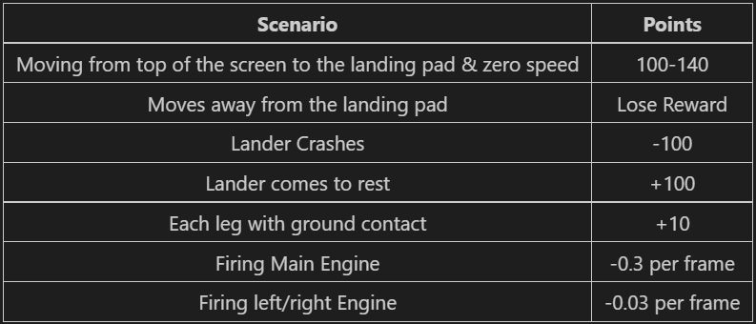
Lunar Lander Reward System
Episode Conclusion Criteria
- The episode is finished if the lander crashes, or lander gets outside of the viewport (x coordinate more than 1), or lander is not awake, where body does not move and does not collide with any other body
Taken from iypnb
1. Reward for moving from the top of the screen to the landing pad and coming to rest is about 100-140 points. If the lander moves away from the landing pad, it loses reward. If the lander crashes, it receives an additional -100 points. If it comes to rest, it receives an additional +100 points. Each leg with ground contact is +10 points. Firing the main engine is -0.3 points each frame, meaning a small penalty. Firing the side engine is -0.03 points each frame. Solved is 200 points. Landing outside the pad is also possible
2. From this, the rewards are not always positive, we can see that if the lunar lander hits the ground at the wrong angle or too fast it crashes and lunar lander get a large penalty.

Slide 7
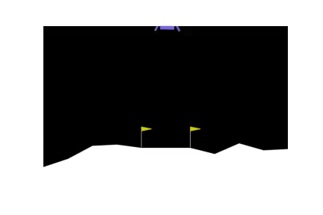
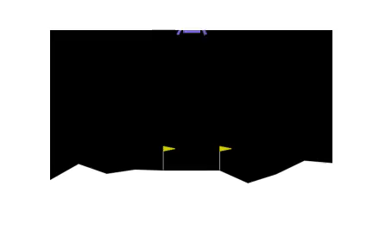

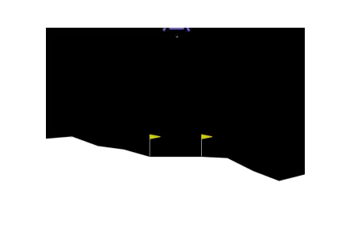
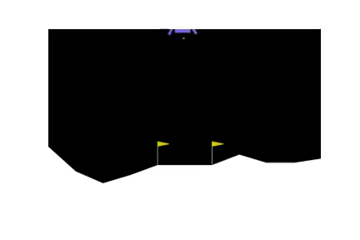
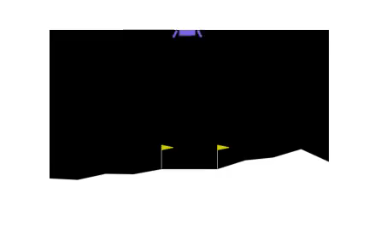
Environment
Visualize actions
Fire left orientation engine: We see the lunar lander fires its engine for it to sway towards the left.
Do Nothing: Agent does nothing
Visualize environment (Randomly sampling actions)
- We will visualize the environment first, and view our agent.
- We sample random actions from the action space
- We see that the agent moves at random, and it does crash everytime, since it is not trained
- The fourth action is to fire right orientation engine, causing the lunar lander to sway towards the right.
- The third action is firing main engine below the lunar lander.
- For this action, if we just keep firing this main engine, we see that the lunar lander does not reach the land, since firing the main engine causes it to levitate upwards.

Slide 8
How do we evaluate RL algorithms
First, we will train our algorithms under the training phase, where the agent will interact with the environment and take its actions based on its policy.
Then it will receive reward scores. With this, we will save the models that obtain a high reward score, to be used for the evaluation phase
Evaluation phase
Next, after training, we use the model that obtain a highest reward score (example: highest is 240 for DQN) on the evaluation environment for 100 episodes.
In the evaluation environment, we will solely use the learned network policy to pick the agent’s action, and calculate its reward. So ideally, in this phase we do not allow the agent to take any random actions, but rather pick actions based on its learned policy during its training phase. With this, we similarly calculate the rewards the agent obtain. This is a more unbiased evaluation as we can see quantify the performance of agent on what it has learned.

Slide 9
Training A2C (Advantage Actor Critic) model (BASELINE)
A2C or Advantage Actor Critic is an reinforcement learning algorithm that combines value optimization and policy optimization approaches. We have the following: the actor and the critic
> Actor: a policy gradient algorithm that decides on an action to take
> Critic: Q-learning algorithm that critiques the action that the Actor selected, providing feedback on how to adjust. It can take advantage of efficiency tricks in Q-learning, such as memory replay.
In the beginning, the agent does is not familiar with the environment, so actions are taken randomly, the Critic observes the action and provides feedback.
The Q value can be learned by parameterizing the Q function with a neural network, leading us to actor critic methods, where the critic estimates the value function. This could be the action-value (the Q value) or state-value (the V value). The actor updates the policy distribution in the direction suggested by the Critic. This model will serve as a baseline for our future experiments, in the Lunar Lander environment.
Huber loss for training
1. We will be using huber loss instead of MSE for our critic. It combines the benefits of MSE and MAE losses.
1. Using mean squared error (mse) as loss function might lead to very high errors when training. These high errors can cause the model to over adjust and fail to converge to a good solution. Huber loss on the other hand is more robust and is less sensitive to outliers.
2. Outliers are penalized, and the network is encouraged to reduce the loss to 0 when loss is very small.
Basic hyperparameters
1. We will set the learning rate to 0.0001, and discount factor gamma to 0.99. This is the recommended and default value for famous RL algorithms. The discount factor establishes the agent's preference to realize to the rewards sooner rather than later, we should pick close to 1, to avoid neglecting future rewards.

Slide 10
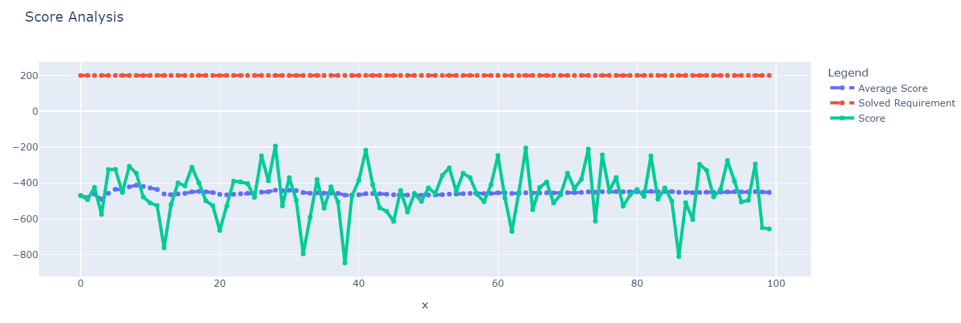
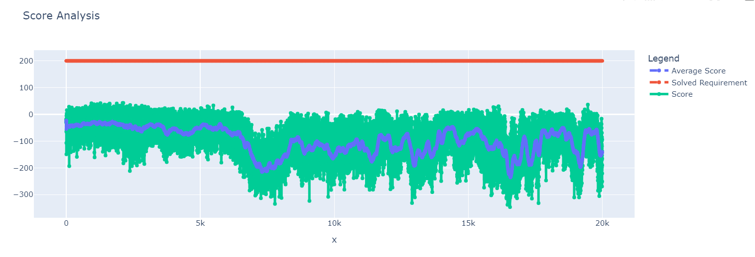
Training A2C (Advantage Actor Critic) model (BASELINE)
TRAINING PHASE
1. We see that A2C does not land at all, with negative rewards consistently. The scores consistent hover around -200 to 0.
2. From the reward analysis plot, we see that the agent is not able to learn properly, even after training for long episodes. It still consistently crashes. It does not solve the environment as well, without any landings.
3. We can conclude that A2C is not very suited for this environment.
EVALUATION PHASE
We see that under the evaluation environment, the algorithm still does not land properly, given its consistent negative reward scores
We believe that the impact of the A2C model is limited in this environment, and for our next model, we will try our DQN.

Slide 11
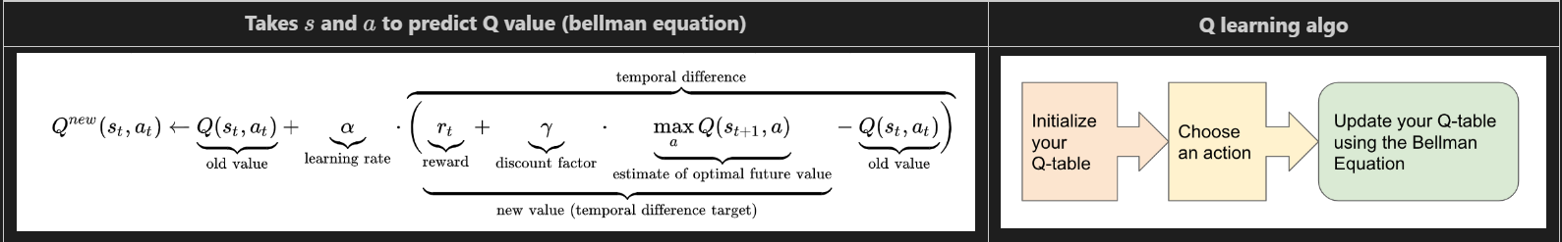
Training DQN
Deep Q-Network (DQN) was proposed by DeepMind, back in 2015. The article they published showed that they can solve a number of Atari games using Deep Q Learning. DQN was able to learn 49 different Atari games just through pixels visible on screen and a score. Using such an approach they managed to play the 49 games to at least the level of a professional human game tester. Before talking about DQN, we will talk about Q Learning
Q Learning
1. Q learning is an implementation of a model free reinforcement learning agent that learns about the environment and tries to maximize the expected reward gained. It does this by computing a Q function Q(s,a). Q(s,a) is a function that predicts the future reward in state s when taking action a. In a scenario where our model is able to accurately predict the Q values (estimation of how good is it to take the action at any state), the agent could just pick the action with highest Q value to maximize reward. In Q learning we randomly pick actions and observe their effects in environment. Then, it uses the bellman equation below to update the Q function. We can imagine it as an iterative process, as we explore the environment, the Q function gives better approximations by continuously updating the Q-values.
The equation describes the following:
2. The agent was in state s and took action a, it then ended up in state s' and obtained reward r. We then update the predicted value Q(s, a) by adjusting the old value with the temporal difference.
3. Gamma is the discount factor which controls the contribution of rewards further in the future. Reward is the reward gained by moving from state s to state s' using action a.
4. A simple Q learning uses a table as state (from environment) or action (actions to take) to hold all Q values, but it becomes inpractical if the environment have continuous action spaces. Hence, we bring the component of neural network into Q learning.

Slide 12
Putting it together: DQN
Putting it together
1. Deep Q Network is a reinforcement learning algorithm that combines Q-learning with deep neural networks. Such a combination allows agent to learn on high dimensional environments like games.
2. By using a DNN to approximate the Q values, the agent is able to generalize better. In the input of the neural network, we input the observation space, and the output is a Q value for every allowed action in that state. In this study we will use a regular DNN to approximate the Q function.

Slide 13

DQN: Concepts incorporated to improve performance
These are the following innovations incorporated into DQL algorithm to further enhance performance:
Replay Buffer and experienced replay
1. In the normal Q Learning algorithm, the agent learns after every time step, all past experiences are thrown away.
2. A reply buffer is a memory of observations, rewards and subsequent observation. This is used to train the DL model.
3. The purpose of Experience Replay is to store past experiences and then using a random subset of these experiences to update the Q-network, rather than using just the single recent experience. Hence, we use batches of state transitions to learn from, which means that the model gets adjusted for a batch of transitions at once. This leads to training updates that are good for multiple state action pairs at the same time. This results in enhanced training stability.
4. With experience replay we save all state transitions [state, action, reward, new_state]. ^^
5. Another benefit is that the model can revisit past states, where the model could learn more.
Decayed epsilon-greedy exploration policy
1. In order to build an optimal policy, the agent faces the dilemma of exploring new states while maximizing its overall reward at the same time (exploit). This is aka the exploitation and exploration trade off. To balance both, the best overall strategy may involve short term sacrifices.
2. Hence, in this study, we will be using the **decayed epsilon greedy action selection**. The idea of this method is to pick an epsilon value between 0 to 1, that determines the amount of exploration vs exploitation. If the value is 0, we use a pure greedy method, where we are always selecting the highest q value among the all the q values for a specific state. (choose action agent thinks its best). This however has its drawback, where we have an issue in exploration as we can get stuck easily at a local optima. On the other hand, if the value is 1 it will act completely random. Using this idea, if the random number (from 0 to 1) is greater than epsilon we will do exploitation. It means that the agent will take the action with the highest value given a state. Otherwise we willl do exploration, which is taking random action. Apart from this, we will do a decay of our epsilon value starting from 1.0. This is due to multiple reasons: We want to set epsilon to 1.0 to allow early exploration in the beginning through random actions, ideally, we want the agent to explore many different controls across the state space. Another reason is that early in training, the agent has not learnt anything meaningful in terms of associating higher Q-values to certain controls in different states yet, because it simply does not have enough experience, and does not know anything about the environment. Hence, it is not useful to follow (at the start) whatever policy is implied by the initialised network closely, which means exploration in the early phase is likely to be more useful than the network policy, exploration will allow the agent to discover the effect of its actions on the environment, which is why epsilon starts at 1. However later on into training, when the agent has learned more, and where "more experience"/exploration has been collected/conducted, we want our epsilon to be small, so as to let the agent take much lesser random actions, and rather exploit what it has learned (like good strategies). It should exploit its knowledge through the Q-values to pick actions that is optimal in the environment.
3. We set the epsilon value to 1.0 initially, then decay with a value of 0.001.

Slide 14
DQN architecture
1. The idea of DQN is to use a network to map the state space to a Q value for each action
1. We make use of 2 fully connected layers with 256 units with relu activation function.
2. The input dimension is equal to the number of observation space in the environment which is 8 as mentioned earlier.
3. Finally, we have a last dense layer with the number of units equal to the action space, which is 4 for the agent.
4. It is then compiled using huber loss with adam optimizer, with a learning rate of 0.00075. The learning rate defines how big we take a leap into finding optimal policy. In the terms of simple Q Learning it is how much we are updating the Q value with each step.
Next, we also have a target network, a clone of the original network. The purpose of the target network is to stabilize the training of the model. This is because the target network prevents the training process from spiraling. Since we are fixing the targets for multiple time steps, it allows the Q network weights to move consistently towards the targets before an update. We set the update rate to every 120 steps.
Huber LOSS
1. Using mean squared error (mse) as loss function might lead to very high errors when training. These high errors can cause the model to over adjust and fail to converge to a good solution. Huber loss on the other hand is more robust and is less sensitive to outliers.
2. Using huber loss leads to a more stable Q learning training and convergence
Basic hyperparameters
We set batch size to 64, since this is the recommended batch size across papers read, and we also set the number of episdoes to 500. Discount factor is set to 0.99, this is the recommended and default value for famous RL algorithms. 3. Epsilon set to 1.0 as mentioned earlier, with decay.

Slide 15
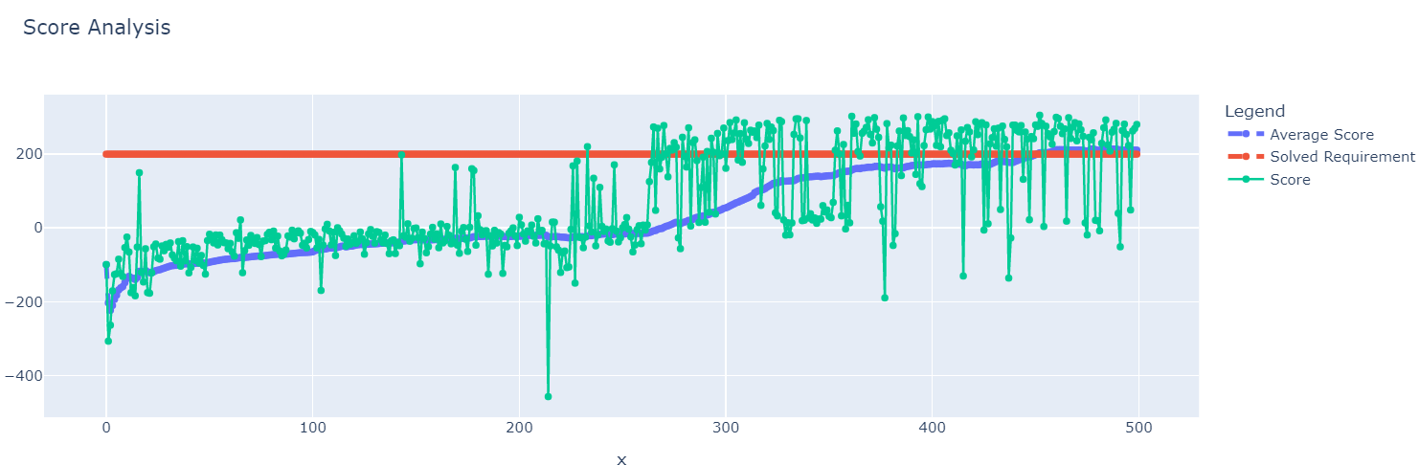
DQN
TRAINING PHASE
1. We see that DQN performs very well, with excellent reward scores. As seen from the reward scores, it completely outperforms our previous A2C model.
2. We see that the average score steadily increases overtime as the episodes increase, with the average score surpassing the 200 mark at the 480th+ episode, and stagnating around 210 AVG score after that. This suggest that DQN has 'solved' the environment, since it has obtained above 200 reward score on average.
3. We also see that the non-average reward score tends to oscillate greatly, with sharp ups and downs, this is likely due to the fact that it is learning. Reward scores can go as high as 300 to as low as -190.
4. One thing I noticed is that the scores tend to plateau with little to no improvement after the 490th episode, this suggests to me that DQN its limited.
5. However, DQN is definitely not the best in terms of reward score, and we can do alot better than this. Overall, this is a good start to model based RL algorithms

Slide 16
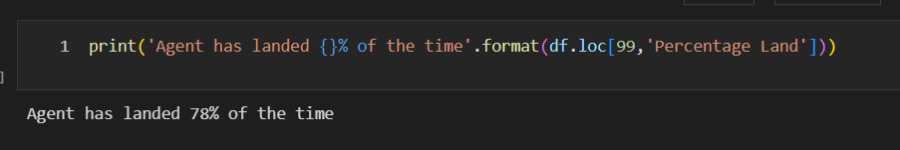
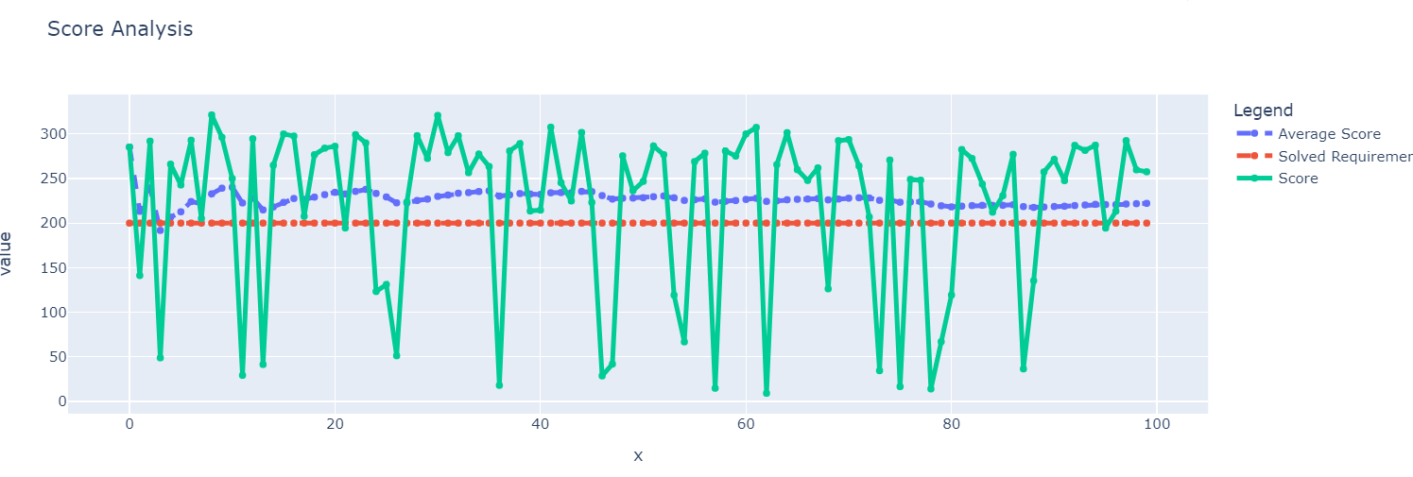
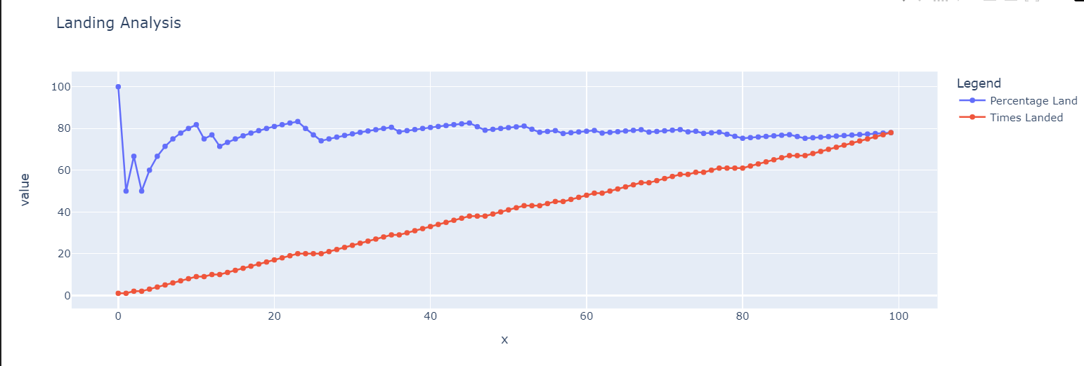
DQN - EVALUATION
EVALUATION PHASE
1. We use the same hyperparameters as before.
4. Here, for evaluation, we use one of the better models.
Save 21 - Episode 489/500, Score: 283.48737253991976 (0.01), AVG Score: 214.09234563963864
1. In the evaluation phase, the lunar lander consistently receives average reward of around 220+, higher than the solved criteria.
2. Hence, DQL is able to perform pretty well in this environment, with decent reward scores. However, I noticed that the rewards obtained is inconsistent - in a way that it can achieve as high as 320, and the next moment, it plunges to 10. I feel that such a scenario may mean that the agent does not generalize very well
3. DQN has an overall landing percentage of 78%, (78 out of 100). It is decent but improvements can still be done to further increase this value.
4. However, there are certain huge spikes as seen from the scores, from soaring above 300 to plunging below 100.
5. For later analysis, we will analyze the landings that did not do as expected (low reward), and landings that performed very well (over 300 reward score). Ideally, we want to see what did the agent do well or do badly at during these landings.

Slide 17
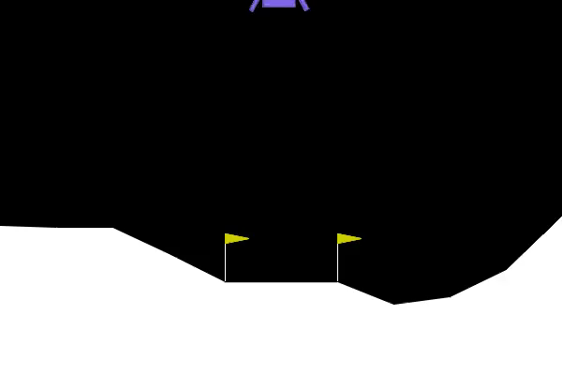
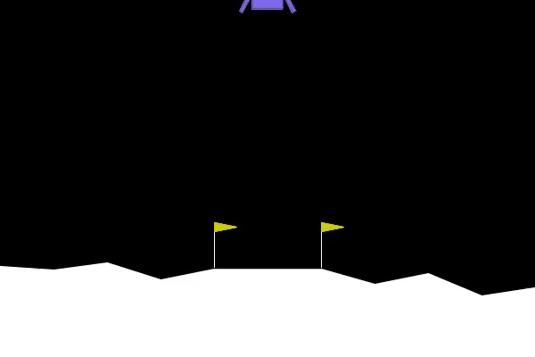
DQN – ANALYZE specific videos that cause spikes/plunge in rewards
Episodes that end well
For this episode, the lunar lander performs well, with over 320 reward score. Let's analyze what it did to achieve such a score.
2. I noticed that the lunar lander lands swiftly, without crashing, in between the 2 yellow flags.
3. I also noticed that it is able to manuevere correctly from the start to the end point.
Episodes that do not end well
1. We see that for the landing that did not achieved a high reward score, where the lander crashes and the body touches the moon.
2. Due to this, this might explain why we received a low reward score for this episode.
3. I noticed that in this episode, the agent does not learn to balance properly, when going lower altitude. As a result, caushing lunar lander to crash

Slide 18
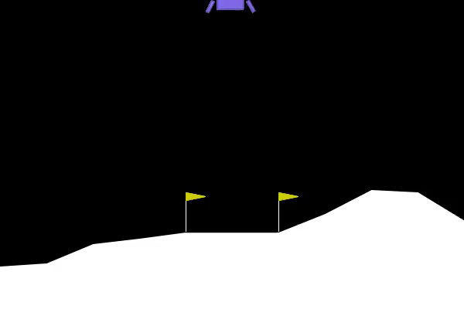
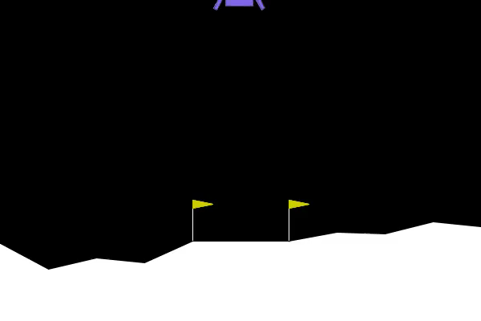
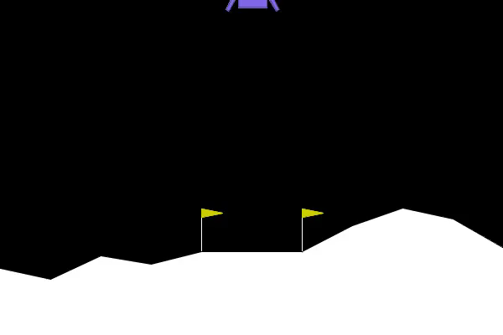
DQN – Sample Videos
1. We see that the lunar lander is able to land well in between the 2 yellow flags, and is upright
2. However, in terms of rewards it is not the best, we need to explore other algorithms

Slide 19
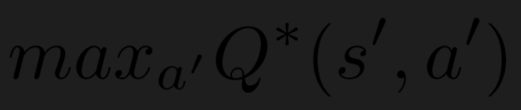
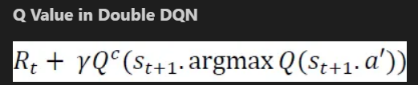
Dueling Double Deep Q Network
1. We will Incorporate a dueling architecture along with a double Deep Q Network as our next model.
2. A problem with DQN is that it tends to overestimate Q values, this is because when calculating the Q values for updating the model, the same model is used for calculating Q(s,a) as for calculating the Q value of the best action in the next state. Such leads to overestimation in Q values/rewards which can reduce its performance as the overestimation can result in a non optimal policy of the agent. In the bellman equation seen earlier, we saw this portion of the equation.
Taking the maximum overestimated values as such is implicitly taking the estimate of the maximum value. This systematic overestimation introduces a maximization bias in learning. And since Q-learning involves bootstrapping, learning estimates from estimates, such overestimation can be problematic.
1. To alleviate the problem of Q value overestimation, we make use of the following innovations: Make use of target network to calculate the Q-Values, while still using the non target network for choosing actions. Hence the evaluation of each action's Q Value and the selection of actions is separated. This innovation was proposed in [Deep Reinforcement Learning with Double Q-learning](https://arxiv.org/abs/1509.06461).
2. To explain further, the double dqn uses two identical neural network models. One learns during the experience replay, just like DQN does, and the other one is a copy of the last episode of the first model. The Q-value is actually computed with this second model.
3. Using these independent estimators, we can unbiased Q-value estimates of the actions selected using the opposite estimator. [We can thus avoid maximization bias by disentangling our updates from biased estimates.](https://arxiv.org/pdf/1509.06461.pdf)
4. Below is how the Q value is computed in Double DQN. We find the index of the highest Q-value from the main model and use that index to obtain the action from the second model.
5. Thus, Using double q learning leads to more realistic Q-values and thus to better models.

Slide 20
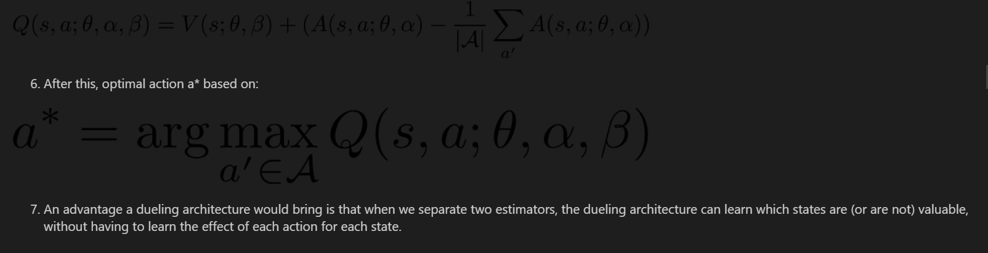
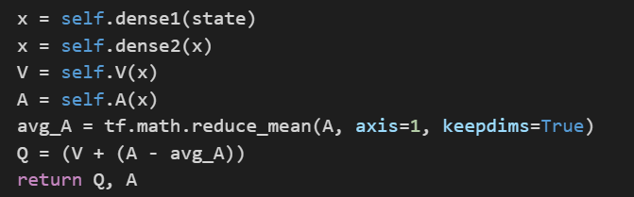
Dueling Double Deep Q Network
1. We will also incorporate a dueling architecture, which is a change in the structure for the model.
2. The dueling architecture is proposed by [Wang, et al.](https://arxiv.org/abs/1511.06581), which aimed to generalize learning across actions without imposing any change to the underlying algorithm.
3. To provide some context, the Q value represents the value of choosing a specific action at a given state, and the V value represents the value of the given state regardless of the action taken.
4. The Advantage is a quantity is obtained by subtracting the Q-value, by the V-value, which intuititvely defines the advantage of selecting an action relative to the others at the given state.
5. Next, about the architecture, it is similar to our DQN, but with certain changes: we split the network into two separate streams, one for estimating the state-value and the other for estimating state-dependent action advantages. After the two streams, we combine the state-value and advantage outputs. Below depicts the process
Similar for our DQN, we also incorporate the concepts of experience replay and epsilon greedy exploration (decayed) and target network (stabilize training) and the same hyperparameters as DQN. Our Dueling D2QN is initialized with 128 units for 2 dense layers, coupled with adam's optimizer, and mean squared erorr loss. These specific confiurations are consistent with the original paper.

Slide 21
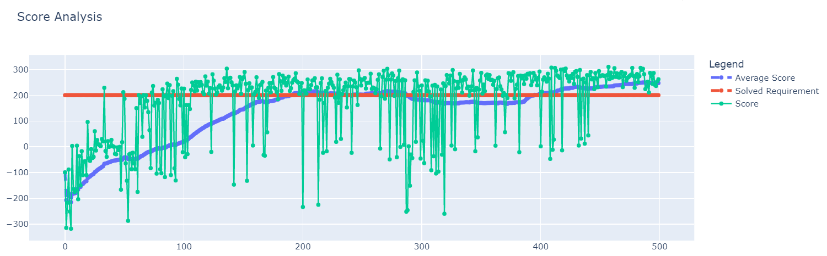
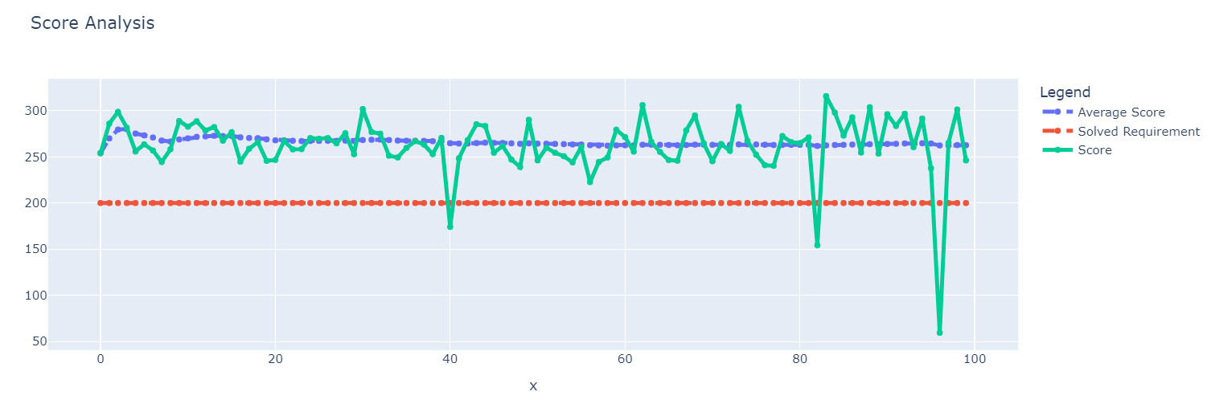
Dueling Double Deep Q Network
TRAINING PHASE
EVALUATION PHASE
1. For evaluation, we use the model that performed the best at around episode 484, with over 300 reward score. We will use that model at that episode.
```Saved 109 - Episode 484/500, Score: 305.83853415216595 (0.01), AVG Score: 248.4805519063113```
1. We see in the evaluation environment, our agent is able to consistently land, while obtaining high rewards
2. Average reward is over 260 in the evaluation phase, which is excellent. This means that the agent is able to pick actions that are positive/and beneficial.
3. Furthermore, from the landing analysis, we see that the model is able to land 97 out of 100 times (97%), crashing a total of 3 times This is excellent and it is an improvement from our previous DQN, where that DQN has only 78% landing rate. Overall, it is a 20% improvement, from our previous run.
4. I suspect that obtaining higher average reward and success rate in landing is attributed to the improved Q value estimation. It appears to perform more cautiously than the DQN model.
5. There are however, still certain spikes and plunge that we need to analyze that brought about positive or negative effects to our rewards.
6. However, I believe that we can still do better in terms of landing rate and reward scores, and let us try to push to 100% landing rate in our next model
1. We see that by adding a dueling architecture, and incorporating the double DQN has increased the performance of agent in the environment tremendously. We see that we consistently achieve over 240 average reward score towards the 450th episode. This means that it has technically sovled the environment, and even picked actions that are positive (higher reward)
2. We have also outperformed the previous DQN in terms of reward scores, by a margin of around 20+. This can be attributed to our improved Q values estimation and that our agent learnt which states are more useful more effectively.

Slide 22
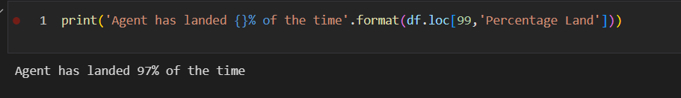
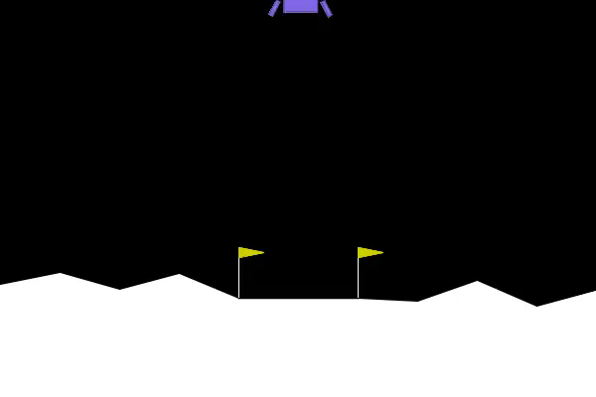
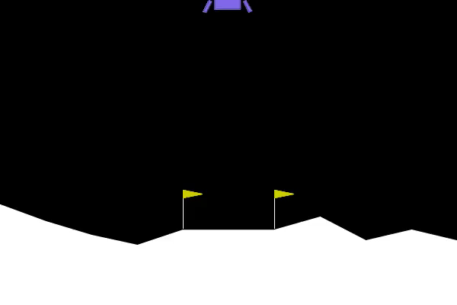
Dueling Double Deep Q Network Evaluation
Lets Analyze specific episodes that caused the agent to land badly: at episode 96
2. I noticed that for that episode, the lunar lander does not even land inside the 2 flags, though it does not crash. Though it tries its best to go inside the flags, it fails. Due to this, this might be the reason why our for that episode, we observe a plunge in scores, simply due to the fact that the agent landed outside the pad.
Landings that went well.
1. We observe that on episode 83, we achieve a reward score surpassing 310.
2. Further observation of the video shows that the agent lands smoothly and swiftly without any difficulties. It is able to be cautious upon closer distance to the ground/landing pad.

Slide 23
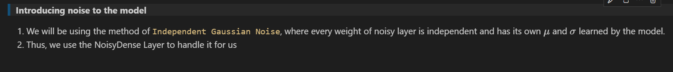
Noisy Networks
Background information
1. In our earlier study, we used decayed epsilon greedy exploration to balance our exploitation and exploration trade off. The concept is that with some probability epsilon (given as hyperparameter) the agent takes a random step instead of acting according to policy it has learned. In a later phase, the agent will exploit what it has learnt and act according tot the policy it has learned.
2. There is also another method which is entropy regularisation: this is used in policy gradient methods when adding entropy of our policy to the loss function, punishing our model for being too certain in its actions
3. However, theese methods are not perfect as they do not take into account the current situation agent experiencing.
4. In this study, we will attempt to perform noisy exploration to tackle the issues both of these methods face.
Incorpotating the idea of Noisy Networks
1. It was introduced in [NOISY NETWORKS FOR EXPLORATION](https://arxiv.org/pdf/1706.10295.pdf), where noise added into weights can improve agent's performance, in some cases advancing the agent from sub to super-human performance.
2. It is a concept utilises noisy linear layers for exploration instead of epsilon-greedy exploration.
3. With this in mind, we try and make the following innovations to our Dueling double Deep q network: Replace our epsilon greedy exploration with noisy exploration; introduce parametric noise to weights.
4. Effectively we are doing the following, we are removing the portion where agent take actions at random, which is the exploration portion of our network policy. And, next we add noise to our dense layers. The parameters of the noise are learned with gradient descent along with the remaining network weights.
5. It was found that introducing parametric noise to weights helps to induce stochasticity to the agent’s policy which can boost efficient exploration. Furthermore, parameters of the noise can be adjusted by the model during training, which allows the agent to decide when and in what proportion it wants to introduce the uncertanty in its weights. In a way, it takes into account the current situation agent experiencing.

Slide 24
Noisy Networks Configuration
1. We initialize our batch size to 64, and select a common discount factor of 0.99. The discount factor establishes the agent's preference to realize to the rewards sooner rather than later, we should pick close to 1, to avoid neglecting future rewards.
For this study, we will use 700 episdoes. This is slightly more than our previous experiments, as we want to facilitate a more meaningful and longer exploration. With this, our goal is to maximize the reward scores.
Similarly, we make use of concepts like experienced replay

Slide 25
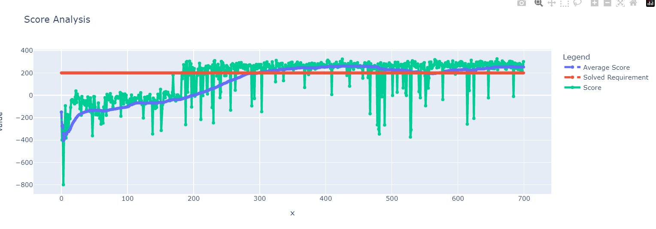
Noisy Networks
TRAINING PHASE
1. From our training, we see that noisy nets are able to achieve over 252 to 260 reward score on average. This is generally an improvement from our previous model of around 245. This might be due to the fact that noisy exploration is able to aid in terms of helping the policy network to converge into a better and more robust solution, therefore the increase in scores.
2. As for the normal reward scores, it has achieved consistently close to 300 reward.
3. We observe that this is by far our best performing model, outperforming our original D3QN with epsilon greedy exploration.
4. Furthermore, the training seems to be slightly more stable towards end of training, though there are several plunges observed.

Slide 26
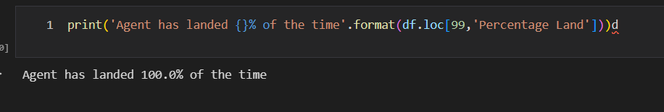
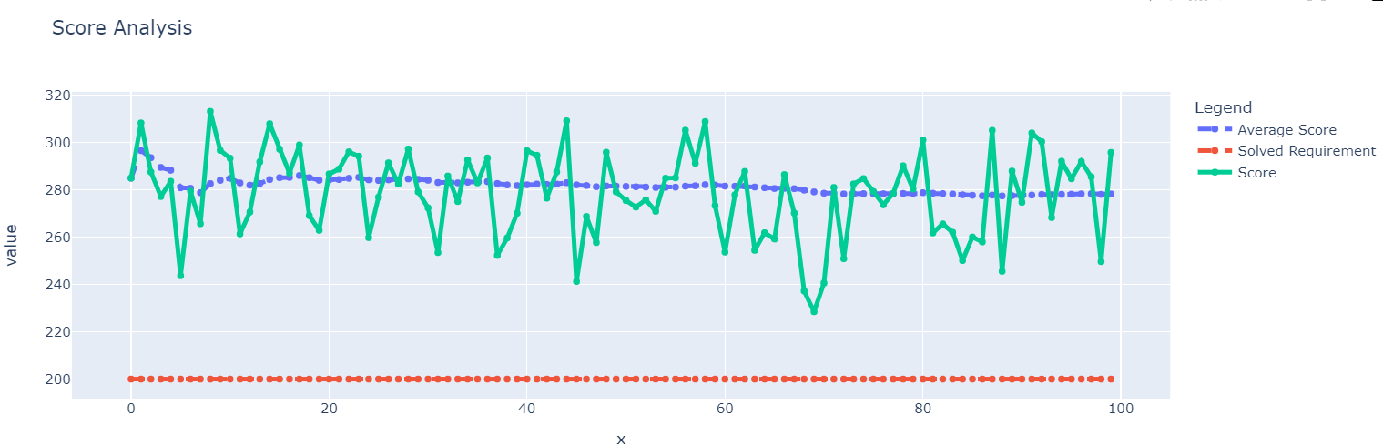
Noisy Networks
EVALUATION PHASE.
We used the trained model for evaluation - `300 reward score as seen in training phase (last)`
```Episode 699/700, Score: 300.33238900253866 (1.0), AVG Score: 252.44665145534265```
1. During the evaluation phase, our agent perform exceptionally well, with average reward of around 275-278. This means the agent is able to not only land well, but is able to take the most efficient action correctly at the right time. Our noisy nets outperform all our other models. This could be due to the fact that the induced noise helped in terms of providing a more meaningful exploration, as opposed to our decay epsilon greedy strategy. Such leads to allowing the agent to generalize better, leading to an increase in performance.
2. Furthermore, from the landing analysis, it has a 100% landing rate for 100 episodes. This is excellent, and it is an improvement from our previous run (97% landing rate).
3. I noticed that there are some spikes of the reward score, such as the occasional spike, reaching 310+ reward score. We will investigate these episodes to discover what did the agent do such that it had obtained such a high reward score.
4. I also noticed that the rewards scores are much consistent, in a way that they do not go below 200.

Slide 27
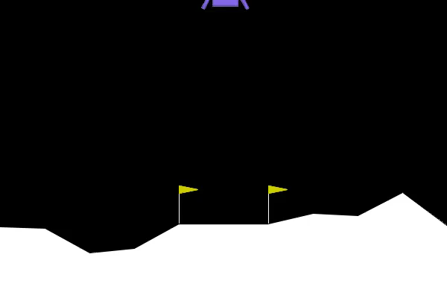
Noisy Networks landing analysis
1. We notice that for episode 8, agent obtain a reward score of 313, which is excellent. Further analysis showed that the lunar lander is able to land swiftly and efficiently without crashing

Slide 28
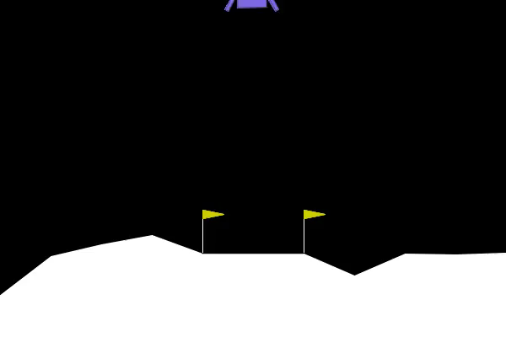
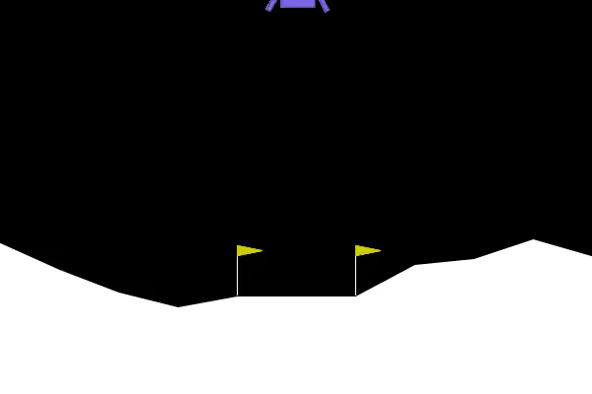
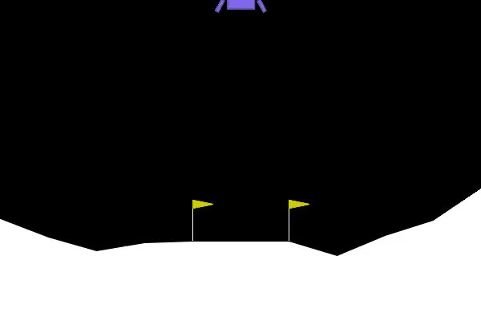
Noisy Networks landing analysis
Sample a few landing videos for landing analysis
1. We see from the videos that the agent is able to land smoothly with no difficulties. It is also able to land very efficiently, (<= 5 seconds).
2. The agent seems to know when to be cautious, as seen from the slowdown in speed when approaching a lower altitude. This means that the agent knows how to land carefully without risk.
3. This means that our agent is not only able to take a cautious approach when landing, it is able to also land efficiently without crashing

Slide 29
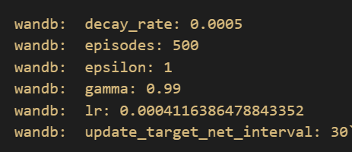

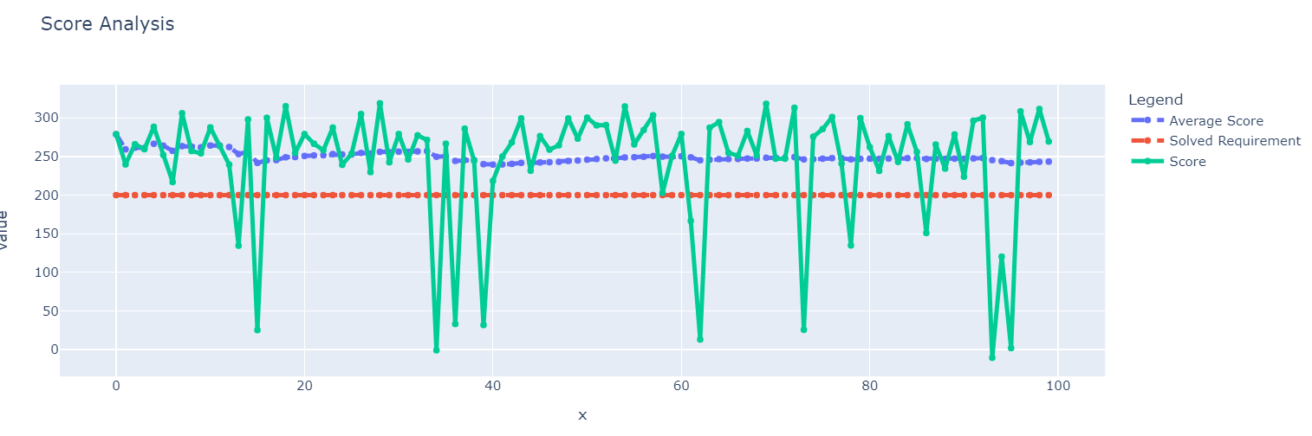
Hyper Parameter tuning for DQN
RESULTS & BEST PARAMS:
For tuning, we use wandb's sweep function. We use random search to search for the most optimal hyperparameters for our DQN model, to see if we can further improve our average score.
Hyperparameters tuned: learning rate (min = 0.0001, max = 0.01); Update target network interval (5, 10, 20, 30, 50, 100, 130); decay rate [0.0005, 0.0008, 0.0015].
We wanted to investigate if updating the target network at fewer or more frequent intervals would result in a better performance. Similarly, tuning the learning rate determines how big of a leap we take in finding optimal policy. In the terms of simple QLearning it's how much you are updating the Q value with each step. Tuning the decay rate also determines how frequent the agent has a chance to explore rather than exploit.
After tuning, we note the following params that helped us obtain an average score of 245, an improvement from our original DQN of 210. We will retrain this model and re evaluate. Though it still does not outperform our noisy net model, I would still like to re evaluate it. We see that by tuning, we achieve on average 240 reward on the evaluation environment, which is an improve of 20 on average from our original DQN, furthermore the landing rate has also increased by 10%
It seems that updating the target network more frequenly helped, along with a decreased learning rate.

Slide 30
Hyper Parameter tuning for noisy net
The reason why we will not tune our dueling double dqn is because, noisy nets are similar, but an improvement to D3QN.
Hyperparameters tuned: learning rate (min = 0.0001, max = 0.01); Update target network interval (5, 10, 20, 30, 50, 100, 130)
I wanted to investigate if updating the target network at fewer or more frequent intervals would result in a better performance. Similarly, tuning the learning rate determines how big of a leap we take in finding optimal policy. In the terms of simple QLearning it's how much you are updating the Q value with each step.
RESULTS
- Due to limited computational power and colab runtime, I am unable to complete the run, due to the long hours of runtime.
- Scrolling through, we see that our tuning has managed to find average scores that are of above 220, however it does not outperform our current noisy net.
- As such, we have to move to evaluation

Slide 31
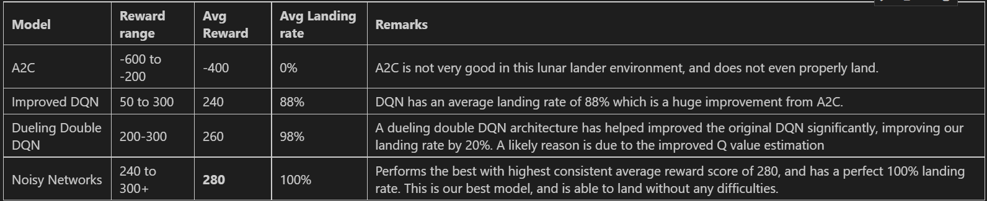
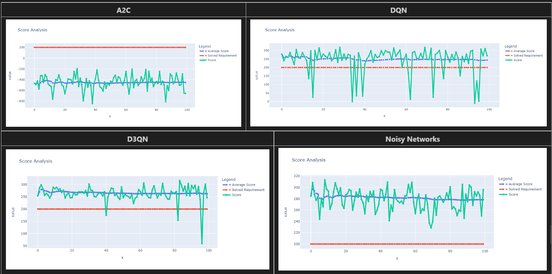
Evaluation

Slide 32
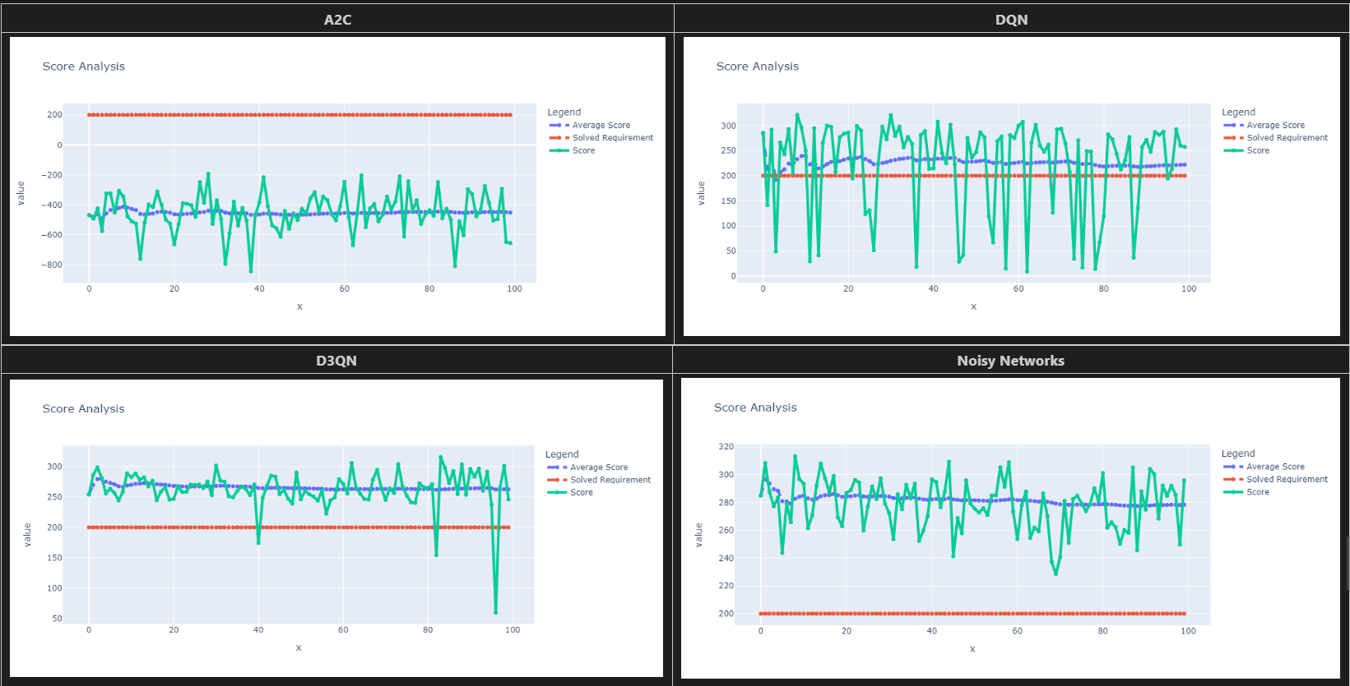
Evaluation
From all of the above, we can conclude that noisy networks are the best, with perfect landing rate of 100%. It has also achieved an excellent average reward score of 280, while peaking at a reward score of 313. It has also a good success in landing rates. With the lowest failure rate, it has proven itself as the best model for landing the lunar lander, given the importance of a low failure rate in a high risk environment like landing a rocket autonomously.

Slide 33
Evaluation
1. Before we conclude, let's visualize the highest reward landing achived by our best model in the evaluation environment
2. This landing achieved a reward score of 313, let's analyze what the agent did well
3. Upon closer analysis, I noticed that the agent is able to cautiously land without any difficulties. It tends to slow down upon reaching lower altitudes and manueveres efficiently using its engines to the landing pad.

Slide 34
CONCLUSION
1. In this study, we have managed to experiment several models starting from A2C, which did not perform well at all with 0 landings, to noisy networks that made use of the noise induce in layers to enhance exploration. Noisy networks make use of noisy exploration instead of the conventional epsilon greedy exploration.
2. Furthermore, we have manage to incrementally improve our reward scores for each model, starting from DQN at 220 to Dueling double dqn at 260, to noisy networks at 280. However, due to limited colab runtime, we were only able to improve DQN by a margin of 20. Overall, we would consider this a success, given the fact that we have solved the environment and obtain a perfect landing rate of 100%
Given more time and computational power, we would like to further fine tune the noisy net's parameters so that we can achieve a higher reward score, outperforming all contenders in the papers with code leaderboard

