Slide 1
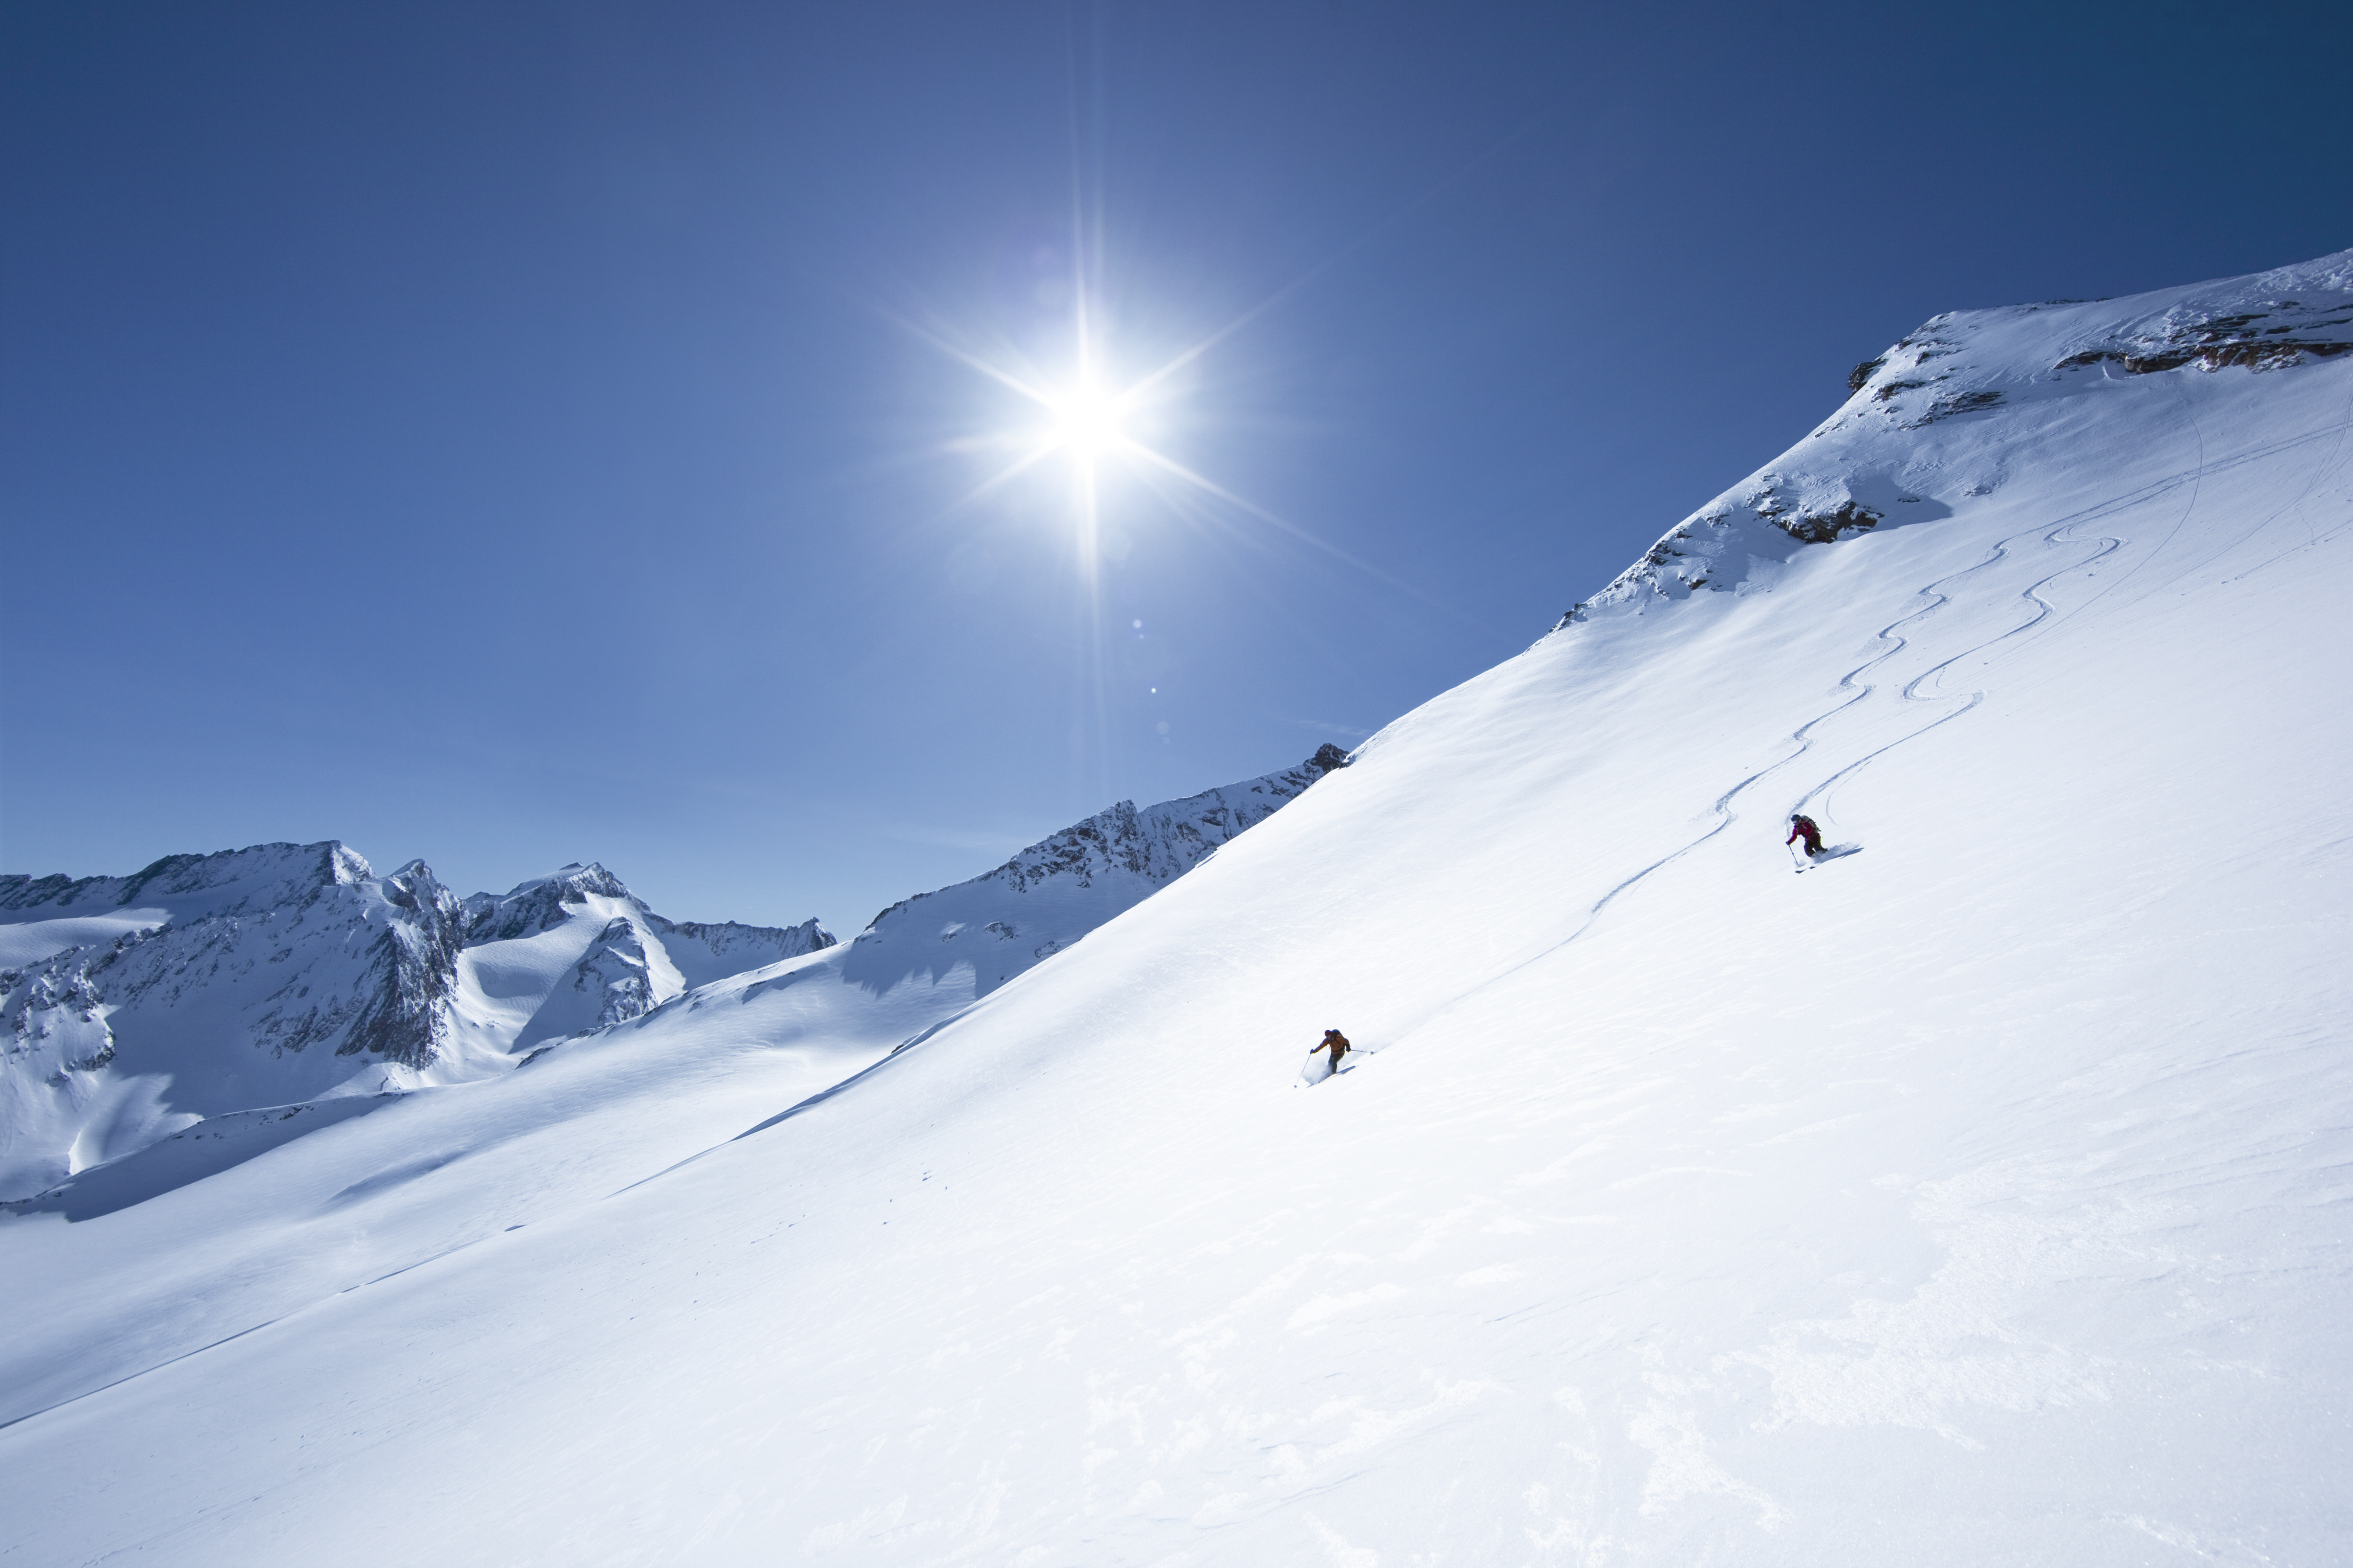

10th
HGSFP
Winter School
January 27-31, 2017 in Obergurgl, Austria
Lectures on research topics of all HGSFP branches
Participate in poster sessions
Socialize with like-minded and take part in outdoor activities
Special Invitation lecture:
Monica Dunford
From riots to raves: Modeling collective
human behavior to avoid catastrophe
Mathematical Physics
L. Witkowski
Folk theorems of Quantum Gravity
Environmental
Physics
P. Yogeshwar
Environmental Geophysics using Electromagnetic Methods
Complex Classical Systems
K. Grußmayer
Single-Molecule Fluorescence and Super-Resolution Imaging
Fundamental Interactions
N. Berger
Two, three, many? How quarks make hadrons
C. Anders
Jets to the future: Boosted boson and top jets as a probe for new physics
Astronomy and Cosmology
B. M. Schäfer
Fundamental principles and their realisation in physical laws
G. Parmentier
Star Clusters and Star Cluster Systems
Complex Quantum Systems
S. Hoekstra
Fundamental physics with cold molecules
F. Jendrzejewski
Engineering static and dynamical gauge fields with ultracold matter

