Slide 1
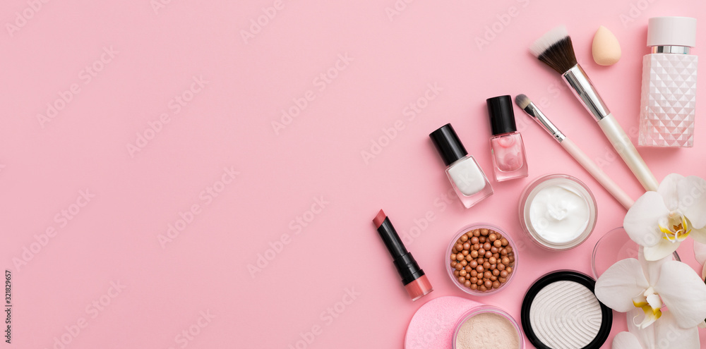
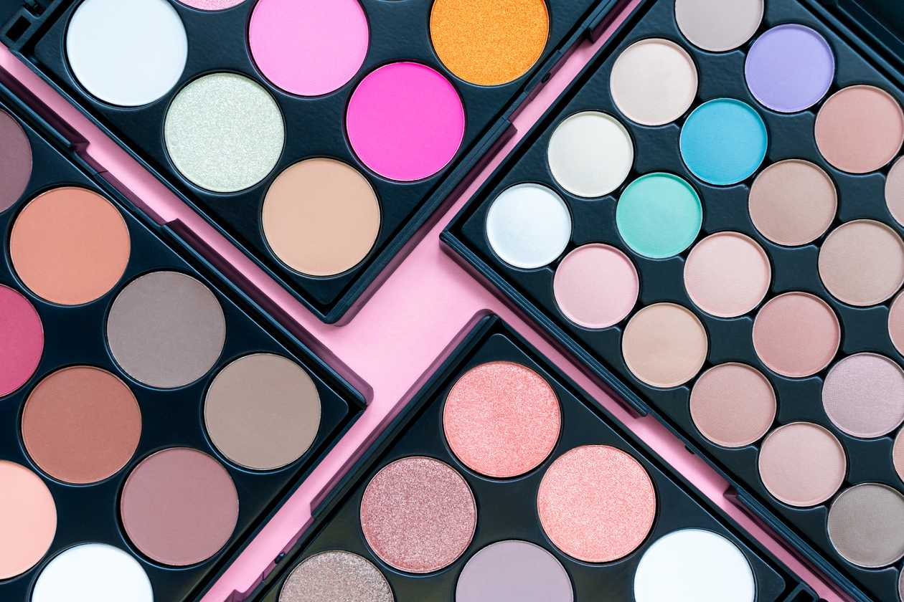
Welcome to my Website
Beauty Girl
Name:LEE HUI XIN

Slide 2

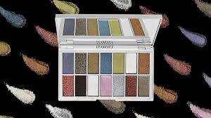
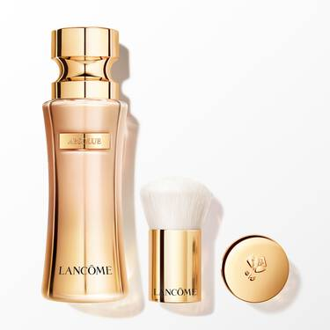
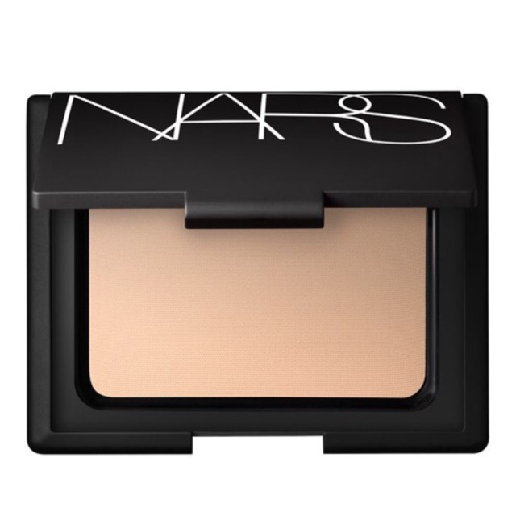
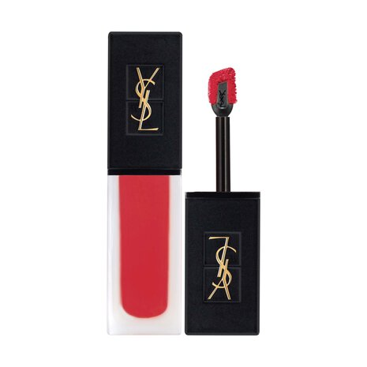
My product

Slide 3

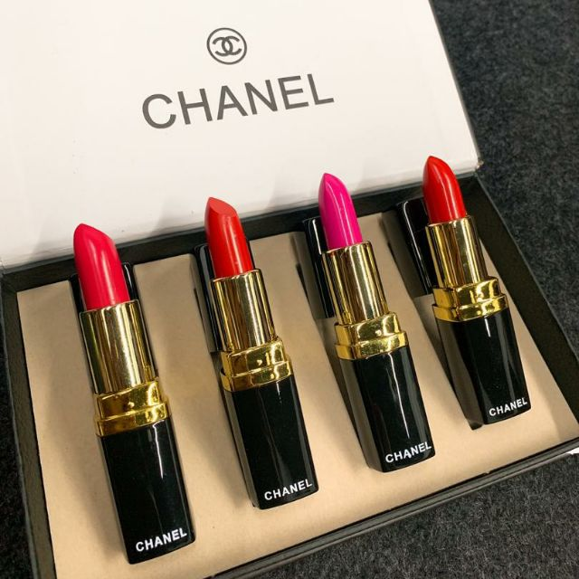
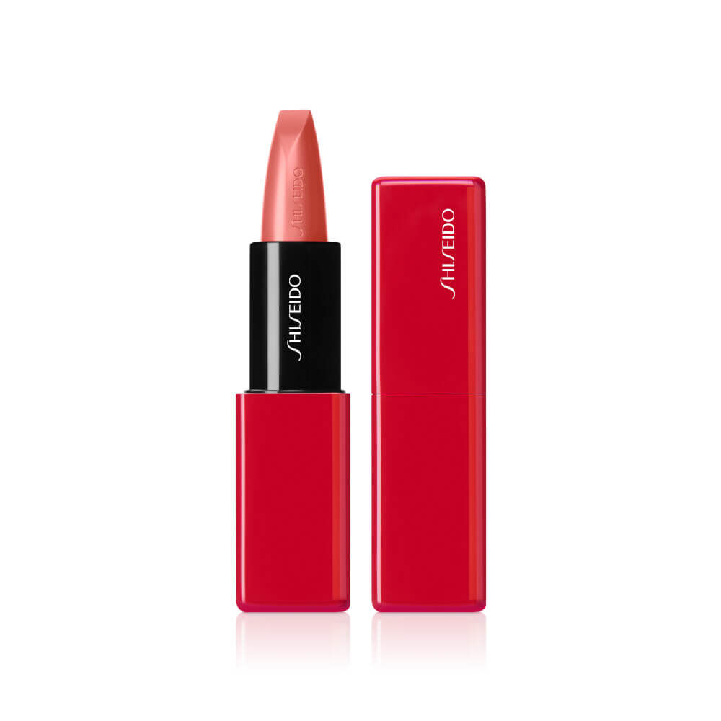
Lipstick

Slide 4
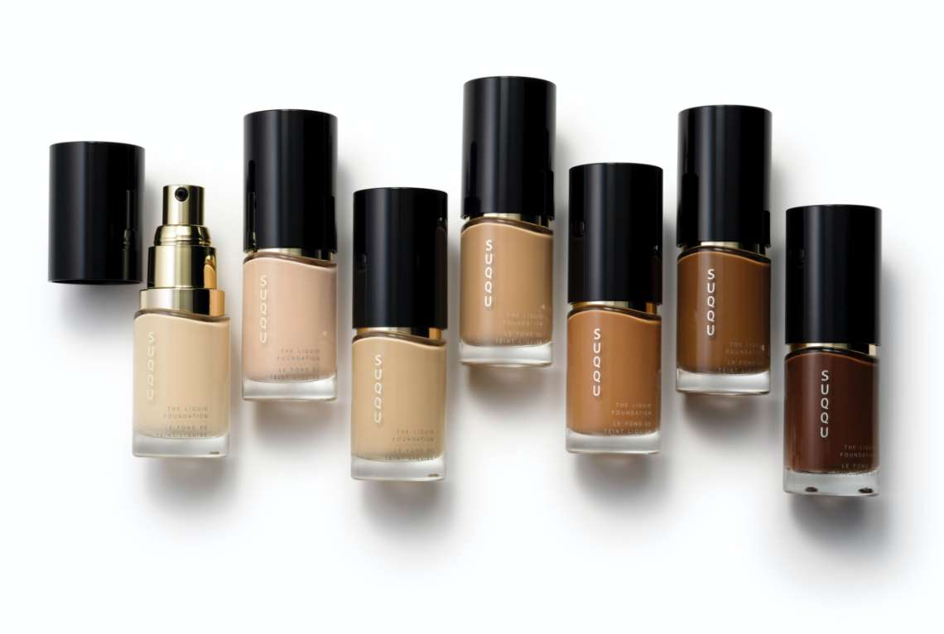
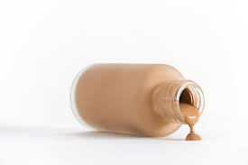
Liquid Foundation

Slide 5
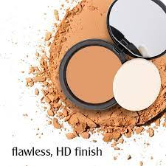
Pressed Powder

Slide 6
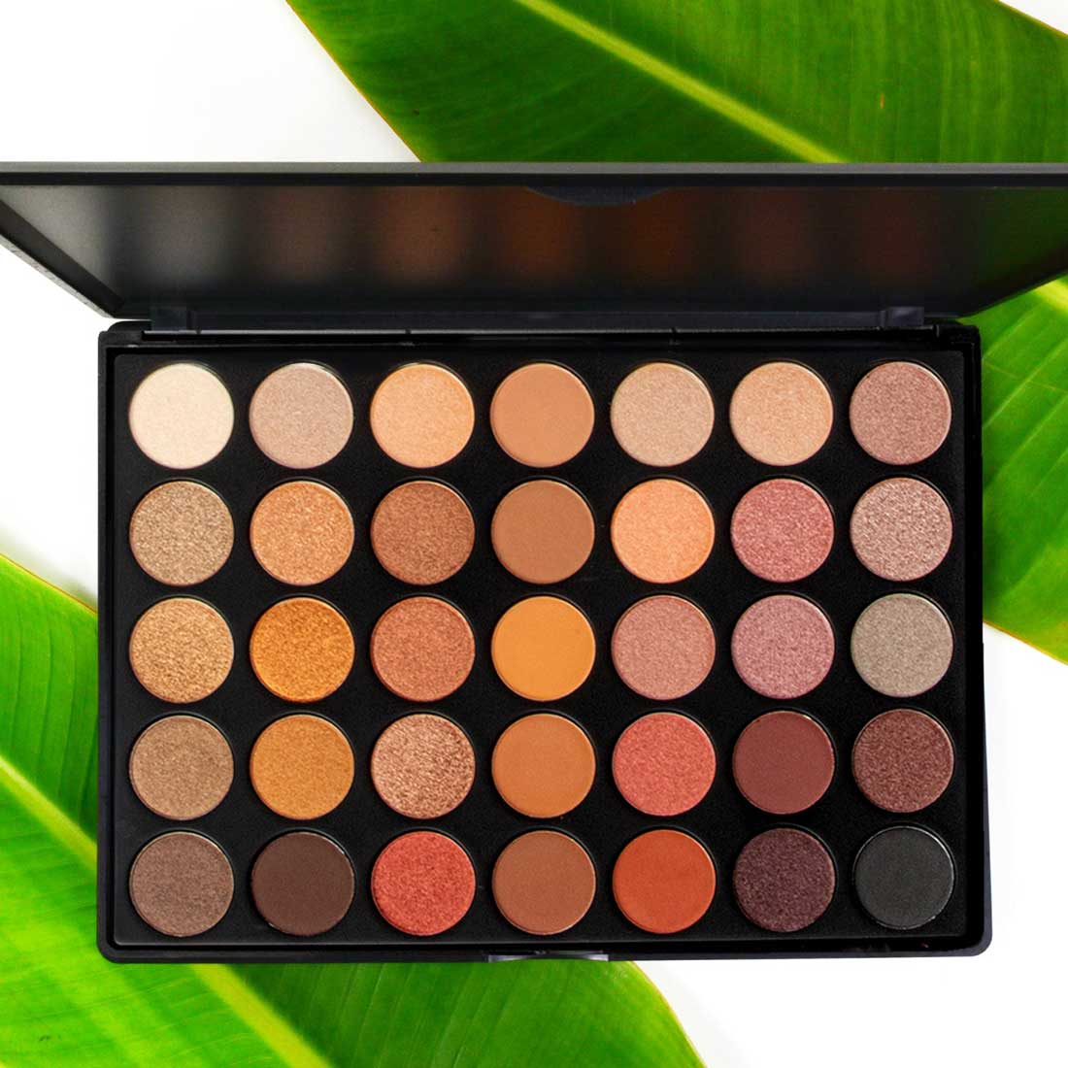
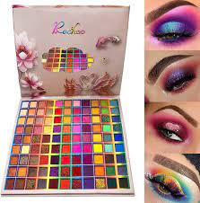
Eye Shadow

Slide 7
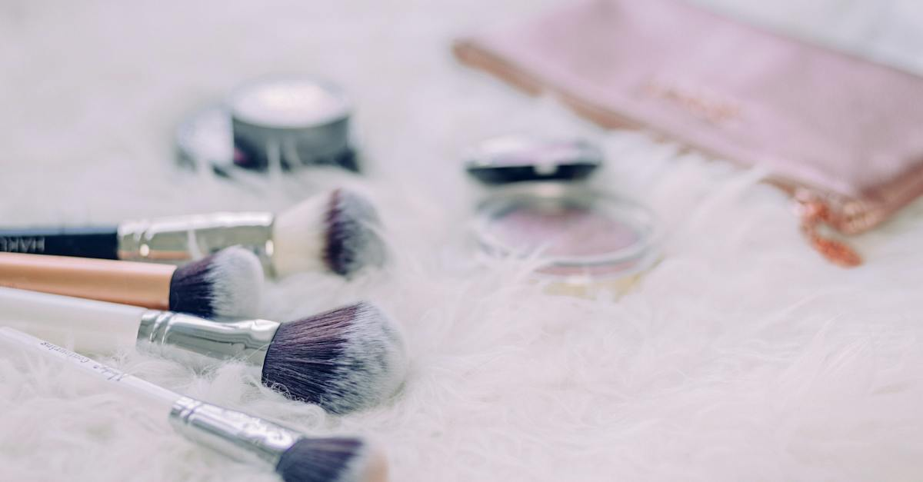
About Us
We have 20 years of experience
Customers who have purchased our products stay Yes!
Very good value for money

Slide 8

Facebook
Whatsapp
Instagram
Contact Us
PhoneNumber
Youtube
This Photo by Unknown Author is licensed under CC BY

Slide 9

This Photo by Unknown Author is licensed under CC BY-SA-NC

