Slide 1
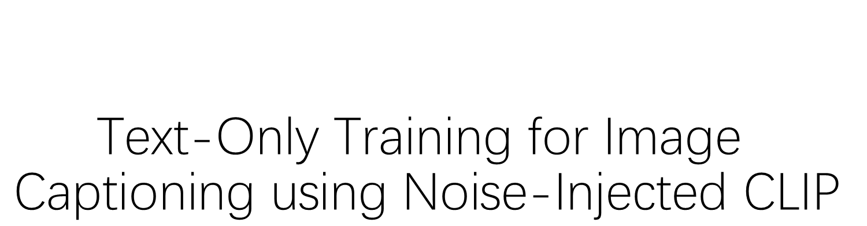
$$\text{Text}\text{−}\text{Only} \text{Training} \text{for} \text{Image} \text{Captioning} \text{using} \text{Noise}\text{−}\text{Injected} \text{CLIP}$$
Li Haoyang 2000012918
Liu Haowen 2000012993

Slide 2
Outline
Motivations & Contributions
Overview
Methods
Tasks & Results
Limitations
Our TODO List

Slide 3
Motivations & Contributions
Traditional training method of image captioning requires large datasets of captioned images (paired text-image data), but it is hard to collect.
Image-text pairs Text-only training for image captioning.
A simple and intuitive technique to overcome the inherent domain gap of CLIP.

Slide 4
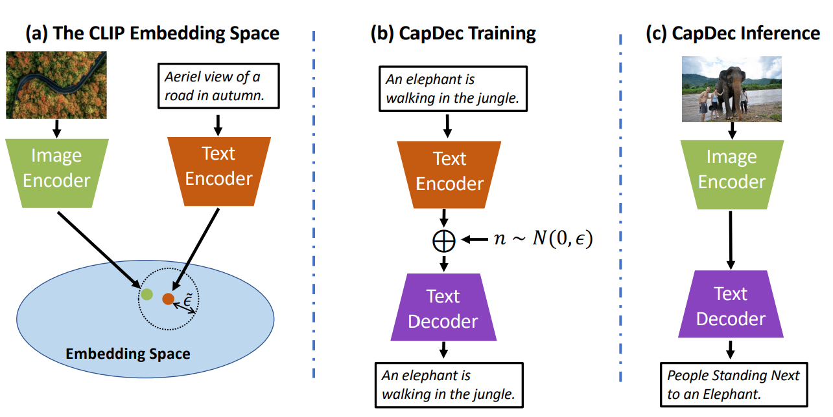
Overview
CLIP + CapDec (Captioning via Decoding).

Slide 5
Overview
CLIP + CapDec (Captioning via Decoding).

Slide 6

Overview
CLIP + CapDec (Captioning via Decoding).
ClipCap 2111.09734.pdf (arxiv.org)

Slide 7
Overview
CLIP + CapDec (Captioning via Decoding).

Slide 8
Overview
CLIP + CapDec (Captioning via Decoding).

Slide 9
Overview
CLIP + CapDec (Captioning via Decoding).

Slide 10
Overview
CLIP + CapDec (Captioning via Decoding).

Slide 11
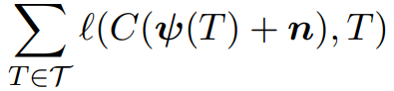
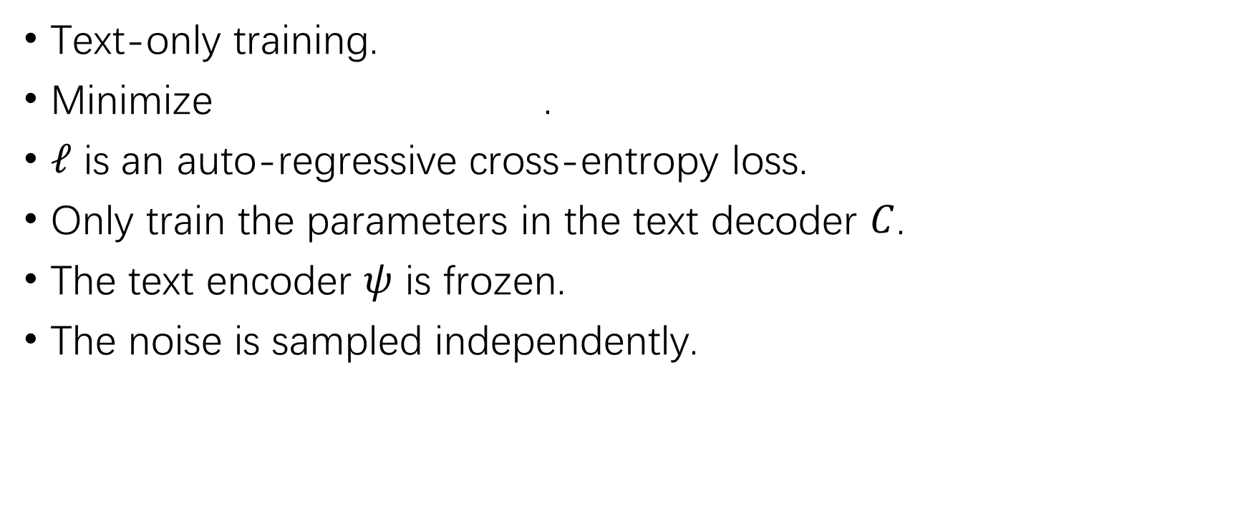
Training
Text-only training.
Minimize .
$ℓ$ is an auto-regressive cross-entropy loss.
Only train the parameters in the text decoder $C$.
The text encoder $ψ$ is frozen.
The noise is sampled independently.

Slide 12
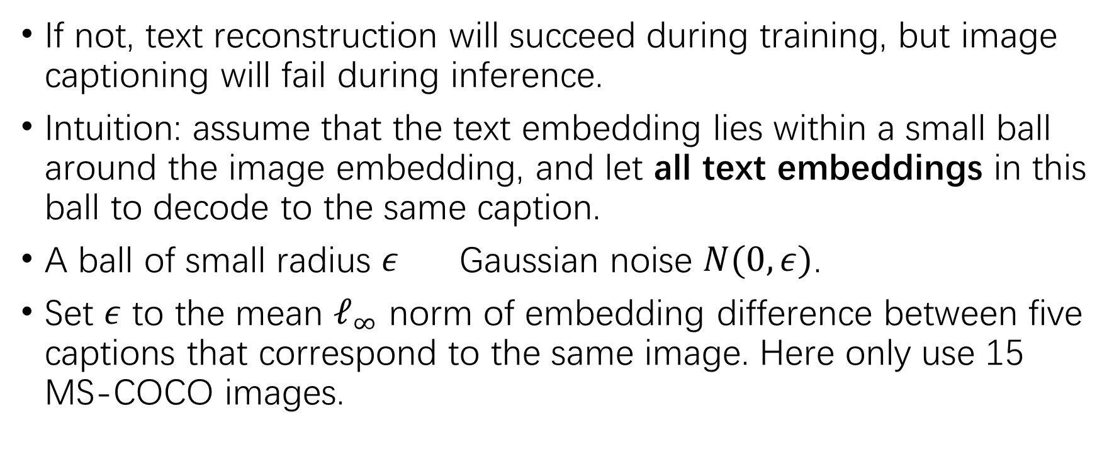
Why Noise Injection?
If not, text reconstruction will succeed during training, but image captioning will fail during inference.
Intuition: assume that the text embedding lies within a small ball around the image embedding, and let all text embeddings in this ball to decode to the same caption.
A ball of small radius $ε$ Gaussian noise $N(0,ε)$.
Set $ε$ to the mean $ℓ_{∞}$ norm of embedding difference between five captions that correspond to the same image. Here only use 15 MS-COCO images.

Slide 13
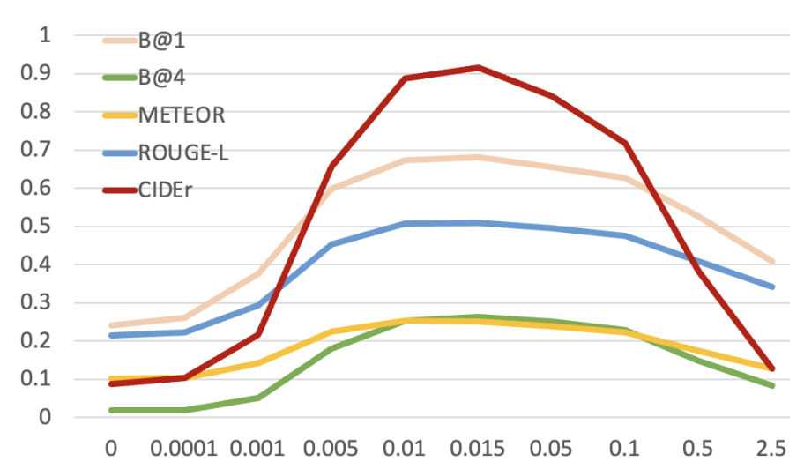

The Effect of Noise Level
Note that this figure is shown for analysis purpose only. The noise variance they choose is according to the method mentioned before. That is, $ε^{2}$ is calculated to be $0.016$.

Slide 14
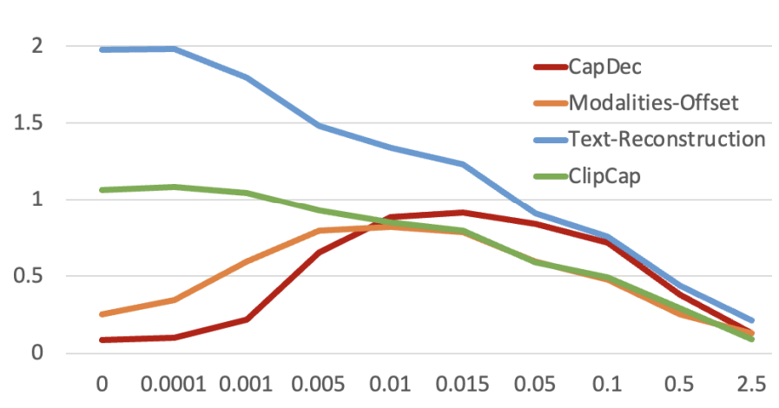
More Analysis
Noise = regularization or augmentation?
The role of noise is domain-gap correction.

Slide 15
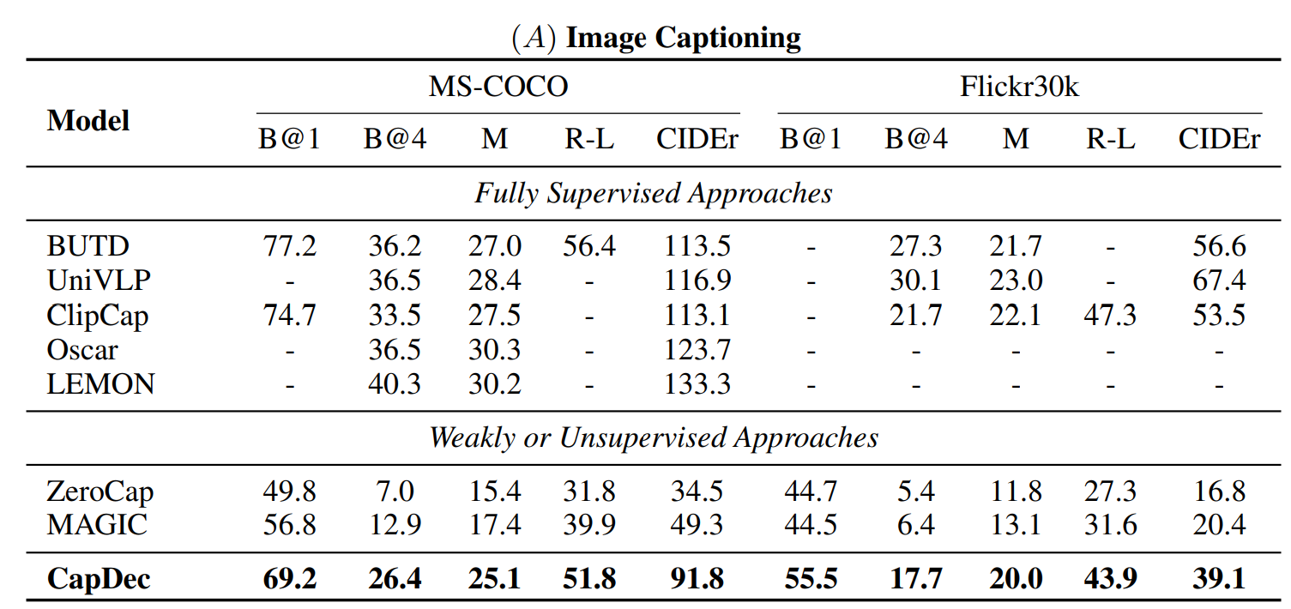
Tasks & Results
Image captioning.

Slide 16
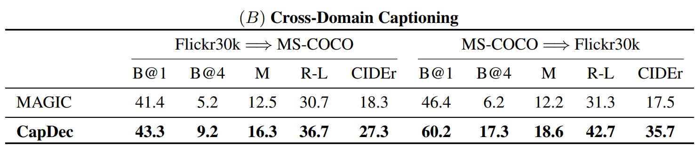
Tasks & Results
Cross-domain captioning.

Slide 17
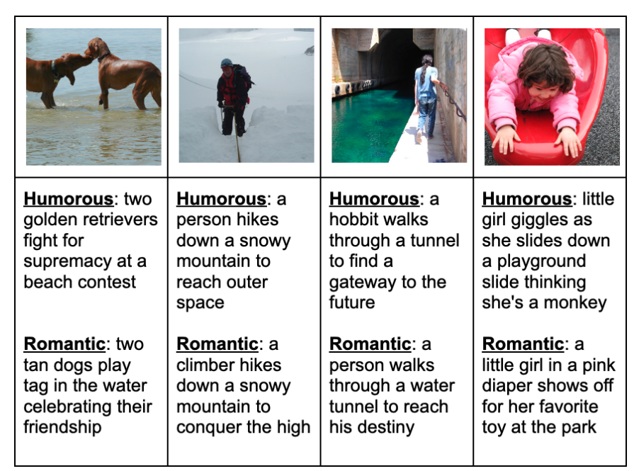
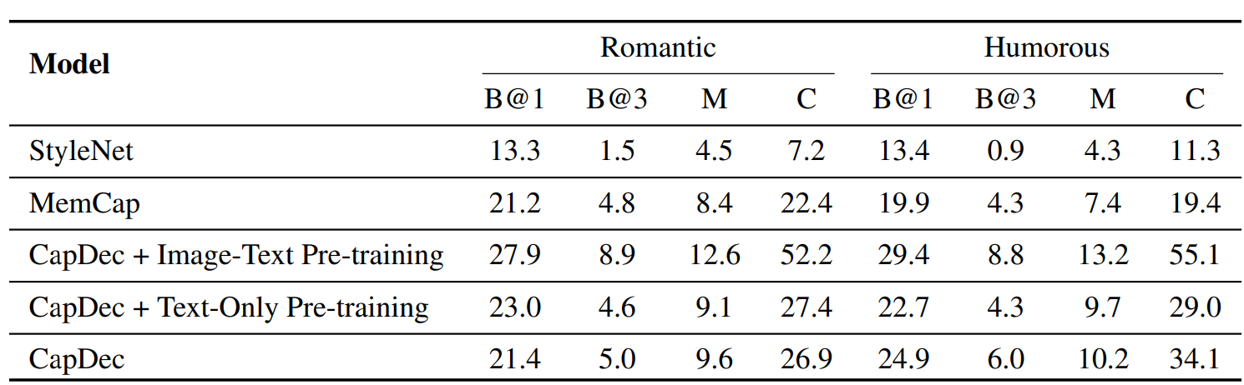
Tasks & Results
Style-guided captioning.

Slide 18
Limitations
Though it achieves superior results compared to the baselines that use only text at training, but it is still outperformed by fully supervised baselines.
CapDec relies on CLIP and a language model both of which were pre-trained on large English corpora. Extending CapDec’s capabilities to other languages is a significant challenge.

Slide 19
Our TODO List

Slide 20
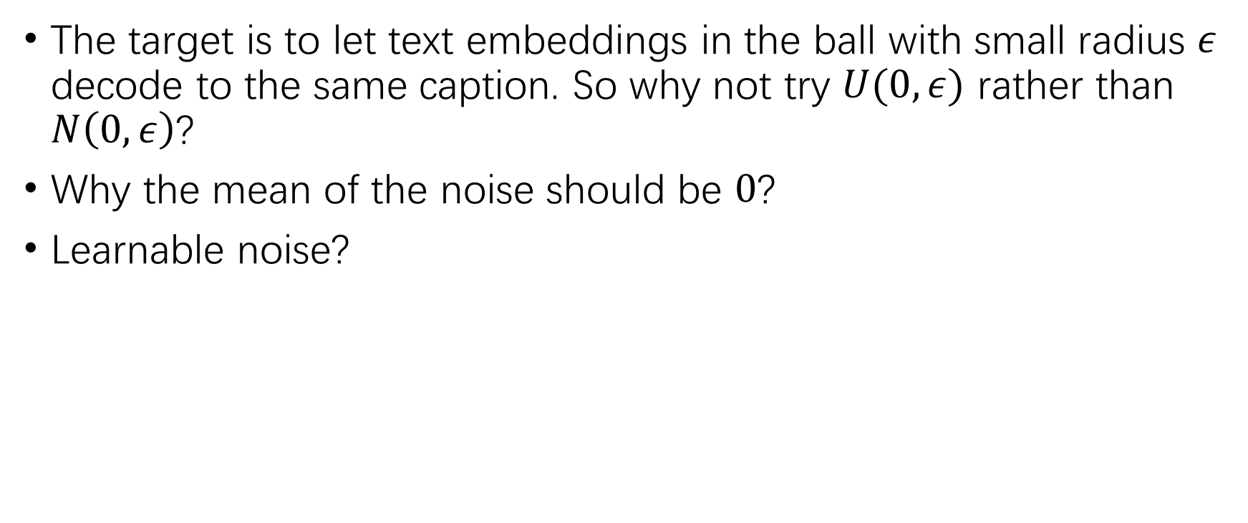
Brain Storm 1: Try Other Noise ?
The target is to let text embeddings in the ball with small radius $ε$ decode to the same caption. So why not try $U(0,ε)$ rather than $N\left(0,ε\right)$?
Why the mean of the noise should be $0$?
Learnable noise?

Slide 21
Brain Storm 2: Auxiliary Training ?
Inspired by the “auxiliary classifier” in GoogleNet we’ve learned.
If we are working on a different scenario: few image-text pairs & a plenty of text-only training data. We may use image-text pairs for CapDec auxiliary training.
Frozen the image encoder.
Training in turns.

Slide 22
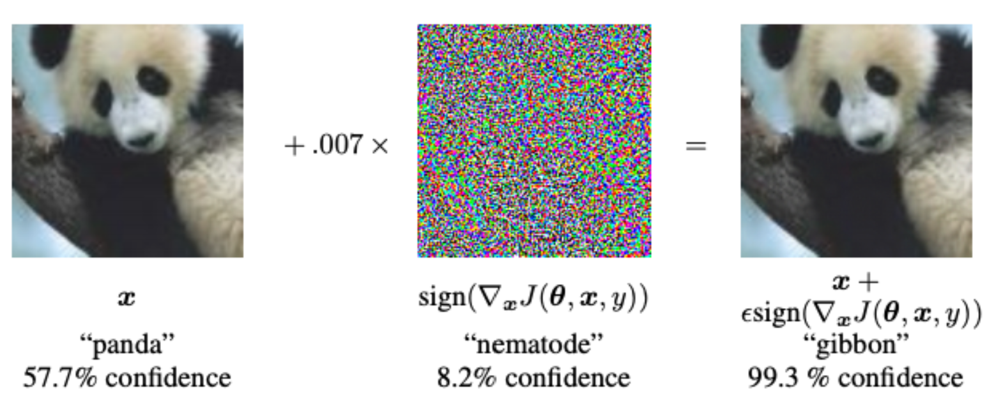
Brain Storm 3: Adversarial Training ?
Though the basic goal of adversarial training is to enhance the robustness of the model, and the author claims that the noise injection is not a kind of data augmentation……It still worth trying~
Implement FGSM or PGD in the embedding space.
Maybe we can then have a better understanding of the essence of the noise.

