Slide 1

Operating System (CSC 3150) Tutorial 7
SHIHAO HONG
School of Science and Engineering
E-mail: 220019037@link.cuhk.edu.cn

Slide 2
Target
In this tutorial, we will learn Assignment 4 related File System concepts.
File System
FCB (file-control block)
Contiguous Allocation
Free Space Management
Assignment 4 structure
Assignment 4 File Operations

Slide 3
File Attribute
Name – only information kept in human-readable form
Identifier – unique tag (number) identifies file within file system
Type – needed for systems that support different types
Location – pointer to file location on device
Size – current file size
Protection – controls who can do reading, writing, executing
Time, date, and user identification – data for protection, security, and usage monitoring
Information about files are kept in the directory structure, which is maintained on the disk
Many variations, including extended file attributes such as file checksum
Information kept in the directory structure

Slide 4
File System Structure
File structure
Logical storage unit
Collection of related information
File system resides on secondary storage (disks)
Provided user interface to storage, mapping logical to physical
Provides efficient and convenient access to disk by allowing data to be stored, located retrieved easily
Disk provides in-place rewrite and random access
I/O transfers performed in blocks of sectors (usually 512 bytes)
File control block – storage structure consisting of information about a file
Device driver controls the physical device
File system organized into layers

Slide 5
File System Layer
Device drivers manage I/O devices at the I/O control layer
Given commands like “read drive1, cylinder 72, track 2, sector 10, into memory location 1060” outputs low-level hardware specific commands to hardware controller
Basic file system given command like “retrieve block 123” translates to device driver
Also manages memory buffers and caches (allocation, freeing, replacement)
Buffers hold data in transit
Caches hold frequently used data
File organization module understands files, logical address, and physical blocks
Translates logical block # to physical block #
Manages free space, disk allocation
Logical file system manages metadata information
Translates file name into file number, file handle, location by maintaining file control blocks
Directory management
Protection

Slide 6
File System structure
We have system calls at the API level, but how do we implement their functions?
On-disk and in-memory structures
Boot control block contains info needed by system to boot OS from that volume
Needed if volume contains OS, usually first block of volume
Volume control block (superblock, master file table) contains volume details
Total # of blocks, # of free blocks, block size, free block pointers or array
Directory structure organizes the files
Names and inode numbers, master file table
Per-file File Control Block (FCB) contains many details about the file
Inode number, permissions, size, dates
NTFS stores into in master file table using relational DB structures

Slide 7
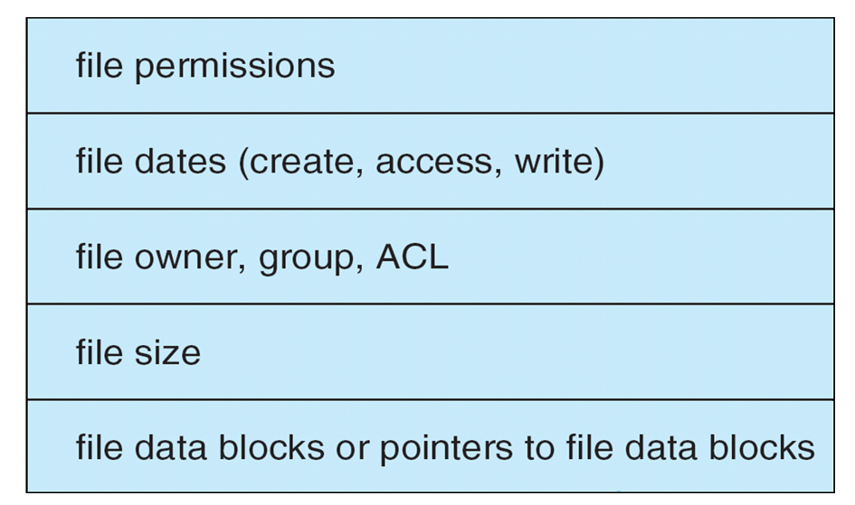
FCB (file-control block)

Slide 8
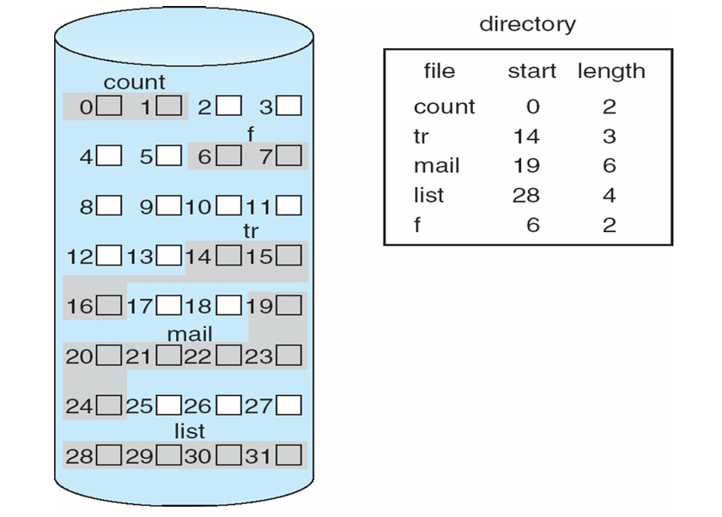
Contiguous Allocation
An allocation method refers to how disk blocks are allocated for files:
Contiguous allocation – each file occupies set of contiguous blocks

Slide 9
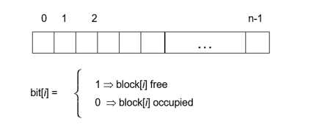
Free Space Management
File system maintains free-space list to track available blocks/clusters
(Using term “block” for simplicity)
Bit vector or bit map (n blocks)
For example, consider a disk where blocks 2, 3, 4, 5, 8, 9, 10, 11, 13, 17, 18 are free and the rese blocks are allocated.
The free-space bit map would be 0011110011111100011…

Slide 10
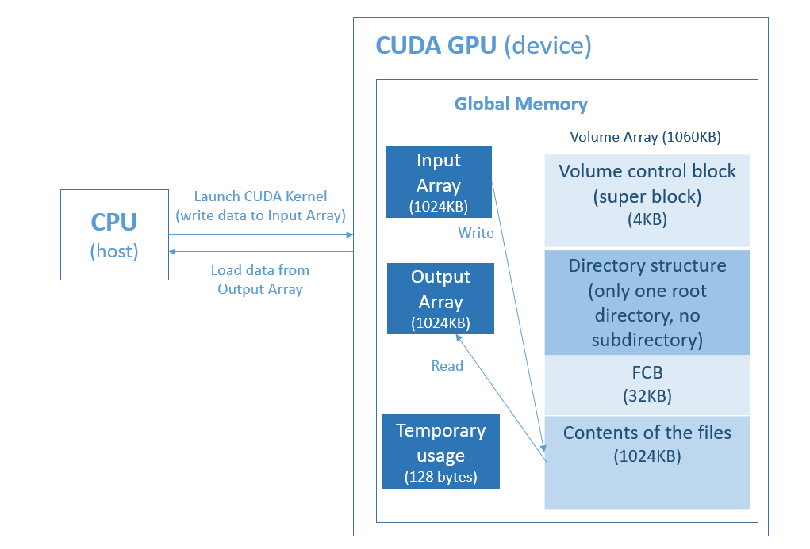
Assignment 4 Structure

Slide 11
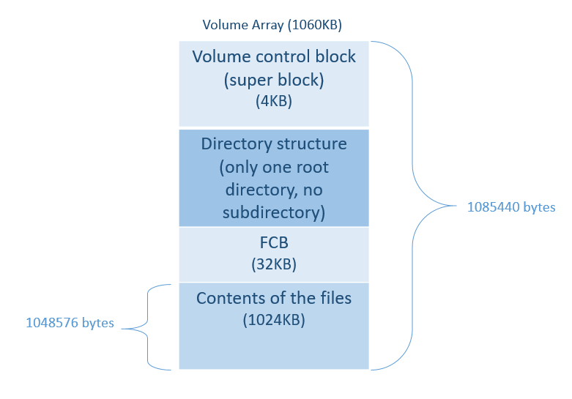
Assignment 4 Structure
The size of volume is 1085440 bytes
The size of files total is 1048576 bytes
The maximum number of file is 1024
The maximum size of a file is 1024 bytes
The maximum size of a file name is 20 bytes
FCB size is 32 bytes.
FCB entries is 32KB/ 32 bytes = 1024
Storage block size is 32 bytes.

Slide 12
Assignment 4 File Operations
open
Open a file.
Give a file pointer to find the file’s location.
Space in the file system must be found for the file.
An entry for the new file must be made in the directory.
Also accept access-mode information: read/write
When to use write mode, if no such file name can be found, create a new zero byte file.
Return a write/read pointer.
fp = open (char *s, int op)
File name
G_READ / G_WRITE

Slide 13
Assignment 4 File Operations
write
To write a file.
A write pointer to identify the location in the file.
If the file have existed, cleanup the older contents of the file and write the new contents.
Take the input buffer to write bytes data to the file .
write (uchar *input, u32 size, u32 fp)
Input buffer
Bytes of data write to file
Write pointer

Slide 14
Assignment 4 File Operations
read
To read contents from a file.
A read pointer to identify the location in the file.
To read bytes data from the file to the output buffer.
The offset of the opened file associated with the read pointer is 0 (always read the file from head.)
read(uchar *output, u32 size, u32 fp)
Output buffer
Bytes of data read from file
Read pointer

Slide 15
Assignment 4 File Operations
rm
To delete a file and release the file space.
Search the directory for the named file.
Implement gsys() to pass the RM command.
gsys(int op, char *s)
Delete command: RM
File name you want to delete

Slide 16
Assignment 4 File Operations
ls
List information about files.
Implement gsys() to pass the LS_D/LS_S commands.
LS_D list all files name in the directory and order by modified time of files.
LS_S list all files name and size in the directory and order by size.
If there are several files with the same size, then first create first print.
gsys(int op)
list command:
LS_D / LS_S

Slide 17
Thank you

