Slide 1

Operating System (CSC 3150) Tutorial 8
SHIHAO HONG
School of Science and Engineering
E-mail: 220019037@link.cuhk.edu.cn

Slide 2
Target
In this tutorial, we will discuss Assignment 4.
Assignment 4 Structure
Assignment 4 Hints
Q & A

Slide 3
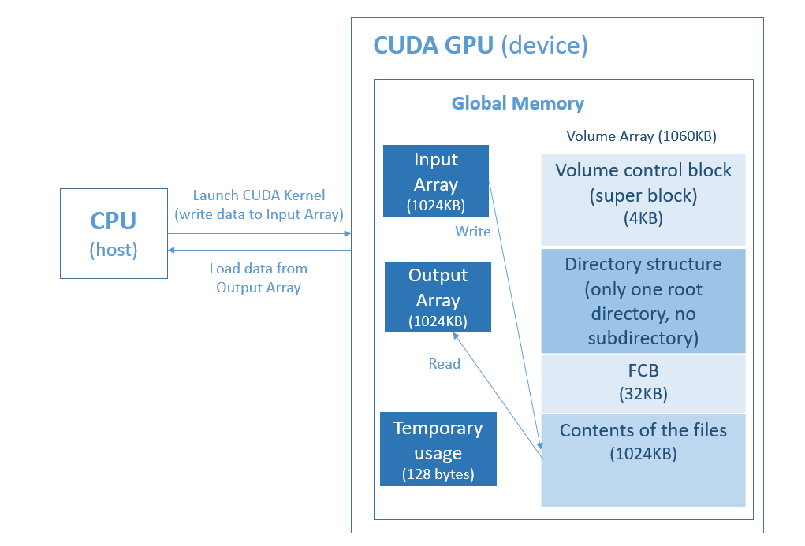
Assignment 4 Structure

Slide 4
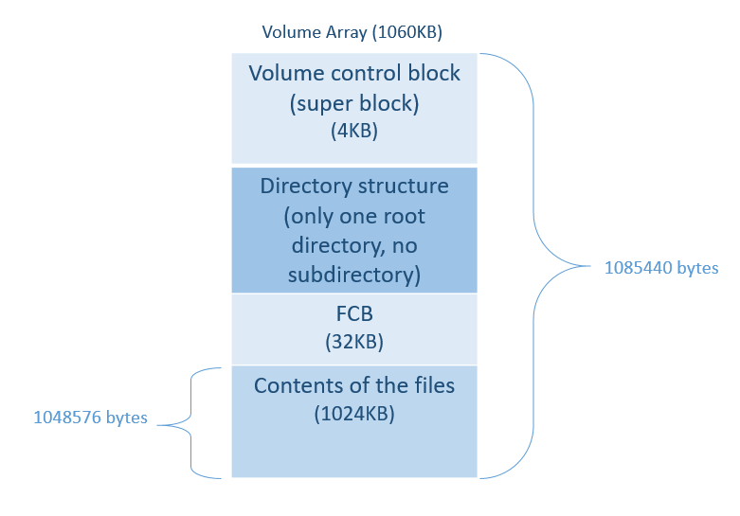
Assignment 4 Structure
The size of volume is 1085440 bytes
The size of files total is 1048576 bytes
The maximum number of file is 1024
The maximum size of a file is 1024 bytes
The maximum size of a file name is 20 bytes
FCB size is 32 bytes.
FCB entries is 32KB/ 32 bytes = 1024
Storage block size is 32 bytes.

Slide 5
Assignment 4 Hints
super block
For free space management. If using bit-map management, can store bit information in this part.
Each bit indicates the storage block is free or not.
Size: 4KB (4096 bytes, 32768 bits)
Think about bit and byte translation. (e.g., volume[i] = 2, then it means 00000010)
Think about cases that available bits being placed in different bytes.
Think about the mapping offset for storage block.

Slide 6
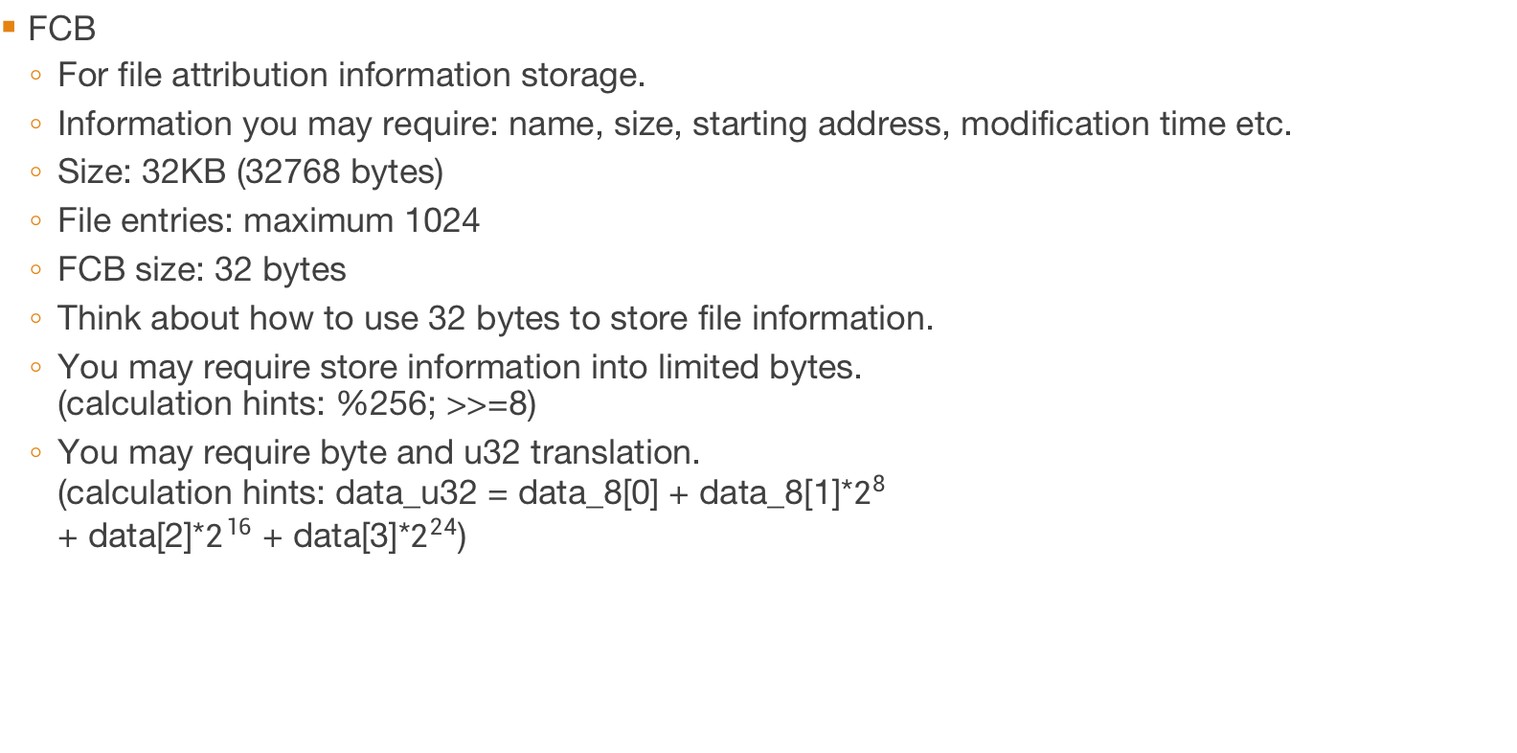
Assignment 4 Hints
FCB
For file attribution information storage.
Information you may require: name, size, starting address, modification time etc.
Size: 32KB (32768 bytes)
File entries: maximum 1024
FCB size: 32 bytes
Think about how to use 32 bytes to store file information.
You may require store information into limited bytes. (calculation hints: %256; >>=8)
You may require byte and u32 translation. (calculation hints: data_u32 = data_8[0] + data_8[1]*$2^{8}$ + data[2]*$2^{16}$ + data[3]*$2^{24}$)

Slide 7
Assignment 4 Hints
Storage block
For data storage.
Size: 1024KB
Block size: 32 bytes
Storage block entries: 32768
Maps with super block for free space management.

Slide 8
Assignment 4 Hints
File operation
fp is pointing to the address (considered as volume array index) of the fcb of the file.
open: find fcb (file space) for existing or non-existed files.
write: find free space and dump contents; update bit map; update fcb information.
read: read contents basing on fcb.
rm: release file space (update fcb information)
ls: base on fp to find file information; list by size or modified time.

Slide 9
Assignment 4 Q & A
Q & A

Slide 10
Thank you

