Slide 1

Operating System (CSC 3150) Tutorial 10
shihao hong
School of Science and Engineering
E-mail: 220019037@link.cuhk.edu.cn

Slide 2
Target
In this tutorial, we will discuss Assignment 5 related functions.
Assignment 5 Structure
DMA buffer
ioctl
arithmetic
write (blocking / non-blocking)
read (readable)
work
Assignment 5 makefile and scripts
Bonus Hints
Assignment 5 Problems

Slide 3
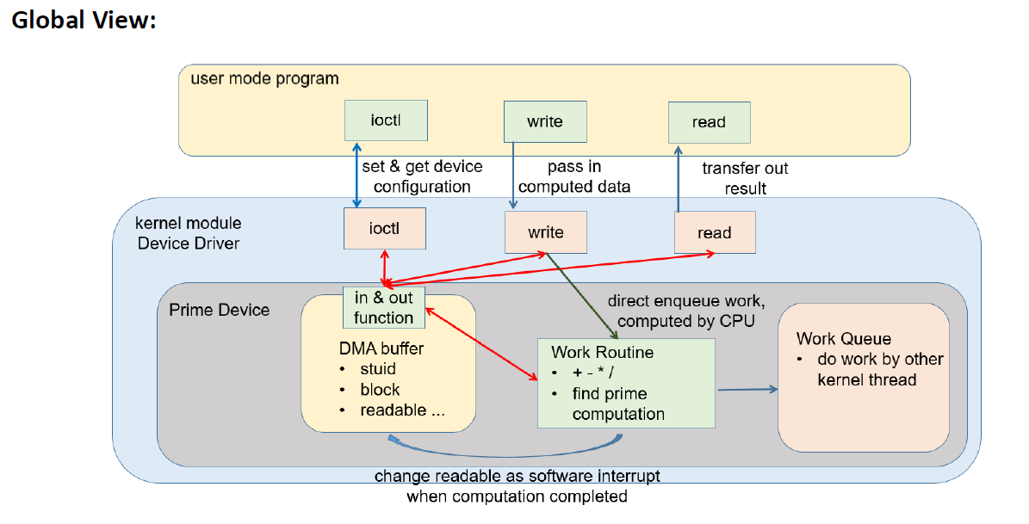
Assignment 5 Structure

Slide 4
DMA buffer
The data is stored in DMA buffer.
Ports being defined:
#define DMA_BUFSIZE 64
#define DMASTUIDADDR 0x0 // Student ID
#define DMARWOKADDR 0x4 // RW function complete
#define DMAIOCOKADDR 0x8 // ioctl function complete
#define DMAIRQOKADDR 0xc // ISR function complete
#define DMACOUNTADDR 0x10 // interrupt count function complete
#define DMAANSADDR 0x14 // Computation answer
#define DMAREADABLEADDR 0x18 // READABLE variable for synchronize
#define DMABLOCKADDR 0x1c // Blocking or non-blocking IO
#define DMAOPCODEADDR 0x20 // data.a opcode
#define DMAOPERANDBADDR 0x21 // data.b operand1
#define DMAOPERANDCADDR 0x25 // data.c operand2

Slide 5
DMA buffer
When doing data transfer within kernel, you could use in/out function. “c/s/i” depends on what type of data you want to read or write.
In and out function to write/read into/from DMA buffer. (Already defined in template)
void myoutc(unsigned char data,unsigned short int port) { *(volatile unsigned char*)(dma_buf+port) = data; }
void myouts(unsigned short data,unsigned short int port) { *(volatile unsigned short*)(dma_buf+port) = data;}
void myouti(unsigned int data,unsigned short int port) { *(volatile unsigned int*)(dma_buf+port) = data; }
unsigned char myinc(unsigned short int port) { return *(volatile unsigned char*)(dma_buf+port); }
unsigned short myins(unsigned short int port) { return *(volatile unsigned short*)(dma_buf+port); }
unsigned int myini(unsigned short int port) { return *(volatile unsigned int*)(dma_buf+port);}
Write data into DMA buffer with specific port.
Read data from DMA buffer with specific port.

Slide 6
DMA buffer
Demo usage of in and out function:
In user program, use ioctl to set I/O mode: int ret = 0; ioctl(fd, HW5_IOCSETBLOCK, &ret);
Transfer data from user to kernel: int value; get_user(value, (int *)arg);
Store I/O mode to DMA buffer in kernel: myouti(value, DMABLOCKADDR);
Get I/O mode from DMA buffer in kernel: int IOMode = myini(DMABLOCKADDR);

Slide 7
ioctl
Set and get device configuration
Masked labels: (defined in “ioc_hw5.h”)
(HW5_IOC_SETSTUID) Set student ID: printk your student ID
(HW5_IOCSETRWOK) Set if RW OK: printk OK if you complete R/W function
(HW5_IOCSETIOCOK) Set if ioctl OK: printk OK if you complete ioctl function
(HW5_IOCSETIRQOK) Set if IRQ OK: printk OK if you complete bonus
(HW5_IOCSETBLOCK) Set blocking or non-blocking: set write function mode
(HW5_IOCWAITREADABLE) Wait if readable now (synchronize function): used before read to confirm it can read answer now when use non-blocking write mode.

Slide 8
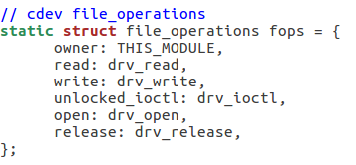
ioctl
In user program, when ioctl is called, it will map to drv_ioctl in kernel. (If you’ve defined operation ioctl as drv_ioctl when adding the cdev.)
In kernel, when you received different command from user program, you need to use the in and out function to change the configurations in DMA buffer.

Slide 9
arithmetic
In user program, use arithmetic function to trigger read and write.
When write is triggered, it will transfer data into kernel. At the same time, it will put the arithmetic work into work queue.

Slide 10
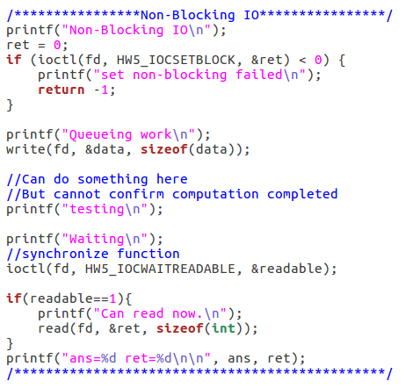
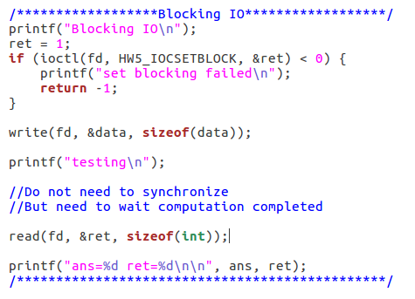
arithmetic
For blocking write, the work queue will be forced to wait the termination of computation. So we could read the result when write completed.
For non-blocking write, the work routine will be continued. So in user program, we use ioctl to check device’s readable configuration before read the result. This is for synchronization and ensure you’ve read the correct answer.

Slide 11
write (blocking / non-blocking)
In user program, write the data into your device.
In kernel, transfer data into DMA buffer.
Check the device I/O mode.
Use “INIT_Work” to define what function (drv_arithmetic) should be executed in work routine.
Basing on I/O mode (blocking or non-blocking), place the work into work queue.

Slide 12
read (readable)
In user program, use ioctl to check readable flag to synchronize the result when there is non-blocking write.
In user program, read the computed result from device.
In kernel, read the result from DMA buffer.
Clean the result and set readable as false.
Readable setting is checked via drv_ioctl. If it is non-readable, then just sleep and waiting.

Slide 13
drv_arithmetic
In kernel, drv_arithmetic is to execute the computation when the work is in queue.
It should complete ‘+’, ‘-’, ‘*’, ‘/’ and ‘p’ computations basing on the data being stored in DMA buffer.
It should check blocking and non-blocking setting from DMA buffer.
If the device is executing non-blocking write, set the readable as true when completed computation.

Slide 14
work
Define a work: struct work_struct *work
INIT_WORK(work, func): initialize work. Func is defined what function need to be executed for this work.
schedule_work(work): put work task in global workqueue.
flush_scheduled_work(): It is to flush the kernel-global work queue. Forces execution of the kernel-global workqueue and blocks until its completion.
Use work to control block and non-blocking write.

Slide 15
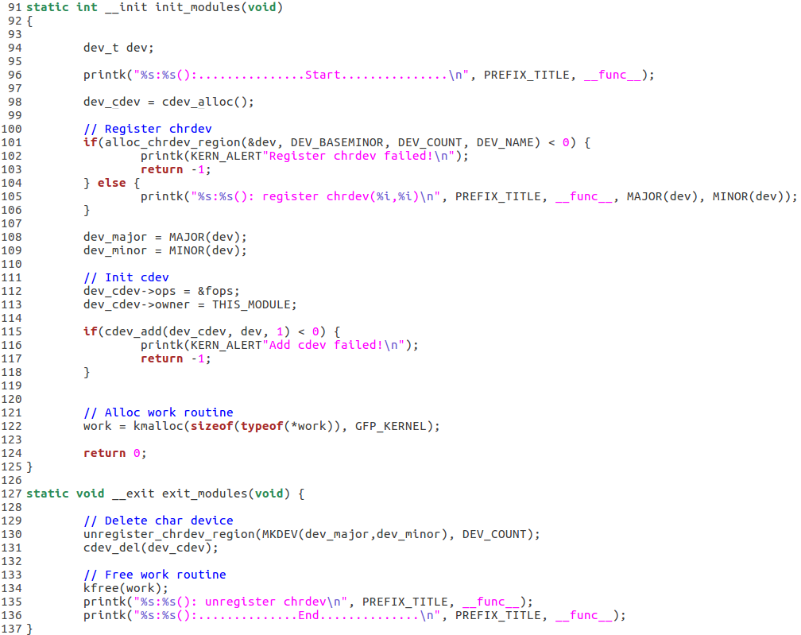
work example (kernel)

Slide 16
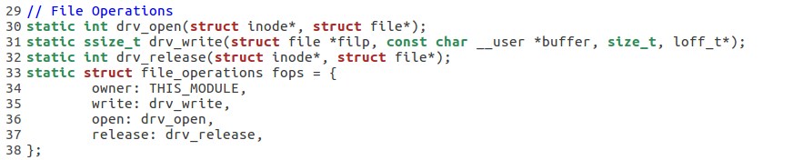
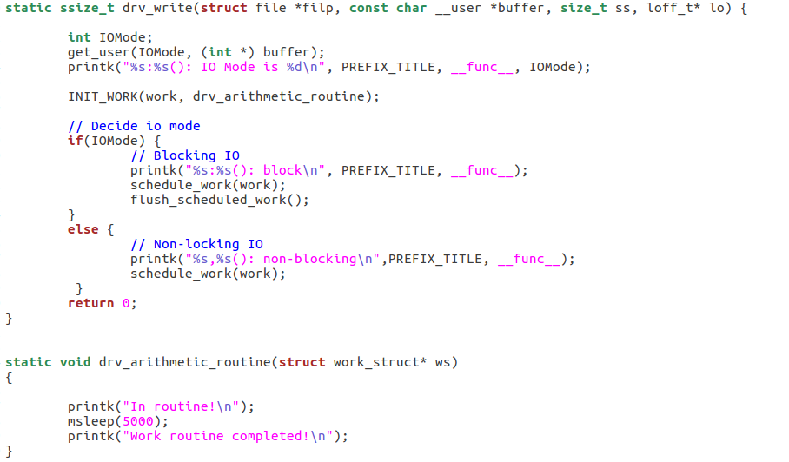
work example (kernel)
Blocking I/O: put the work into queue, and flush global work queue to block until its completion.
Non blocking I/O: put the work into queue.
For this work, let it sleep for 5 seconds.

Slide 17
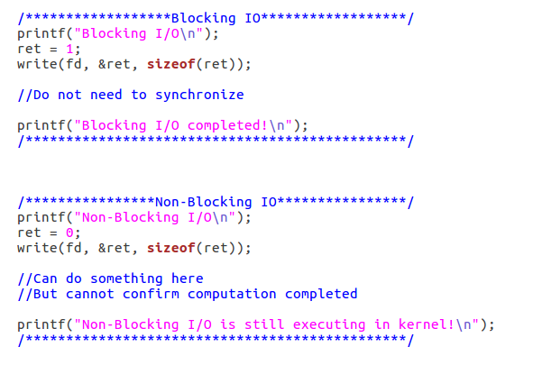
work example (user program)

Slide 18
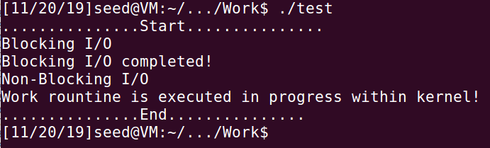
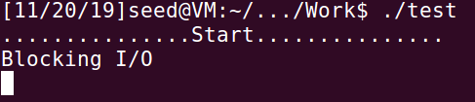
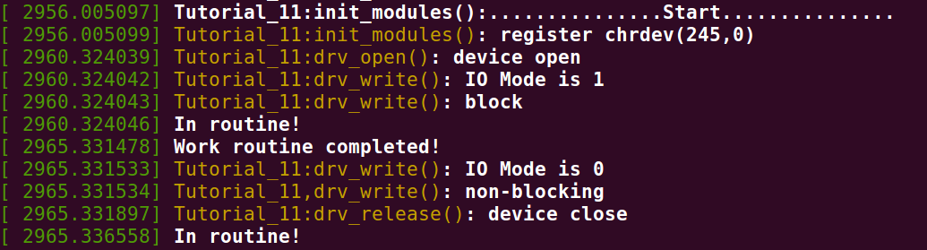
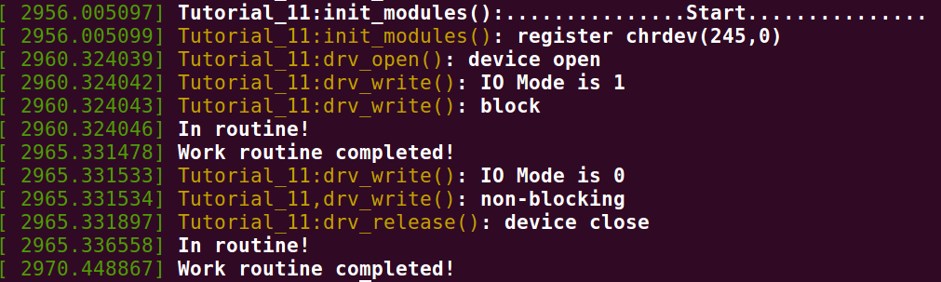
work example (output)
User program output
For blocking write, you will see it will not continue print message until the work is executed completely.
Kernel log output (display immediately when user program terminates)
Kernel log output (display 5 seconds later)

Slide 19
Assignment 5 makefile and scripts
Command “make” includes executions:
Build kernel module “mydev.ko”
Insert kernel module “sudo insmod mydev.ko”
For first time active your device:
Check available MAJOR and MINOR number. (When initialize your kernel module, use alloc_chrdev_region() and MAJOR() / MINOR() to check. After insert your module, type “dmesg” to check the result.)
create a file node for “mydev”. Run “sudo ./mkdev.sh MAJOR MINOR”.
You don’t need to create this file node every time. Just create it if it does not exist. (You can run “sudo ./rmdev.sh” to remove this file node.)
Run test “./test”:
Command “make clean” includes executions:
Remove kernel module “sudo rmmod mydev.ko”
Clean test executable file “rm test”
Display kernel message including “OS_AS5” (“dmesg | grep OS_AS5”)

Slide 20
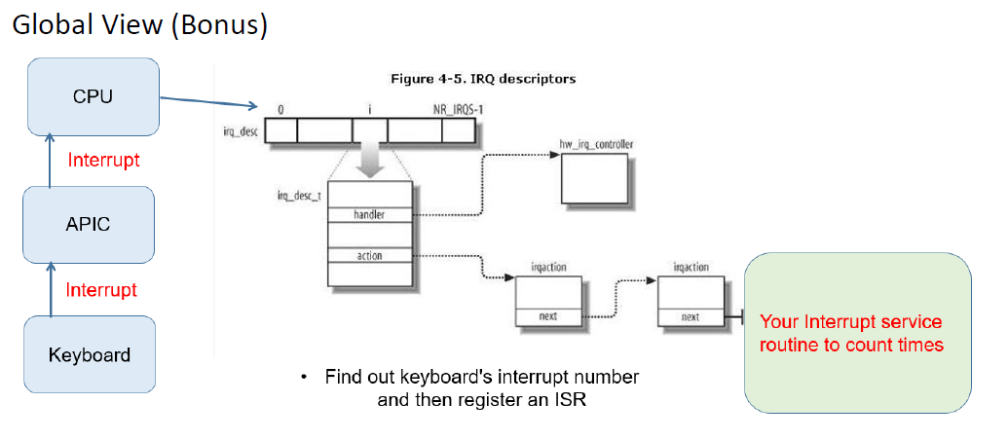
Bonus Hints

Slide 21
Bonus Hints
request_irq ( unsigned int irq, irq_handler_t handler, unsigned long irqflags, const char * devname, void * dev_id);
irq: Interrupt line to allocate (Hints: Can check from “watch -n 1 cat /proc/interrupts”)
handler: Function to be called when the IRQ occurs. (Hints: count interrupt times when IRQ occurs)
irqflags: Interrupt type flags (Hints: IRQF_SHARED Interrupt is shared)
devname: An ascii name for the claiming device. (Hints: Once your kernel module is inserted/removed, it will auto be displayed under “watch -n 1 cat /proc/interrupts”. Define any name you want to show.)
dev_id: A cookie passed back to the handler function.

Slide 22
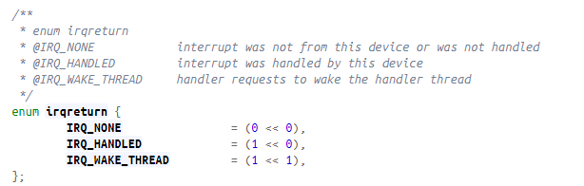
Bonus Hints
free_irq ( unsigned int irq, void * dev_id);
irq: Interrupt line to free
dev_id: Device identity to free.
irq_handler_t handler
https://elixir.bootlin.com/linux/v4.10.14/source/include/linux/interrupt.h
typedef irqreturn_t (*irq_handler_t)(int, void *);
https://elixir.bootlin.com/linux/v4.10.14/source/include/linux/irqreturn.h
More detailed usage for irq handler
Understanding Linux Kernel, Page 591 - 595

Slide 23
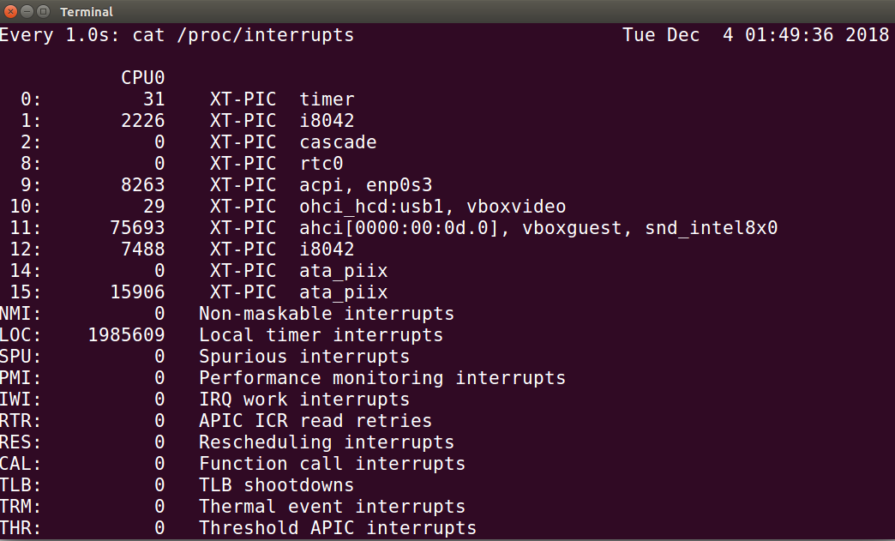
Bonus Hints
Run command “watch -n 1 cat /proc/interrupts”
IRQ_NUM should be defined as 1 for below case. (Share interrupt with i8042, the keyboard interrupt)

Slide 24
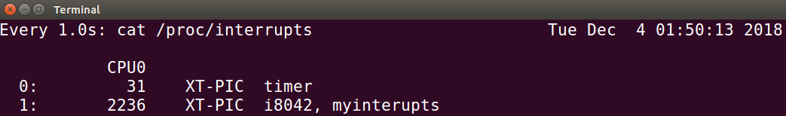
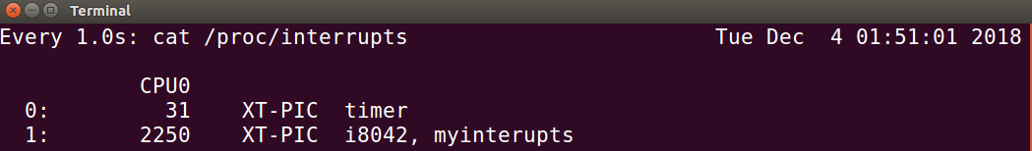
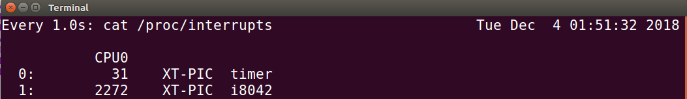
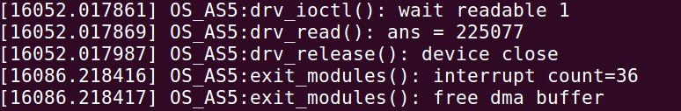
Bonus Hints
Inserted mydev.ko
After run test
Remove mydev.ko
Interrupt counting

Slide 25
Assignment 5 Problems
“Command not found” for “sudo ./mkdev.sh Major Minor”.
Do not use the script anymore, type the command directly.
sudo mknod /dev/mydev c major minor
sudo chmod 666 /dev/mydev
ls -l /dev/mydev

Slide 26
Assignment 5 Problems
get_user / put_user cannot transfer data with type DataIn
This macro copies a single simple variable from user space to kernel space.
It supports simple types like char and int, but not larger data types like structures or arrays.
Some students may get killed error when running test program if transferring DataIn via get_user / put_user.
For data with type DataIn, you can transfer via buffer, second parameter of the drv_write / drv_read.
Or you could use copy_from_user / copy_to_user.

Slide 27
Assignment 5 Problems
How to change device readable setting?
When the device is unreadable, use a while loop with msleep in kernel.
Use the while loop to keep checking readable setting.
If unreadable, use msleep to let this work to be sleeped.
In this case, the CPU is available to continue computation.
Once the computation completes, change readable setting.
Then in while loop, if it detects the readable setting is updated, it will stop looping.

Slide 28
Assignment 5 Problems
When will drv_release be called?
If close() is called in user program, drv_release() will be called in kernel.
If close() is not called in user program, when that process is terminated (./test completes execution), close() will be automatically called.

Slide 29
Assignment 5 Problems
Bonus: interrupt counting will not always be 36.
It depend on what you’ve typed in via keyboard.
You only need to calculate the interrupt numbers during mydev.ko being inserted.
You could verify the number via “watch -n 1 cat /proc/interrupts”.
Sometimes, even if you only press once in keyboard, the interrupt will occur twice or multiple times.

Slide 30
Reference
Work queues
https://www.ibm.com/developerworks/library/l-tasklets/index.html
https://linuxtv.org/downloads/v4l-dvb-internals/device-drivers/ch01s06.html
Get user / Put user
https://www.fsl.cs.sunysb.edu/kernel-api/re244.html
https://www.fsl.cs.sunysb.edu/kernel-api/re245.html
Request and free irq
https://elixir.bootlin.com/linux/v4.10.14/source/include/linux/interrupt.h
https://www.fsl.cs.sunysb.edu/kernel-api/re667.html
https://www.kernel.org/doc/htmldocs/kernel-api/API-free-irq.html

Slide 31
Thank you

