Slide 1

Operating System (CSC 3150) Tutorial 9
Shihao Hong
School of Science and Engineering
E-mail: 220019037@link.cuhk.edu.cn

Slide 2
Target
In this tutorial, we will discuss how to make a device in Linux and Assignment 5 related functions.
Create file system node
Allocate device number
Initialize and remove a CDEV
File operations
Test device
Work Routine
Blocking and Non-blocking I/O
DMA buffer

Slide 3
Device Driver(Textbook Chap.18.8 )
Linux Device Drivers include character devices (such as printers, terminals, and mice), block devices (including all disk drives), and network interface devices.
Block devices include all devices that allow random access to completely independent, fixed-sized blocks of data, including hard disks and floppy disks, CD-ROMs and Blu-ray discs, and flash memory. Block devices are typically used to store file systems, but direct access to a block device is also allowedso that programs can create and repair the file system that the device contains. Applications can also access these block devices directly if they wish. Forexample, a database application may prefer to perform its own fine-tuned layout of data onto a disk rather than using the general-purpose file system.
Character devices include most other devices, such as mice and keyboards. The fundamental difference between block and character devices is random access—block devices are accessed randomly, while character devices are accessed serially byte by byte. For example, seeking to a certain position in a file might be supported for a DVD but makes no sense for a pointing device such as a mouse.
Network devices are dealt with differently from block and character devices. Users cannot directly transfer data to network devices. Instead, they must communicate indirectly by opening a connection to the kernel’s networking subsystem.

Slide 4

Create file system node
command “mknod”
makes a directory entry and corresponding i-node for a special file.
mknod Name b/c Major Minor
Name: device name
b: indicates the special file is a block-oriented device (disk, diskette, or tape)
c: indicates the special file is a character-oriented device (other devices)
Major: major device, which helps the operating system find the device driver code.
Minor: minor device, that is the unit drive or line number
A script to use mknod is provided (mknod.sh)
Make a device named “mydev” under /dev

Slide 5
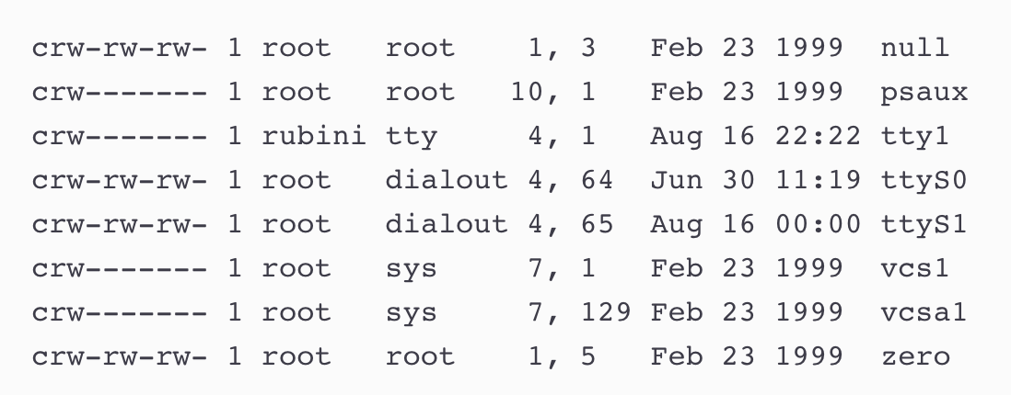
Create file system node
major numbers: 1, 4, 7, 10,
minors numbers: 1, 3, 5, 64, 65, 129.
The major number identifies the driver associated with the device.
The minor number is used only by the driver specified by the major number, which provides a way for the driver to differentiate among them.
ls -l output screenshot
Notes:
For example, /dev/null and /dev/zero are both managed by driver 1, whereas virtual consoles and serial terminals are managed by driver 4; similarly, both vcs1 and vcsa1 devices are managed by driver 7. The kernel uses the major number at open time to dispatch execution to the appropriate driver.

Slide 6
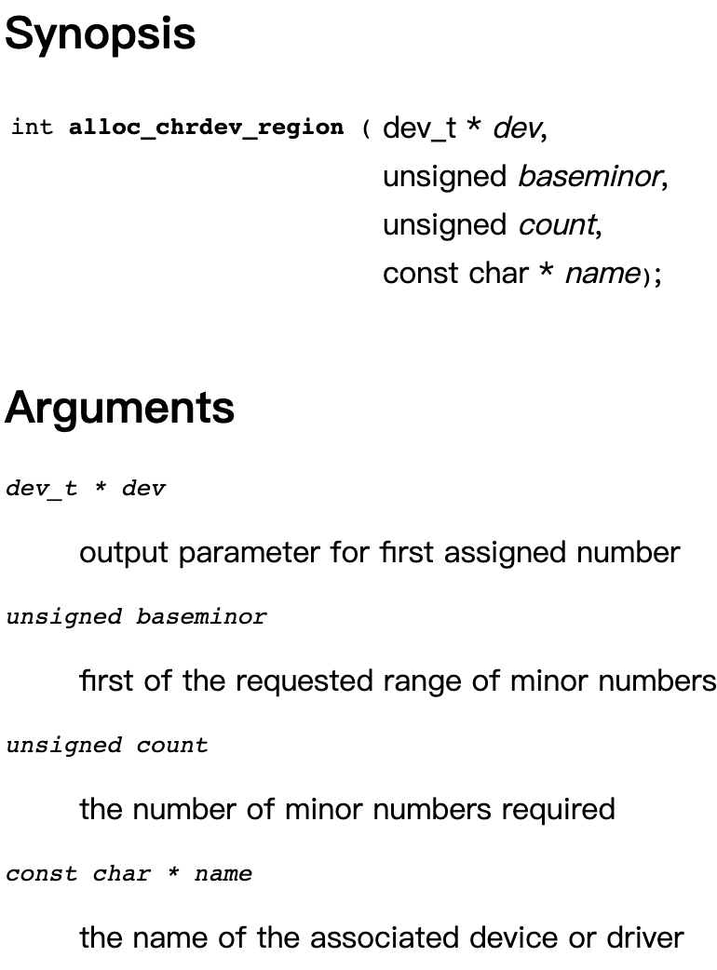
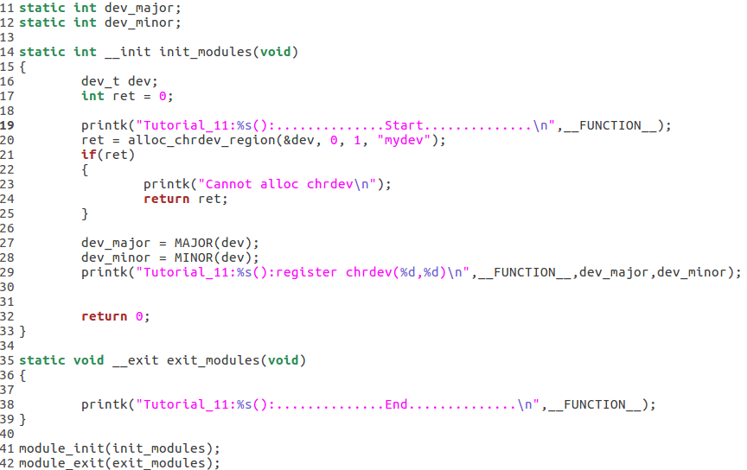
Create file system node
You can get available major and minor number by:
Create a kernel module
Use alloc_chrdev_region() in module_init() function
Call MAJOR() and MINOR().

Slide 7
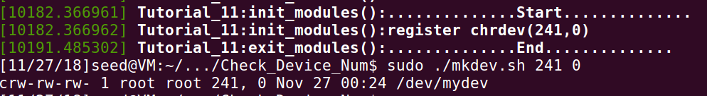
Create file system node
Insmod mydev module to check available major and minor number.
Run “mkdev.sh” to create directory for mydev

Slide 8
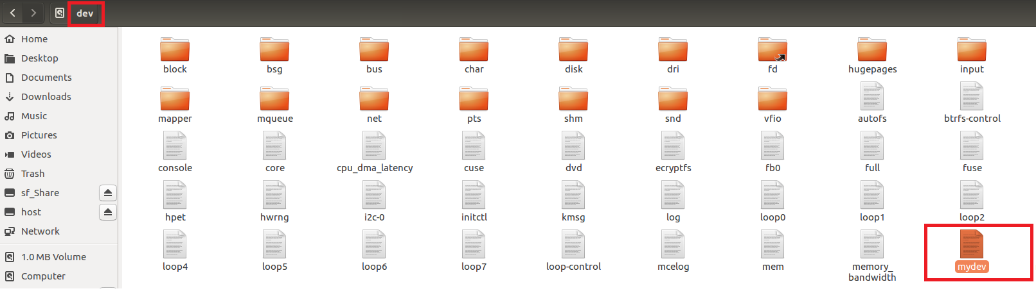
Create file system node
Under “/dev”, you will find “mydev”

Slide 9
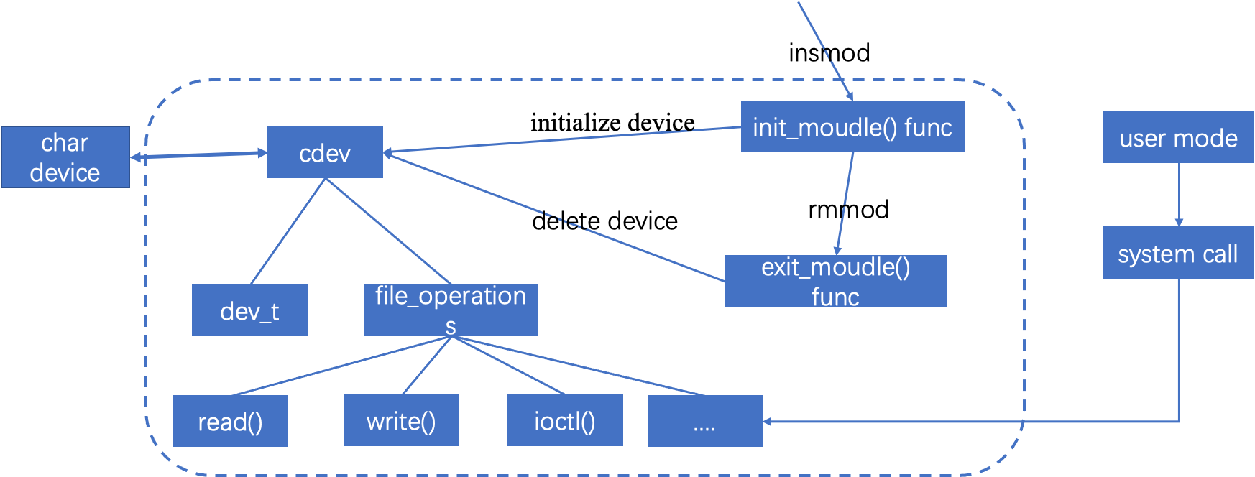
Before we continue
Essentially, writing the Char Driver is to define the cdev structure:
Through its member dev_t to define the device number (divided into major and minor device numbers) to determine the uniqueness of the character device
Through its member file_operations to define the interface functions provided by the character device

Slide 10
Register range of device number
alloc_chrdev_region( dev_t * dev, unsigned baseminor, unsigned count, const char * name)
Allocates a range of char device numbers.
The major number will be chosen dynamically.
It returns (along with the first minor number) in dev. Returns zero or a negative error code.
dev: output parameter for first assigned number
baseminor: first of the requested range of minor numbers
count: the number of minor numbers required
name: the name of the associated device or driver

Slide 11
Unregister range of device number
unregister_chrdev_region ( dev_t from, unsigned count)
This function will unregister a range of count device numbers, starting with from.
The caller should normally be the one who allocated those numbers in the first place.
from: the first in the range of numbers to unregister
count: the number of device numbers to unregister

Slide 12
Initialize and remove a CDEV
cdev_alloc()
Allocate a cdev structure
Allocates and returns a cdev structure, or NULL on failure
cdev structure is defined as: struct cdev *dev_cdevp;
cdev_init(struct cdev * cdev, const struct file_operations * fops)
Initializes cdev, remembering fops, making it ready to add to the system with cdev_add
cdev: the structure to initialize
fops: the file_operations for this device

Slide 13
Initialize and remove a CDEV
cdev_add(struct cdev * p, dev_t dev, unsigned count)
adds the device represented by p to the system, making it live immediately.
A negative error code is returned on failure.
p: the cdev structure for the device.
dev: the first device number for which this device is responsible.
count: the number of consecutive minor numbers corresponding to this device.
cdev_del(struct cdev * p)
removes p from the system, possibly freeing the structure itself
p: the cdev structure to be removed

Slide 14
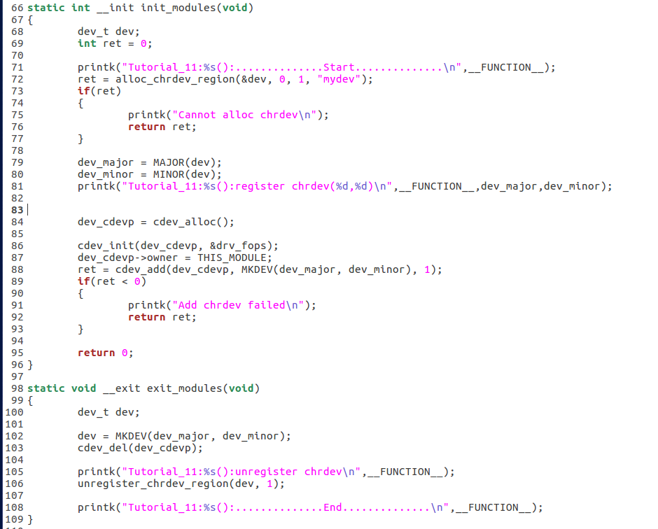
Initialize and remove a CDEV

Slide 15
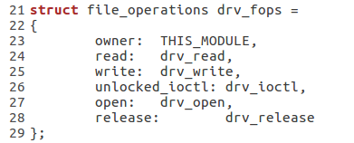
File operations
In Linux, control device just likes R/W file.
You should write a struct file_ operation to map the operations to functions in this module.
And use cdev_init() at module init to bind cdev and file_ operations.
File operations are defined in fs.h
https://elixir.bootlin.com/linux/latest/source/include/linux/fs.h#L1730

Slide 16
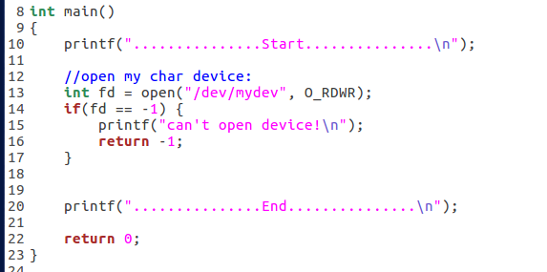

File operations
In user mode, open a file
In kernel device, it maps to “drv_open”

Slide 17
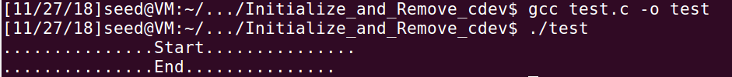
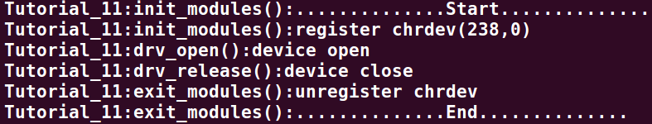
Test device
Test the file operations in your device (./Initialize_and_Remove_cdev)
Run make file to build mydev.ko: make
Insert your device module: sudo insmod mydev.ko
Check the major and minor number: dmesg
Run mknod script to create file system node : sudo ./mkdev.sh Major Minor
Build test executable file: gcc test.c -o test
Run test: ./test
Remove your device module: sudo rmmod mydev.ko
Check messages in kernel log: dmesg
Remove filesystem node: sudo ./rmnod.sh

Slide 18
Work Routine
In Linux, the work could be written in a work routine function in module.
Use INIT_WORK() and schedule_work() to queue work to system queue.
work: struct work_struct *work
INIT_WORK(work, func): initialize work (from an allocated buffer).
schedule_work(work): put work task in global workqueue
flush_scheduled_work(): flush work on work queue. It is to flush the kernel-global work queue. Forces execution of the kernel-global workqueue and blocks until its completion.

Slide 19
Blocking and Non-blocking I/O
Your write function in module can be blocking or non-blocking.
Blocking write need to wait computation completed.
Non-blocking write just return after queueing work.
Use work routine to control blocking and non-blocking write.

Slide 20
DMA buffer
Direct Memory Access
To simulate register and memory on device, you could kmalloc a dma buffer.
This buffer is as I/O port mapping in main memory.
What device do is written in work routine function . This function get data from this buffer.
You need to implement in & out function to access dma buffer just like physical device.
out function is used to output data to dma buffer.
in function is used to input data from dma buffer.

Slide 21
DMA buffer
kzalloc(size_t size, gfp_t flags)
allocate memory. The memory is set to zero.
size: how many bytes of memory are required.
flag: the type of memory to allocate (GFP_KERNEL - Allocate normal kernel ram.)
For flags, more details could be checked on: https://www.kernel.org/doc/htmldocs/kernel-api/API-kmalloc.html
kfree(const void * objp)
free previously allocated memory
objp: pointer returned by kmalloc / kzalloc
If objp is NULL, no operation is performed.

Slide 22
Reference
Char devices
https://www.kernel.org/doc/htmldocs/kernel-api/chrdev.html
https://www.oreilly.com/library/view/linux-device-drivers/0596000081/ch03s02.html
https://www.programmersought.com/article/10174645171/
Operating-System-Concepts Chapter 18.8
Work queues
https://www.ibm.com/developerworks/library/l-tasklets/index.html
https://linuxtv.org/downloads/v4l-dvb-internals/device-drivers/ch01s06.html

Slide 23
Thank you

