Slide 1
PRESENTED BY
Mingshu Lu
Catherine Chen
OPTION WHEEL
STRATEGY
Jessica Xu
Theo Li
Jackie Zhang
Systematic Premium Harvesting via
Cash-Secured Puts & Covered Calls
$10M
2013–2024
D10 vs D20
20 Stocks
Initial Capital
Backtest Period
Delta Regimes
Equal-Weight
Systematic Options Strategy | 2025

Slide 2
01
Objective & Strategy Overview
3–4
TABLE OF
CONTENTS
02
Layer 1 — Stock Selection
5–6
03
Layer 2 — Data Pipeline
7
04
Layer 3 — Delta Computation
8–9
Option Wheel Strategy
Systematic Premium Harvesting
05
Layer 4 — Contract Selection
10–11
06
Layer 5 — Backtesting Engine
12
07
Risk Controls & Infrastructure
13–14
08
Performance Framework
15

Slide 3
Objective
Option Wheel Strategy
Investment Mandate & Design Goals
Design a strategy with balanced risk-return characteristics — higher yield than Treasuries, lower volatility than equities.
Return Target
Volatility Control
Drawdown Discipline
Expected return above 3-month Treasury bills, capturing option premium alpha without requiring directional equity bets.
Clearly lower annualized volatility than the S&P 500. Systematic premium income cushions daily P&L and smooths the equity curve.
Smaller peak-to-trough losses than long-only equity exposure. Assigned stocks benefit from cost-basis reduction via collected premiums.
WHY THE WHEEL STRATEGY?
01
Premium Income
02
Path-Independent
03
Rule-Based
04
Risk-Tiered
Earns put + call premiums each 4-week cycle as a recurring income source.
Generates returns in flat or slowly trending markets — not just bull runs.
Fully mechanical selection eliminates discretionary bias and emotional decisions.
D10/D20 delta regimes offer two calibrated risk-return profiles for comparison.
Option Wheel Strategy | Systematic Premium Harvesting | 2013–2024

Slide 4
Strategy Overview
Option Wheel Strategy
The Wheel Cycle — Simplified State Machine
1
2
3
4
5
▶
▶
▶
▶
Select Underlying
Sell Cash-Secured Put
Expiration Check
Sell Covered Call
Rinse & Repeat
20 stocks selected each rebalance via multi-factor scoring (Quality, Momentum, Consensus)
Sell OTM put at target delta (D10: −0.10 / D20: −0.20). Collect premium. DTE ∈ [21,27]
Put OTM: keep premium, sell new put.
Put ITM (S < K): stock assigned at strike K
Sell OTM call at target delta (+0.10 / +0.20) on assigned shares. Collect premium.
Call OTM: keep shares, sell new call.
Call ITM (S > K): shares called away. Return to Step 1.
Delta Regime
Put Target
Call Target
Assignment Probability
Premium Level
Risk Profile
D10 Strategy
−0.10 delta
+0.10 delta
Lower (~10%)
Lower
Conservative
D20 Strategy
−0.20 delta
+0.20 delta
Higher (~20%)
Higher
Moderate
Simplified version: hold to expiration, no early close, no roll.

Slide 5
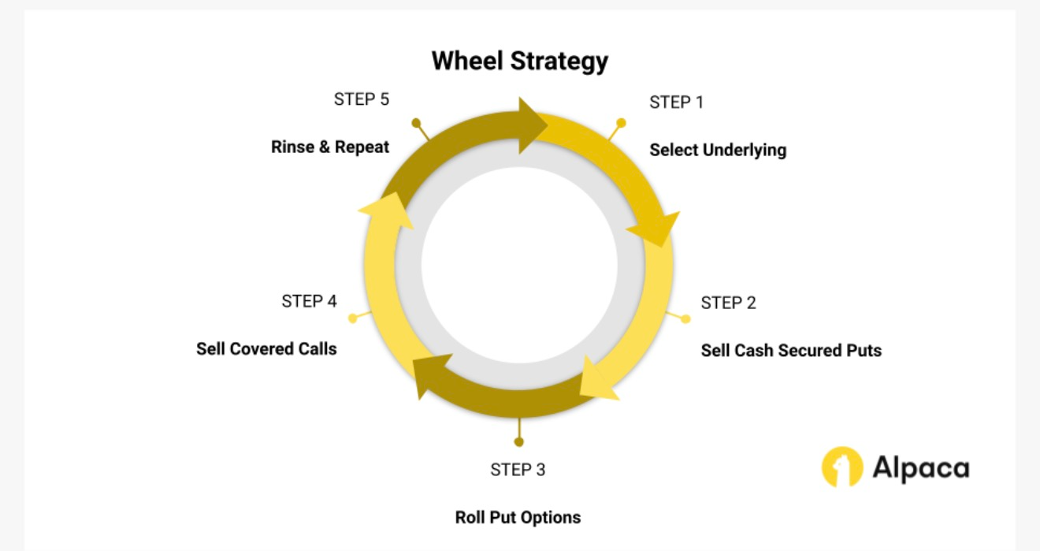

Slide 6
Layer 1: Stock Selection
Option Wheel Strategy
Multi-Factor Scoring Model — S&P 500 Universe
Composite Score = 0.5 × Market Cap + 0.2 × Quality (ROE) + 0.2 × Momentum (6M) + 0.1 × Analyst Consensus
50%
Market Cap
20%
Quality (ROE)
20%
Momentum (6M)
10%
Analyst Consensus
Liquidity Filter
Financial Health
Price Trend
I/B/E/S Ratings
Selects large-cap S&P 500 equities to ensure deep options markets, tight bid-ask spreads, and sufficient open interest for 4-week contracts.
Return on Equity measures management efficiency and balance sheet strength — filtering for firms with durable earnings power and low distress risk.
6-month trailing return captures medium-term price continuation. Avoids mean-reverting laggards that are more likely to see put assignment.
I/B/E/S institutional ratings. Inverted and normalized: Strong Buy receives highest score, reflecting broad market conviction and lower downside risk.
SELECTION RULES
Universe:
S&P 500 constituents
Rebalance:
Every 4 weeks (aligned with option expiry cycle)
Price Filter:
Exclude stocks priced above $1,000 (contract sizing)
Output:
Top 20 stocks ranked by composite score, equal weight 5% each
Option Wheel Strategy | Systematic Premium Harvesting | 2013–2024

Slide 7
Layer 2: Data Pipeline
Option Wheel Strategy
Unified Data Architecture — 4 Output Tables
Raw Data Sources
→
Data Pipeline (Member 2)
→
4 Output Tables
→
Downstream Modules
01
OptionTable_rebal
02
UnderlyingPrice
date | ticker | cp_flag | exp_date | strike | mid | dte
date | ticker | close
Rebalance-date option chain snapshot. Filtered to DTE ∈ [21,27] and exp_date > rebalance_date. mid = close. Used by Members 3 & 4.
Full daily closing prices 2013–2024 for all selected stocks. Used for daily MTM valuation, expiration ITM/OTM check, and BS delta input.
→ Member 3 (IV) → Member 4 (Contract)
→ Member 3 (S input) → Member 5 (MTM)
03
RiskFree3M
04
OptionMTMTable
date | r_3m_annual_pct
date | ticker | cp_flag | exp_date | strike | mid
Daily 3-month T-bill annualized rate. Missing values forward-filled, aligned to trading calendar. Used as risk-free rate r in Black-Scholes.
Daily mid prices for only the traded contracts during their holding period [trade_date, exp_date]. Used exclusively for daily P&L marking of open positions.
→ Member 3 (r input) → Member 5 (cash yield)
→ Member 5 (daily MTM)
Data Sources: WRDS/CRSP (stock prices) | WRDS/IBES (fundamentals & consensus) | Databento API (options)

Slide 8
Layer 3: Delta Computation
Option Wheel Strategy
Black-Scholes IV Inversion → European Delta Approximation
Why Delta? Delta ≈ probability of assignment at expiration. Targeting a specific delta creates two calibrated risk regimes: D10 (~10% assignment) vs D20 (~20% assignment).
Step 1
KEY FORMULAS
Implied Volatility (IV) Inversion
No sigma input available. Given market mid price, solve for σ such that BS_price(σ) = mid.
Method: Newton-Raphson iteration (fast convergence, 5–10 iterations).
d1
[ ln(S/K) + (r + σ²/2)·T ] / (σ·√T)
Δ_call
N(d1)
Step 2
European Black-Scholes Delta
Δ_call = N(d1) Δ_put = N(d1) − 1
d1 = [ln(S/K) + (r + σ²/2)T] / (σ√T)
Using inferred IV, current stock price S, risk-free rate r.
Δ_put
N(d1) − 1
IV solve
BS_price(σ) = market_mid → Newton-Raphson
Step 3
European Approximation
Note
DTE ∈ [21,27] ⇒ early exercise premium negligible ⇒ European BS is valid
Although these are technically American-style equity options, all contracts target DTE ∈ [21,‧27] days. With such short expiration windows, the probability of early exercise is negligible for near-term OTM positions. European Black-Scholes therefore provides an accurate and tractable approximation of delta.
Output: IVTable + DeltaTable (date | ticker | cp_flag | exp_date | strike | iv | delta)
Option Wheel Strategy | Systematic Premium Harvesting | 2013–2024

Slide 9
Layer 4: Contract Selection
Option Wheel Strategy
Closest-Delta Rule — D10 vs D20 for Puts & Calls
Rule: For each ticker at each rebalance date, select the contract minimizing |delta − target|. Tie-break: higher mid price (more premium).
D10 PUT
D10 Put — Cash-Secured
D10 CALL
D10 Call — Covered Call
Select from OptionTable_rebal (DTE ∈ [21,27])
Activated only when shares held (post-assignment)
Target delta: −0.10
Target delta: +0.10
Choose | delta − (−0.10) | minimum
Choose | delta − (+0.10) | minimum
Lower assignment probability (~10%)
Lower call-away probability (~10%)
Lower premium collected
Allows more upside participation
D20 PUT
D20 Put — Cash-Secured
D20 CALL
D20 Call — Covered Call
Select from OptionTable_rebal (DTE ∈ [21,27])
Activated only when shares held (post-assignment)
Target delta: −0.20
Target delta: +0.20
Choose | delta − (−0.20) | minimum
Choose | delta − (+0.20) | minimum
Higher assignment probability (~20%)
Higher call-away probability (~20%)
Higher premium collected
Less upside participation, more income
PutSheet and CallSheet output: strategy_id | rebalance_date | ticker | cp_flag | exp_date | strike | trade_price | delta_used

Slide 10
Layer 5: Backtesting Engine
Option Wheel Strategy
Time-Driven State Machine — Daily Simulation 2013–2024
STEP 1
Expiration Settlement
STEP 2
Rebalance — Open Positions
STEP 3
Daily MTM Snapshot
If date == exp_date:
If date == rebalance_date:
Every trading day:
Put ITM (S < K): Buy 100 shares at strike K. Cash −= K × 100.
For each of 20 selected stocks:
Equity = Cash + Σ(shares × stock_close) − Σ(short_option_mid × 100)
Put OTM (S ≥ K): Option expires worthless. Premium already booked.
shares == 0 → Sell Put from PutSheet. Cash += premium × 100.
Stock MTM: UnderlyingPrice.close
Call ITM (S > K): Sell 100 shares at strike K. Cash += K × 100.
shares > 0 → Sell Call from CallSheet. Cash += premium × 100.
Option MTM: OptionMTMTable.mid (short options are liabilities)
Call OTM (S ≤ K): Option expires worthless. Hold shares.
Skip if existing open option on same ticker.
Record: daily_pnl = equity_today − equity_yesterday
OUTPUTS
DailyPortfolio
TradeLog
Performance
strategy_id | date | cash | equity | daily_pnl
strategy_id | date | ticker | event | detail | cash_change | shares_change
CAGR | Volatility | Sharpe | Max Drawdown | VaR
D10 and D20 run as fully independent accounts. Initial capital: $10,000,000 each.

Slide 11
Risk Controls & Infrastructure
Option Wheel Strategy
Transaction Costs, Position Sizing & Data Sources
TRANSACTION COST ASSUMPTIONS
POSITION SIZING & CONSTRAINTS
Options Commission
Initial Capital:
$10,000,000 per strategy (D10 and D20 independent)
TC
$0.30 per contract (standard retail brokerage rate). Applied at open and close.
Max Position:
5% of capital per stock = $500,000 max exposure each
Slippage
SL
1% slippage applied to both stock fills (assignment) and option premium received.
Stock Count:
20 stocks per period, equal-weighted at 5%
No Early Close
Contracts:
1 contract (100 shares) per position
EX
All positions held to expiration. No rolling, no early buy-to-close. Simplifies backtest and reflects systematic execution.
Rebalance:
Every 4 weeks; DTE ∈ [21,27] for selected contracts
Cash Yield
CF
Uninvested cash earns the 3-month T-bill rate (daily, forward-filled). Tracked via RiskFree3M table.
Backtest:
2016-04-29 to 2024-12-31 (full cycle, ~8.5 years)
DATA SOURCES
Stock Prices & Fundamentals: WRDS / CRSP | Analyst Ratings: WRDS / I/B/E/S | Options Data: Databento API
Option Wheel Strategy | Systematic Premium Harvesting | 2013–2024

Slide 12
Performance Results
Option Wheel Strategy
Apr 2016 – Dec 2024 | D10 vs D20 vs SPY vs AGG
D10/D20 deliver equity-like risk-adjusted returns at ~40% lower volatility than SPY, with ~9pp better max drawdown protection.
Total Return
CAGR
Ann. Volatility
D10: +65.9% │ D20: +81.5% │ SPY: +226% │ AGG: +12.4%
D10: 6.0% │ D20: 7.1% │ SPY: 14.6% │ AGG: 1.4%
D10: 9.9% │ D20: 10.2% │ SPY: 16.8% │ AGG: 6.4%
Sharpe Ratio
Max Drawdown
VaR 95% / CVaR 95%
D10: 0.640 │ D20: 0.727 │ SPY: 0.868 │ AGG: 0.212
D10: −25.5% │ D20: −25.2% │ SPY: −34.5% │ AGG: −23.5%
D10: −0.96% / −1.57% │ D20: −0.96% / −1.56% │ SPY: −1.68% / −2.77%
REGIME ANALYSIS (CAGR │ Sharpe │ Max DD)
2017–2019
2020
2021
2022
2023–2024
Bull Market
COVID Shock
Recovery & Bubble
Inflation Bear
AI Rally (2023–24)
D10: 8.1% / 1.46 / −6.5%
D20: 7.3% / 1.25 / −7.2%
D10: 12.9% / 0.85 / −13.2%
D20: 11.9% / 0.86 / −12.5%
D10: 18.4% / 1.68 / −5.5%
D20: 26.5% / 1.87 / −4.8%
D10: −19.2% / −1.08 / −25.0%
D20: −19.2% / −1.08 / −24.8%
D10: 9.2% / 1.45 / −4.0%
D20: 11.8% / 1.59 / −4.6%
Benchmark: S&P 500 Total Return Index | Risk-free: 3-month T-bill (daily)

Slide 13
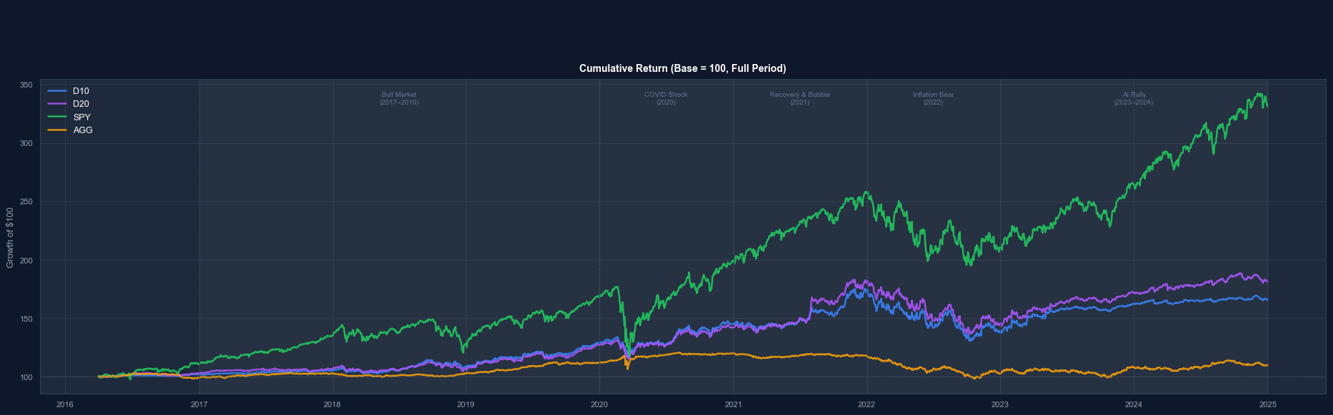
Performance Results — Regime & Tail Risk
Option Wheel Strategy
Subsample performance across 5 market regimes | Correlation & VaR/CVaR analysis
D10/D20 correlation with SPY spikes in bear markets (0.91 in 2022) but stays low in rallies (0.57 in 2023–24). Daily VaR 95% is 43% smaller than SPY.
Left: CAGR / Volatility / Sharpe / Max Drawdown across 5 regimes vs SPY & AGG | Right: Pairwise correlation matrix, daily VaR 95%/99%, CVaR 95%/99%

Slide 14
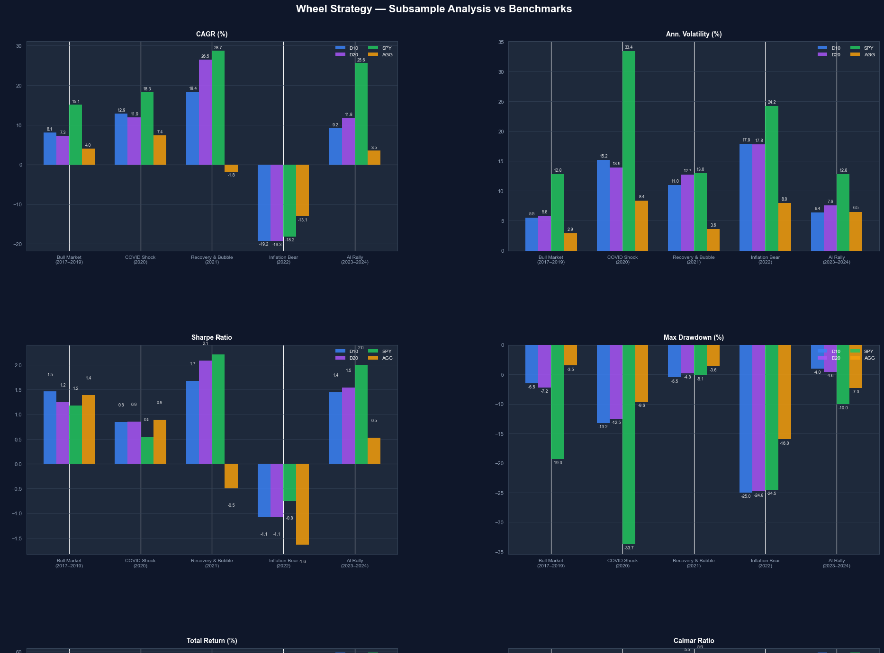

Slide 16
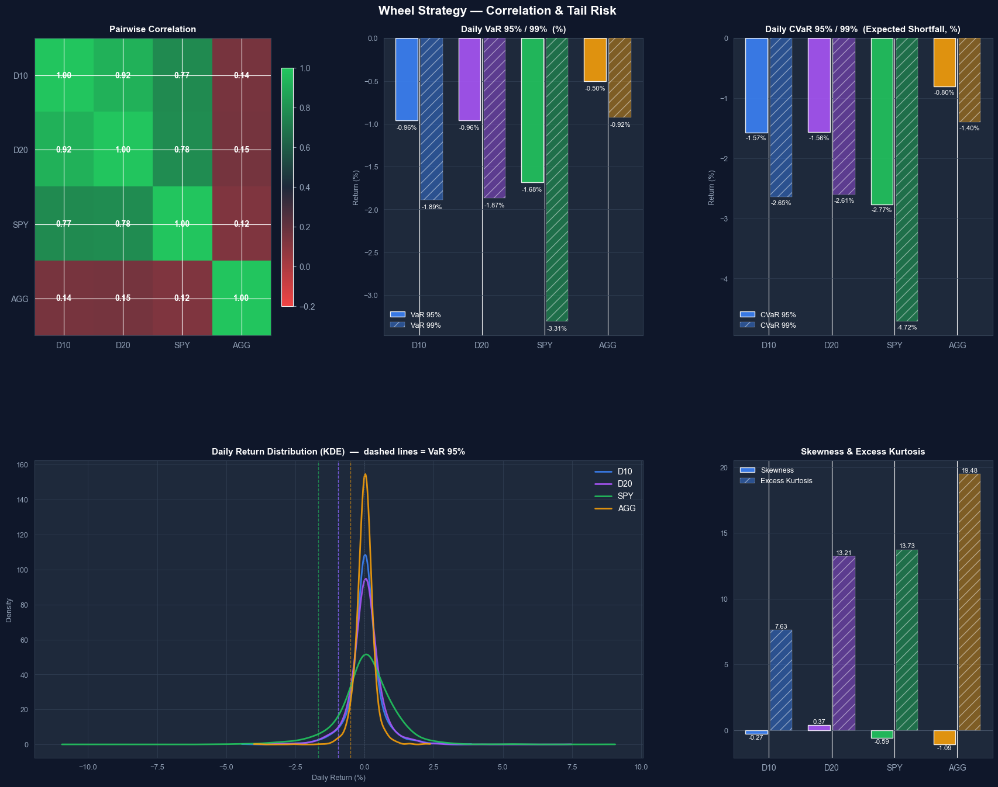

Slide 17
Conclusion
Option Wheel Strategy
Option Wheel Strategy | Apr 2016 – Dec 2024
A systematic, rules-based option wheel strategy that delivers superior risk-adjusted returns relative to both equity and fixed-income benchmarks across diverse market regimes.
Risk-Adjusted Performance
D10 Sharpe 0.640 / D20 Sharpe 0.727 — equity-class returns at ~40% lower volatility than SPY
Max drawdown ~25% vs SPY −34.5%; daily VaR 95% of −0.96% vs SPY −1.68%
Outperforms AGG on every metric while maintaining low correlation (0.14) to fixed income
Regime Resilience
Positive Sharpe in 4 of 5 regimes; only 2022 Inflation Bear drove drawdown (−25%), matching SPY losses
SPY correlation spikes to 0.91 in bear markets but falls to 0.57 in AI Rally — hedging value when it matters most
Premium income provides natural cushion: put premium offsets ~30–50% of assignment losses historically
Structural Limitations & Trade-offs
CAGR gap vs SPY (6–7% vs 14.6%) reflects the structural upside cap from short calls in strong bull runs
Put assignment in bear markets converts to long equity exposure, increasing drawdown correlation with SPY
Transaction costs (~24–34 bps/year) are manageable but compound over time; execution slippage is a real risk
Investment Mandate Fit
Ideal for investors seeking equity-like Sharpe with lower volatility and drawdown than a passive S&P index
Complements a core equity portfolio as a volatility-dampening overlay with uncorrelated premium income stream
Fully mechanical rules eliminate discretionary bias; scalable and auditable with WRDS + Databento data stack
Option Wheel Strategy | Systematic Premium Harvesting | 2016–2024

Slide 18
Future Work
Option Wheel Strategy
Three extensions to improve capital efficiency and risk-adjusted returns
The current strategy provides a solid baseline. The following enhancements target the key structural gaps: upside cap in bull markets, idle cash drag, and fixed delta sensitivity to vol regimes.
01
02
03
Volatility-Regime Strike Selection
Equity-First Initialisation
Idle Capital Deployment
Replace fixed delta targets with a Realised/Implied Vol (RV/IV) signal
Sell options only when IV > RV (positive volatility risk premium)
Higher delta when VRP is wide; pull back in low/inverted VRP regimes (e.g. Inflation Bear 2022)
Start fully invested in long equities; immediately sell covered calls (buy-write overlay)
Eliminates ramp-up lag; call premiums become return enhancers on fully-deployed capital
Expected to narrow CAGR gap vs SPY in strong bull markets (2021: SPY +28.7%; 2023–24: SPY +57.6%)
Current rule: 1 contract (100 shares) per position; residual cash below the 100-lot threshold earns T-bill rate only
Deploy idle cash into puts on lower-priced universe stocks to generate additional premium income
Improves capital efficiency without changing the strategy’s risk profile; all positions remain subject to the same delta filter
Option Wheel Strategy | Systematic Premium Harvesting | 2016–2024

