Slide 1
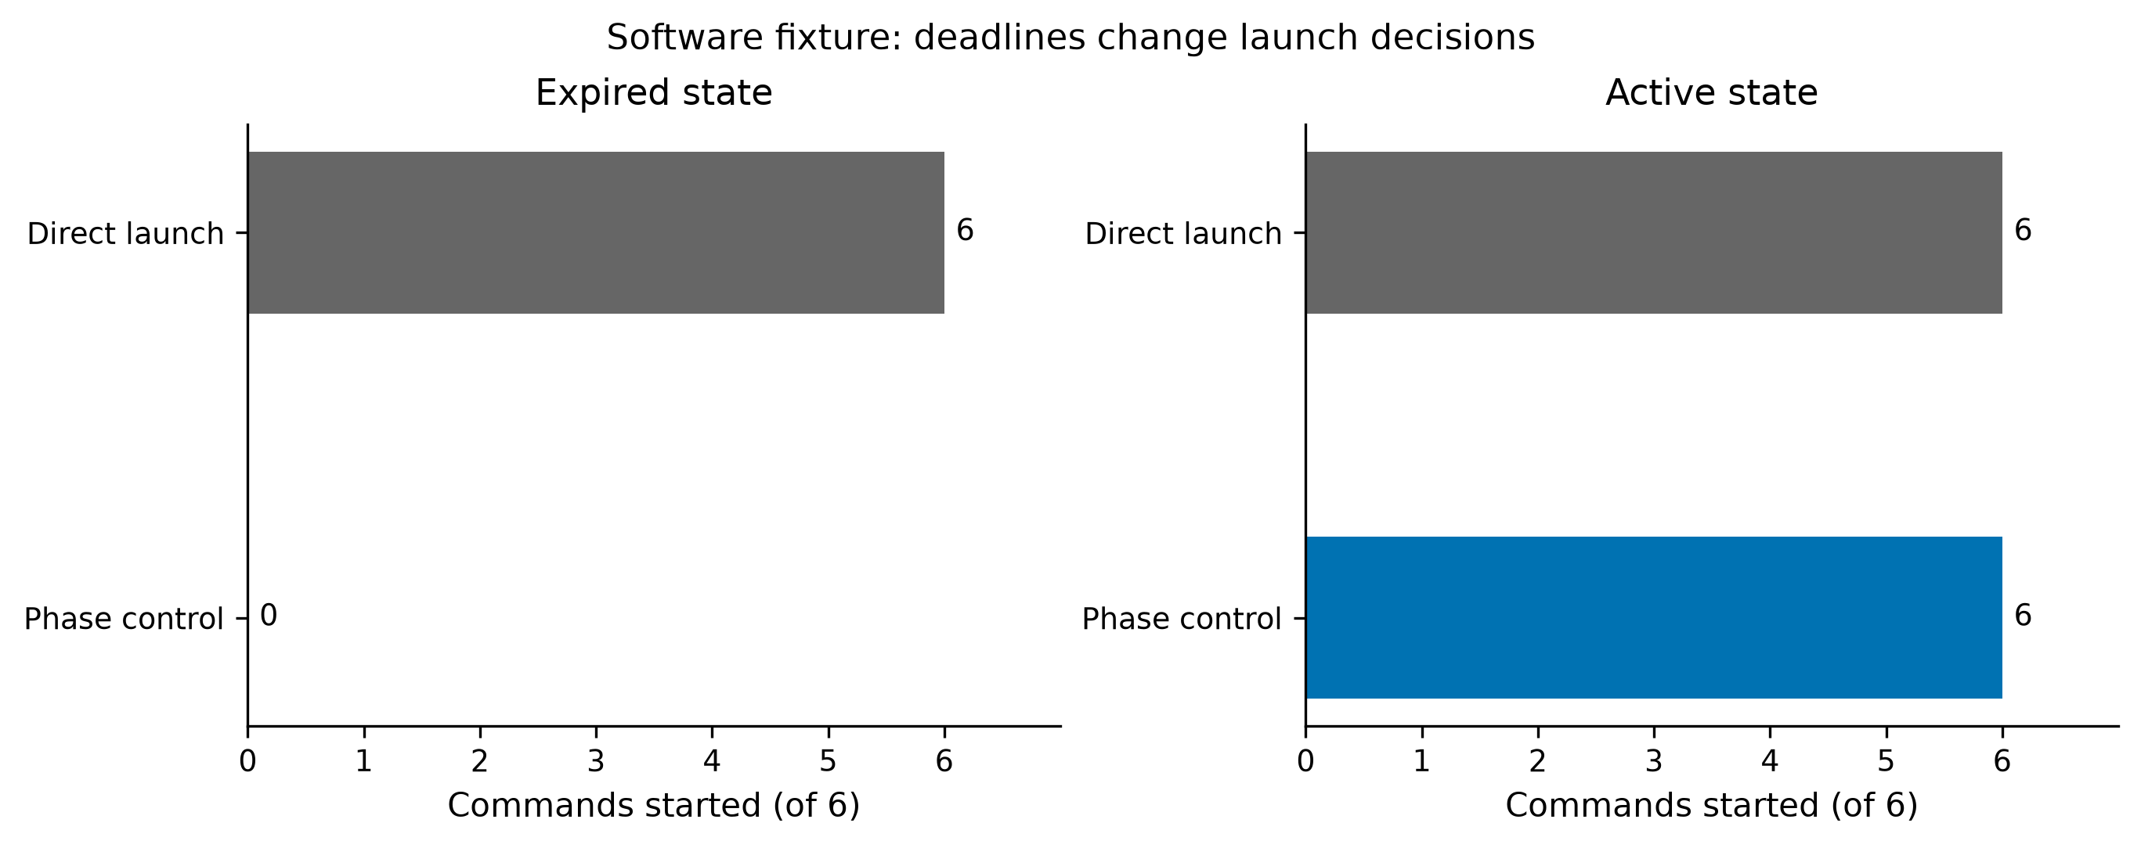
Notes:
Local software fixture: expired controlled launches 0 of 6; active 6 of 6. No claim of statistical generalization.

