Slide 1
Points collection
Shape semantic decompsition

Slide 2
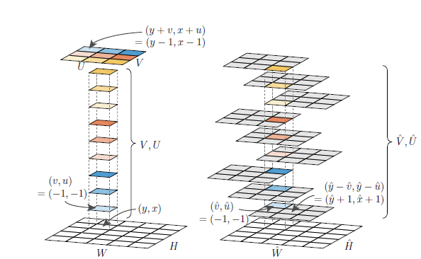
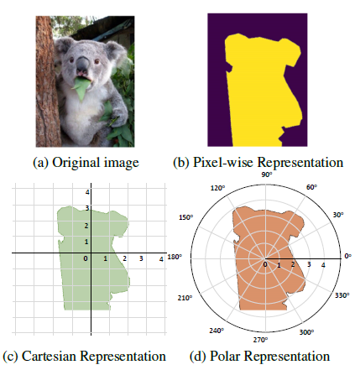
Single shot/stage instance segmentation
TensorMask
PolarMask
CenterMask

Slide 3
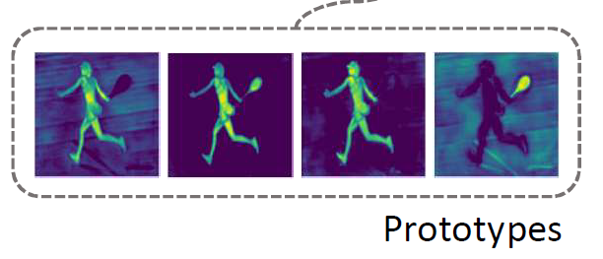
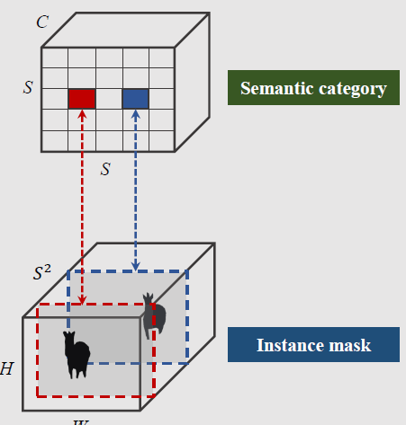
YOLACT
SOLO

Slide 4
?
(1)
(2)

