Slide 1
EclEmma
http://www.eclemma.org/

Slide 2
Installation
http://www.eclemma.org/installation.html
Option 1: Install from Eclipse Marketplace Client
From your Eclipse menu select Help → Eclipse Marketplace.
Search for "EclEmma".
Hit Install for the entry "EclEmma Java Code Coverage".
Follow the steps in the installation wizard.

Slide 3
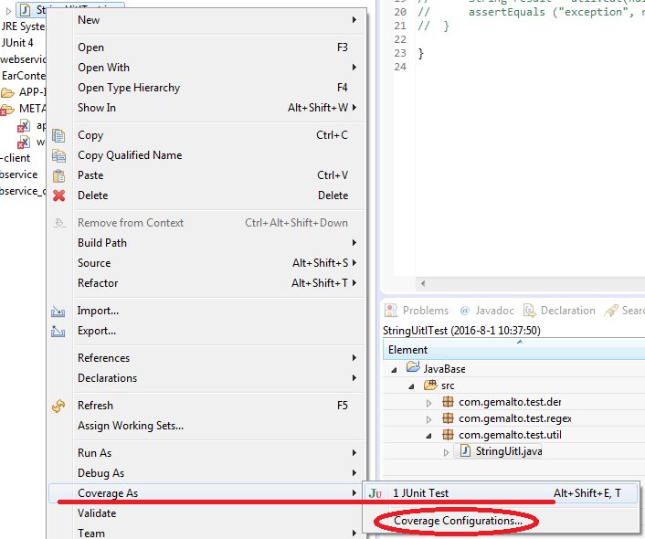
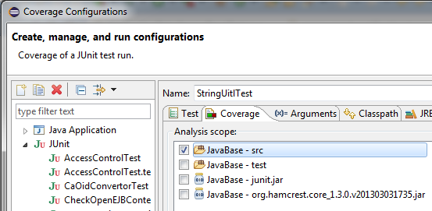
Launching in Coverage Mode

Slide 4
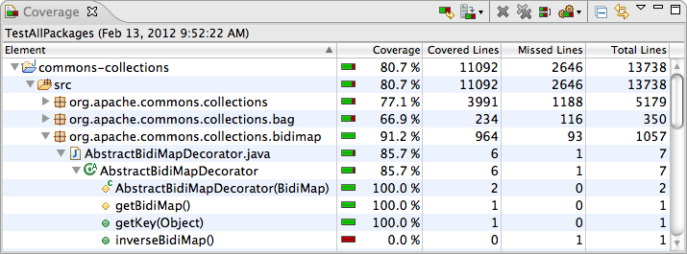
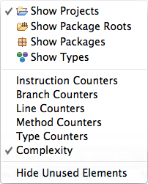
Using the Coverage View

Slide 5
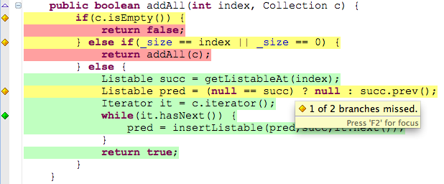
Source Code Annotation

