Slide 1
DB Knowledge
--By Shengli
17/03/2017

Slide 2
Oracle
三思笔记之一步一步学Oracle

Slide 3
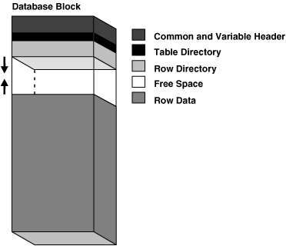
Block
Overhead: Header + Table Directory + Row Directory
Header (Common and Variable)
The header contains general block information, such as the block address and the type of segment (for example, data or index).
Table Directory
This portion of the data block contains information about the table having rows in this block.
Row Directory
This portion of the data block contains information about the actual rows in the block (including addresses for each row piece in the row data area).
Row Data
This portion of the data block contains table or index data. Rows can span blocks.
Free Space
Free space is allocated for insertion of new rows and for updates to rows that require additional space

Slide 4
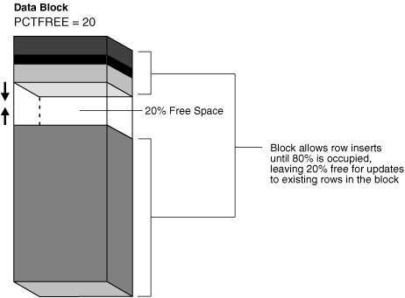
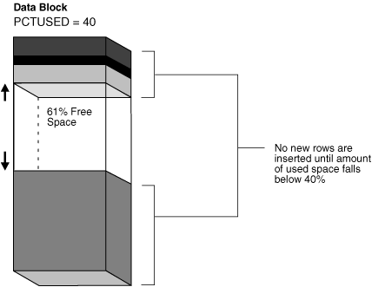
Block: PCTFREE & PCTUSED
The PCTFREE parameter sets the minimum percentage of a data block to be reserved as free space for possible updates to rows that already exist in that block.
The PCTUSED parameter sets the minimum percentage of a block that can be used for row data plus overhead before new rows are added to the block.

Slide 5
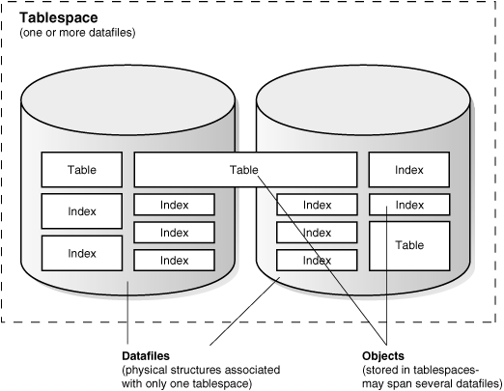
Tablespaces and Datafiles
An Oracle database consists of one or more logical storage units called tablespaces, which collectively store all of the database's data.
Each tablespace in an Oracle database consists of one or more files called datafiles, which are physical structures that conform to the operating system in which Oracle is running.
A database's data is collectively stored in the datafiles that constitute each tablespace of the database.

