Slide 1

Fourier Analysis on the Boolean Cube
Shuchen Li (Peking University)

Slide 2
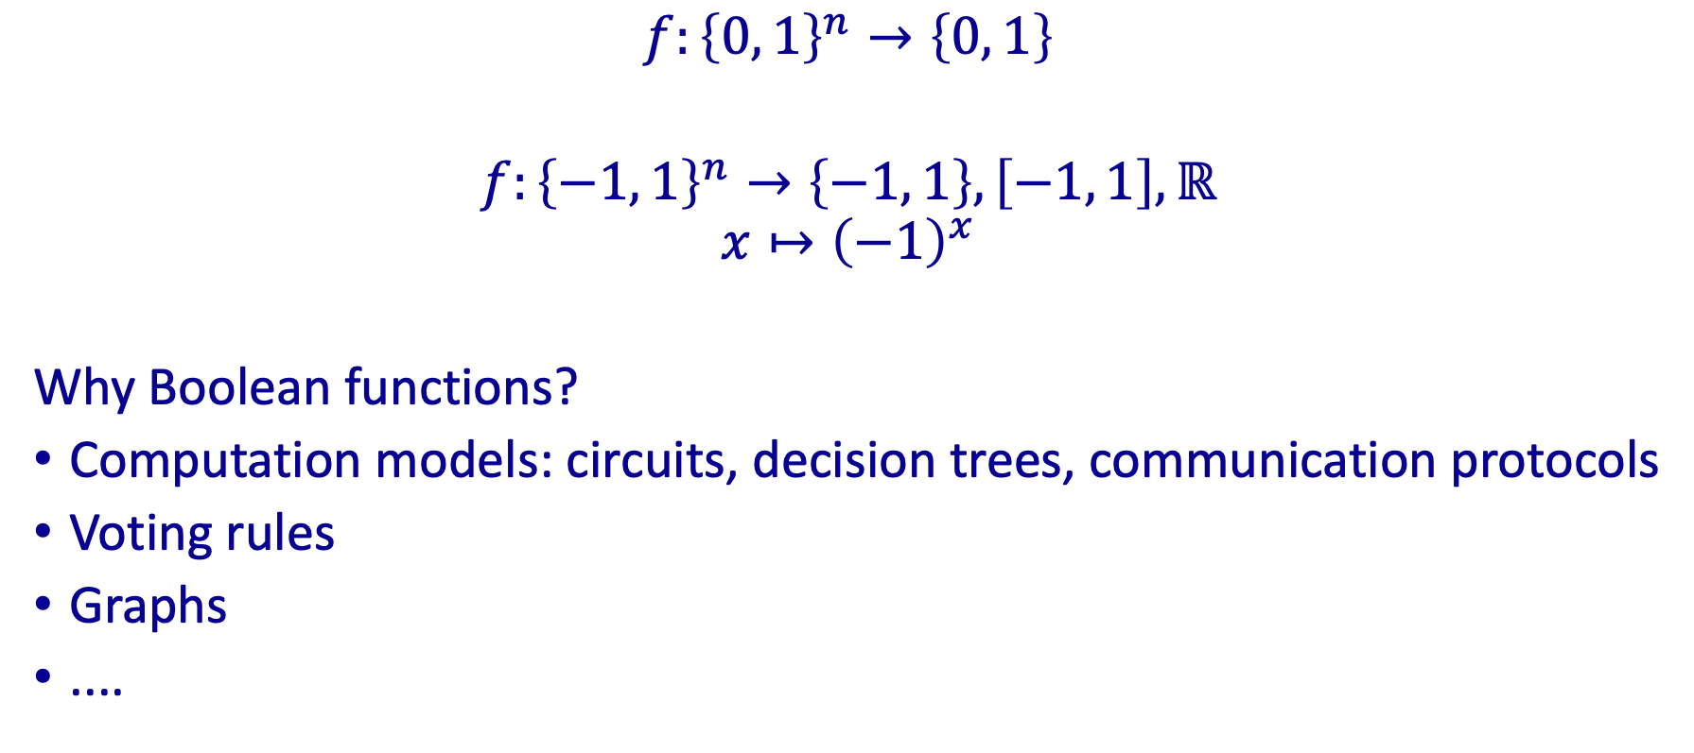
Boolean Functions
1
-
1
-
$$f:{\left\{0, 1\right\}}^{n}→\left\{0, 1\right\}$$
$f:{\left\{−1, 1\right\}}^{n}→\left\{−1, 1\right\}, \left[−1, 1\right], ℝ$
$$x↦{\left(−1\right)}^{x}$$
Why Boolean functions?
Computation models: circuits, decision trees, communication protocols
Voting rules
Graphs
....
0
0
+
+
0
+
0
+
1
-
1
-

Slide 3
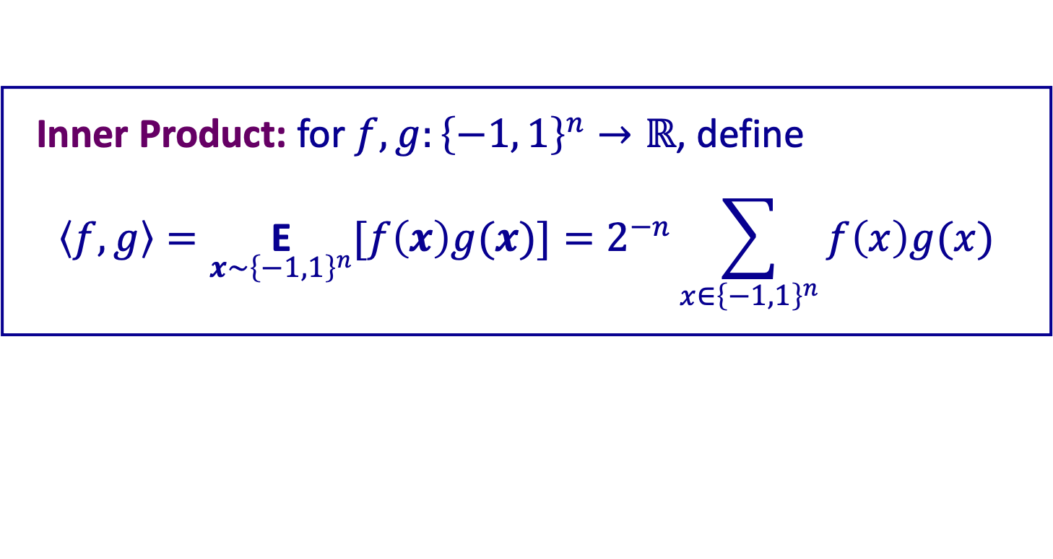

Boolean Functions
The set of all Boolean functions $f:{\left\{−1, 1\right\}}^{n}→ℝ$ forms a linear space
How to find a “good” basis for the space?
Inner Product: for $f,g:{\left\{−1, 1\right\}}^{n}→ℝ$, define
$$\left\langle f, g\right\rangle =\underset{x\sim {\left\{−1, 1\right\}}^{n}}{\text{E}}{[f\left(x\right)g(x)]}=2^{−n}\sum_{x∈{\left\{−1, 1\right\}}^{n}}{f\left(x\right)g(x)}$$

Slide 4
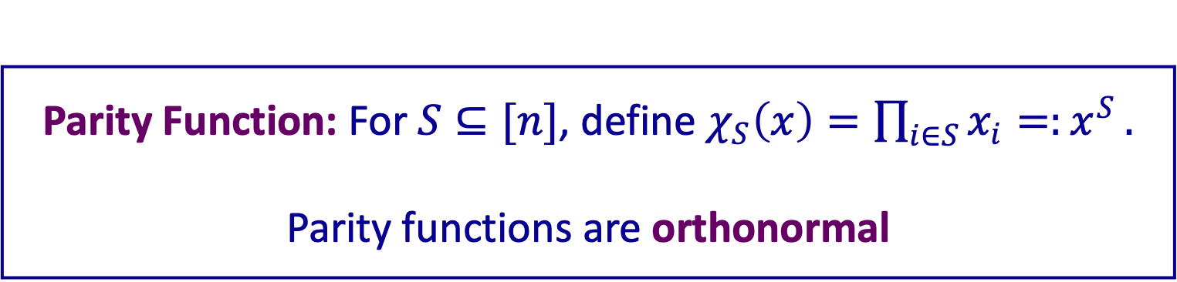
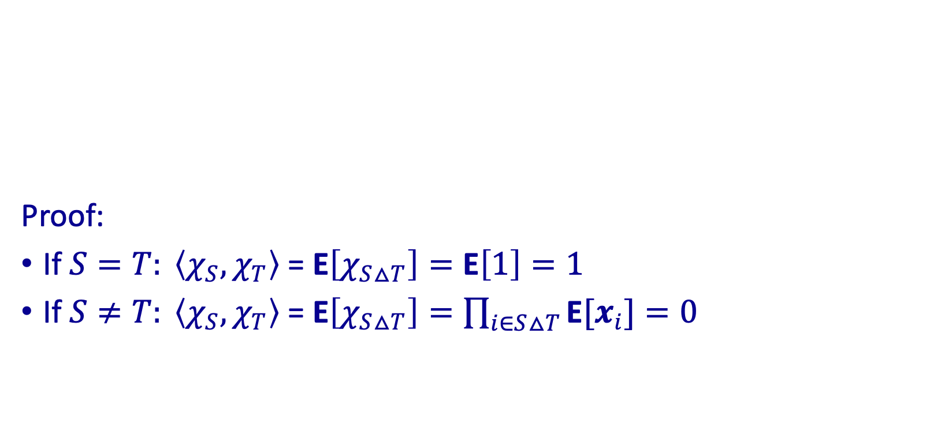
Parity Functions are orthonormal
Proof:
If $S=T: \left\langle χ_{S},χ_{T}\right\rangle \text{ = }\text{E}\left[χ_{S△T}\right]=\text{E}\left[1\right]=1$
If $S≠T: \left\langle χ_{S},χ_{T}\right\rangle \text{ = }\text{E}\left[χ_{S△T}\right]=\prod_{i∈S△T}{\text{E}[x_{i}]=0}$
Parity Function: For $S⊆[n]$, define $χ_{S}\left(x\right)=\prod_{i∈S}{x_{i}=:x^{S}}.$
Parity functions are orthonormal

Slide 5
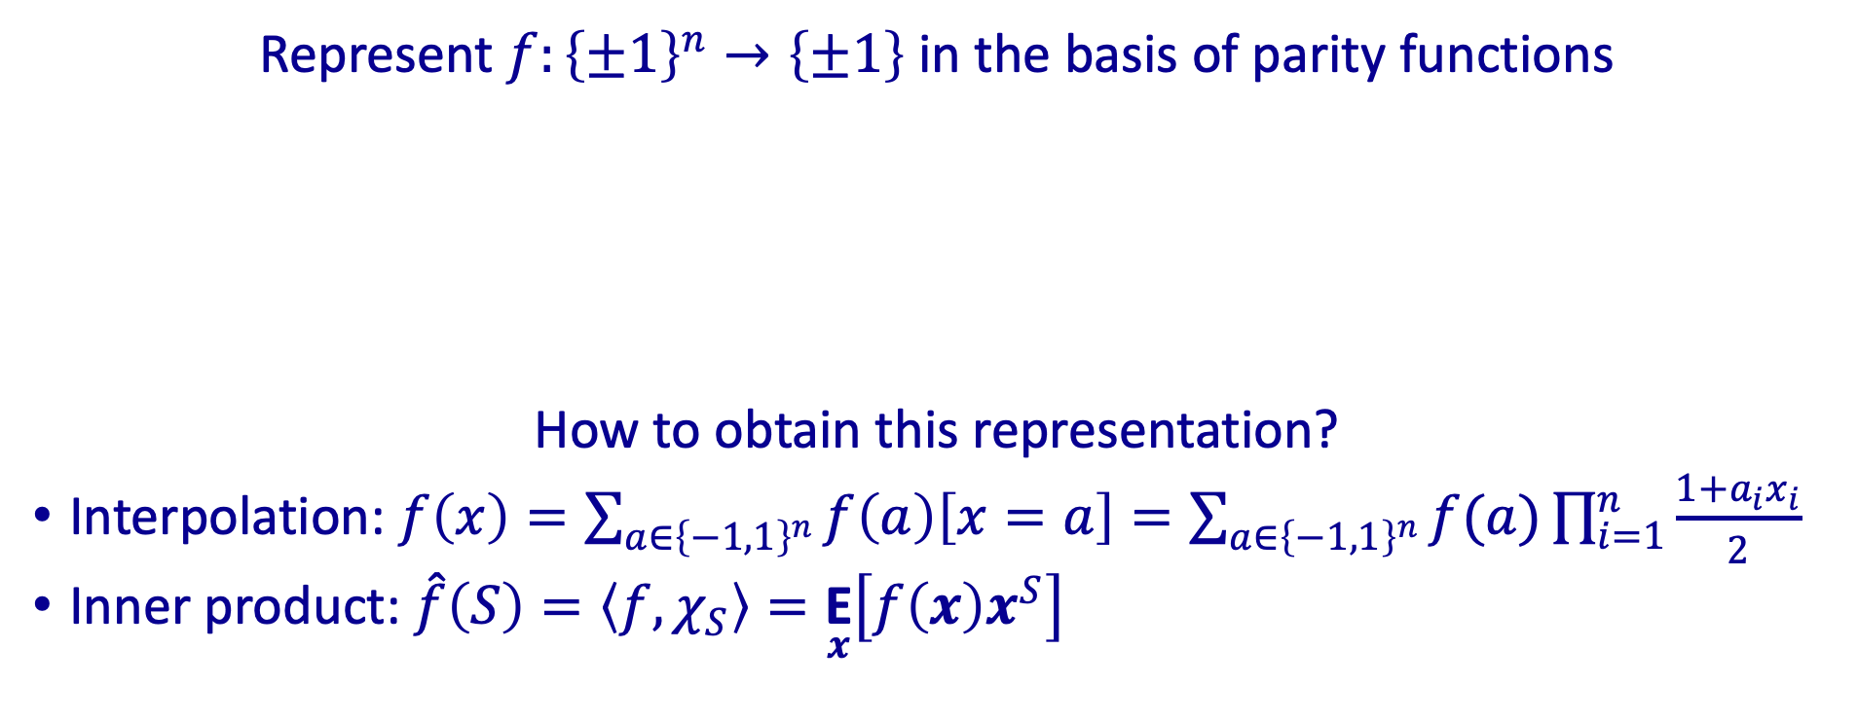

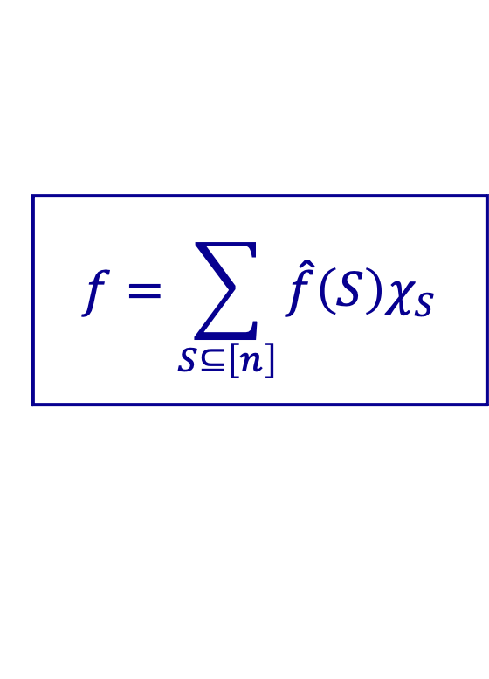
Fourier Expansion
Represent $f:{\left\{±1\right\}}^{n}→\left\{±1\right\}$ in the basis of parity functions
How to obtain this representation?
Interpolation: $f\left(x\right)=\sum_{a∈{\left\{−1,1\right\}}^{n}}{f\left(a\right)\left[x=a\right]}=\sum_{a∈{\left\{−1,1\right\}}^{n}}{f(a)\prod_{i=1}^{n}{\frac{1+a_{i}x_{i}}{2}} }$
Inner product: $\hat{f}\left(S\right)=\left\langle f, χ_{S}\right\rangle =\underset{x}{\text{E}}\left[f\left(x\right)x^{S}\right]$
$$f=\sum_{S⊆\left[n\right]}{\hat{f}\left(S\right)χ_{S}}$$
$${\text{Maj}}_{3}\left(x_{1},x_{2},x_{3}\right)=\frac{1}{2}x_{1}+\frac{1}{2}x_{2}+\frac{1}{2}x_{3}−\frac{1}{2}x_{1}x_{2}x_{3}$$

Slide 6
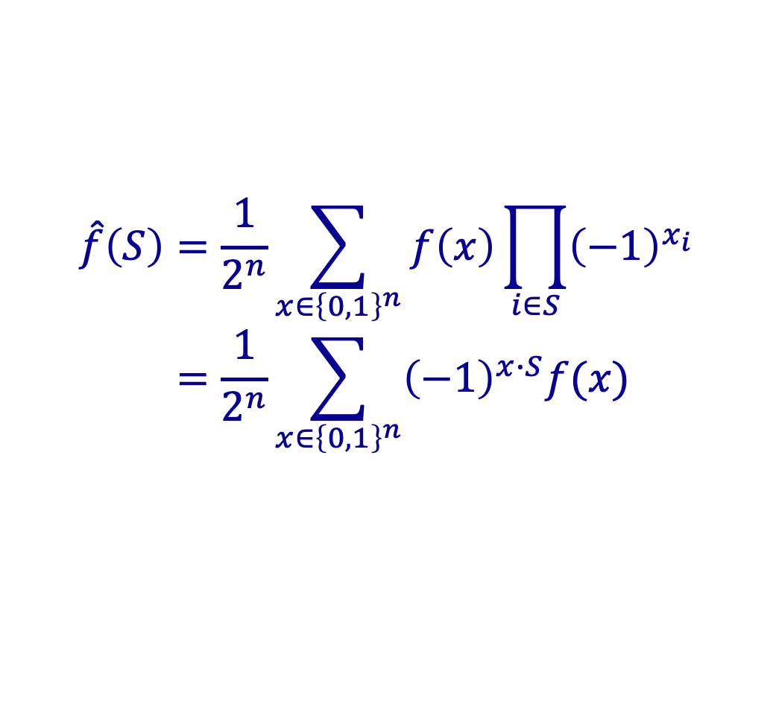

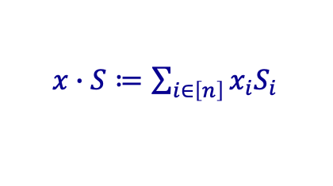
Fourier Expansion, an Example
In $\left\{0, 1\right\}$ representation ($f:{\left\{0, 1\right\}}^{n}→ℝ$), the Fourier coefficients (remember the isomorphism $x↦{\left(−1\right)}^{x}$):
It is the $n$-qubit Hadamard gate in quantum computing
$$\hat{f}\left(S\right)=\frac{1}{2^{n}}\sum_{x∈{\left\{0,1\right\}}^{n}}{f\left(x\right)\prod_{i∈S}{{\left(−1\right)}^{x_{i}}}} \\ =\frac{1}{2^{n}}\sum_{x∈{\left\{0,1\right\}}^{n}}{{\left(−1\right)}^{x∙S}f(x)}$$
$x∙S≔\sum_{i∈\left[n\right]}{x_{i}S_{i}}$

Slide 7
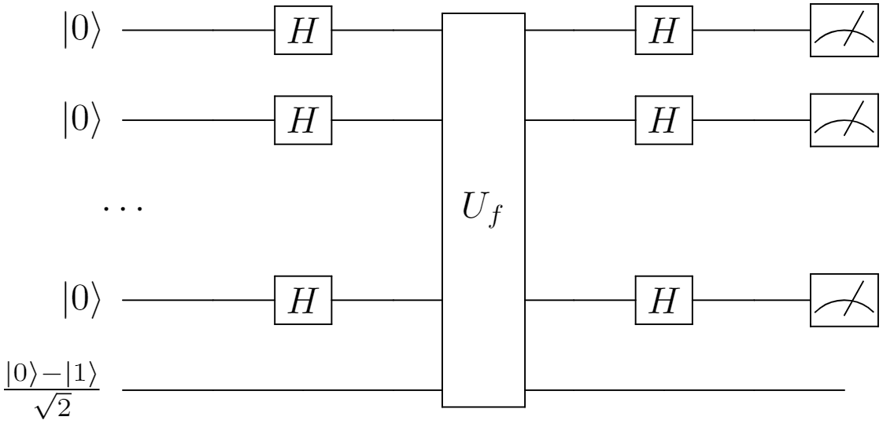

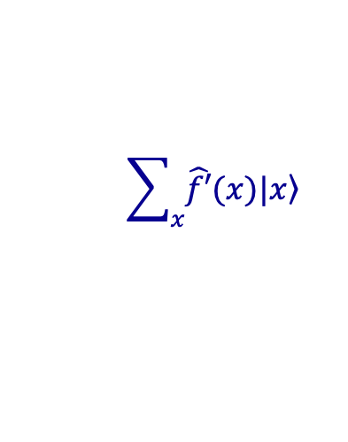
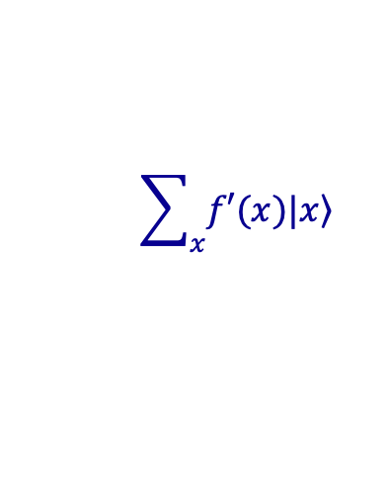
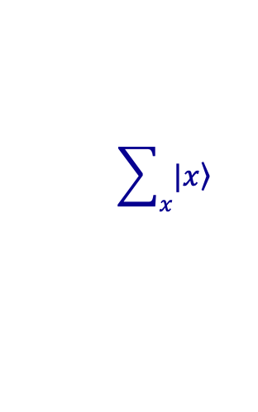
Bernstein–Vazirani Algorithm
Given (quantum) oracle access to $f\left(x\right)=a∙x$, find $a$
$$f^{′}\left(x\right)≔{\left(−1\right)}^{f\left(x\right)}={\left(−1\right)}^{a∙x}⟹\hat{f^{′}}\left(S\right)=\left[S=a\right]$$
$$\sum_{x}{\left.|x\right\rangle }$$
$$\sum_{x}{f′(x)\left.|x\right\rangle }$$
$$\sum_{x}{\hat{f′}(x)\left.|x\right\rangle }$$

Slide 8
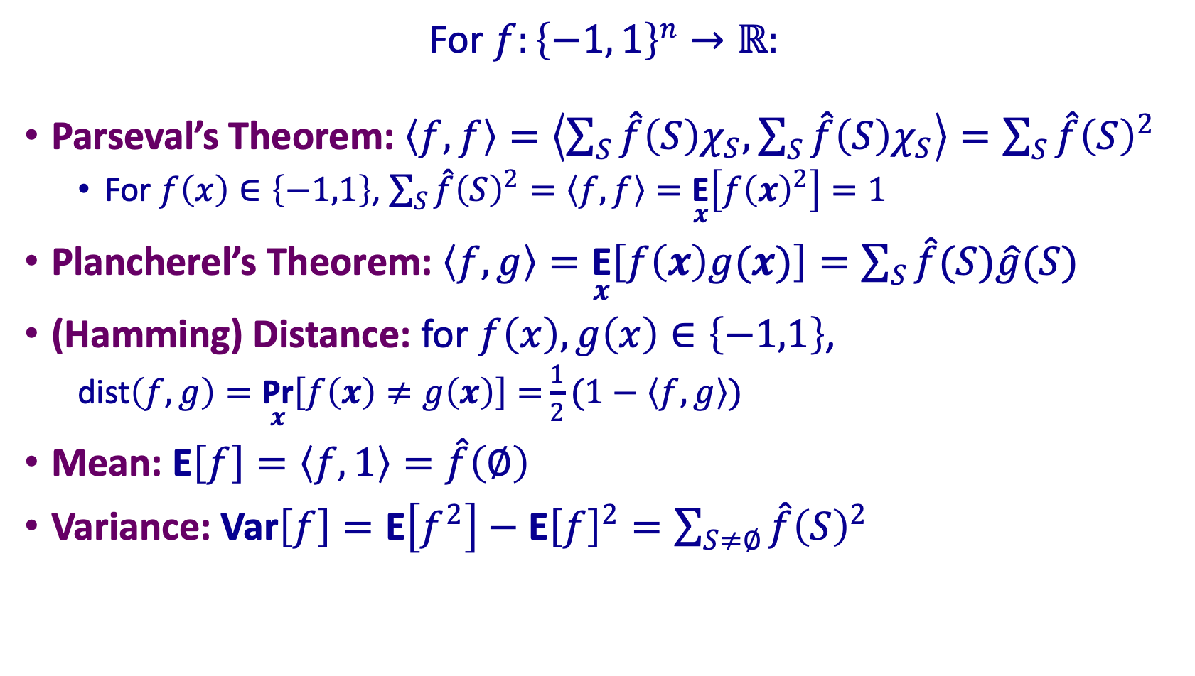
Basic Fourier Formulas
For $f:{\left\{−1, 1\right\}}^{n}→ℝ:$
Parseval’s Theorem: $\left\langle f,f\right\rangle =\left\langle \sum_{S}{\hat{f}\left(S\right)χ_{S},}\sum_{S}{\hat{f}\left(S\right)χ_{S}}\right\rangle =\sum_{S}{\hat{f}{\left(S\right)}^{2}}$
For $f\left(x\right)∈\left\{−1,1\right\}$, $\sum_{S}{\hat{f}{\left(S\right)}^{2}}=\left\langle f,f\right\rangle =\underset{x}{\text{E}}\left[f{\left(x\right)}^{2}\right]=1$
Plancherel’s Theorem: $\left\langle f,g\right\rangle =\underset{x}{\text{E}}\left[f\left(x\right)g(x)\right]{=\sum_{S}{\hat{f}(S)\hat{g}(S)}}$
(Hamming) Distance: for $f\left(x\right),g\left(x\right)∈\left\{−1,1\right\}\text{, }$
$\text{dist}\left(f, g\right)=\underset{x}{\text{Pr}}\left[f\left(x\right)≠g\left(x\right)\right]=\frac{1}{2}(1−\left\langle f, g\right\rangle )$
Mean: $\text{E}\left[f\right]=\left\langle f, 1\right\rangle =\hat{f}\left(∅\right)$
Variance: $\text{Var}\left[f\right]=\text{E}\left[f^{2}\right]−\text{E}{\left[f\right]}^{2}=\sum_{S≠∅}{\hat{f}{\left(S\right)}^{2}}$

Slide 9


Convolution
Let $f, g:𝔽_{2}^{n}→ℝ$, define their convolution:
$$\left(f∗g\right)\left(x\right)={\text{E}}_{y\sim 𝔽_{2}^{n}}[f\left(y\right)g(x−y)]$$
$$\begin{aligned}\hat{f∗g}(S)=&\underset{x∼𝔽_{2}^{n}}{\text{E}}\left[(f∗g)(x)χ_{S}(x)\right] \\ =&\underset{x,y∼𝔽_{2}^{n}}{\text{E}}\left[f(y)g(x−y)χ_{S}(x)\right] \\ =&\underset{y,z∼𝔽_{2}^{n}}{\text{E}}\left[f(y)g(z)χ_{S}(y+z)\right] \\ \\ =&\underset{y,z∼𝔽_{2}^{n}}{\text{E}}\left[f(y)χ_{S}(y)g(z)χ_{S}(z)\right] \\ =&\hat{f}(S)\hat{g}(S)\end{aligned}$$

Slide 10

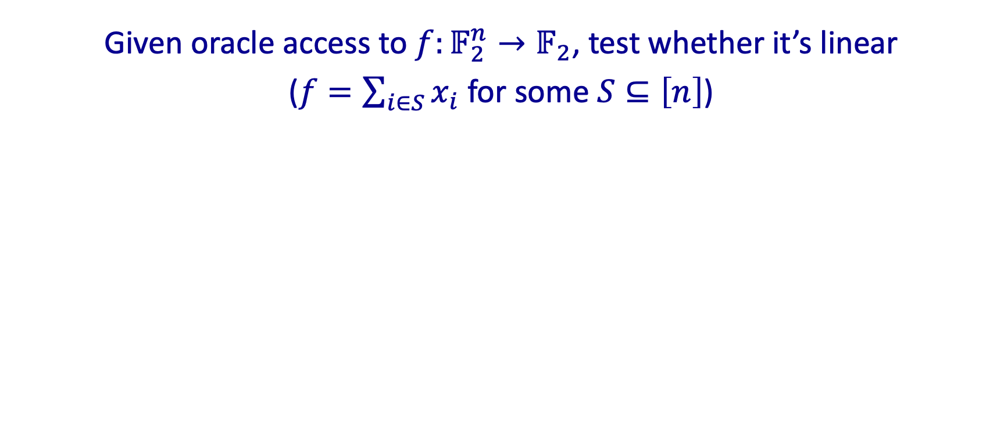
Linearity Testing
Given oracle access to $f:𝔽_{2}^{n}→𝔽_{2}$, test whether it’s linear
($f=\sum_{i∈S}{x_{i}}$ for some $S⊆\left[n\right]$)
Blum-Luby-Rubinfeld Test
Choose independently $x,y\sim 𝔽_{2}^{n}$
Query $f\left(x\right), f\left(y\right), f\left(x+y\right)$
Accept if $f\left(x\right)+f\left(y\right)=f(x+y)$
If accept probability $≥1−ε$, then $\text{dist}\left(f,g\right)≤ε$ for some linear $g$.

Slide 11
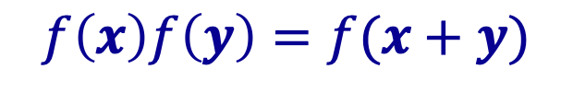

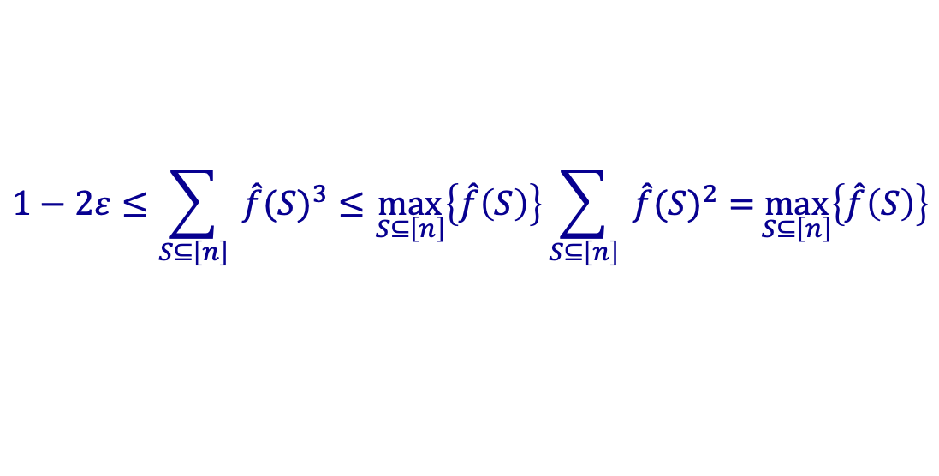

Blum-Luby-Rubinfeld Linearity Test
Replace $f$ by ${\left(−1\right)}^{f}$, the accept condition $f\left(x\right)+f\left(y\right)=f\left(x+y\right)$
Take $S^{∗}=\underset{S}{argmax}\left\{\hat{f}\left(S\right)\right\}$, then $\text{dist}\left(f, χ_{S^{∗}}\right)=\frac{1}{2}\left(1−\hat{f}\left(S\right)\right)≤ε$
$$f\left(x\right)f\left(y\right)=f(x+y)$$
$$\begin{aligned}\text{Pr}[\text{accept}]&=\underset{x,y}{\text{E}}\left[\frac{1}{2}+\frac{1}{2}f(x)f(y)f(x+y)\right]=\frac{1}{2}+\frac{1}{2}\underset{x}{\text{E}}[f(x)⋅\underset{y}{\text{E}}[f(y)f(x+y)]] \\ &=\frac{1}{2}+\frac{1}{2}\underset{x}{\text{E}}[f(x)⋅(f∗f)(x)]=\frac{1}{2}+\frac{1}{2}\sum_{S⊆\left[n\right]}{ }\hat{f}(S)\hat{f∗f}(S) \\ &=\frac{1}{2}+\frac{1}{2}\sum_{S⊆\left[n\right]}{ }\hat{f}(S)^{3}≥1−ε\end{aligned}$$
$$1−2ε≤\sum_{S⊆\left[n\right]}{ }\hat{f}(S)^{3}≤\max_{S⊆\left[n\right]}\left\{\hat{f}\left(S\right)\right\}\sum_{S⊆\left[n\right]}{ }\hat{f}(S)^{2}=\max_{S⊆\left[n\right]}\left\{\hat{f}\left(S\right)\right\}$$

Slide 12
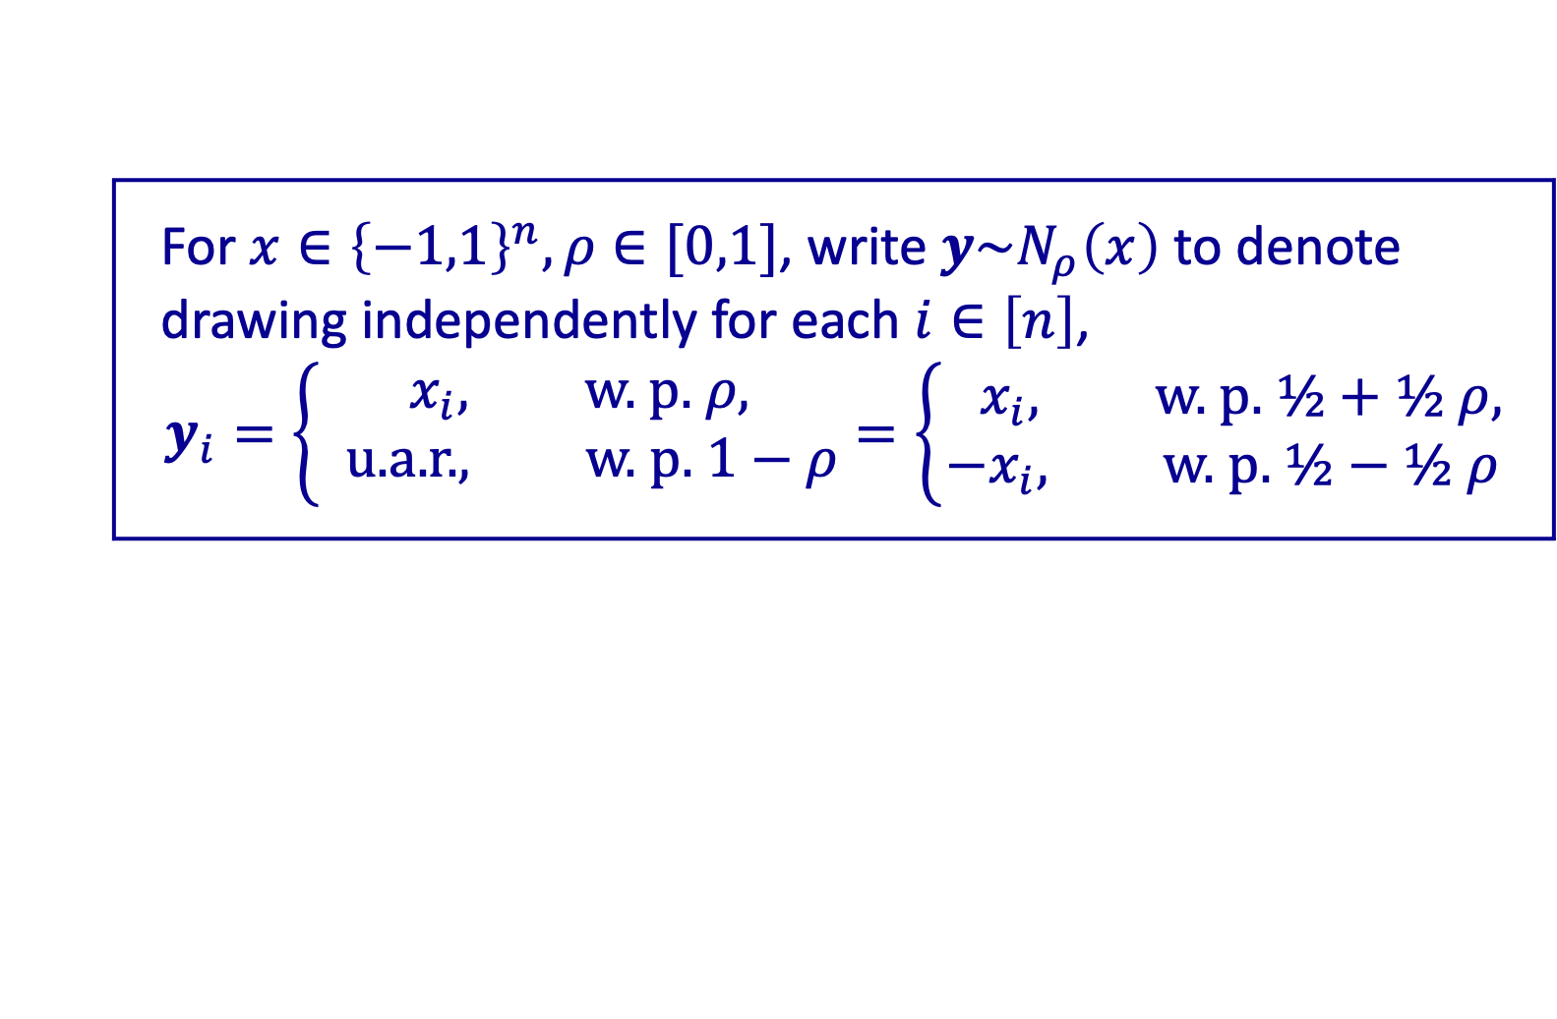




Correlated Pair
For $x∈{\left\{−1,1\right\}}^{n}, ρ∈[0,1]$, write $y\sim N_{ρ}\left(x\right)$ to denote drawing independently for each $i∈\left[n\right]$,
$$y_{i}=\left\{\begin{aligned}x_{i}, \text{w}\text{. }\text{p}\text{.} ρ, \\ \text{u}\text{.}\text{a}\text{.}\text{r}\text{.}, \text{w}\text{. }\text{p}\text{. }1−ρ\end{aligned}\right.=\left\{\begin{aligned}{ x}_{i}, \text{w}\text{. }\text{p}\text{.} ½+½ ρ, \\ −x_{i}, \text{w}\text{. }\text{p}\text{. }½−½ ρ\end{aligned}\right.$$
If $x\sim {\left\{−1,1\right\}}^{n}$ and $y\sim N_{ρ}\left(x\right)$, say $(x, y)$ is a $ρ$-correlated pair
Write ${\left(x, y\right)}_{ρ}$ for short
symmetric in $x$ and $y$
${\text{E}}_{{\left(x, y\right)}_{ρ}}\left[x_{i}\right]={\text{E}}_{{\left(x, y\right)}_{ρ}}\left[y_{i}\right]=0, {\text{E}}_{{\left(x, y\right)}_{ρ}}\left[x_{i}y_{i}\right]=ρ$
$$ρ∈\left[−1,1\right]$$
$$y$$
$$x$$

Slide 13
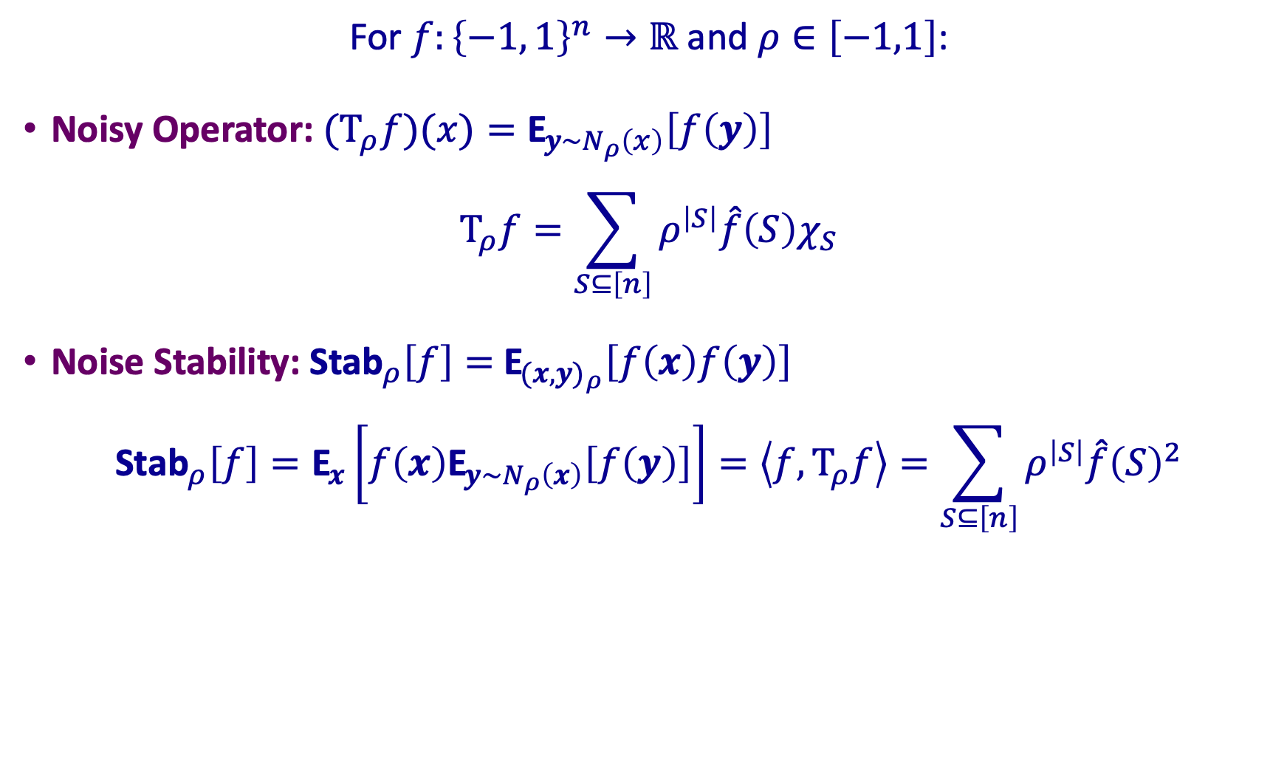
“Noisy” Fourier Formulas
For $f:{\left\{−1, 1\right\}}^{n}→ℝ$ and $ρ∈\left[−1,1\right]$:
Noisy Operator: ${\text{(}\text{T}}_{ρ}f)(x)={\text{E}}_{y\sim N_{ρ}\left(x\right)}\left[f\left(y\right)\right]$
$${\text{T}}_{ρ}f=\sum_{S⊆\left[n\right]}{ρ^{\left|S\right|}\hat{f}\left(S\right)χ_{S}}$$
Noise Stability: ${\text{Stab}}_{ρ}\left[f\right]=$ ${\text{E}}_{{(x,y)}_{ρ}}\left[f\left(x\right)f\left(y\right)\right]$
$${\text{Stab}}_{ρ}\left[f\right]={\text{E}}_{x}\left[f\left(x\right){\text{E}}_{y\sim N_{ρ}\left(x\right)}\left[f\left(y\right)\right]\right]=\left\langle f,{\text{T}}_{ρ}f\right\rangle =\sum_{S⊆\left[n\right]}{ρ^{\left|S\right|}\hat{f}{\left(S\right)}^{2}}$$

Slide 14
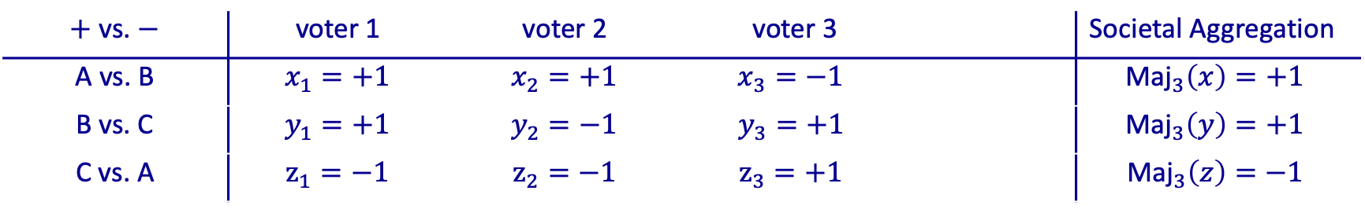
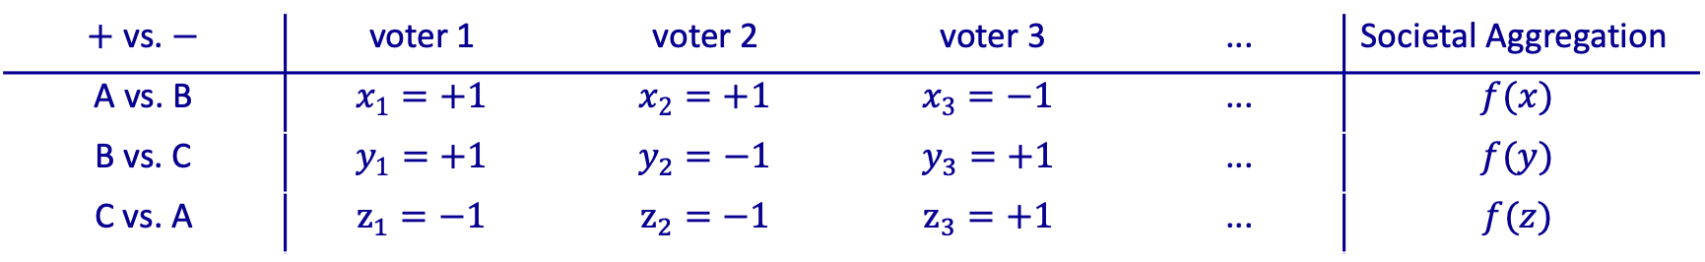


Condorcet Election
$+$vs. $−$ | voter 1 | voter 2 | voter 3 |  | Societal Aggregation
A vs. B | $$x_{1}=+1$$ | $$x_{2}=+1$$ | $$x_{3}=−1$$ |  | $${\text{Maj}}_{3}\left(x\right)=+1$$
B vs. C | $$y_{1}=+1$$ | $$y_{2}=−1$$ | $$y_{3}=+1$$ |  | $${\text{Maj}}_{3}\left(y\right)=+1$$
C vs. A | $$z_{1}=−1$$ | $$z_{2}=+1$$ | $$z_{3}=+1$$ |  | ${\text{Maj}}_{3}\left(z\right)=+1$
$+$vs. $−$ | voter 1 | voter 2 | voter 3 | ... | Societal Aggregation
A vs. B | $$x_{1}=+1$$ | $$x_{2}=+1$$ | $$x_{3}=−1$$ | ... | $$f(x)$$
B vs. C | $$y_{1}=+1$$ | $$y_{2}=−1$$ | $$y_{3}=+1$$ | ... | $$f(y)$$
C vs. A | $$z_{1}=−1$$ | $$z_{2}=−1$$ | $z_{3}=+1$ | ... | $f(z)$
$+$vs. $−$ | voter 1 | voter 2 | voter 3 |  | Societal Aggregation
A vs. B | $$x_{1}=+1$$ | $$x_{2}=+1$$ | $$x_{3}=−1$$ |  | $${\text{Maj}}_{3}\left(x\right)=+1$$
B vs. C | $$y_{1}=+1$$ | $$y_{2}=−1$$ | $$y_{3}=+1$$ |  | $${\text{Maj}}_{3}\left(y\right)=+1$$
C vs. A | $$z_{1}=−1$$ | $$z_{2}=−1$$ | $$z_{3}=+1$$ |  | ${\text{Maj}}_{3}\left(z\right)=−1$
The aggregating function should always produce a rational outcome,
if all inputs are rational ☺
Arrow’s Impossibility Theorem
Suppose $f$ is an aggregating function that always output rationally if all inputs are rational, then $f=±χ_{\{i\}}.$
Not All Equal (rational): $\text{NAE}\left(a,b,c\right)=[¬(a=b=c)]$

Slide 15
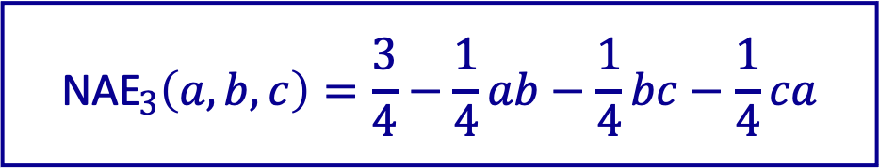


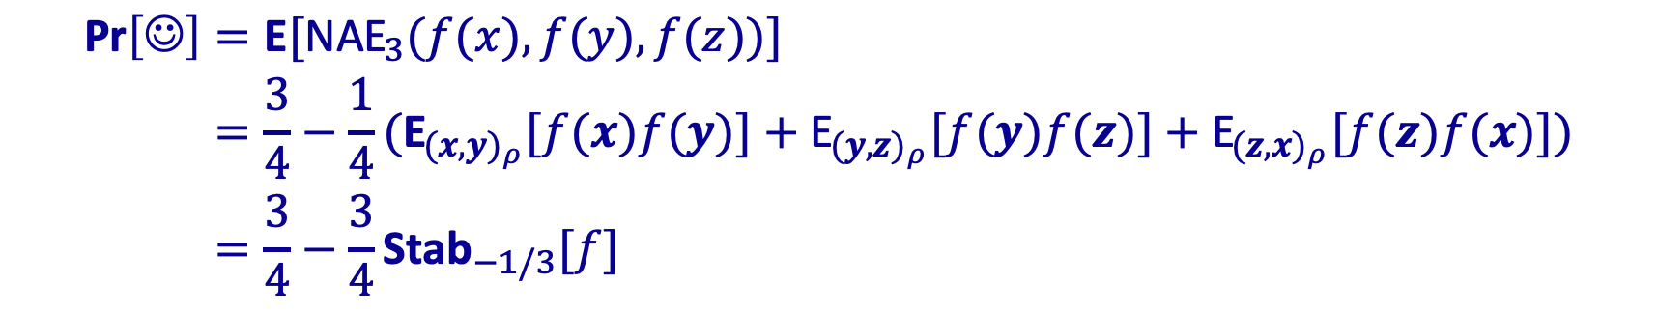
The Probability of a Condorcet Winner
Compute $\text{Pr}\left[\text{☺}\right]$, assuming $\left(x_{i},y_{i},z_{i}\right)$ are ind. u.a.r from
$$\left\{\left(+,+,−\right),\left(+,−,+\right),\left(−,+,+\right),\left(+,−,−\right),\left(−,+,−\right),\left(−,−,+\right)\right\}$$
$${\text{NAE}}_{3}\left(a,b,c\right)=\frac{3}{4}−\frac{1}{4}ab−\frac{1}{4}bc−\frac{1}{4}ca$$
$$\begin{aligned}\text{Pr}\left[\text{☺}\right]&=\text{E}[{\text{NAE}}_{3}(f(x),f(y),f(z))] \\ &=\frac{3}{4}−\frac{1}{4}({\text{E}}_{(x,y)_{ρ}}[f(x)f(y)]+{\text{E}}_{(y,z)_{ρ}}[f(y)f(z)]+{\text{E}}_{(z,x)_{ρ}}[f(z)f(x)]) \\ &=\frac{3}{4}−\frac{3}{4}{\text{Stab}}_{−1/3}[f]\end{aligned}$$
$$\text{E}\left[x_{i}\right]=\text{E}\left[z_{i}\right]=0, \text{E}\left[x_{i}z_{i}\right]=−\frac{1}{3}$$

Slide 16

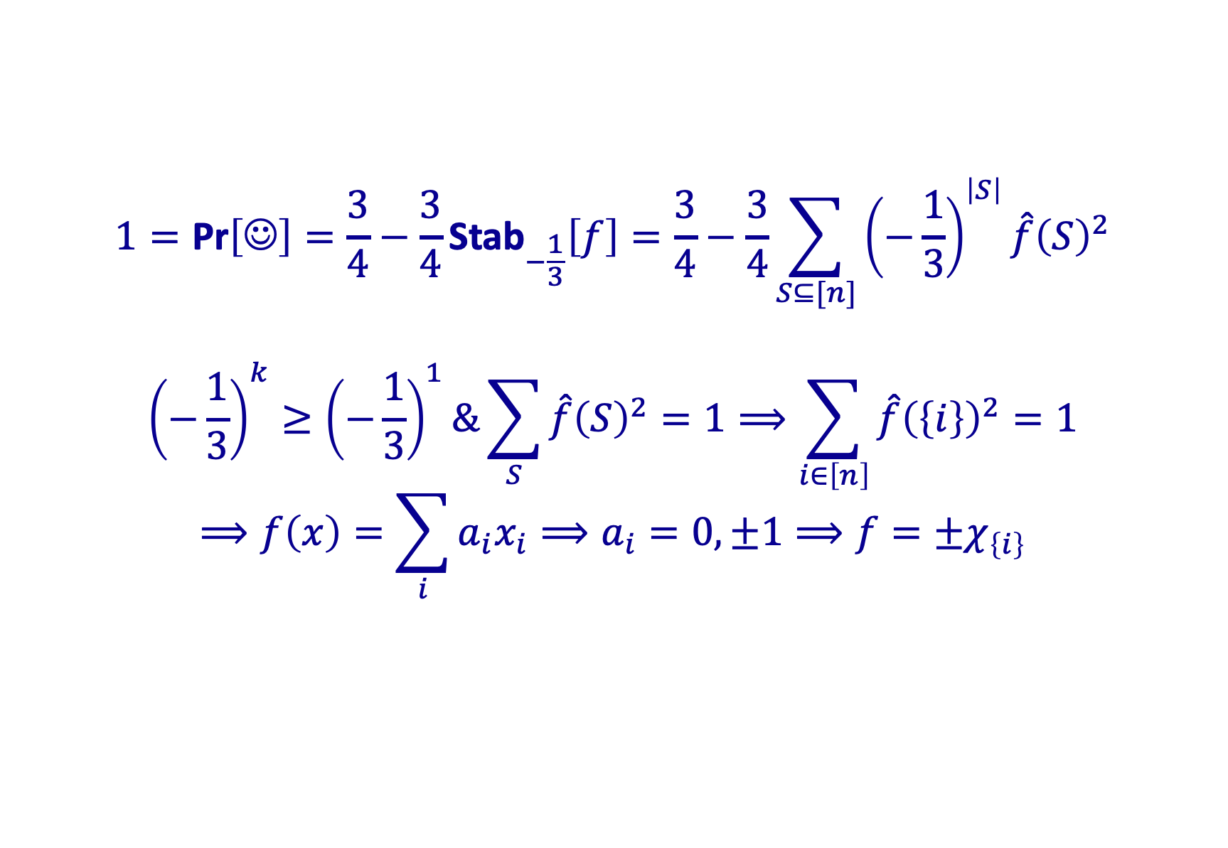
Proof of Arrow’s Theorem
$$1=\text{Pr}\left[\text{☺}\right]=\frac{3}{4}−\frac{3}{4}{\text{Stab}}_{−\frac{1}{3}}\left[f\right]=\frac{3}{4}−\frac{3}{4}\sum_{S⊆[n]}{{\left(−\frac{1}{3}\right)}^{\left|S\right|}\hat{f}{\left(S\right)}^{2}}$$
$${\left(−\frac{1}{3}\right)}^{k}≥{\left(−\frac{1}{3}\right)}^{1}\&\sum_{S}{\hat{f}{\left(S\right)}^{2}=1}⟹\sum_{i∈\left[n\right]}{\hat{f}{\left(\left\{i\right\}\right)}^{2}=1}$$
$$⟹f\left(x\right)=\sum_{i}{a_{i}x_{i}}⟹a_{i}=0,±1⟹f=±χ_{\left\{i\right\}}$$
-
-
+
+
$${2a}_{i}$$
+
+
-
-

Slide 17
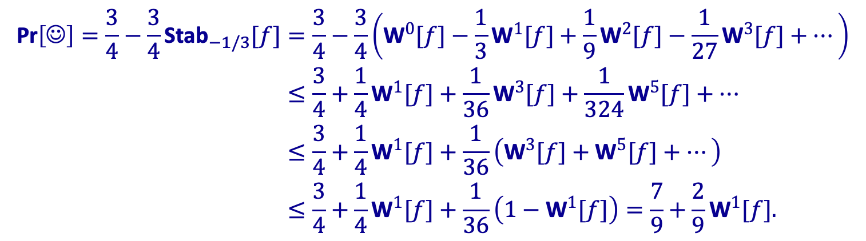

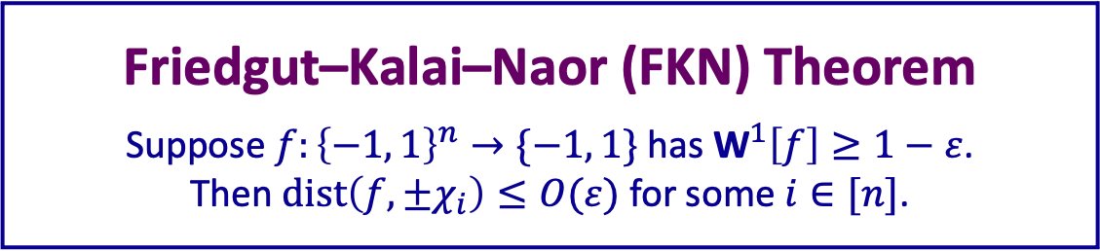
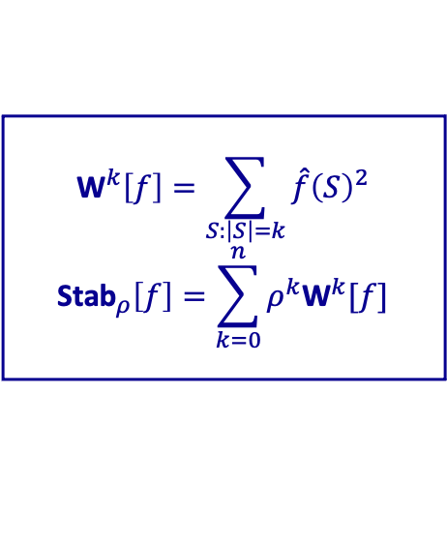
“Robust” Arrow’s Theorem
$$\begin{aligned}\text{Pr}\left[\text{☺}\right]=\frac{3}{4}−\frac{3}{4}{\text{Stab}}_{−1/3}[f]&=\frac{3}{4}−\frac{3}{4}\left({\text{W}}^{0}[f]−\frac{1}{3}{\text{W}}^{1}[f]+\frac{1}{9}{\text{W}}^{2}[f]−\frac{1}{27}{\text{W}}^{3}[f]+⋯\right) \\ &≤\frac{3}{4}+\frac{1}{4}{\text{W}}^{1}[f]+\frac{1}{36}{\text{W}}^{3}[f]+\frac{1}{324}{\text{W}}^{5}[f]+⋯ \\ &≤\frac{3}{4}+\frac{1}{4}{\text{W}}^{1}[f]+\frac{1}{36}\left({\text{W}}^{3}[f]+{\text{W}}^{5}[f]+⋯\right) \\ &≤\frac{3}{4}+\frac{1}{4}{\text{W}}^{1}[f]+\frac{1}{36}\left(1−{\text{W}}^{1}[f]\right)=\frac{7}{9}+\frac{2}{9}{\text{W}}^{1}[f].\end{aligned}$$
If $\text{Pr}\left[\text{☺}\right]≥1−ε$, then ${\text{W}}^{1}\left[f\right]≥1−\frac{9}{2}ε$
$${\text{W}}^{k}\left[f\right]=\sum_{S:\left|S\right|=k}{\hat{f}{\left(S\right)}^{2}}$$
$${\text{Stab}}_{ρ}\left[f\right]=\sum_{k=0}^{n}{ρ^{k}{\text{W}}^{k}[f]}$$
Friedgut–Kalai–Naor (FKN) Theorem
Suppose $f:{\left\{−1, 1\right\}}^{n}→\{−1, 1\}$ has ${\text{W}}^{1}\left[f\right]≥1−ε$.
Then $\text{dist}\left(f,±χ_{i}\right)≤O(ε)$ for some $i∈[n]$.

Slide 18
Thank you!

