Slide 1


Deep Hyperspherical Learning
Weiyang Liu, Yan-Ming Zhang, Xingguo Li, Zhiding Yu, Bo Dai, Tuo Zhao, Le Song
Georgia Institute of Technology

Slide 2
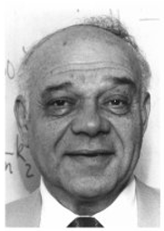
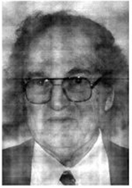
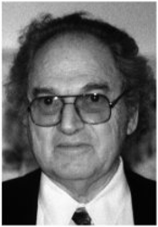
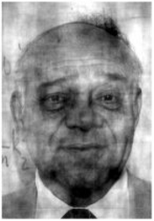
Motivation
2D Fourier Transform for images
Phase contains the crucial discriminative information!
A
The magnitude of A + The phase of B =
B
The magnitude of B + The phase of A =

Slide 3



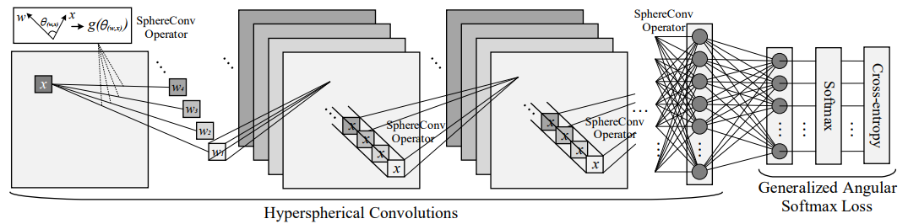
SphereNet: a network that focuses on the angular (phase) information
Hyperspherical Convolutional (SphereConv) Operator:
Where is the angle between the kernel parameter w and the local patch x. A simple example is cosine SphereConv:
We use this SphereConv operator to replace the original inner product based convolutional operator in the CNNs, and propose the SphereNet. (SphereNet comes from that angle can be viewed as the geodesic distance on a unit hypersphere)

Slide 4

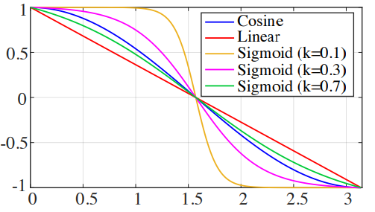

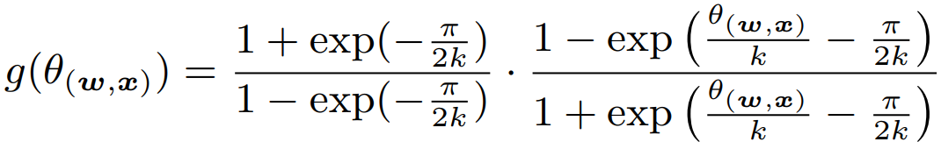
Four SphereConv operators
linear SphereConv
cosine SphereConv
sigmoid SphereConv
Learnable SphereConv
with the parameter k to be learned in back-prop

Slide 5
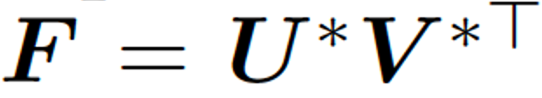






















Theoretical Insights
Suppose the observation is (ignore the bias), where is the weight, is the input that embeds weights from previous layers.
Scaling issue of neural networks:
Consider the objective:
Lemma1: Consider a pair of global optimal points satisfying and . For any real , let and , then we have , where is the restricted condition number with being the largest and being the smallest nonzero eigenvalues.
Insensitiveness to Scaling for SphereConv:
Consider our proposed cosine SphereConv operator, an equivalent problem is:
where and are diagonal matrices.
Lemma2: For any real , let and , then we have asdsdasdasd for all and . , where is defined as in Lemma1.

Slide 6

Regular Neural Nets: scales as
SphereConv: insensitive to scaling

Slide 7
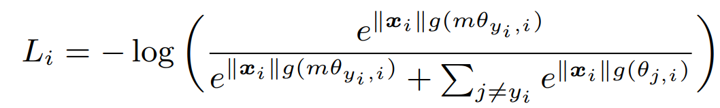
More on SphereNets
SphereConv can also be used to the fully connected layers, recurrent layers, etc.
SphereConv can also be viewed as a normalization method that could avoid covariate shift (due to the bounded outputs), and can work simultaneously with Batch Normalization.
We also design angular loss functions for SphereConv, i.e., generalized angular softmax (GA-Softmax) loss

Slide 8
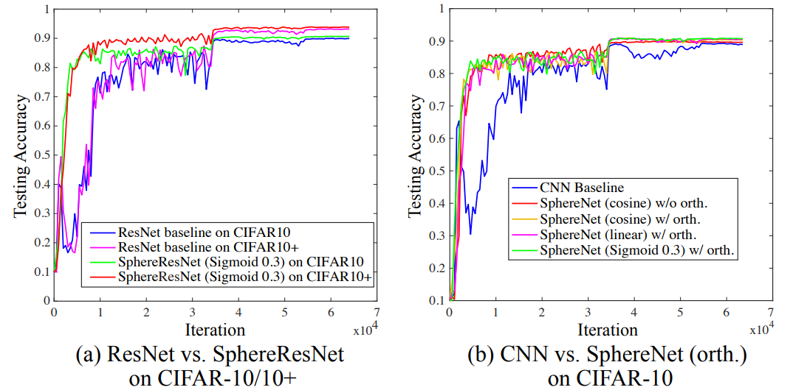
Experiments
Faster Convergence and better accuracy on CIFAR-10, CIFAR-100

Slide 9
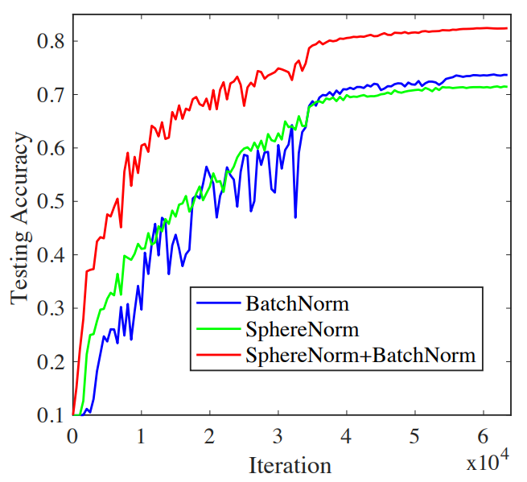
Experiments
SphereConv can be used as a new normalization method (SphereNorm), comparable to Batch Normalization. But they can be used simultaneously.
The advantages of SphereNorm are very significant, especially with small mini-batch size.
Mini-batch size =4!

Slide 10
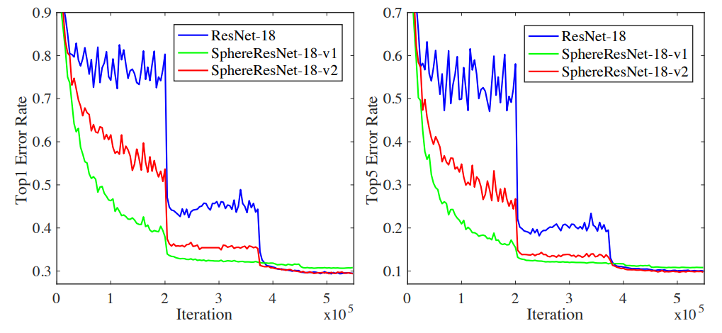
Experiments
Faster Convergence and comparable accuracy on Imagenet-2012

Slide 11
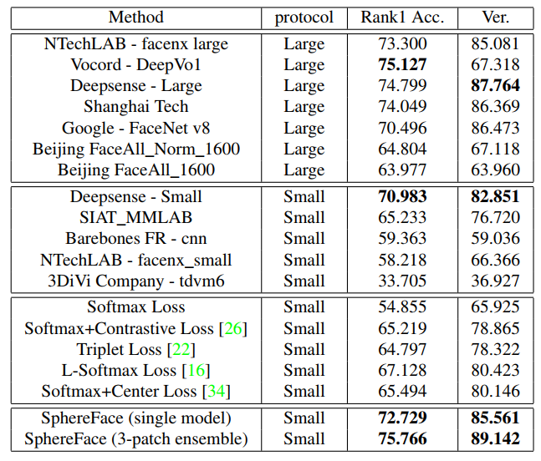
More experiments
Using the SphereConv only to the last fully connected layer gives impressive results on face recognition.

Slide 12
The End
The code will be made available at
https://github.com/wy1iu/SphereNet
The code of SphereFace is available at
https://github.com/wy1iu/sphereface

